Slide 1
Carbon Cycle
Presentation by
G.Sreekantha

Slide 4
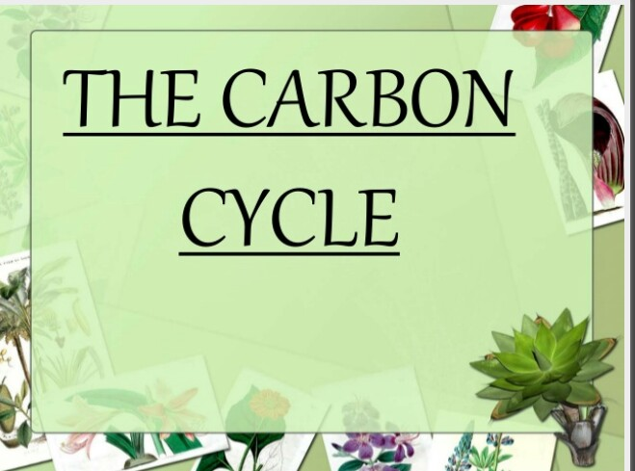

Slide 5
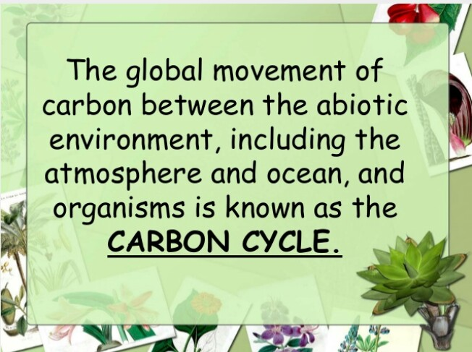

Slide 21
