Slide 1
Design and construction of a fish pond

Slide 2
INTRODUCTION
The success of any aquaculture system relies on its design and construction
The major designing features can be deliberated on the basis of the site,physiography,soure and nature of water supply
Organisms to be cultured and techniques of management including feeding and harvesting

Slide 3
Site selection
One of the most important aspects of the planning of aquaforms is the selection of site(proper site= successful aqua forming)
There are several aspects have to be considered to construct a pond
Topography ,water supply ,temperature ,humidity
Evoporation,sunshine & wind speed ans its direction

Slide 4
Size of the farm
Generally the size of the farm varies fron 2 to 200 hectares
The size of the farm has to e determine on the basis of a number of factors
They include the land available ,quantity of water
Technology to be followes production & income
Economically viable & acess to market ,manpower and equipment

Slide 5
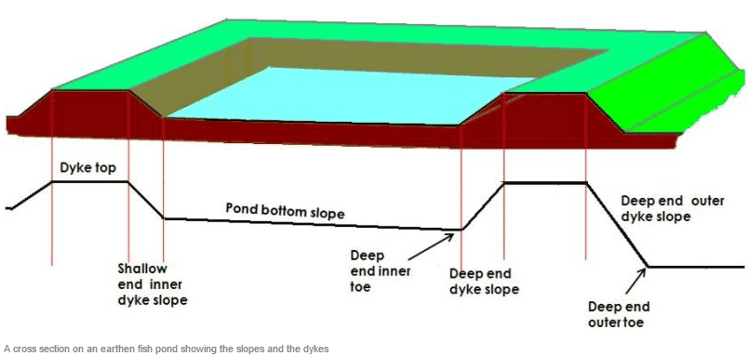
Dike design
Dikes are essential and protecting structures of pond
The life of the farm depend upon the dike system
Dikes should be carefully designed
Dikes
Main
secondary
Teritary

Slide 6
Berm
If the production pond is more than 5 hec a platform like space between dike and water
Known as the berm may vary between 0.5 – 1.0 m
Dependening on the size of the pond and height of the dike

Slide 7
Water supply and drain system
Thw water supply and drainage system have to be designed to convey the required quantites of water in the pond
Inlet & outlets
Pipes
Sluices
Monk

Slide 8
Inlet & outlets
These are many types of water control structers for the use in freshwater and coastal pond
The inlet may be anything from a simple pipe to a concrete sluice
The outlet control structure used is the mot or open sluice or turn –down pipe

Slide 9
Pipes & sluice
For small ponds ,simple pipes are used for water supply
The inlet \outlet pipes are to be provided with the screens to prevent the unwanted fishes entry ,escape of fishes from pond
Another commomly used water control sturucter is open sluice
It is made of wood or concrete and bricks
It is especially useful where thr discharges are higher in large ponds

Slide 10
Monk
This is the main exit point for water
It is constructed over a strong foundation either with concrete or with bricks at the deepest point of the pond toword innerside of the lake
Water will comeout only on rasing these plates

Slide 11
Thank you

