Slide 1
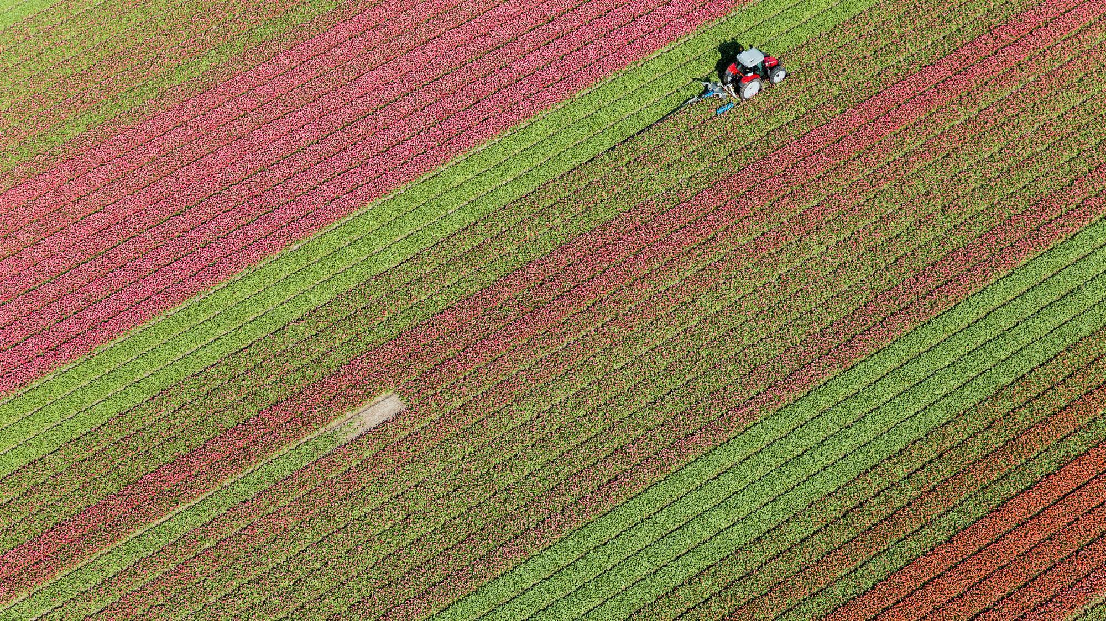
Classification of culture systems

Slide 2
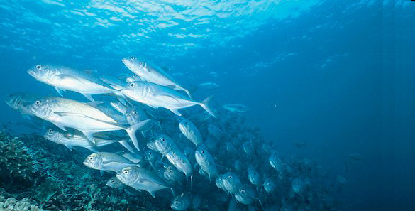
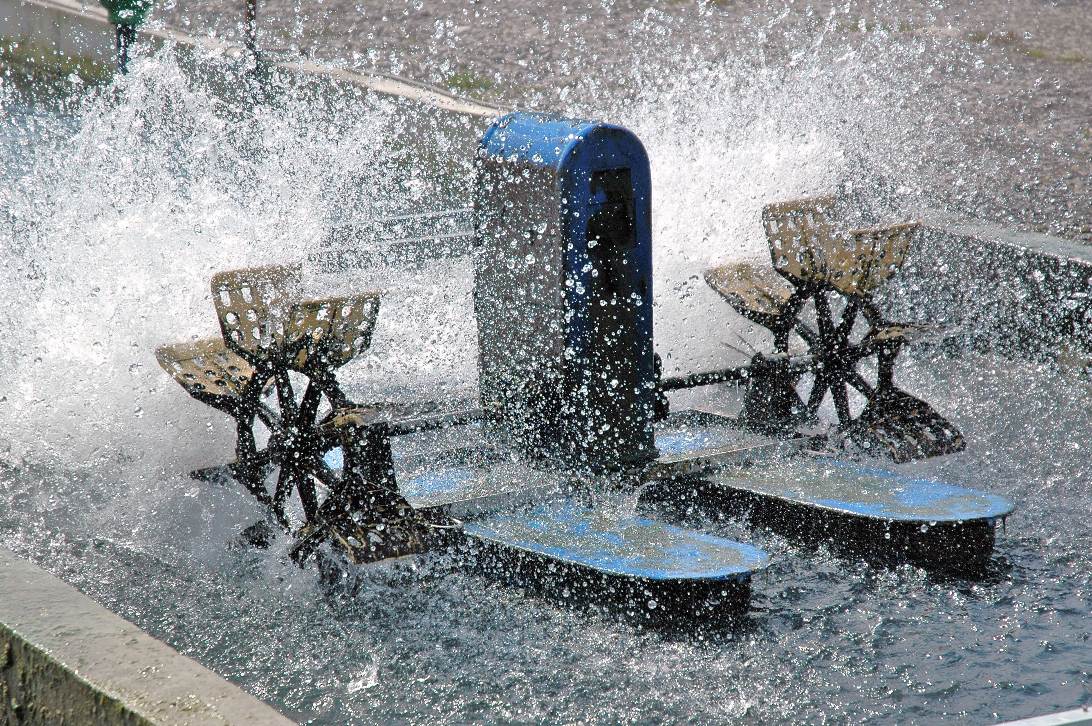
Classification of culture systems
Introduction
Cage culture
Pen culture
Pond culture

Slide 3
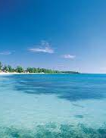
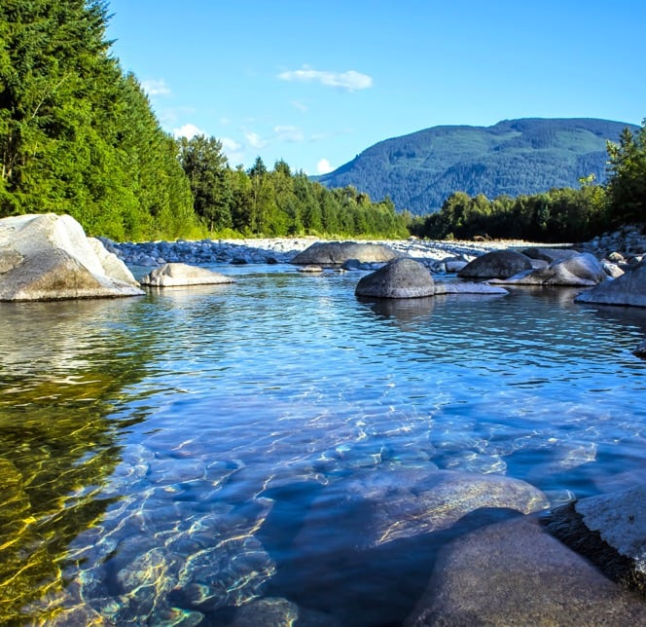
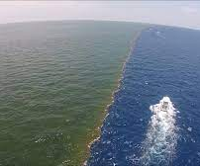
Introduction
Aqua culture is the practice of cultivating the aquatic organisms in the controlled conditions for higher procuduction
in aqua culture there were may types of practices and different types of cultureing like fresh, marine, barkish water in this aqua cultures we will use systems for our fecebility

Slide 4
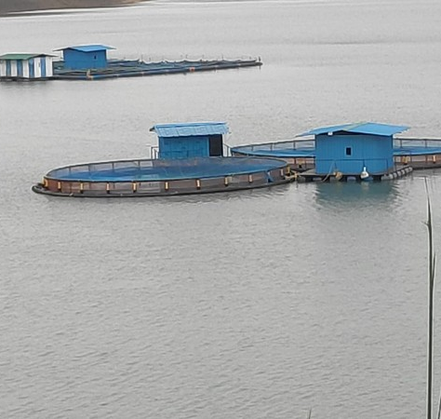
Cage culture
This method was applied were there will be no use of the land like pond culture
Large waters bodies as well as flowing water bodies will be in usage
Cage culture is not so laboures
And free from predators ,no oxygen defficency
Easy exchange of water is possible
We can easy chech growth of fishes if any diseases have arised

Slide 5
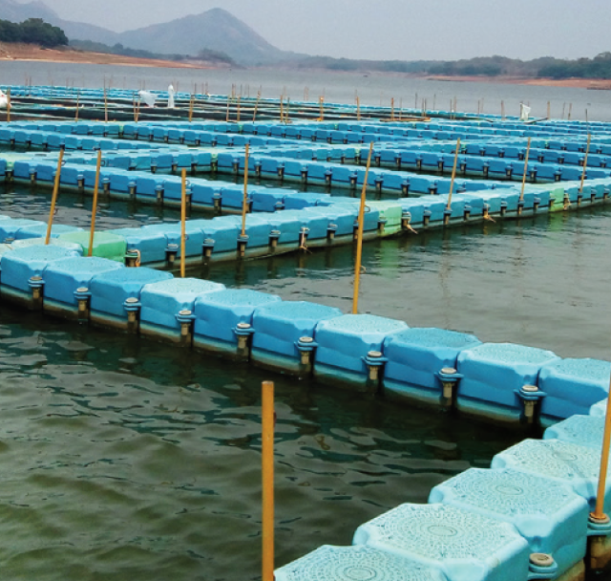
Construction of cage
Cages are circular,basket or cubic in shape
They may be floating,submerged or fixed to bottam
Maintaing large is difficult than maintain the small ones
These areconstructed with bamboo interspreed with the wooden planks or pvcs,metallic ,alluminium frames
Inside the cage is lined with the mosquito nets with 10x15 dia ,outer it is lined with the 20x15 dia net
So that water can enter into cage and fishes wont come out from cage

Slide 6
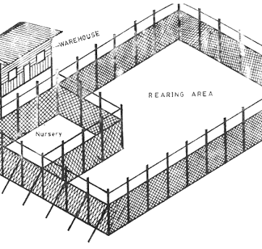
Pen culture
This Aqua culture system was practised in open water systems
This practice was mimimising the limiting effect of metabolities and pollutents on cultivatedstock
Greater production is very limited space has been found possible under those conditions

Slide 7
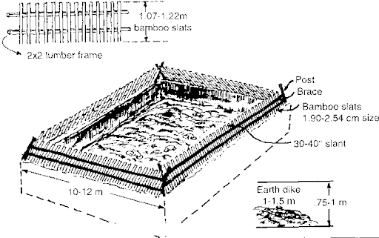
Site for pen culture
Low tidal amplitude
Pens should be constructed in shaddy areas
Depth not less than meter
Water with sutable ph
Soo much silt should not be there
To much decomposing organic matter is also should be avoided

Slide 8
The way to get started is to quit talking and begin doing.
Walt Disney

Slide 9
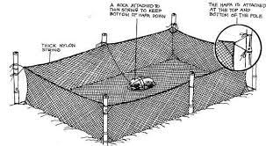
Construction of pen
Pen are constructed with the bamboo sticks and net screens
Bamboo are soaked in water for 1 weak and dried for 1 weak and shaped based our whish
Constructed foursides with th certain mesurements internally with nylon,kuralon,fixed internal – external dias
These are fixed totally inside
These are more carried out in japan ,peru , kerala
Culturing of prawns,milk fish,mullets
Generally feeding should be done in intervels
Pen culture is labourous because of checking the nets

Slide 10
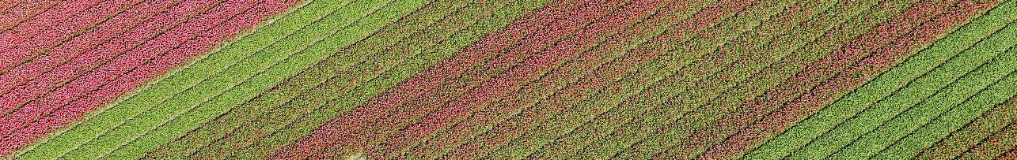
Pond culture
Site selection
preparation
Intensive type of culture, preparation for fresh ormarimeculture
It should he more than 1.5hectars
preparation
Selection of the site for pond preparation
Ploughing,weeding,liming.

Slide 11
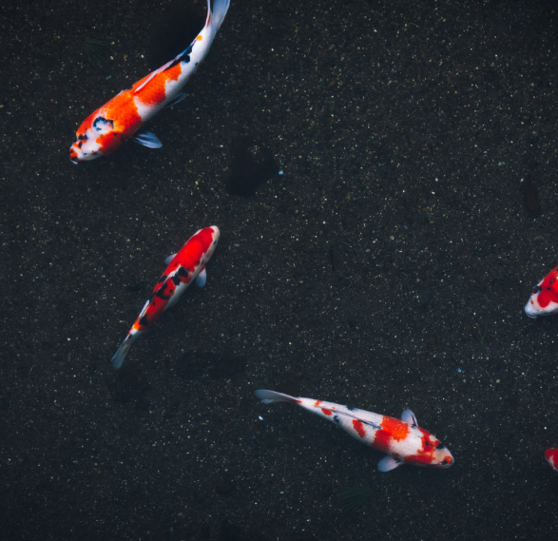
Summary
In aqua culture there will be different water bodies fresh,marine,barkish but there we can implant different aqtua culture systems in the any type of system for our fesesability

Slide 12
Thank You

