Slide 1
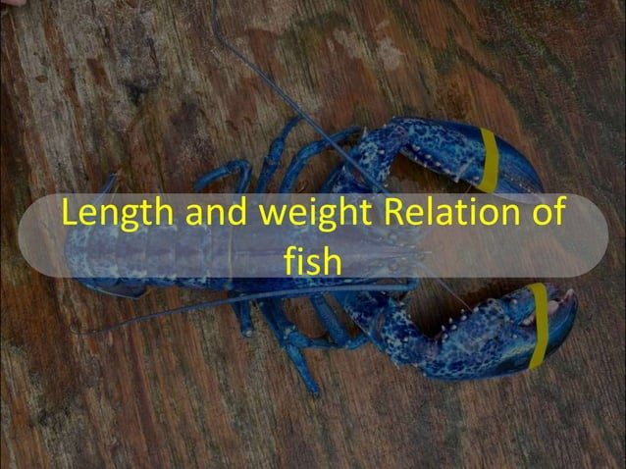
Presentation by
G.Sreekantha
Lecturer in Aquaculture

