Slide 1
PARENTAL CARE IN FISHES
PRESENTATAION BY
G.SREEKANTHA
Lecturer in aquaculture
D.N.R (A) College

Slide 7
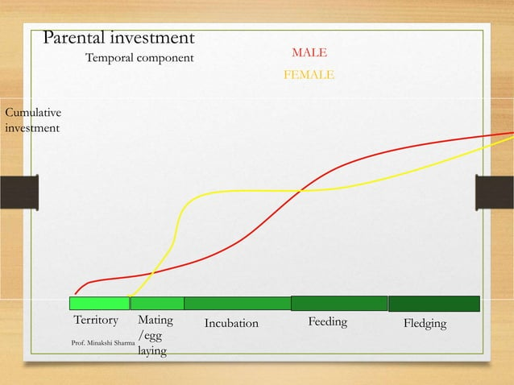

Slide 14
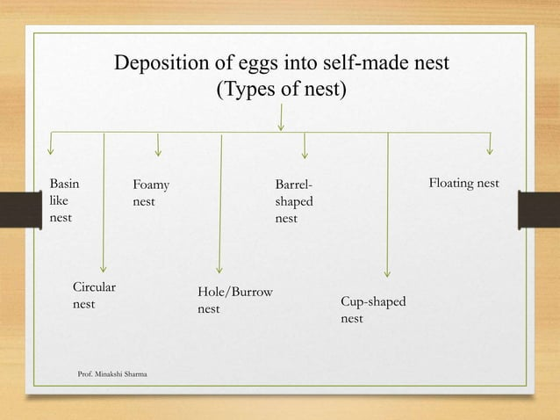

Slide 16
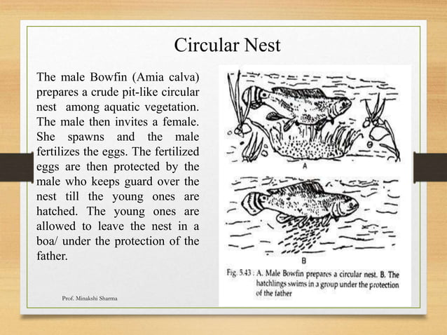

Slide 27
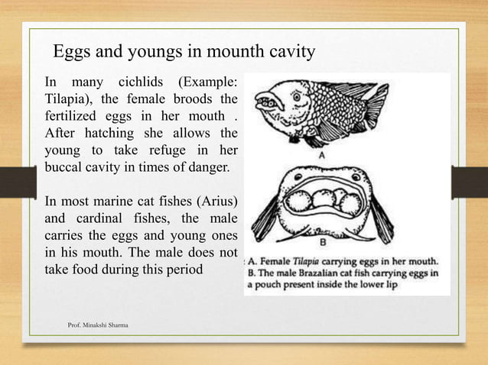

Slide 29
