Slide 1
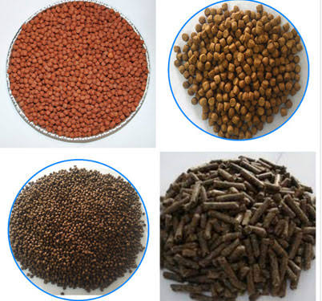
ARTIFICIAL FEED
Presentation by
G.Sreekantha

Slide 4
