Slide 1
Cold water fishes

Slide 2
Introduction
Body Is elongated, cylindrical with scals in the skin
Barbs are absent.
An additional adipose fin is located posrerrior to the dorsal
They mainly feed cannibalism

Slide 3
1.Brown trout (salmon trutta fario)
This is common fish living in the rivers&lakes of the northern hemisphere.
It was introduced into the rives of Himalayas.
Adipose fin is present
Fins are darkly coloured.
Pectoral fins are smaller in size.
Scales are minute.
Black spotr are seen all along the body.

Slide 4
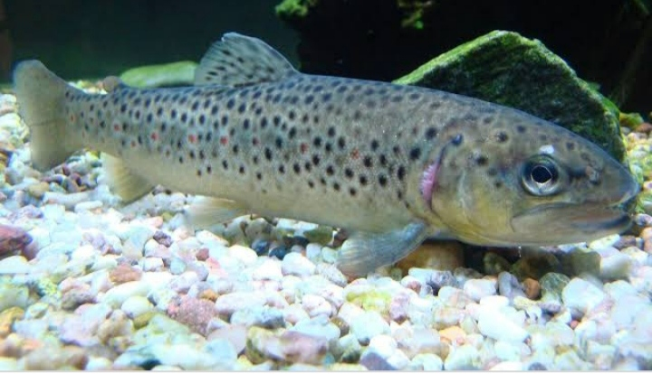

Slide 5
2.Rainbow trout (salmo gairdneri)
Thus fishes of northern lakes, rivers of Kerala.
Mouth is a narrow opening.
Demarcation between the body &caudal fins is unclean.
Adipose fin is located at the dorsal &caudal fins are pinkish with dark spots.
Body is differently coloured.
Head& dorsal sides are coloured metallic blue with reddish bands on the sides.
Belly is right coloured, black spots are seen all along the body above the lateral lines.
Fish measures about 40cm, wt.. 1.3kg

Slide 6
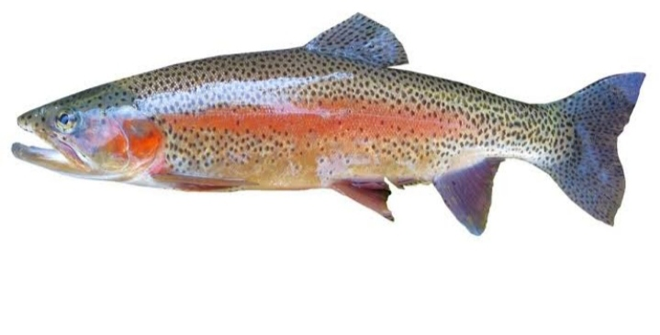

Slide 7
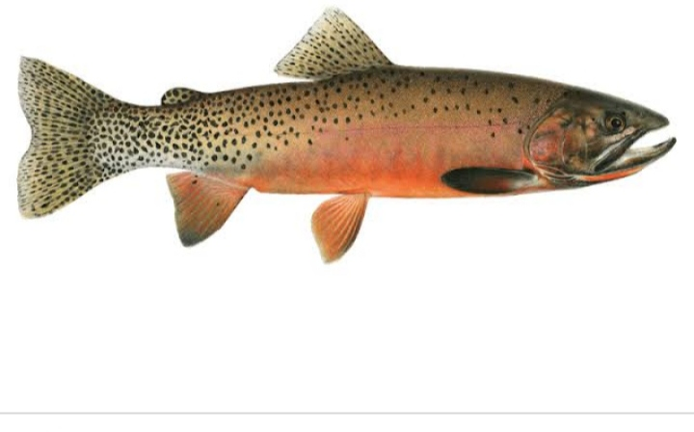

Slide 8
B. Mahseers (order:cypriniformes
Tor tor
Fish with small mouth, deep &stout body.
Lips are tender&flesy.
Head is short, rostral&long maxillary barbs.
Caudal fins I’d deeply forked.
Dorsal side of the body grayish green while laterl sides are pinkish.
Dorso laterals are greenish gold.
Ventro laterals are olive green &belly is silvery white.
Fish is omnivores it mainly depends upon insect larvae, molluscans, algae&other small fishes.
)

Slide 9
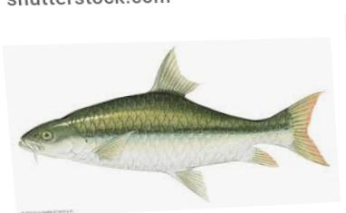

Slide 10
Tor puttitora (yellow finned mahseer)
It is seen in the streets of Himalayas.
Adults can grow to about 2.7m.
Head is wide &pointed.
Males have enlarged lips.
Two pairs of barbs arise from the snout.
Pectoral fins are shoter then head while caudal is deeply notched.
Omnivorous fish

Slide 11
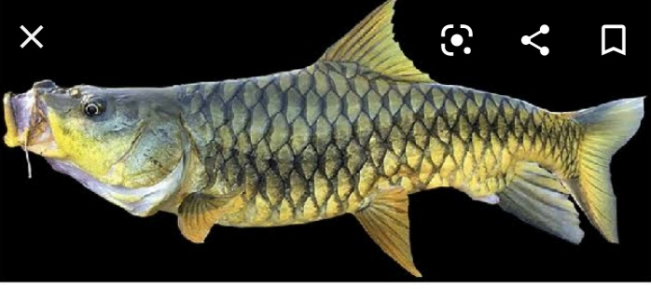

Slide 12
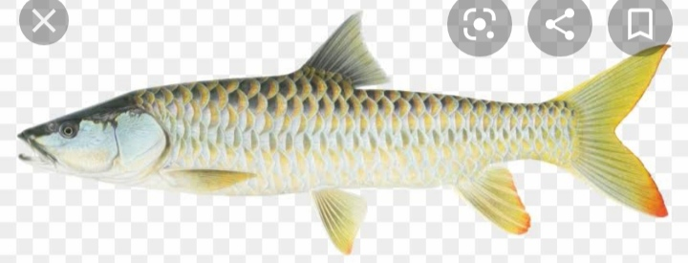

Slide 13
Torkhudree(Mahseer)
It has a short and wide head which is equal to the depth of the body.
Snout is pointed.
Mouth is surrounded by fleshy lips.
Caudal fin is sharply decided &clearly demarcated.
Body is deeply coloured on its dorsal &lateral sides while tinged yellow.
Eggs are yellowish.
Fish bottom feeder..
Omnivorous.

Slide 14
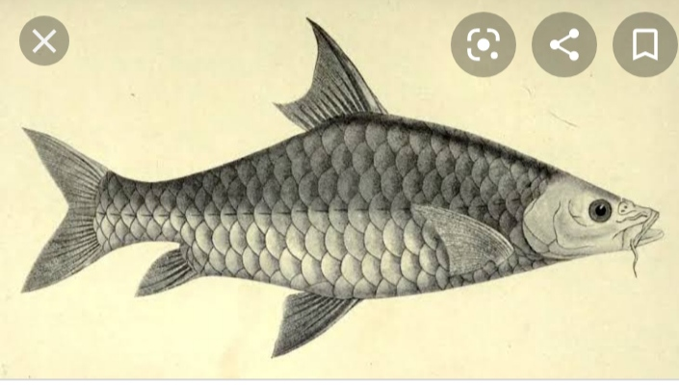

Slide 15
Doctor fish (tinca tincA)
It is the native Europe &west Siberia.
Omnivorous fish.
Feeding :diatom, blue green algae, green algae plants.
Other bottom living organisms..
Maximum length is about 40cm.

Slide 16
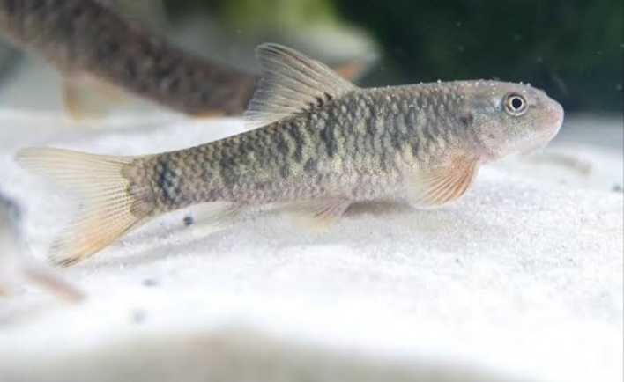

Slide 17
Chocolate mahseer ( Acrossocheilus hexagonalepis)
These are largely distributed in the hill streems of Himalayas &assam.
Eyes are reddish.
Lips aer thick.
Mouth is subterminal.
Scales are large.
Caudal fin lobes are pointed.
Head &dorsal sides of the body coloured shiny green.
The fish feed upon bottom plants, insects, molluscans.
Fish length 1m. Wt. About 11kgs.

Slide 18
