Slide 1
Indian major carps
Presented by
K. Sridher

Slide 2
Introduction
These can grow by feeding on phyto and zooplankton, decaying organic materials, aqwtic etc. Stomach is absent in their alimentary canals.
Pharyngeal bones replace the function of grinding.
They can lie even low oxygen environments.
Skin may be naked or may posses cycloid scales
They can sustain in high temperature and Turbidity of water
Thus grow fast and can reproduce even in artificial ponds

Slide 3
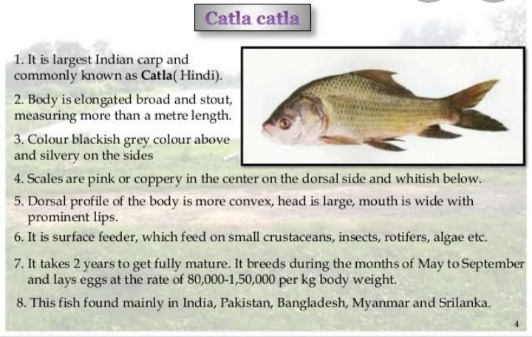

Slide 4
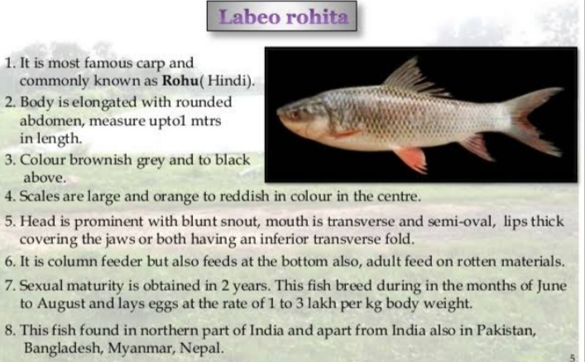

Slide 5
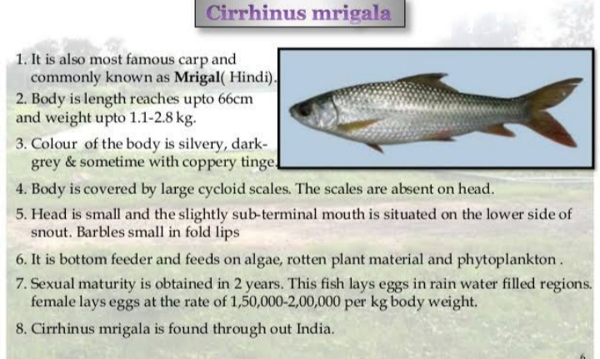

Slide 6
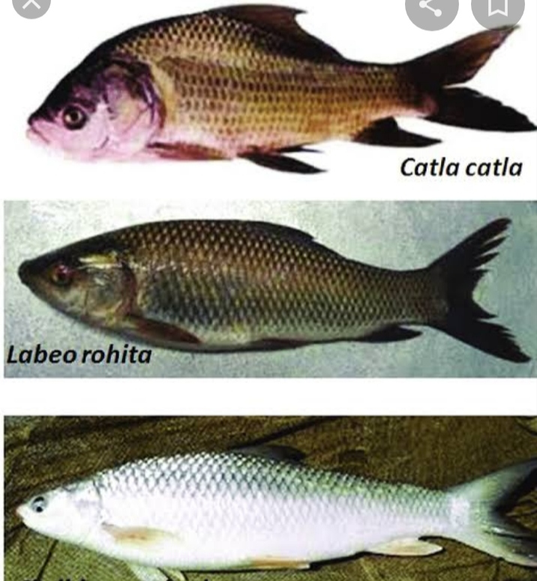

Slide 7
Thank you

