Slide 1
ECONOMICS-BASIC CONCEPTS IN ECONOMICS
Presentation by
G.Sreekantha

Slide 4
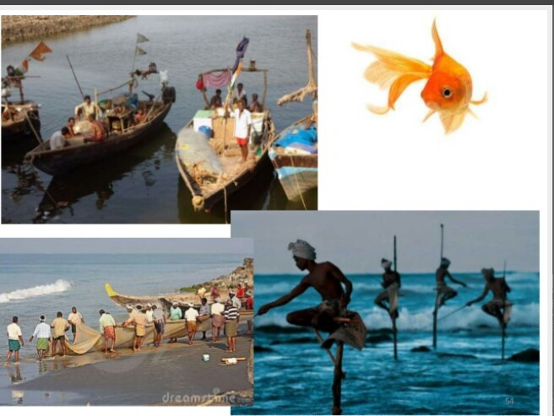

Slide 13
Introduction
Economics is mainly concerned with Choices at all levels of Society. Choices made by individuals, from or by the government.
Economics is Study of why Choice are necessary and how they are made.
It is a study generally under taken with the aim to improve in some way or other the outcome of the choices.

Slide 14
Definition
According to Adam Smith who is known "Father of economics". " Economics is the Science of wealth.
Robbins define economics as - Science which Studies human behaviour as a relationship between ends and scarce means which have alternative uses

Slide 15
Definition by Adam Smith - 1876
Adam smith in his book, `Wealth of Nation ` defined Economics "as a science of wealth." But this definition is not correct , as here exclusive attention was paid to wealth only,rather than the man for whom the wealth is meant for. Hence economics can be better regarded as a science of Man, rather than of wealth , which occupy only a secondary place, the man being the primary being.

Slide 16
Definition by Lionel Robin's - 1933.
"Economics is the study of mankind in Ordinary business of life, between ends & scarce means which have alternative uses". It is said to be the most modern & scientific definition of Economics, as it has taken into account the material, social, religious, Political, spiritual & human activities of man.

Slide 17
Robbins Definition is based on the following facts:
1. Our ends or wants are Unlimited,Which can no be satisfied, the multiplicity of human wants is the foundation stone of economics.
2. Although wants are unlimited, means (wealth) at our disposal to Satisfy these wants are scarce or limited. This scarcity is the nd 2 foundation stone over which, the structure of Economics rests.

Slide 18
3. The scarce means have alternative uses,so one should choose from the various Choices available before him to get maximum satisfaction, the 3rd foundation of economics.
In spite of all these essence in this definition it is also variously criticized as:
a.The definition lacks human touch.
b.It has reduce economics merely to evaluate things or resource allocation but overlooks national income & employment, economic growth etc.

Slide 19
Recent economists avoid the controversy of definition, in stead of defining they plunge straight into its study, as it is better to know what Economics is by study, rather than to be lost in the discussion of its definition.

Slide 20
Modern Concepts of Economics
Descriptive Economics:Under this we collect all the relevant facts about a particular topic,Concerned.
Economics theory:It gives a Simplified explanation of the way in which an economics System works and the important features of such system. It is two types
A) Micro economics B)Macro economics

Slide 21
Macro economics: It is the analysis of the entire economic system, the overall conditions of an economy like total investment and total production.
Micro economics:micr economics is a branch. Of economics that studies the behaviour of Individuals and firms in making decisions. Regarding the allocation of scarrce resources and the interaction among these individuals.

Slide 22
Applied economics: It taken the frame work of analysis Provided by economics theory and tries either to use this analysis to explain the Cause and Significant of events reported by descriptive economics.

Slide 23
Basic terms in Economics
1 Goods and Services: Anything which is Capable of Satisfying human want i,e, possesses a quality or quantity by Virtue of which it satisfies human want.
a) Free Good:Exist in nature in super abundance.
b) Economic Good:scarce in nature and one has to pay to get it.
2 Utility: The want satisfying quality of a good is called as Utility is subjective, utility of an article varies with the Change in Conditions and Circumstances. Utility is three types-From utility, Palace utility, time utility.

Slide 24
1. From utility: Utility Can be imparted to a good by Changing it's form. E.g. making a furniture out of a wood log.
2. Place utility: Utility Can be increased by transporting a good from 1 place to other. E.g. fish in a city have greater utility than at the Production Center.
3.Time utility: By storing a good to sell at the time of Scarcity gives it better utility. E.g. fish in off - season.

Slide 25
3 Value and price: Value of a Commodity of means it's Power to get other Commodities in exchange for itself.
4 Wealth and income:Total Stalk of goods and services at a Particular time.
5 Demand:Demand means that the various quantities of a given Commodity or service which Consumer would buy in a market in a given period of time at Various Prices.

Slide 26
THANK YOU

