Slide 1
PRESENT STATUS OF AQUARIUM TRADE IN INDIA
PRESENTATION BY
G.SREEKANTHA

Slide 2
INTRODUCTION
keeping of fish for ornamental purpose has a very long history going back to ancient Egypt and roman empires .
Well over a thousand years ago , Chinese had begun developing first truly domesticated ornamental fish.
According to archaeological studies, Sumerians domesticated fish 4500 years BC.
Hungarians had used fish for knowing weather conditions.
In the year 1853, first marine ornamental fish exhibition was conducted In London.

Slide 3
Ornamental fish:
Ornamental fish usually mean attractive colourful fishes of various characteristics, which are kept as pets in confined space of an aquarium or a garden pool for fun and factory fancy.
Ornamental fish are usually kept in glass aquarium and hence popularly known as Aquarium fishes.
Ornamental fish keeping is becoming popular as an easy and stress relieving hobby.
Gold fish is the most common variety of aquarium fishes.
Ornamental fish are peaceful in nature and compatible with other fishes in the aquarium.

Slide 4
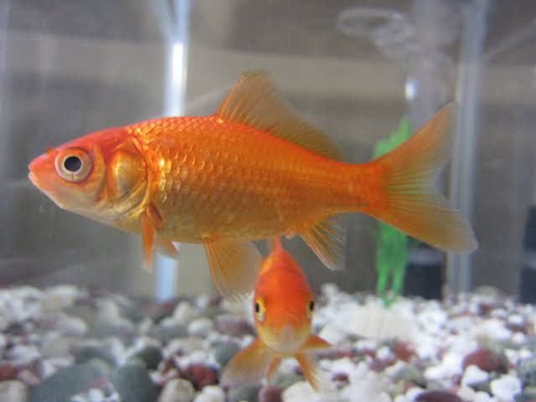

Slide 5
They readily accept artificial food and easily adopt to living in small confinements.
They provide aesthetic therapeutic and educational benefits.
These colourful fish are also as living jewels for their beautiful colours and playful behaviour.
Ornamental fish farming is a promising sector that offers alternative employment to both rural and urban unemployed youth.
This contributes to the growth of national income , promote equitable distribution of income and enhances foreign exchange to India.

Slide 6
Worldwide ornamental fish trade crosses 362 million dollars , out of which our nation share is only 0.32%.
Even though ornamental fish export started in the year 1969, we are still lagging behind.
According to recent survey our country’s trade is nearly about Rs.300 crores, but it has potential to reach Rs.1200 crores.
USA, UK, Germany, Singapore , Malaysia , Japan , France are importing and Singapore , japan, Czech , republic , Thailand , Malaysia , Israel , Indonesia are exporting.
In India the hobby of keeping ornamental fish bloomed with the opening of Tarapore wala aquarium in Mumbai in 1951 and consequently , several aquarium societies were formed in the city.
India is adobe of various ornamental fishes that are traded globally.

Slide 7
Ornamental fish trade in India
The unit value of ornamental fish is higher to that of food fish.
The domestic trade of ornamental fish is dominated by production and marketing of low value ornamental fish such as gold fish , koi carps , sharks, gourami , angels , barbs , etc.., and the retail price for these fishes are around 15-50 per each.
In India , about 80% of the ornamental fish come from freshwaters and most of them are exotic species.
Among the freshwater fishes, 98% are cultured and only 2% are captured from wild.
The captive breeding of ornamental fishes can open up new avenues and lead to the supply of hatchery bred young ones to the global markets throughout the year.
Further , community based ornamental fish culture has the effect of direct conservation benefits and it will be a sustainable livelihood to the rural people.

Slide 8
Quantity - wise ornamental fish exports from India during 2010-2016 shows high export in the year 2011-2012 and very low export in the year 2013-2014.
Andhra Pradesh is endowed with a vast and varied water resources viz : reservoirs, rivers , canals , lakes tanks and ponds.
The inland waters offer immense scope for development of ornamental fish culture, breeding and trade.
India is blessed with rich resources like rivers , streams , backwaters,
lagoons , coral reefs of Lakshadweep islands and minicoy in Andaman and nicobar islands , okha-pitan , gulf of Kutch, coast of Kerala , Comoran, gulf of mannar and palk bay are abound with highly attractive and varied species of ornamental fishes.
Western ghats of India is one of the 34 biodiversity hotspots of the world.
Among the total freshwater fishes reported from the western ghats, 40 are considered as ornamental fishes, of which 37 are endemic to the western ghats (NFDB 2016).
The variety of ornamental fishes available in different water bodies of each state is vivid and colourful.

Slide 9
The most important fishes in the ornamental fish trade are the Gold fish, black noter, tetras, guppies , platys , sword tail etc..
In Karnataka , the main varieties are guppy, molly, platy, sword tail, etc…
The ornamental fish breeding sector of Maharashtra is very well developed apart from the common live bearers .
The breeders prefer breeding high priced varieties such as Oscar , flower horn , tetras , discus and cichlids.
Almost all culture based ornamental fishes of India come from the backyard hatcheries and rearing units.
Majority of the breeders in India produce exotic fishes than indigenous , marine and brackish water fish.
Gold fish is highest consumer preferred variety and hence breeding is in India.
In Kolkata Guppy, molly , sword tail , platy and egg layers like gold fish , koi , tiger barb and some imported fish like silver shark, angel, red tailed etc..

Slide 10
Inspite of vast resources , ornamental fish culture in A.P is very limited.
Several species of ornamental fishes exist in the inland waters of Andhra Pradesh are untapped and commercial production of these aquarium fishes is on much lower scale.
Ornamental fish culture is existing in a few districts such as Nellore , Chittoor , west Godavari and Krishna.
There is a need to promote and popularise ornamental fish trade in the sun rise state of Andhra Pradesh which will provide substantial livelihood , self employment and income to rural folk.

Slide 11
THANK YOU

