Slide 1
Marine Aquarium
Presentation by
G.Sreekantha

Slide 2
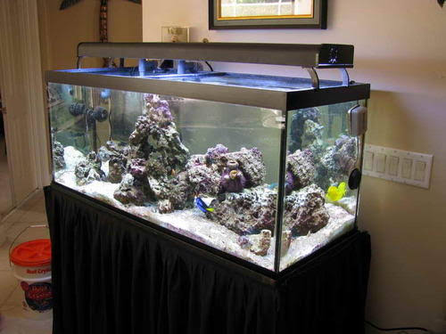

Slide 3
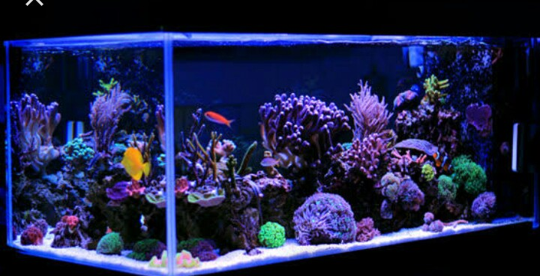

Slide 4
Introduction
Marine aquarium is an aquarium in which marine plants and animals are kept
Marine fish keeping in difference from Freshwater Counterpart because of the fundamental differences in the Constitution of salt water and the resulting differences in the adoption of its in habitats.
The first salt water tanks used were Venetian glass jars Where Romans kept anemones outdoors.

Slide 5
Tropical Marine Aquarium
This is the Common type of Aquarium.
It houses Marine animals from tropical Climates.
The temperature to be maintained is between 24 and 28°C.
Eg:Tropical reef tanks,fish – only- tanks.Live for these aquariums are acquired through Commercial means.

Slide 6
Temperature (Cold water) Marine Aquarium
It holds the fish of temperature Climate.
Temperature is to be maintained at 24°C.
Colourful Species like ornate clown fish,blennies and Sea Anemones are some of the inhabitants.

Slide 7
Live rock
It is composed of lime stone and decomposing coral Skelton covered with beneficial algal Coralline & Tiny Vertebrates & bacteria.
Live rock acts as buffer to maintain sea PH at 8.0 – 8.3 in the aquarium Live rock has acod neutralizing Capacity.

Slide 8
FIlteration
Marine aquarium needs a complex filtration requirements compared to most Freshwater aquariums.
Wet and dry filters and protein skimmers are used to remove organic Compound before their degradation.

Slide 9
Lighting
Regular Cyclical lighting is used in aquarium to stimulante day and night.
Ligting provides security and enables rest to the In habitants.
High out put lighting is required for many invertebrates such as corals & Anemones to survive.

Slide 10
Water testing
Water quality monitoring is mandatory for successful marine aquarium Keeping.
Salinity should be maintained between 28 & 35 PPT.

Slide 11
Acclimatization
Acclimatization is a process that performed while adding a new marine life to an aquarium.
Acclimatization is mandatory for invertebrates like Sea Anemones and Corals which lack Osmoregulation.

Slide 12
Water exchange
Water exchange is used to maintain calcium carbonate Alkalinity and Magnesium which are rapidly depleted in a reef aquarium.
Water change helps to remove the toxic substances and the environment healthy.

Slide 13
Thank you

