Slide 1
DANTULARI NARAYANA RAJA COLLEGE (AUTONOMUS)
ADIKAVI NANNAYA UNIVERSITY
Department of Biochemistry
Conducted BY SIR.RAMESH (HOD) M.SC M.PHIL

Slide 2
BIOCHEMICAL CORRELATION IN
DISORDERS

Slide 3
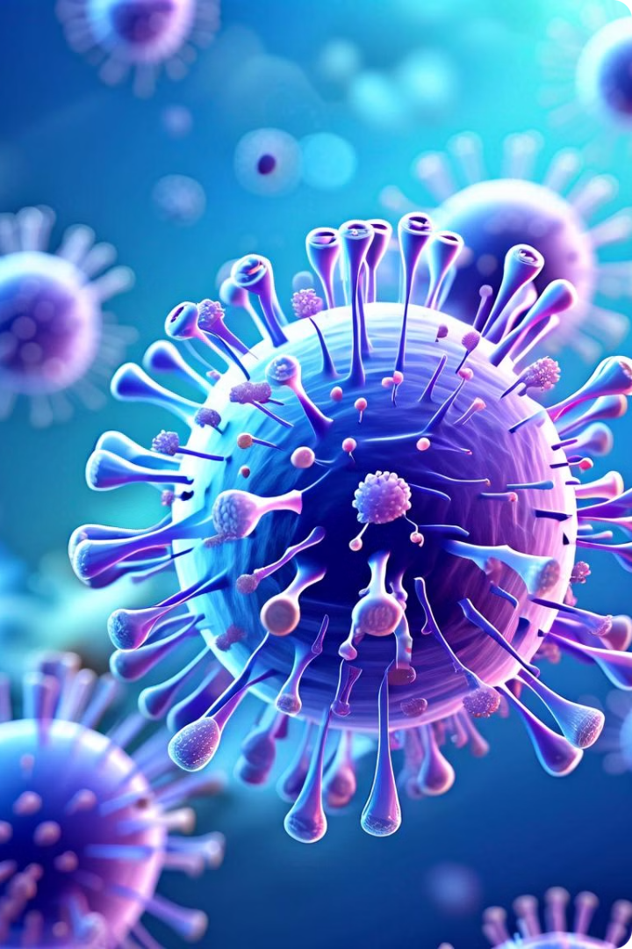
Autoimmune Disorders: An Overview
Autoimmune disorders are a group of chronic conditions where the body's immune system, which normally protects against foreign invaders like bacteria and viruses, mistakenly attacks the body's own tissues and organs. This can lead to a wide range of symptoms, depending on which organs are affected. Autoimmune disorders are complex and often have a combination of genetic and environmental factors contributing to their development.

Slide 4
Types of Autoimmune Disorders
1
Rheumatoid Arthritis
2
Systemic Lupus Erythematosus (SLE)
A chronic inflammatory disorder that primarily affects the joints, causing pain, stiffness, swelling, and decreased range of motion.
A chronic autoimmune disorder that can affect various organs, including the skin, joints, kidneys, heart, and brain.
3
Multiple Sclerosis (MS)
4
Crohn's Disease and Ulcerative Colitis
An autoimmune disease that affects the central nervous system, damaging the myelin sheath that protects nerve fibers, leading to neurological problems.
Inflammatory bowel diseases that affect the digestive tract, causing chronic inflammation and abdominal pain, diarrhea, and weight loss.

Slide 5
Causes of Autoimmune Disorders
Genetic Predisposition
Environmental Triggers
Hormonal Factors
Certain genes can increase the risk of developing autoimmune disorders. Having a family history of these conditions can be a factor.
Hormones, particularly estrogen, can influence the immune system's activity and contribute to the development of autoimmune disorders.
Exposure to infections, certain medications, smoking, and environmental toxins can trigger the immune system to attack the body's own tissues.

Slide 6
Symptoms of Autoimmune Disorders
Joint Pain and Stiffness
Fatigue and Weakness
Many autoimmune disorders affect the joints, causing pain, stiffness, swelling, and decreased range of motion.
Chronic fatigue and weakness are common symptoms of autoimmune disorders, often due to inflammation and immune system overactivity.
Skin Rashes and Inflammation
Digestive Issues
Some autoimmune disorders affect the skin, causing rashes, redness, and inflammation. These rashes can be itchy and painful.
Autoimmune disorders can affect the digestive system, causing abdominal pain, diarrhea, constipation, and nausea.

Slide 7
Diagnosis and Treatment
1
Medical History and Physical Examination
Doctors will review the patient's medical history, family history, and perform a physical examination to assess symptoms.
2
Blood Tests and Imaging Studies
Blood tests help identify markers of inflammation and autoantibodies, while imaging studies like X-rays and MRI can reveal affected organs.
3
Treatment Options
Treatment goals include reducing inflammation, managing symptoms, and preventing complications. Treatments may include medications, lifestyle modifications, and therapies.

Slide 8
Living with Autoimmune Disorders
Medication Management
Healthy Lifestyle
Support Groups and Counseling
Staying Informed
Maintaining a healthy lifestyle through a balanced diet, regular exercise, and stress management can improve overall well-being and manage symptoms.
Taking prescribed medications consistently is crucial to manage symptoms and prevent complications. Working closely with a healthcare provider is essential.
Connecting with support groups and seeking counseling can provide emotional support, coping mechanisms, and a sense of community.
Staying informed about autoimmune disorders and current research can empower individuals to manage their conditions effectively and participate in their healthcare decisions.

Slide 9
Research and Future Directions
New Treatments
Research is ongoing to develop novel therapies that target specific immune pathways and minimize side effects.
Precision Medicine
Personalized medicine approaches aim to tailor treatment strategies based on an individual's genetic and other factors.
Early Detection and Prevention
Research focuses on identifying biomarkers for early diagnosis and developing strategies to prevent the development of autoimmune disorders.

