Slide 1
DANTULARI NARAYANA RAJA COLLEGE (AUTONOMUS)
ADIKAVI NANNAYA UNIVERSITY
Department of Biochemistry
Conducted BY SIR.RAMESH (HOD) M.SC M.PHIL

Slide 2
BIOCHEMICAL CORRELATION IN
DISORDERS

Slide 3
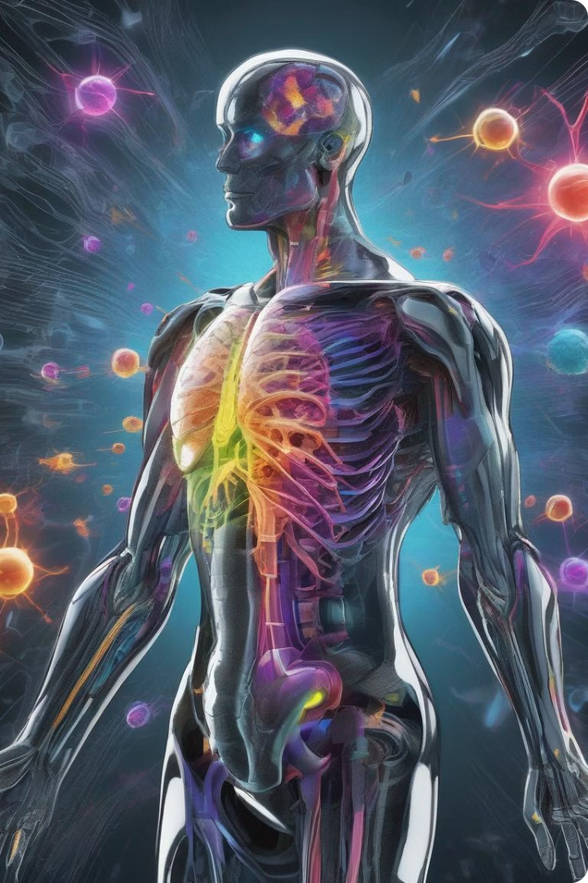
Hormones and Autoimmunity: A Complex Relationship
Autoimmune diseases are conditions where the body's immune system mistakenly attacks its own healthy tissues. Hormones play a crucial role in regulating the immune system and influencing the development and progression of these diseases.
The intricate interplay between hormones and autoimmunity is not fully understood. However, evidence suggests that hormonal imbalances can contribute to the onset or exacerbation of autoimmune conditions.

Slide 4
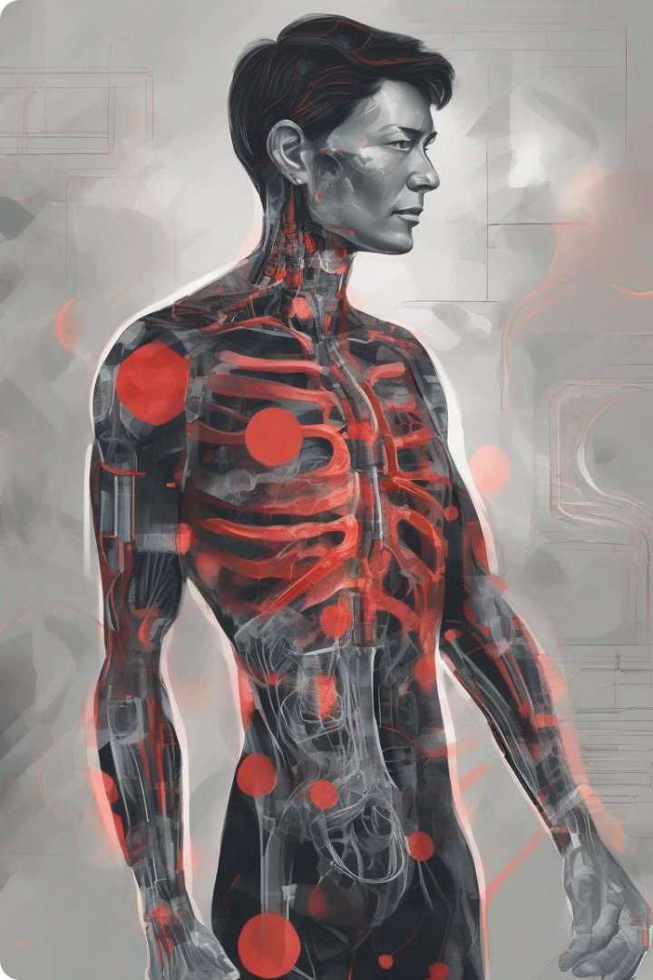
Understanding Autoimmune Diseases
Autoimmune diseases are chronic conditions that occur when the body's immune system mistakenly attacks its own healthy tissues. This can happen when the immune system is unable to distinguish between foreign invaders, like bacteria or viruses, and the body's own cells.
There are over 80 known autoimmune diseases, affecting various parts of the body. Examples include rheumatoid arthritis, lupus, inflammatory bowel disease, and multiple sclerosis. Each disease has unique symptoms and treatment approaches.

Slide 5
The Role of Hormones in Immune Regulation
Hormones play a crucial role in regulating the immune system. The endocrine system, responsible for hormone production, works in conjunction with the immune system to maintain a balance.
Hormones, like cortisol and cytokines, act as messengers, influencing the activity of immune cells. They help to fine-tune the immune response, ensuring that it's strong enough to fight off infections but not overly aggressive, leading to autoimmune diseases.

Slide 6
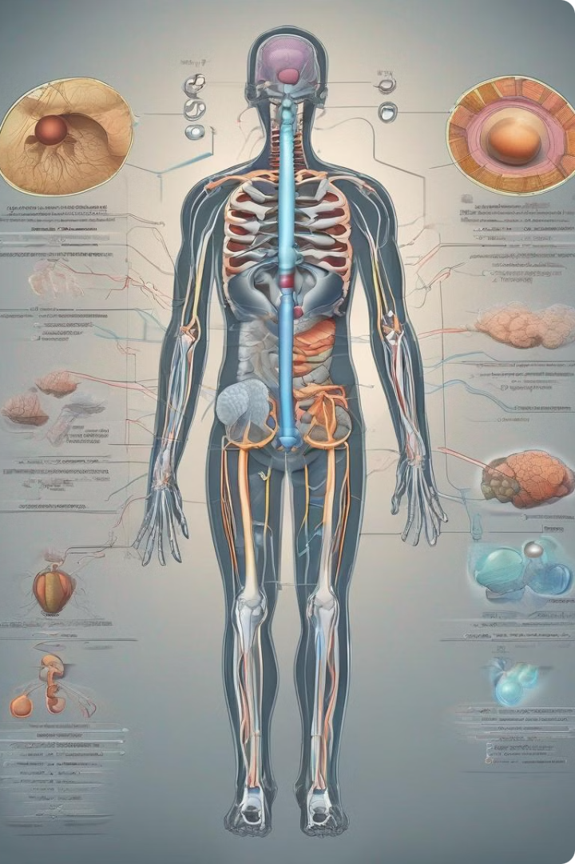
Common Hormonal Imbalances and Their Link to Autoimmune Disease
Hormonal imbalances can disrupt the delicate balance of the immune system, increasing the risk of developing autoimmune diseases. When hormones are out of whack, the immune system may misinterpret healthy cells as foreign invaders, triggering an attack on the body's own tissues.
Common hormonal imbalances associated with autoimmune diseases include thyroid disorders, adrenal imbalances, and sex hormone imbalances. Understanding the connection between these imbalances and autoimmune disorders is crucial for effective diagnosis, treatment, and prevention.

Slide 7
Thyroid Disorders
Hypothyroidism
Hyperthyroidism
Hypothyroidism is a condition where the thyroid gland doesn't produce enough thyroid hormones. These hormones regulate metabolism, heart rate, and body temperature. Symptoms include fatigue, weight gain, and depression. Hypothyroidism is often treatable with medication.
Hyperthyroidism is a condition where the thyroid gland produces too much thyroid hormone. This can lead to rapid heartbeat, weight loss, and anxiety. Hyperthyroidism is often treated with medication or surgery.

Slide 8
Adrenal Imbalances
1
Stress Response
2
Hormonal Cascade
3
Autoimmune Connection
The adrenal glands produce cortisol, a hormone critical for stress response. Chronic stress can lead to adrenal fatigue, characterized by low cortisol levels. This can manifest as fatigue, low mood, and difficulty concentrating.
Adrenal imbalances can disrupt the delicate balance of other hormones in the body. This is because the adrenal glands are involved in the production of several hormones, including cortisol, aldosterone, and DHEA. Imbalances in these hormones can impact various bodily functions.
Research suggests a potential link between adrenal imbalances and autoimmune diseases. Adrenal fatigue may compromise the immune system, making individuals more susceptible to autoimmune conditions. However, more research is needed to fully understand this connection.

Slide 9
Sex Hormone Imbalances
Estrogen Dominance
Progesterone Deficiency
Testosterone Deficiency
Estrogen dominance is when the levels of estrogen are higher than the levels of progesterone. This imbalance can contribute to various symptoms such as irregular periods, weight gain, mood swings, and fatigue. It is important to seek advice from a healthcare professional to address any concerns regarding hormone imbalance.
Progesterone is a crucial hormone responsible for regulating the menstrual cycle, maintaining pregnancy, and supporting overall well-being. A deficiency in progesterone can lead to various issues like irregular periods, infertility, and mood disorders. It is crucial to consult a healthcare professional to discuss any concerns about progesterone levels.
Testosterone is the primary male sex hormone, but it also plays a significant role in women's health. A deficiency in testosterone can affect libido, energy levels, muscle mass, and bone density. It is essential to address any concerns regarding testosterone levels with a healthcare professional.

Slide 10
Estrogen Dominance
What It Is
Symptoms and Impact
Managing Estrogen Dominance
Estrogen dominance occurs when estrogen levels are high relative to progesterone. This can happen due to factors like stress, poor diet, and exposure to environmental toxins. This imbalance can disrupt hormonal balance and lead to a variety of health problems.
Symptoms of estrogen dominance can include irregular periods, weight gain, fatigue, and mood swings. In some cases, it can also contribute to autoimmune conditions, potentially by affecting immune cell function and inflammation.
Managing estrogen dominance often involves lifestyle changes, such as reducing exposure to environmental toxins and adopting a healthy diet. Natural therapies like herbs and supplements, as well as bioidentical hormone replacement therapy, can also be considered under the guidance of a healthcare professional.

Slide 11
Progesterone Deficiency
Menstrual Cycle Irregularities
Mood Swings and Depression
Premenstrual Syndrome (PMS)
Progesterone is crucial for regulating the menstrual cycle. Low levels can cause irregular periods, such as missed periods or very short cycles. This is often a primary symptom for women with progesterone deficiency.
Progesterone has a calming effect on the brain, so a deficiency can contribute to mood swings, anxiety, and even depression. These mood changes can be severe and significantly impact quality of life.
Progesterone deficiency can worsen PMS symptoms, causing more severe cramping, bloating, breast tenderness, and mood swings. These symptoms can be debilitating and interfere with daily activities.

Slide 12
- Testosterone Deficiency
Fatigue and Low Energy
Muscle Loss and Weakness
Hair Loss and Changes in Body Composition
Mood Swings and Depression
Testosterone deficiency can lead to chronic fatigue, low energy, and a lack of motivation. This can significantly impact daily life, making it difficult to maintain a healthy lifestyle and participate in activities that were once enjoyable.
Testosterone plays a crucial role in muscle growth and maintenance. A deficiency can result in muscle loss, decreased strength, and an overall decline in physical performance. This can affect both athletic abilities and daily tasks that require physical effort.
Testosterone plays a role in mood regulation and cognitive function. A deficiency can lead to mood swings, irritability, anxiety, and even depression. These mental health challenges can further exacerbate the effects of testosterone deficiency on overall health and quality of life.
Testosterone deficiency can contribute to hair loss, particularly on the scalp, and changes in body composition, such as an increase in body fat and a decrease in lean muscle mass. These changes can negatively affect self-esteem and overall well-being.

