Slide 1
DANTULARI NARAYANA RAJA COLLEGE (AUTONOMUS)
ADIKAVI NANNAYA UNIVERSITY
Department of Biochemistry
Conducted BY SIR.RAMESH (HOD) M.SC M.PHIL

Slide 2
BIOCHEMICAL CORRELATION IN
DISORDERS

Slide 3
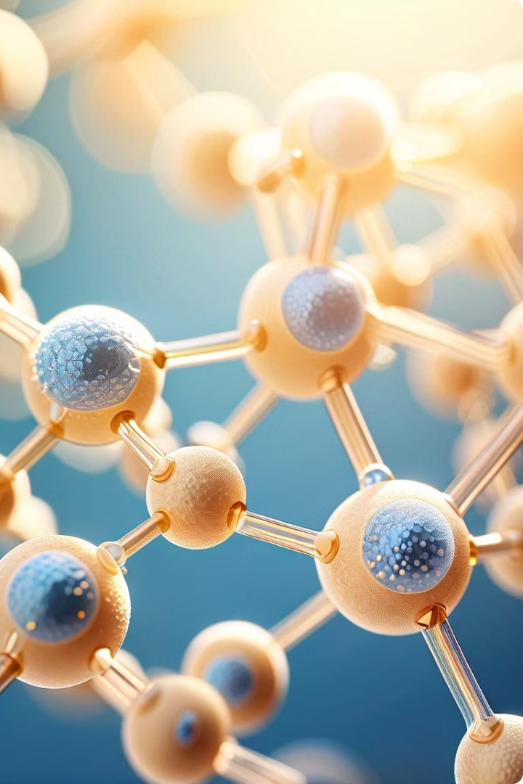
Protein Misfolding and Disease
Protein misfolding is a complex biological process that can lead to a wide range of debilitating diseases. These diseases, collectively known as protein misfolding disorders, are characterized by the accumulation of misfolded proteins, which can disrupt cellular function and lead to various pathological effects. The proper folding of proteins is crucial for their biological activity, and even minor errors in the folding process can have severe consequences for cells and tissues.

Slide 4
Common Misfolded Protein Diseases
1
Alzheimer's Disease
2
Parkinson's Disease
Alzheimer's disease is a neurodegenerative disorder characterized by the accumulation of amyloid plaques and tau tangles in the brain, both of which are misfolded proteins. These plaques and tangles disrupt communication between neurons, leading to cognitive decline and memory loss.
Parkinson's disease is another neurodegenerative disorder, marked by the accumulation of misfolded alpha-synuclein protein in the brain. This accumulation disrupts the function of neurons responsible for movement control, leading to tremors, rigidity, and slow movements.
3
Huntington's Disease
4
Cystic Fibrosis
Huntington's disease is a neurodegenerative disorder caused by the accumulation of misfolded huntingtin protein. This misfolded protein leads to degeneration of neurons in the brain, particularly in regions involved in movement, cognition, and emotional regulation.
Cystic fibrosis is a genetic disorder caused by mutations in the CFTR gene. These mutations result in the production of a misfolded protein, which is unable to function properly in transporting chloride ions across cell membranes. This dysfunction leads to the build-up of thick mucus in the lungs, pancreas, and other organs.

Slide 5
Impact of Mineral Deficiency on Protein Folding
Mineral Deficiency
Impact on Protein Folding
Related Diseases
Zinc (Zn)
Zn is crucial for the activity of numerous enzymes involved in protein folding, including those involved in disulfide bond formation and chaperone activity. Deficiency can disrupt these processes, leading to misfolding.
Growth retardation, immune deficiency, impaired wound healing, hair loss, skin lesions, taste and smell disturbances, and delayed puberty.
Copper (Cu)
Cu is an essential cofactor for enzymes involved in protein folding, such as lysyl oxidase, which is involved in collagen synthesis. Deficiency can disrupt protein structure and function.
Anemia, bone disorders, connective tissue disorders, neurological disorders, and cardiovascular diseases.
Magnesium (Mg)
Mg plays a vital role in protein synthesis and folding by stabilizing ribosomes and influencing the activity of chaperone proteins. Deficiency can disrupt these processes.
Muscle weakness, fatigue, headache, nausea, vomiting, insomnia, and seizures.

Slide 6
Mechanisms of Protein Misfolding
Genetic Mutations
Environmental Stress
Cellular Crowding
Mutations in the DNA sequence can lead to changes in the amino acid sequence of a protein, which can disrupt its folding process. These mutations can alter the protein's structure, leading to misfolding and aggregation.
Environmental factors such as heat shock, oxidative stress, and exposure to toxic chemicals can disrupt protein folding. These stressors can cause proteins to unfold or misfold, leading to aggregation and cellular dysfunction.
The crowded environment inside cells can hinder protein folding. High concentrations of proteins and other molecules can interfere with the proper folding of nascent proteins, leading to misfolding and aggregation.

Slide 7
Role of Chaperone Proteins
Chaperone Function
Types of Chaperones
Chaperone Deficiency
Chaperone proteins are essential for maintaining protein homeostasis in cells. They assist in the proper folding of newly synthesized proteins, preventing aggregation and ensuring that proteins function correctly. Chaperones can also refold misfolded proteins, preventing their accumulation and potentially toxic effects.
There are various types of chaperone proteins, each with specific roles. Some chaperones, like heat shock proteins (HSPs), are induced by stress conditions. Other chaperones, like chaperonins, provide a protected environment for protein folding.
Deficiency in chaperone proteins can lead to an increased accumulation of misfolded proteins, contributing to protein misfolding disorders. Mutations in chaperone genes or environmental factors can disrupt chaperone function, contributing to disease pathogenesis.

Slide 8
Therapeutic Approaches to Protein Misfolding Disorders
Pharmacological Therapies
Gene Therapy
Developing drugs that target specific pathways involved in protein misfolding or aggregation can provide therapeutic benefits. These drugs can inhibit protein aggregation, enhance protein degradation, or modulate chaperone function.
Gene therapy approaches aim to correct genetic mutations underlying protein misfolding disorders. This could involve introducing functional copies of genes, silencing mutant genes, or enhancing chaperone expression.
Protein Degradation Therapies
Lifestyle Modifications
Targeting the degradation of misfolded proteins is a promising therapeutic approach. This could involve enhancing the cellular machinery responsible for protein degradation or developing compounds that specifically target and degrade misfolded proteins.
Lifestyle modifications, such as diet, exercise, and stress management, can play a role in mitigating protein misfolding. For example, diets rich in antioxidants may help reduce oxidative stress, which can contribute to protein misfolding.

Slide 9
Conclusion and Future Directions
Protein misfolding disorders pose significant challenges for medicine. Understanding the complex mechanisms underlying protein misfolding is crucial for developing effective therapeutic strategies. Future research will focus on developing novel drugs and therapies that target specific pathways involved in protein misfolding and aggregation. Furthermore, exploring the role of environmental factors and lifestyle modifications in mitigating protein misfolding will be critical for developing preventive measures and improving patient outcomes.

