Slide 1
DANTULARI NARAYANA RAJA COLLEGE (AUTONOMUS)
ADIKAVI NANNAYA UNIVERSITY
Department of Biochemistry
Conducted BY SIR.RAMESH (HOD) M.SC M.PHIL

Slide 2
BIOCHEMICAL CORRELATION IN
DISORDERS

Slide 3
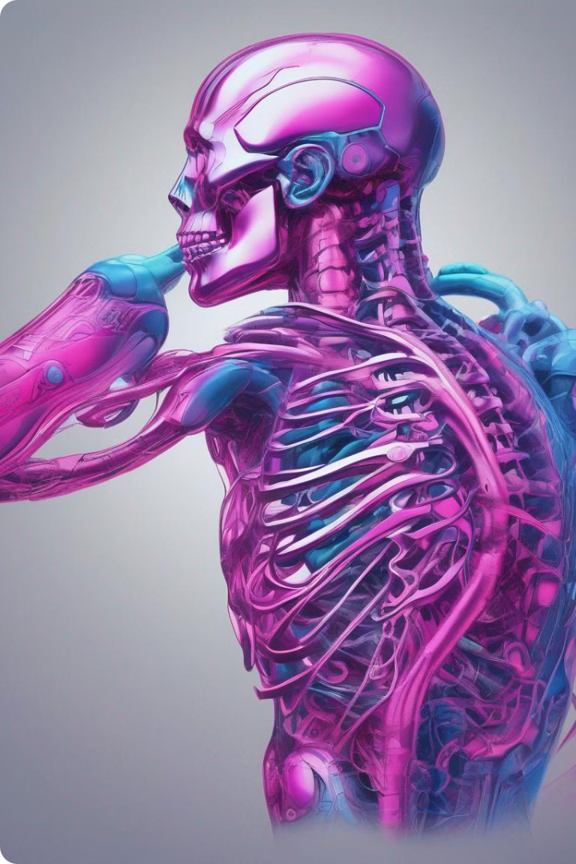
Organ-Specific Disorders
Organ-specific disorders, as the name suggests, are diseases that affect specific organs in the human body. These disorders are distinct from systemic diseases which affect multiple organs. Each organ has its own unique structure and function, and therefore, its own unique set of diseases. Understanding the specific mechanisms by which these disorders affect the body is crucial for developing effective treatments and preventing complications.

Slide 4
Cardiovascular Disorders
1
Heart Disease
2
Stroke
Heart disease, a leading cause of death worldwide, encompasses a range of conditions that affect the heart's ability to pump blood efficiently. This can include coronary artery disease, heart attacks, heart failure, and arrhythmias.
Stroke occurs when a blood clot blocks an artery in the brain, depriving brain tissue of oxygen and causing damage. This can lead to paralysis, speech difficulties, and cognitive impairment.
3
Hypertension
4
Peripheral Artery Disease
High blood pressure, known as hypertension, puts extra strain on the heart and blood vessels, increasing the risk of heart disease, stroke, and kidney problems.
Peripheral artery disease affects the blood vessels that supply blood to the legs and feet, leading to pain, numbness, and even amputation.

Slide 5
Respiratory Disorders
1
2
3
4
Asthma
Chronic Obstructive Pulmonary Disease (COPD)
Pneumonia
Pulmonary Embolism
Asthma is a chronic respiratory disease characterized by inflammation and narrowing of the airways, making breathing difficult. Triggers can include allergens, exercise, and cold air.
Pneumonia is an infection of the lungs that causes inflammation and fluid buildup, making breathing painful and difficult. It can be caused by bacteria, viruses, or fungi.
Pulmonary embolism occurs when a blood clot travels to the lungs, blocking blood flow and potentially causing respiratory distress.
COPD is a progressive lung disease that obstructs airflow and makes it difficult to breathe. It's often caused by smoking, but can also be triggered by exposure to air pollution.

Slide 6
Gastrointestinal Disorders
Digestive Disorders
Liver Disorders
Pancreatic Disorders
Digestive disorders affect the organs involved in the digestion and absorption of food, such as the stomach, intestines, and liver.
Liver disorders affect the liver, which plays a vital role in detoxification, protein synthesis, and bile production.
Pancreatic disorders affect the pancreas, which produces enzymes for digestion and hormones for blood sugar regulation.
Hepatitis
Gastroesophageal Reflux Disease (GERD)
Cirrhosis
Pancreatitis
Liver Cancer
Pancreatic Cancer
Irritable Bowel Syndrome (IBS)
Crohn's Disease and Ulcerative Colitis
Peptic Ulcer Disease

Slide 7
Renal Disorders
Kidney Failure
Kidney Infections
Kidney Stones
Hypertension
Kidney failure occurs when the kidneys lose their ability to filter waste products from the blood, leading to fluid buildup, electrolyte imbalances, and other complications.
Kidney stones are hard deposits that form in the kidneys, causing pain, blood in the urine, and potentially blockage of the urinary tract.
High blood pressure can damage the kidneys over time, leading to kidney failure.
Kidney infections, also known as pyelonephritis, are infections of the kidneys and urinary tract. They can cause pain, fever, and difficulty urinating.

Slide 8
Neurological Disorders
Alzheimer's Disease
Parkinson's Disease
Multiple Sclerosis (MS)
Stroke
Stroke occurs when a blood clot blocks an artery in the brain, depriving brain tissue of oxygen and causing damage. This can lead to paralysis, speech difficulties, and cognitive impairment.
Alzheimer's disease is a progressive brain disorder that causes memory loss, confusion, and changes in personality. It's a leading cause of dementia in the elderly.
Parkinson's disease is a progressive nervous system disorder that affects movement, causing tremors, stiffness, and slowness of movement.
MS is an autoimmune disease that damages the myelin sheath, the protective covering of nerve fibers in the brain and spinal cord, causing a range of neurological symptoms.

Slide 9
Endocrine Disorders
Disorder
Affected Gland
Symptoms
Diabetes
Pancreas
High blood sugar, frequent urination, thirst, fatigue
Hypothyroidism
Thyroid
Fatigue, weight gain, cold intolerance, dry skin
Hyperthyroidism
Thyroid
Weight loss, rapid heartbeat, anxiety, tremor
Cushing's Syndrome
Adrenal Glands
Weight gain, high blood pressure, muscle weakness, stretch marks

