Slide 1
DANTULARI NARAYANA RAJA COLLEGE (AUTONOMUS)
ADIKAVI NANNAYA UNIVERSITY
Department of Biochemistry
Conducted BY SIR.RAMESH (HOD) M.SC M.PHIL

Slide 2
GENETICS & ECOLOGY

Slide 3
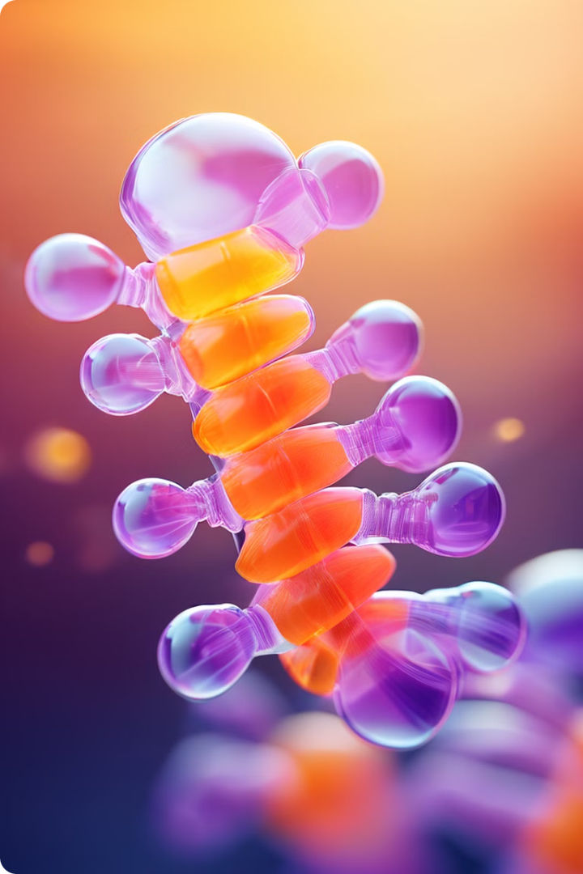
Introduction to Chromosomal Disorders
Chromosomal disorders are a group of conditions that occur when there is a change in the structure or number of chromosomes. Chromosomes are thread-like structures found in the nucleus of every cell that contain genetic information. They carry genes that determine our physical and mental characteristics. These disorders can occur during the formation of the egg or sperm, or during early embryonic development. They can affect various aspects of an individual's health, including physical development, intellectual function, and overall well-being. This presentation aims to provide a comprehensive overview of chromosomal disorders, covering their types, causes, symptoms, diagnosis, treatment, and support.

Slide 4
Types of Chromosomal Disorders
1
Numerical Abnormalities
2
Structural Abnormalities
3
Mosaic Chromosomal Disorders
These disorders involve an extra copy or a missing copy of a chromosome. Examples include Down syndrome (trisomy 21), Turner syndrome (monosomy X), and Klinefelter syndrome (XXY).
These disorders involve changes in the structure of a chromosome, such as deletions, duplications, inversions, or translocations. These structural changes can alter the gene sequence and lead to a range of health issues.
In these disorders, some cells have the normal chromosome complement, while others have an abnormal chromosome complement. This leads to a range of symptoms, often milder than those seen in individuals with a complete chromosomal disorder.

Slide 5
Causes and Risk Factors
Causes
Risk Factors
Chromosomal disorders primarily arise due to errors during cell division, specifically meiosis, which is the process that produces sperm and egg cells. These errors can occur spontaneously or be influenced by various factors.
Maternal age: The risk of having a child with a chromosomal disorder increases with maternal age, particularly after the age of 35.
Previous child with a chromosomal disorder: If a couple has already had a child with a chromosomal disorder, the risk of having another child with the same condition is increased.
Exposure to certain environmental factors: Exposure to certain environmental factors, such as radiation or certain chemicals, can increase the risk of chromosomal disorders.

Slide 6
Symptoms and Diagnosis
1
2
3
Symptoms
Diagnosis
Confirmation
The symptoms of chromosomal disorders vary depending on the specific condition and the genes affected. Some common symptoms include intellectual disabilities, developmental delays, physical abnormalities, and health problems.
Diagnosis typically involves a combination of clinical evaluation, genetic testing, and imaging studies. Genetic testing can include karyotyping, which is a test that examines the chromosomes, and FISH (fluorescence in situ hybridization), which uses fluorescent probes to identify specific chromosome regions.
A definitive diagnosis of a chromosomal disorder is typically confirmed through genetic testing, which allows for the identification of specific chromosomal abnormalities.

Slide 7
Prenatal Screening and Testing
Screening Tests
Diagnostic Tests
Non-invasive Prenatal Testing (NIPT)
These tests are offered to all pregnant women to assess the risk of having a baby with a chromosomal disorder. They are not diagnostic and can provide a false positive or negative result.
These tests are performed when there is a higher risk of a chromosomal disorder, and they can provide a definitive diagnosis. Examples include amniocentesis and chorionic villus sampling (CVS).
This is a newer type of prenatal screening test that analyzes fetal DNA in the mother's blood. It is highly accurate and can detect a range of chromosomal abnormalities.

Slide 8
Treatment and Management
Early Intervention
Early intervention programs can help children with chromosomal disorders reach their full potential. These programs provide specialized services, such as therapy, education, and support, tailored to the individual's needs.
Medical Management
Medical management focuses on addressing the specific health concerns associated with the chromosomal disorder. This may include monitoring for medical conditions, providing necessary treatments, and managing any complications.
Lifelong Support
Individuals with chromosomal disorders may require lifelong support, which can include access to specialized resources, such as educational programs, healthcare services, and social support networks. This support helps individuals live fulfilling and independent lives.

Slide 9
Genetic Counseling and Support
Genetic Counseling
Support Groups
Community Resources
Genetic counseling provides information about chromosomal disorders, including their causes, inheritance patterns, risks, and available testing options. It also offers emotional support and guidance for families facing these challenges.
Support groups connect individuals with chromosomal disorders and their families with others who share similar experiences. These groups provide a safe and understanding environment to share information, coping strategies, and emotional support.
Various community resources offer support services for individuals with chromosomal disorders and their families. These resources can include educational programs, therapy, respite care, and advocacy services.

