Slide 1
DANTULARI NARAYANA RAJA COLLEGE (AUTONOMUS)
ADIKAVI NANNAYA UNIVERSITY
Department of Biochemistry
Conducted BY SIR.RAMESH (HOD) M.SC M.PHIL

Slide 2
GENETICS & ECOLOGY

Slide 3
Genes: The Building Blocks of Life
Genes are the fundamental units of heredity, responsible for carrying and transmitting genetic information from one generation to the next. They reside within our chromosomes, acting as blueprints for the intricate machinery that governs our physical traits, physiological functions, and even our susceptibility to certain diseases. Understanding genes is essential for comprehending the very essence of life and the complexities of our existence. This presentation will delve into the fascinating world of genes, exploring their structure, variations, and implications for our health and future.

Slide 4
DNA Structure and Genetic Information
Our genetic blueprint, DNA (deoxyribonucleic acid), is a complex molecule composed of two long strands of nucleotides, spiraling together to form a double helix. These nucleotides are arranged in a specific sequence, forming the code that determines our traits. Each gene within this code is a segment of DNA responsible for instructing the production of specific proteins, the essential building blocks of our bodies. Proteins play crucial roles in countless biological processes, including cell growth, metabolism, and immune response.
The information encoded within our genes is passed down from our parents, determining a wide range of characteristics, from eye color and height to susceptibility to certain diseases. Understanding the structure of DNA and the way genes function is crucial for deciphering the intricacies of inheritance and for advancing our understanding of human biology.
DNA Structure
Genetic Code
DNA consists of two strands of nucleotides, arranged in a double helix. Each nucleotide comprises a sugar molecule, a phosphate group, and one of four nitrogenous bases: adenine (A), thymine (T), guanine (G), and cytosine (C).
The sequence of nucleotides within a gene forms the genetic code. Each three-nucleotide sequence, called a codon, specifies a particular amino acid. The order of codons within a gene determines the sequence of amino acids in a protein.

Slide 5
Gene Variations: Mutations and Polymorphisms
While our genes are largely identical across individuals, subtle variations exist, contributing to the unique diversity of the human population. These variations can arise from changes in the DNA sequence, known as mutations. Some mutations are harmless, while others can lead to significant alterations in protein function, potentially causing disease. These mutations can be inherited from parents or acquired through environmental factors.
In addition to mutations, genetic variations can also occur in the form of polymorphisms, which are common variations in DNA sequences that are present in at least 1% of the population. Polymorphisms can influence traits such as eye color, height, and even susceptibility to certain diseases. They can also play a role in our responses to medications and environmental factors.
1
Mutations
2
Polymorphisms
Changes in the DNA sequence, sometimes leading to altered protein function and disease.
Common variations in DNA sequences present in at least 1% of the population, influencing traits and susceptibility to disease.
3
Single Nucleotide Polymorphisms (SNPs)
4
Insertions and Deletions (INDELS)
The most common type of polymorphism, involving a single nucleotide change in the DNA sequence.
Variations involving the insertion or deletion of nucleotides in the DNA sequence.

Slide 6
Causes of Genetic Variations
Genetic variations can arise from various sources, both internal and external. During DNA replication, the process by which cells create copies of their DNA, errors can occur, leading to mutations. These errors are rare but can significantly impact the resulting DNA sequence. Environmental factors can also contribute to genetic variations.
Exposure to radiation, certain chemicals, and viruses can damage DNA, increasing the likelihood of mutations. Even normal cellular processes, such as oxidative stress, can cause DNA damage and lead to variations. Understanding the causes of genetic variations is crucial for preventing disease and for developing strategies to protect our genetic integrity.
Cause
Description
DNA Replication Errors
Mistakes during DNA copying can lead to mutations.
Radiation Exposure
Radiation can damage DNA, increasing the risk of mutations.
Chemical Exposure
Certain chemicals can interact with DNA and cause mutations.
Viral Infections
Some viruses can integrate their genetic material into our DNA, leading to changes.

Slide 7
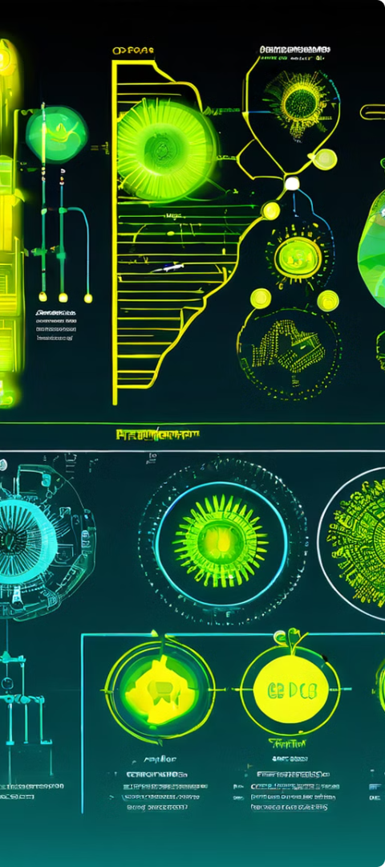
Implications of Genetic Variations
Genetic variations have significant implications for our health and well-being. They can influence a wide range of traits, from physical characteristics to susceptibility to diseases. For example, certain gene variations can increase the risk of developing cardiovascular disease, cancer, or neurodegenerative disorders. On the other hand, variations in other genes can protect against certain diseases.
Furthermore, genetic variations can also influence our responses to medications. Some individuals may experience adverse drug reactions due to variations in genes involved in drug metabolism or transport. Understanding the implications of genetic variations is crucial for personalized medicine, which aims to tailor treatments to individual genetic profiles.
Increased Disease Risk
Certain gene variations can increase the likelihood of developing specific diseases.
Drug Response Variability
Genetic variations can influence how individuals respond to medications, affecting efficacy and potential side effects.
Personalized Medicine
Genetic testing can help tailor treatments to individual genetic profiles for better outcomes.

Slide 8
Genetic Testing and Personalized Medicine
Genetic testing has revolutionized our understanding of health and disease. It allows us to identify specific gene variations that can predict an individual's risk of developing certain diseases. This information empowers individuals to make informed choices about their health, such as lifestyle modifications, preventive measures, and early detection screenings.
Personalized medicine is a rapidly growing field that utilizes genetic information to tailor treatments to individual patients. By identifying gene variations that influence drug metabolism or disease susceptibility, healthcare providers can optimize treatment plans for better efficacy and fewer side effects. This personalized approach promises to improve patient outcomes and revolutionize healthcare delivery.
Predictive Testing
Diagnostic Testing
Pharmacogenetic Testing
Identifies gene variations associated with increased risk of developing certain diseases, allowing for preventive measures and early detection.
Confirms or excludes a suspected genetic diagnosis, helping to guide treatment decisions.
Identifies gene variations that influence drug metabolism and response, enabling individualized medication choices.

Slide 9
Ethical Considerations and Future Trends
As our understanding of genes and their implications continues to advance, ethical considerations become increasingly important. Issues surrounding privacy, confidentiality, and the potential for genetic discrimination require careful attention. Societal discussions and regulations are crucial to ensure responsible use of genetic information and to protect individual rights.
The future of genetic research holds immense promise. Continued advancements in gene editing technologies, such as CRISPR-Cas9, offer unprecedented potential for treating and preventing genetic diseases. The development of personalized therapies tailored to individual genetic profiles has the potential to revolutionize medicine, leading to more effective and targeted treatments. However, it is essential to proceed cautiously, ensuring ethical considerations are at the forefront of research and development.
Privacy and Confidentiality
Ethical Considerations
Gene Editing Technologies
Future Trends
Personalized medicine, gene therapy, and other advancements hold promise for revolutionizing healthcare.
Protecting sensitive genetic information from unauthorized access and misuse is crucial.
Ensuring responsible use of genetic information and addressing potential societal impacts is essential.
Advances in gene editing offer potential for treating and preventing genetic diseases.

