Slide 1
DANTULARI NARAYANA RAJA COLLEGE (AUTONOMUS)
ADIKAVI NANNAYA UNIVERSITY
Department of Biochemistry
Conducted BY SIR.RAMESH (HOD) M.SC M.PHIL

Slide 2
GENETICS & ECOLOGY

Slide 3
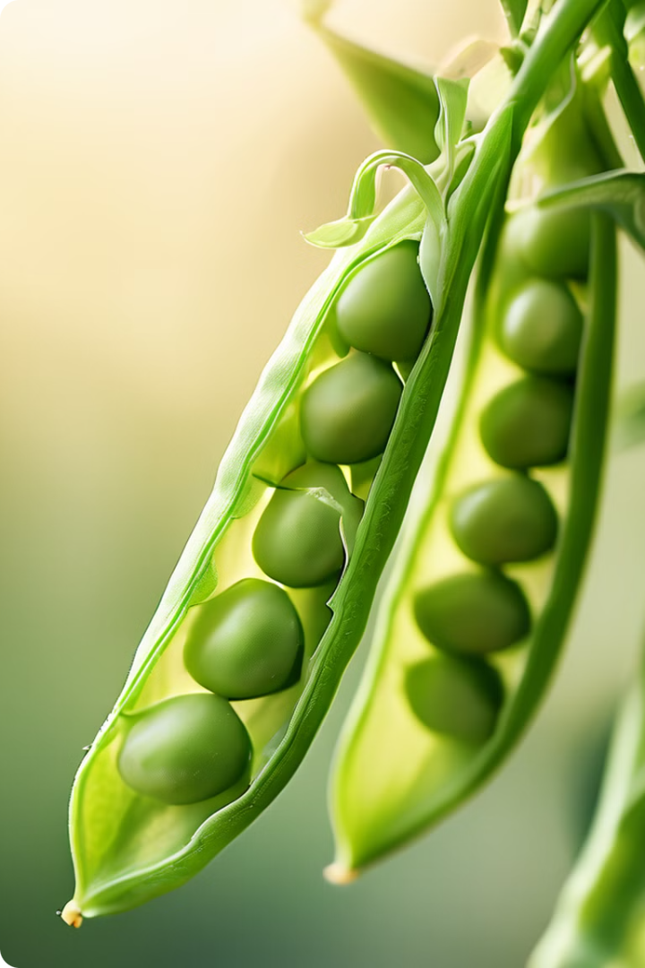
Introduction to Mendel's Laws
Gregor Mendel, an Austrian monk, is considered the "father of genetics" for his groundbreaking work on inheritance patterns in pea plants. He meticulously studied the transmission of traits through generations, laying the foundation for our understanding of how genes are passed down. Mendel's research, conducted in the mid-19th century, revolutionized biology, revealing the fundamental principles of heredity that govern all living organisms.

Slide 4
Mendel's First Law: The Law of Segregation
Mendel's first law, the Law of Segregation, states that each individual possesses two alleles for each trait, and these alleles separate during gamete formation, with each gamete receiving only one allele. This means that a parent contributes only one of its two alleles for a given trait to its offspring. For example, a pea plant with the genotype "Yy" (one dominant "Y" allele for yellow seeds and one recessive "y" allele for green seeds) will produce gametes that carry either the "Y" or the "y" allele.
1
Alleles
2
Gametes
These are alternative forms of a gene that determine a specific trait, like seed color or flower shape.
These are reproductive cells like sperm or egg, carrying only one allele from each pair.
3
Homozygous
4
Heterozygous
This describes an individual with two identical alleles for a trait, like "YY" for yellow seeds or "yy" for green seeds.
This describes an individual with two different alleles for a trait, like "Yy" for yellow seeds.

Slide 5
Mendel's Second Law: The Law of Independent Assortment
Mendel's second law, the Law of Independent Assortment, states that alleles for different traits segregate independently of each other during gamete formation. This means that the inheritance of one trait does not influence the inheritance of another trait. For example, the inheritance of seed color in a pea plant is independent of the inheritance of flower color. The Law of Independent Assortment explains the vast diversity seen in offspring, allowing for various combinations of traits.
Dihybrid Crosses
Independent Segregation
Genetic Diversity
These involve two different traits, like seed color and flower color, where each parent carries two alleles for each trait.
During gamete formation, alleles for different traits sort independently, meaning the combination of alleles for one trait is not influenced by the combination of alleles for another trait.
This law allows for a wide range of combinations in offspring, contributing to the genetic diversity observed in populations.

Slide 6
Inheritance Patterns: Dominant and Recessive Traits
In Mendelian inheritance, traits are determined by genes, with each gene having two alleles. One allele is dominant, meaning it will be expressed even if the other allele is recessive. A recessive allele is only expressed if both alleles are recessive. This explains why some traits are more common than others, as dominant alleles are more likely to be expressed.
Dominant Allele
Recessive Allele
This allele is expressed even when paired with a recessive allele. It is represented by a capital letter, for example, "T" for tallness in pea plants.
This allele is only expressed when paired with another recessive allele. It is represented by a lowercase letter, for example, "t" for shortness in pea plants.
Phenotype
Genotype
This refers to the observable characteristics of an individual, like tallness or shortness, determined by the genotype.
This refers to the genetic makeup of an individual, the combination of alleles, like "TT," "Tt," or "tt."

Slide 7
Genotypes and Phenotypes
The genotype refers to the genetic makeup of an individual, the combination of alleles they possess. The phenotype, on the other hand, refers to the observable characteristics of an individual, determined by the genotype. Understanding the relationship between genotype and phenotype is crucial for predicting the inheritance of traits. For example, a pea plant with the genotype "TT" or "Tt" will have the phenotype of tallness, as the "T" allele is dominant, while a pea plant with the genotype "tt" will have the phenotype of shortness, as both alleles are recessive.
Genotype
Phenotype
TT
Tall
Tt
Tall
tt
Short

Slide 8
Punnett Squares and Probability
Punnett squares are a valuable tool for predicting the probability of different genotypes and phenotypes in offspring. They visually represent the possible combinations of alleles that can be inherited from each parent. By analyzing the Punnett square, we can determine the probability of an offspring inheriting specific traits. This is essential for understanding the inheritance patterns of traits and for making informed predictions about offspring characteristics.
Step 1
Step 2
Step 3
Step 4
Determine the genotypes of the parents for the trait in question.
Set up a Punnett square, with one parent's alleles listed across the top and the other parent's alleles listed down the side.
Fill in the Punnett square by combining the alleles from each parent to create the possible genotypes of the offspring.
Analyze the Punnett square to determine the probability of each genotype and phenotype in the offspring.

Slide 9
Practical Applications of Mendel's Laws
Mendel's laws have far-reaching implications beyond the study of peas. They form the basis of modern genetics and have revolutionized our understanding of inheritance, disease, and evolution. These principles are applied in various fields, including agriculture, medicine, and biotechnology.
Agriculture
Medicine
Biotechnology
Evolution
Breeders use Mendel's laws to improve crop yields, develop pest-resistant varieties, and enhance the nutritional value of food.
Doctors use genetic testing to diagnose diseases, predict disease risk, and tailor treatments based on individual genetic profiles.
Scientists use genetic engineering techniques to modify organisms for various purposes, such as producing pharmaceuticals and improving crop production.
Mendel's laws provide insights into the mechanisms of evolution, explaining how genetic variation arises and is passed down through generations.

