Slide 1
DANTULARI NARAYANA RAJA COLLEGE (AUTONOMUS)
ADIKAVI NANNAYA UNIVERSITY
Department of Biochemistry
Conducted BY SIR.RAMESH (HOD) M.SC M.PHIL

Slide 2
GENETICS & ECOLOGY

Slide 3
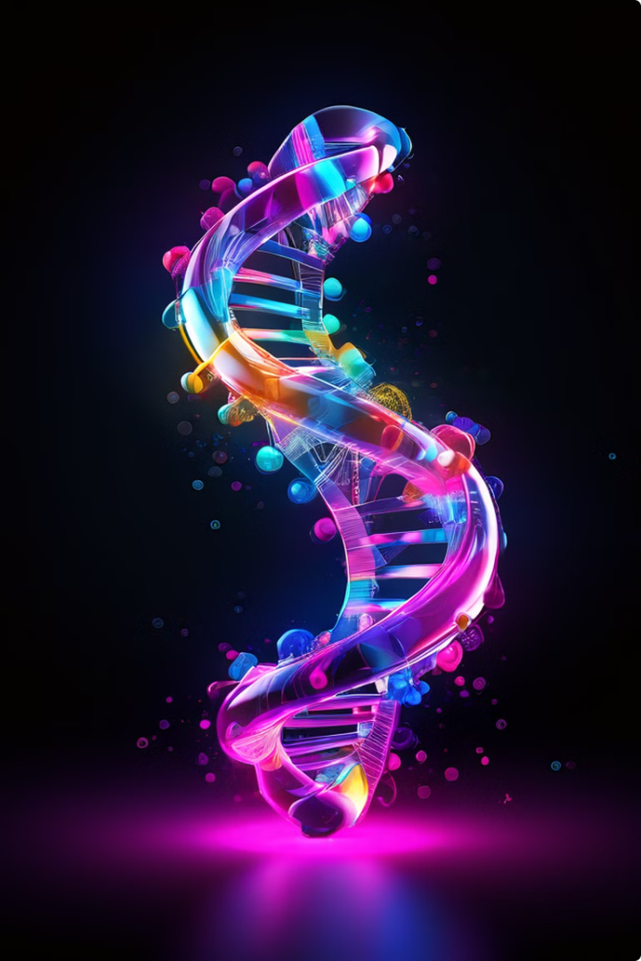
Introduction to Mutations and DNA Repair
Mutations are changes in the DNA sequence that can occur spontaneously or be induced by various factors. These changes can alter the genetic code, potentially affecting the function of proteins and even leading to diseases. However, cells have evolved sophisticated DNA repair mechanisms to correct these errors and maintain genomic integrity. Understanding mutations and repair mechanisms is crucial for comprehending genetic diversity, disease development, and the potential applications in medicine and biotechnology.

Slide 4
Types of Mutations: Substitutions, Insertions, and Deletions
1
Substitutions
2
Insertions
Substitutions are the simplest type of mutation where one nucleotide is replaced with another. These can be silent, missense, or nonsense depending on their impact on the encoded protein.
Insertions involve the addition of one or more nucleotides to the DNA sequence. This can shift the reading frame and cause a frameshift mutation, leading to a completely different protein.
3
Deletions
4
Complex Mutations
Deletions are the removal of one or more nucleotides from the DNA sequence. Similar to insertions, deletions can also cause frameshift mutations and alter the protein structure significantly.
Mutations can also be more complex, involving rearrangements of DNA segments, duplications, or inversions. These complex changes can have significant consequences for gene expression and cellular function.

Slide 5
Causes of Mutations: Replication Errors, Environmental Factors, and Radiation
Replication Errors
Environmental Factors
Radiation
During DNA replication, errors can occur due to the inherent inaccuracy of the DNA polymerase enzyme. These errors are typically corrected by proofreading mechanisms, but some can escape detection and become permanent mutations.
Exposure to certain environmental factors, such as ultraviolet radiation, chemicals, and viruses, can damage DNA and induce mutations. These mutagens can alter the DNA sequence by causing base modifications, strand breaks, or cross-links.
Ionizing radiation, like X-rays or gamma rays, can cause DNA damage by generating reactive oxygen species. These species can break DNA strands, leading to mutations and chromosomal abnormalities.

Slide 6
DNA Repair Mechanisms: Nucleotide Excision Repair, Base Excision Repair, and Mismatch Repair
1
Nucleotide Excision Repair (NER)
NER is responsible for removing bulky lesions from DNA, such as those caused by UV radiation. This process involves recognizing the damage, excising the damaged region, and replacing it with the correct sequence.
2
Base Excision Repair (BER)
BER removes damaged or modified bases from DNA. This process involves recognizing the damaged base, removing it, and replacing it with the correct base.
3
Mismatch Repair (MMR)
MMR corrects mismatches that occur during DNA replication. This process involves recognizing mismatches, excising the incorrect base, and replacing it with the correct one.
4
Double-Strand Break Repair (DSBR)
DSBR is a complex process that repairs double-strand breaks in DNA. This process involves recognizing the break, aligning the broken ends, and rejoining them.

Slide 7
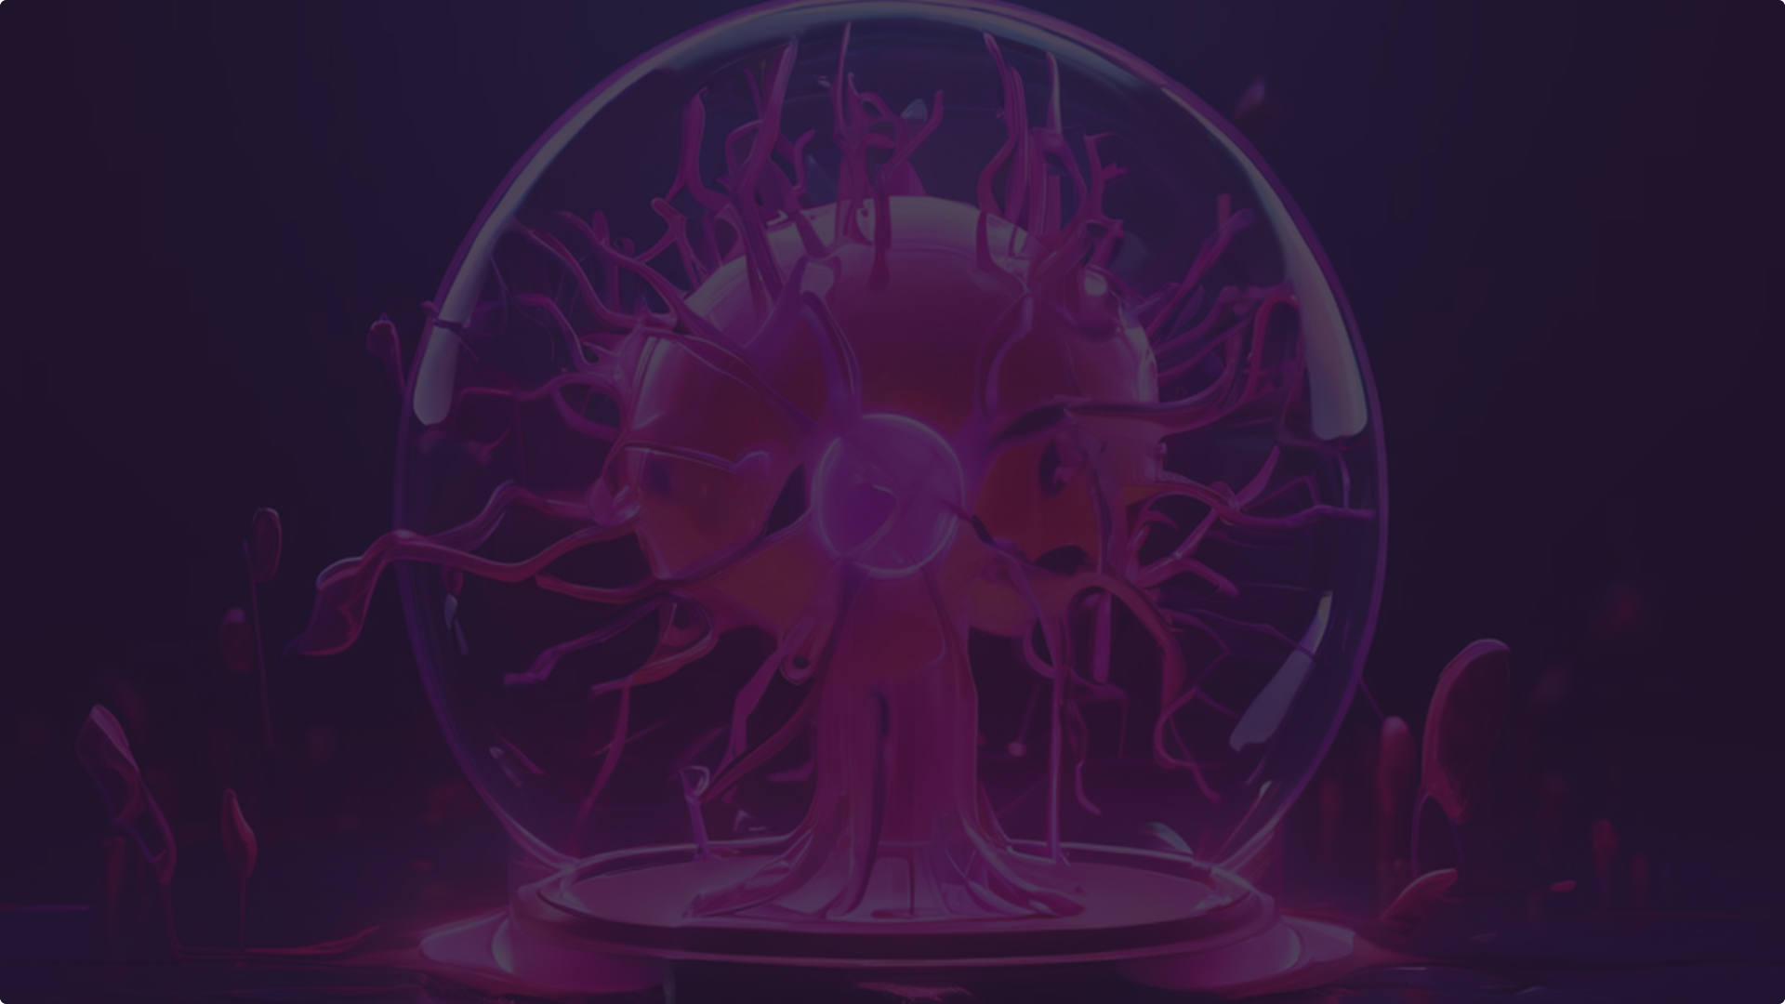
Consequences of Unrepaired Mutations: Cancer, Genetic Disorders, and Aging
Cancer
Genetic Disorders
Aging
Unrepaired mutations can accumulate in genes that regulate cell growth and division, leading to uncontrolled proliferation and the development of cancer. These mutations can also affect DNA repair genes, further increasing the risk of cancer.
Mutations in specific genes can lead to inherited genetic disorders. These disorders can affect various aspects of human health, ranging from metabolic defects to developmental abnormalities.
The accumulation of mutations over time contributes to the aging process. These mutations can impair cellular function, leading to a decline in tissue and organ function. They also contribute to age-related diseases.

Slide 8
Implications of Mutations in Medicine and Biotechnology
Personalized Medicine
Gene Therapy
Biotechnology
Understanding mutations can lead to personalized medicine approaches, where treatments are tailored to an individual's genetic makeup. For example, certain cancers are driven by specific mutations, and targeted therapies can be developed to inhibit these mutated proteins.
Gene therapy aims to correct genetic defects by replacing or modifying mutated genes. This approach is being investigated for various diseases, including genetic disorders and cancer.
Mutations are also used in biotechnology to create new and improved organisms. For example, gene editing technologies, like CRISPR-Cas9, allow for precise modifications of DNA sequences, opening new possibilities for disease treatment and agricultural applications.

Slide 9
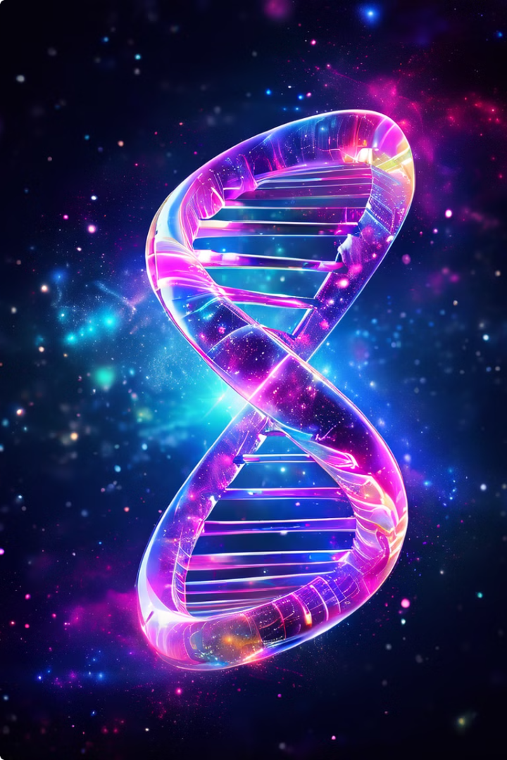
Conclusion: The Importance of Understanding Mutations and DNA Repair
Understanding mutations and DNA repair is fundamental to unraveling the complexity of life. Mutations drive genetic diversity, enabling evolution and adaptation. However, they can also cause diseases and contribute to aging. The study of DNA repair mechanisms reveals how cells maintain genomic integrity, protecting against detrimental mutations. This knowledge has far-reaching implications for medicine, biotechnology, and our understanding of human health. Continued research in this area holds promise for developing new diagnostic tools, therapeutic interventions, and preventive strategies.

