Slide 1
DANTULARI NARAYANA RAJA COLLEGE (AUTONOMUS)
ADIKAVI NANNAYA UNIVERSITY
Department of Biochemistry
Conducted BY SIR.RAMESH (HOD) M.SC M.PHIL

Slide 3
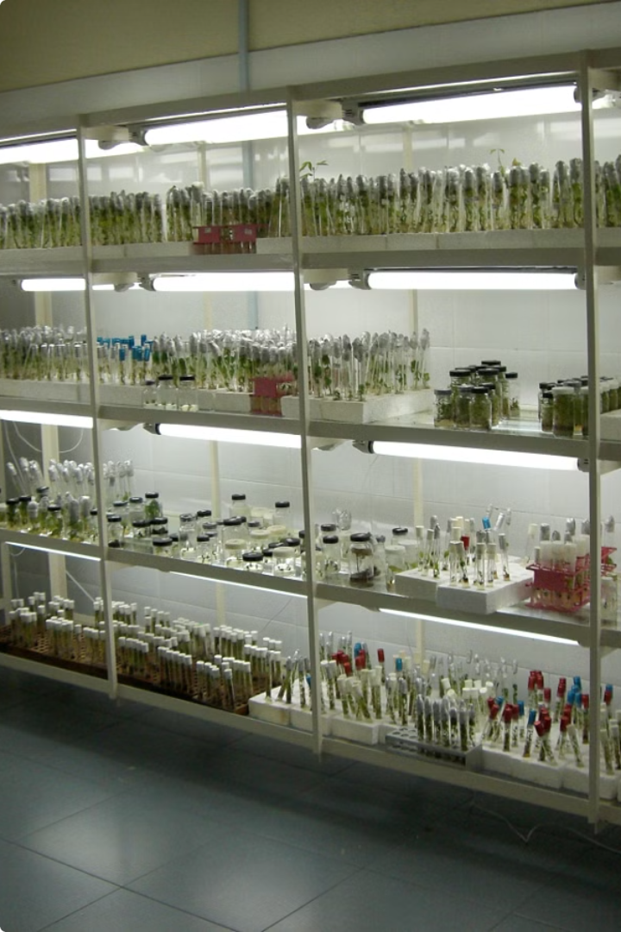
Introduction to Plant Tissue Culture
Plant tissue culture is the process of growing plant cells, tissues, or organs in a controlled, sterile environment. This technique allows for the rapid propagation and manipulation of plants, with applications in agriculture, biotechnology, and scientific research.

Slide 4
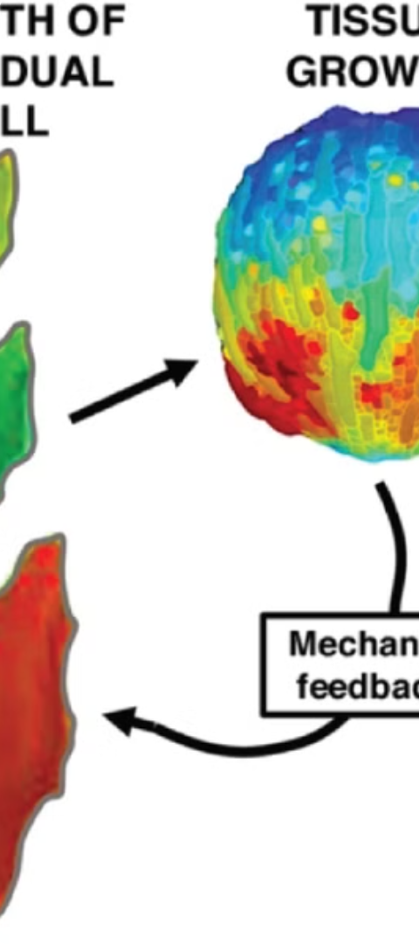
Principles of Plant Tissue Culture
1
Totipotency
2
Aseptic Technique
Plant cells have the ability to regenerate into a complete plant from a single cell.
Maintaining a sterile environment is crucial to prevent microbial contamination.
3
Nutrient Media
Specialized culture media provide the necessary nutrients, hormones, and growth factors for plant cells to thrive.

Slide 5
Techniques and Methods
Callus Culture
Organ Culture
Micropropagation
Inducing the growth of undifferentiated plant cells to form a mass of tissue.
Culturing isolated plant organs, such as roots, shoots, or flowers, to promote growth and development.
Rapidly multiplying plants by using small plant parts, such as meristems or axillary buds.

Slide 6
Applications of Plant Tissue Culture
Crop Improvement
Plant Conservation
Developing disease-resistant, high-yielding, and genetically modified plant varieties.
Preserving rare and endangered plant species through ex-situ conservation.
Pharmaceutical Production
Research and Education
Extracting and producing valuable plant-based compounds, such as pharmaceuticals and natural compounds.
Studying plant growth, development, and gene expression in a controlled environment.

Slide 7
Advantages and Disadvantages
Advantages
Disadvantages
Rapid clonal propagation
High initial investment
Disease-free plants
Specialized equipment required
Year-round production
Potential for genetic variation
Small space requirements
Ongoing maintenance costs

Slide 8
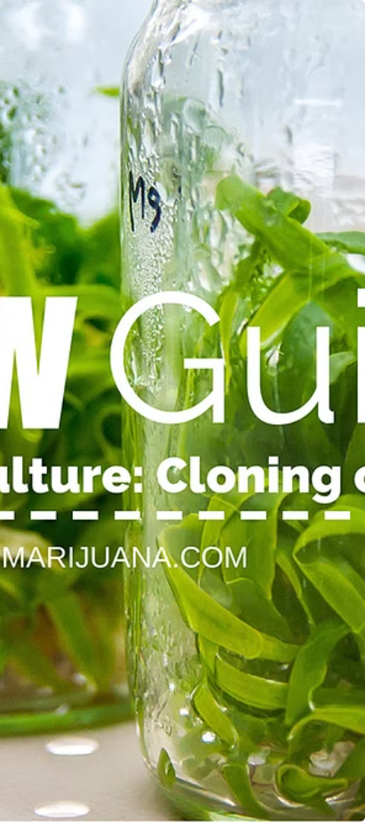
Future Directions in Plant Tissue Culture
Automation
Increasing the use of robotics and AI to streamline tissue culture processes.
Bioreactor Technology
Developing advanced bioreactors to improve efficiency and productivity.
Genome Editing
Integrating CRISPR-Cas9 technology to precisely modify plant genomes.

Slide 9
Conclusion and Summary
Versatile
Rapid Propagation
Advancing Science
Plant tissue culture is a versatile technique with applications in various fields, from agriculture to biotechnology.
The ability to rapidly propagate plants makes tissue culture a valuable tool for commercial and research purposes.
As technology and techniques continue to evolve, plant tissue culture will play an increasingly important role in the future of plant science and biotechnology.

