Slide 1
DANTULARI NARAYANA RAJA COLLEGE (AUTONOMUS)
ADIKAVI NANNAYA UNIVERSITY
Department of Biochemistry
Conducted BY SIR.RAMESH (HOD) M.SC M.PHIL

Slide 3
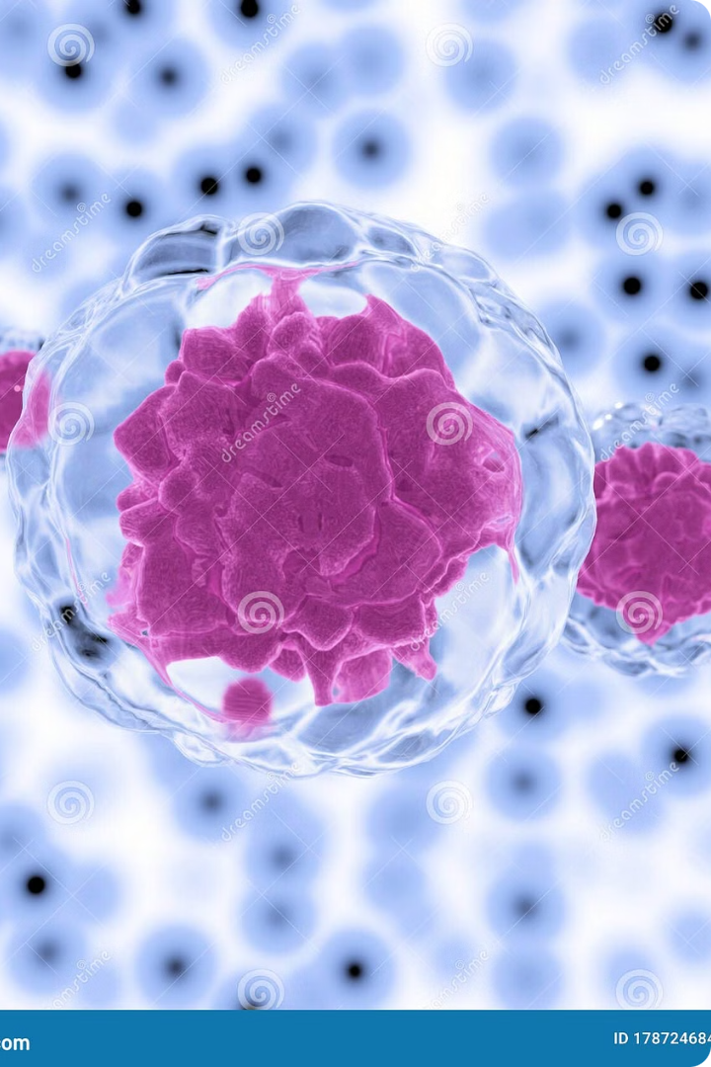
Stem Cells: The Building Blocks of Life
Stem cells are undifferentiated cells that can develop into specialized cell types. They have the potential to repair damaged tissues and organs.

Slide 4
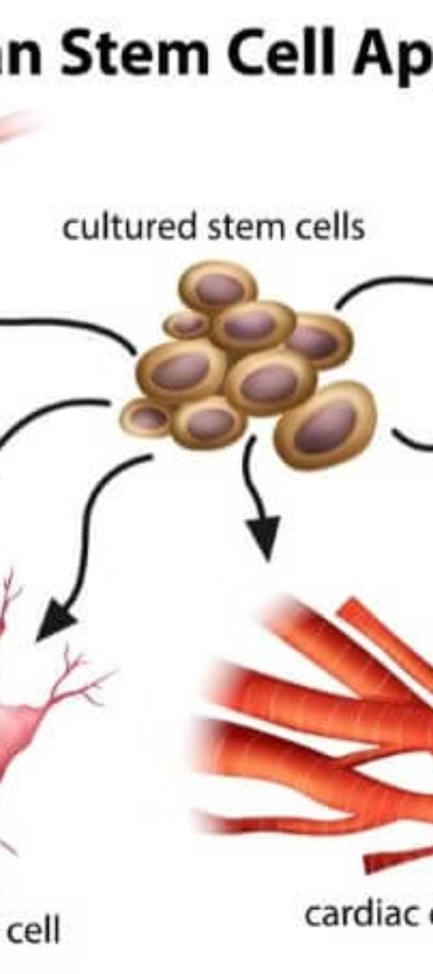
Types of Stem Cells
1
Embryonic Stem Cells
2
Adult Stem Cells
Derived from embryos, they are pluripotent and can become any cell type in the body.
Found in tissues and organs, they are multipotent and can become a limited range of cell types.
3
Induced Pluripotent Stem Cells (iPSCs)
Adult cells reprogrammed to have the characteristics of embryonic stem cells. They offer a potential source for cell therapy.

Slide 5
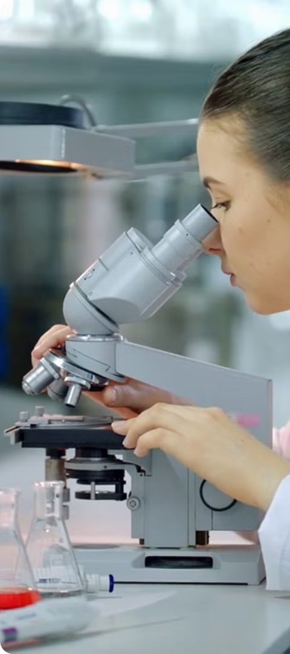
Stem Cell Research
1
Isolation
Stem cells are isolated from various sources, including embryos, adult tissues, and umbilical cord blood.
2
Culture
Stem cells are grown in a lab environment to produce a large number of cells for research and therapeutic purposes.
3
Differentiation
Stem cells are induced to differentiate into specific cell types, such as nerve cells, blood cells, or muscle cells.

Slide 6
Potential Applications of Stem Cells
Disease Modeling
Drug Discovery
Tissue Regeneration
Stem cells can be used to create models of diseases in the lab, allowing researchers to study disease mechanisms and test potential therapies.
Stem cells can be used to screen drugs for their efficacy and safety, accelerating the development of new treatments.
Stem cell therapy holds promise for replacing damaged tissues and organs, treating conditions such as spinal cord injuries, heart disease, and diabetes.

Slide 7
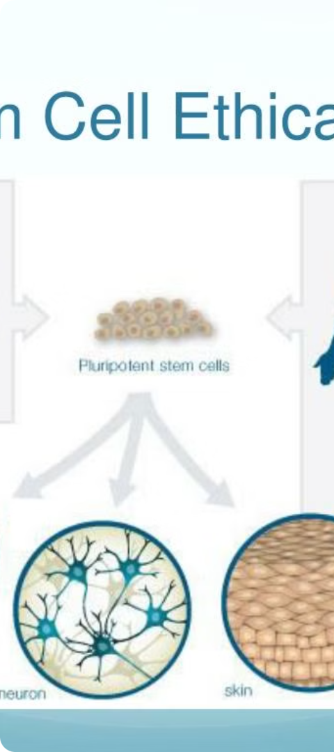
Ethical Considerations of Stem Cell Research
Embryo Destruction
Informed Consent
The use of embryonic stem cells raises ethical concerns about the destruction of human embryos.
It's crucial to ensure that individuals donating stem cells are fully informed about the risks and benefits of stem cell research.
Equity and Access
Stem cell therapies should be accessible to all, regardless of socioeconomic status, race, or gender.

Slide 8
Current State of Stem Cell Therapy
Clinical Trials
Stem cell therapies are currently being tested in clinical trials for a variety of diseases, including Parkinson's disease, Alzheimer's disease, and spinal cord injuries.
Regulatory Oversight
Regulatory agencies worldwide are working to ensure the safety and efficacy of stem cell therapies before they become widely available.
Ethical Considerations
Ongoing discussions about the ethical implications of stem cell therapy are crucial for responsible development and implementation.

Slide 9
Future Directions in Stem Cell Research
Precision Medicine
Stem cells can be used to develop personalized therapies tailored to individual patients' genetic makeup and disease characteristics.
Gene Editing
CRISPR technology and other gene editing tools can be used to correct genetic defects in stem cells, potentially curing inherited diseases.
Bioprinting
3D printing technologies can be used to create functional tissues and organs from stem cells, paving the way for organ transplantation.

