Slide 1
DANTULARI NARAYANA RAJA COLLEGE (AUTONOMUS)
ADIKAVI NANNAYA UNIVERSITY
Department of Biochemistry
Conducted BY SIR.RAMESH (HOD) M.SC M.PHIL

Slide 3
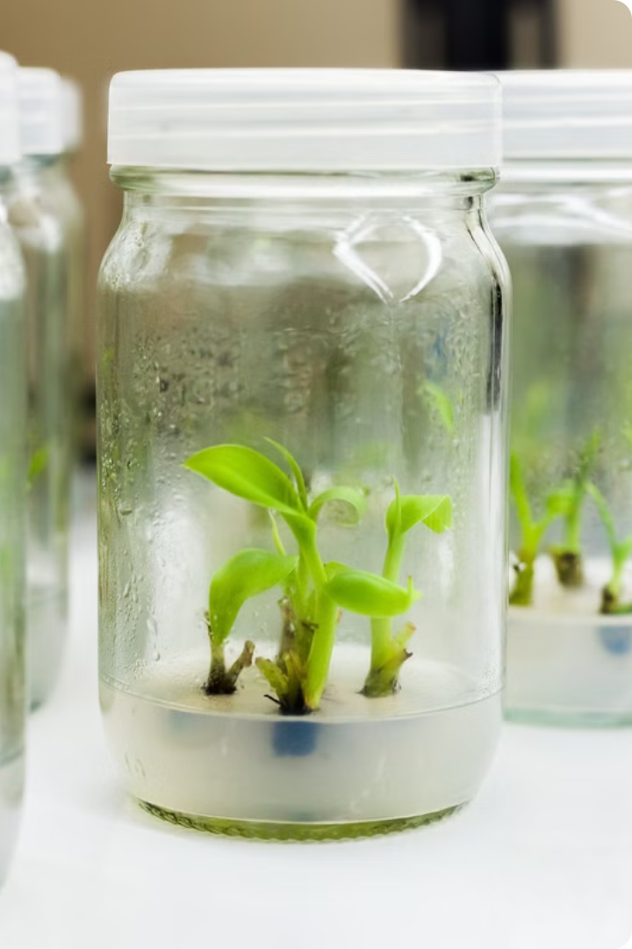
Introduction to Animal Tissue Culture
Animal tissue culture is a powerful technique that allows scientists to grow and study cells outside of an organism's body. This critical method enables a wide range of medical and scientific advancements, from developing new treatments to understanding fundamental cellular processes.

Slide 4
History and Development of Animal Tissue Culture
1900s
1970s-1980s
The foundations of animal tissue culture were laid, with pioneering work by scientists like Ross Harrison and Alexis Carrel.
The field exploded, with widespread adoption and technological innovations like monoclonal antibody production.
1
2
3
1940s-1950s
Significant advancements were made, including the development of cell lines and improved culture media.

Slide 5
Principles of Animal Tissue Culture
Cell Types
Culture Media
Aseptic Technique
A variety of cell types can be cultured, including epithelial, fibroblast, and stem cells.
Specialized media provide nutrients, growth factors, and support for optimal cell growth and function.
Strict sterile protocols are essential to prevent contamination and ensure the integrity of cultures.

Slide 6
Applications of Animal Tissue Culture
1
Drug Testing
2
Cell Biology
Screening new pharmaceutical compounds for safety and efficacy.
Studying cellular processes, signaling pathways, and gene expression.
3
Tissue Engineering
4
Vaccine Development
Growing replacement tissues and organs for transplantation.
Producing viral vaccines using cultured cells.

Slide 7
Techniques and Methods in Animal Tissue Culture
Cell Isolation
Cell Counting
Enzymatic and mechanical methods to extract cells from tissues.
Quantifying cell numbers using hemocytometers or automated counters.
Cell Passaging
Cryopreservation
Subculturing cells to maintain and expand cultures.
Freezing cells for long-term storage and preservation.

Slide 8
Challenges and Ethical Considerations in Animal Tissue Culture
Contamination
Cell Line Identity
Animal Welfare
Data Reproducibility
Maintaining sterile conditions to prevent microbial and cross-contamination.
Ensuring the authenticity and purity of cell lines used in research.
Addressing ethical concerns around the use of animal-derived cells.
Improving consistency and reliability of results across laboratories.

Slide 9
Future Directions and Innovations in Animal Tissue Culture
3D Cultures
Advancing from 2D to more physiologically relevant 3D models.
Organ-on-a-Chip
Integrating multiple cell types to mimic the function of entire organs.
Stem Cell Therapies
Utilizing stem cells for regenerative medicine and tissue engineering.

