Slide 1
DANTULARI NARAYANA RAJA COLLEGE (AUTONOMUS)
ADIKAVI NANNAYA UNIVERSITY
Department of Biochemistry
Conducted BY SIR.RAMESH (HOD) M.SC M.PHIL

Slide 2
ORGANIZATION OF CELL STRUCTURE

Slide 3
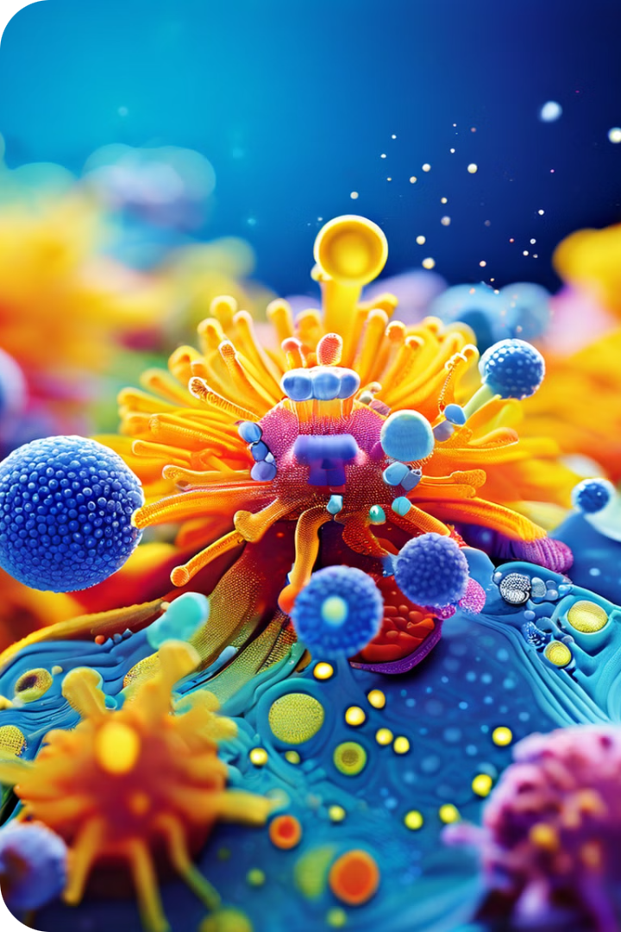
Introduction to Cell Organelles
Cell organelles are specialized structures within a cell that perform specific functions. They are like miniature organs, each with a unique role in maintaining the life of the cell. Understanding the structure and function of these organelles is essential for comprehending the intricate workings of living organisms. This presentation will delve into the key organelles found in eukaryotic cells, exploring their morphology, functions, and importance in cellular processes.

Slide 4
The Nucleus
The nucleus, often referred to as the "control center" of the cell, is the most prominent organelle. It houses the cell's genetic material in the form of DNA, which carries the instructions for all cellular activities. The DNA is organized into chromosomes, which are condensed structures that become visible during cell division. The nucleus is enclosed by a double membrane called the nuclear envelope, which regulates the passage of molecules between the nucleus and the cytoplasm.
Nucleoplasm
Nucleolus
Nuclear Pores
The nucleus is filled with a gel-like substance called nucleoplasm. The nucleoplasm suspends the chromosomes and other nuclear components, providing a medium for their activities.
Within the nucleus is a dense region called the nucleolus. The nucleolus is the site of ribosome synthesis, which are essential for protein production. Ribosomes are assembled in the nucleolus and then exported to the cytoplasm to perform their protein-making function.
The nuclear envelope is punctuated by numerous nuclear pores. These pores act as gateways for the transport of molecules between the nucleus and the cytoplasm. They allow for the movement of essential proteins, RNA, and other molecules required for gene expression and other cellular processes.

Slide 5
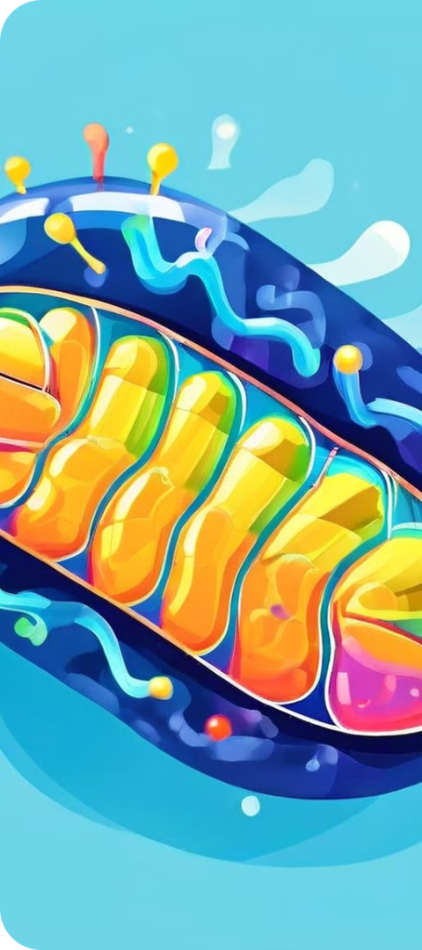
Mitochondria
Mitochondria are often called the "powerhouses" of the cell. These organelles are responsible for generating energy in the form of ATP (adenosine triphosphate), which is the primary energy currency of the cell. Mitochondria have a double membrane structure, with an outer membrane and an inner membrane. The inner membrane is highly folded to form cristae, which increase the surface area for ATP production.
Glycolysis
The process begins with glycolysis, which occurs in the cytoplasm. Glucose is broken down into pyruvate, producing a small amount of ATP. This initial step does not require oxygen.
Krebs Cycle
Pyruvate enters the mitochondria, where it is further broken down in the Krebs cycle. This cycle generates electron carriers, NADH and FADH2, which will be used in the next step.
Electron Transport Chain
The electron carriers transfer electrons through the electron transport chain, a series of proteins located in the inner mitochondrial membrane. This process drives the movement of protons across the membrane, generating a proton gradient that is used to produce ATP through oxidative phosphorylation.

Slide 6
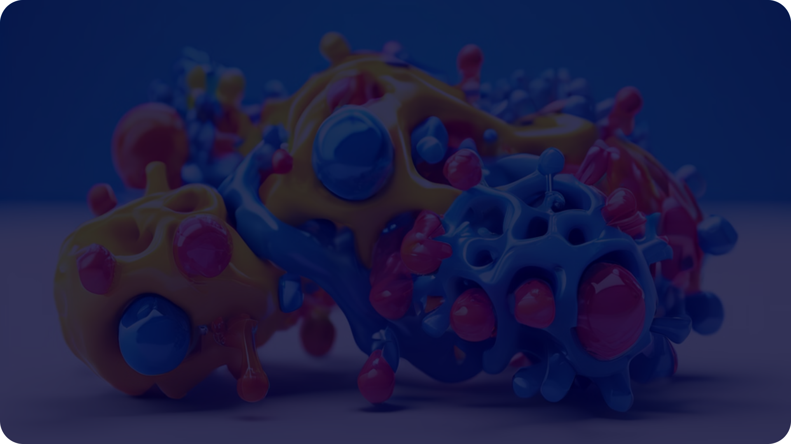
Endoplasmic Reticulum
The endoplasmic reticulum (ER) is a vast network of interconnected membranes that extends throughout the cytoplasm. It is involved in various cellular processes, including protein synthesis, lipid metabolism, and detoxification. There are two distinct forms of ER: rough ER and smooth ER.
1
Rough ER
2
Smooth ER
3
Transport of Molecules
The rough ER is studded with ribosomes, which are responsible for protein synthesis. Proteins synthesized on the rough ER are often destined for secretion or for incorporation into other organelles.
The smooth ER lacks ribosomes and is involved in lipid synthesis, detoxification of harmful substances, and calcium storage. In muscle cells, the smooth ER plays a crucial role in calcium regulation, which is essential for muscle contraction.
The ER serves as a network for transporting molecules throughout the cell. Newly synthesized proteins and lipids are transported along the ER membrane, where they can be modified and packaged for delivery to other organelles or for secretion.

Slide 7
Golgi Apparatus
The Golgi apparatus, also known as the Golgi complex, is a stack of flattened membrane sacs called cisternae. It is involved in the processing, sorting, and packaging of proteins and lipids synthesized in the ER. The Golgi apparatus is often described as the "post office" of the cell, as it directs molecules to their final destinations.
1
Cis Face
Proteins and lipids arrive at the Golgi apparatus from the ER at the cis face. This face is located near the ER and receives incoming vesicles containing newly synthesized molecules.
2
Processing and Sorting
As proteins and lipids move through the Golgi cisternae, they undergo further modifications, including glycosylation (addition of sugars) and phosphorylation (addition of phosphate groups). These modifications help to target proteins and lipids to their correct destinations.
3
Trans Face
At the trans face, the Golgi apparatus packages proteins and lipids into vesicles. These vesicles bud off from the trans face and transport their contents to other organelles, to the cell membrane for secretion, or to other destinations within the cell.

Slide 8
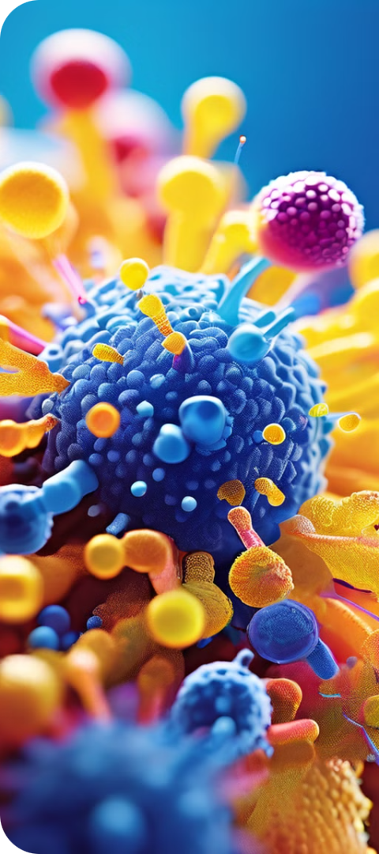
Lysosomes
Lysosomes are membrane-bound organelles that act as the "recycling centers" of the cell. They contain a variety of hydrolytic enzymes, which are capable of breaking down various cellular components, including proteins, carbohydrates, lipids, and nucleic acids. Lysosomes are involved in various cellular processes, including digestion of worn-out organelles, phagocytosis of invading pathogens, and degradation of cellular debris.
Autophagy
Phagocytosis
Lysosomes play a critical role in autophagy, a process where damaged or worn-out organelles are engulfed by lysosomes and broken down into their constituent parts. This process allows the cell to recycle valuable materials and maintain cellular health.
Lysosomes are involved in phagocytosis, a process where cells engulf and digest invading pathogens, such as bacteria and viruses. The lysosomal enzymes destroy the pathogens, preventing infection and protecting the cell.
Cellular Debris
Lysosomes also degrade cellular debris, such as worn-out proteins and damaged DNA. This process is essential for maintaining cellular integrity and preventing the accumulation of harmful waste products.

Slide 9
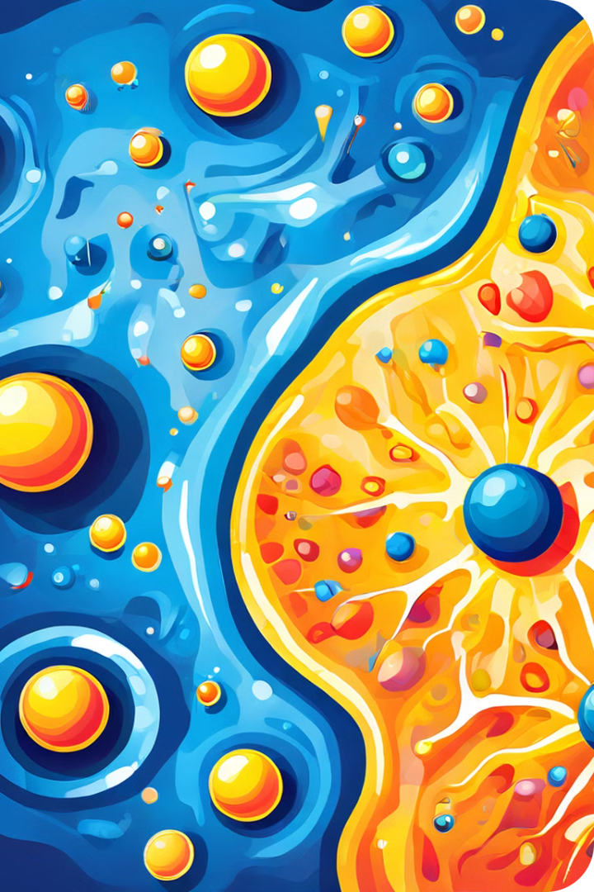
Conclusion
Cell organelles are essential for the survival and proper functioning of all living organisms. Each organelle plays a specific role in maintaining cellular processes, from energy production to protein synthesis, waste removal, and cell signaling. The intricate interactions between these organelles create a complex and dynamic cellular environment that supports life.

