Slide 1
DANTULARI NARAYANA RAJA COLLEGE (AUTONOMUS)
ADIKAVI NANNAYA UNIVERSITY
Department of Biochemistry
Conducted BY SIR.RAMESH (HOD) M.SC M.PHIL

Slide 2
ORGANIZATION OF CELL STRUCTURE

Slide 3
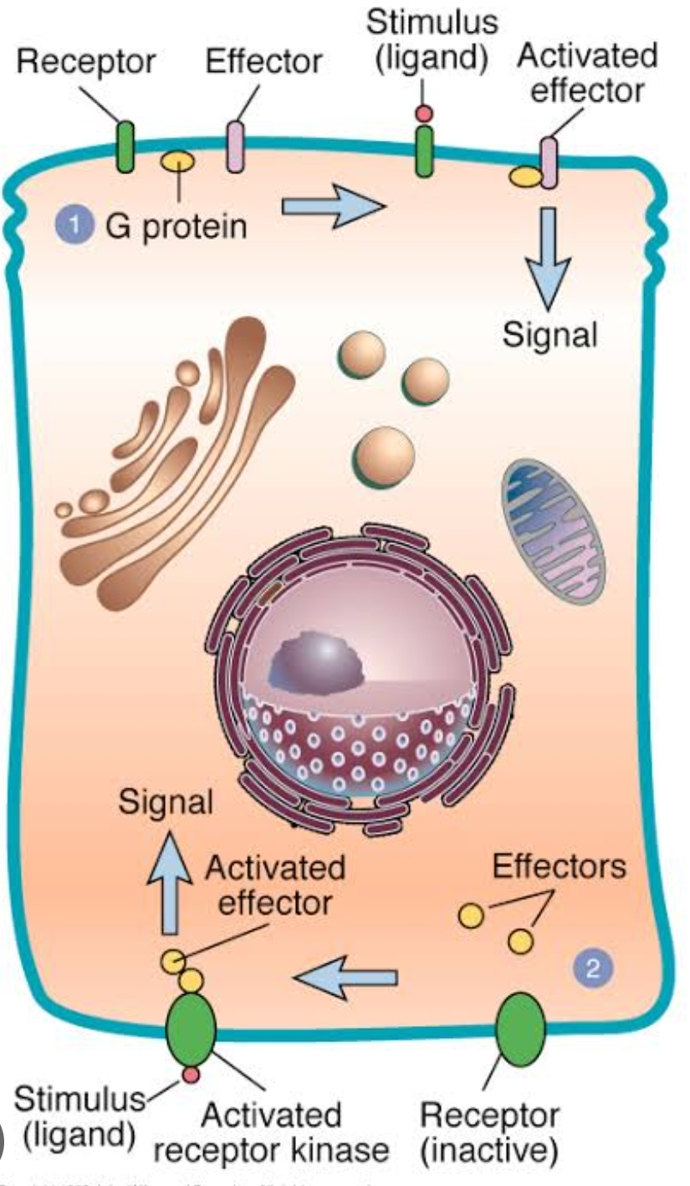
Introduction to Cell Signaling
Cell signaling is a complex and fundamental process in all living organisms. It is the means by which cells communicate with each other, coordinating their activities and ensuring the proper functioning of tissues and organs. This intricate dance of molecular messengers and receptors allows cells to respond to changes in their environment, adapt to external stimuli, and maintain homeostasis.

Slide 4
Types of Cell Signaling
1
Autocrine Signaling
2
Paracrine Signaling
A cell secretes a signaling molecule that binds to receptors on its own surface, essentially communicating with itself. This type of signaling is crucial for self-regulation and development.
A cell releases a signaling molecule that travels a short distance to nearby target cells, affecting their behavior. This is vital for local communication and coordination within tissues.
3
Endocrine Signaling
4
Synaptic Signaling
Cells release hormones that travel through the bloodstream to distant target cells, influencing various physiological processes throughout the body. This long-distance communication is essential for maintaining overall homeostasis.
Neurons release neurotransmitters that rapidly diffuse across a synapse to bind with receptors on the postsynaptic cell. This specialized form of signaling is critical for communication within the nervous system.

Slide 5
Signal Transduction Pathways
1
2
3
Reception
Transduction
Response
The signaling molecule binds to a specific receptor protein on the target cell's surface. This interaction triggers a conformational change in the receptor, initiating the signal transduction pathway.
The signal is relayed through a series of intracellular proteins, often involving phosphorylation cascades or second messenger systems. Each step in the pathway amplifies and modifies the signal.
The signal ultimately reaches a target protein, triggering a specific cellular response, such as gene expression, enzyme activation, or changes in cell shape or behavior.

Slide 6
Key Components of Signaling Pathways
Receptors
Signal Transducers
Effector Proteins
Receptors are proteins that bind to specific signaling molecules, initiating the transduction process. They can be located on the cell surface or within the cytoplasm.
Signal transducers are intracellular proteins that relay the signal from the receptor to downstream components. They often act as switches, cycling between active and inactive states.
Effector proteins carry out the final cellular response. They can be enzymes, transcription factors, or other proteins that directly alter cell behavior.

Slide 7
Regulation of Cell Signaling
Feedback Loops
Protein Degradation
Feedback loops are common regulatory mechanisms in signaling pathways. Negative feedback loops dampen the signal, preventing overactivation, while positive feedback loops amplify the signal, enhancing the response.
The breakdown of signaling proteins can terminate the signal, preventing prolonged activation. This process ensures that the response is transient and controlled.
Desensitization
Cross-Talk
Desensitization occurs when the receptor or downstream components become less responsive to the signal, preventing overstimulation and allowing for adaptation to prolonged stimuli.
Cross-talk involves interactions between different signaling pathways, allowing for coordination and integration of signals. This ensures a balanced and appropriate cellular response to complex stimuli.

Slide 8
Importance of Cell Signaling in Biology
Growth and Development
Cell signaling guides embryonic development, tissue formation, and organogenesis, ensuring proper growth and differentiation.
Metabolism and Homeostasis
Signaling pathways regulate metabolic processes, maintain nutrient levels, and control hormone production, contributing to overall homeostasis.
Immune Response
Cell signaling is essential for immune responses, allowing cells to detect pathogens, activate defense mechanisms, and coordinate immune responses.
Nervous System Function
Synaptic signaling underlies all nervous system functions, from sensory perception to motor control and cognitive processes.

Slide 9
Examples of Cell Signaling in Disease and Therapy
Cancer
Dysregulation of cell signaling pathways can lead to uncontrolled cell growth, proliferation, and metastasis, contributing to the development of cancer.
Diabetes
Insulin resistance, a hallmark of type 2 diabetes, involves defects in insulin signaling pathways, leading to impaired glucose uptake and utilization.
Neurodegenerative Diseases
Disruptions in neuronal signaling pathways contribute to neurodegenerative diseases, such as Alzheimer's disease and Parkinson's disease, leading to neuronal dysfunction and cell death.
Therapeutic Applications
Understanding cell signaling pathways allows for the development of targeted therapies that modulate signaling activity, such as cancer drugs that inhibit specific signaling cascades or drugs that enhance insulin signaling in diabetes.

