Slide 1
DANTULARI NARAYANA RAJA COLLEGE (AUTONOMUS)
ADIKAVI NANNAYA UNIVERSITY
Department of Biochemistry
Conducted BY SIR.RAMESH (HOD) M.SC M.PHIL

Slide 2
ORGANIZATION OF CELL STRUCTURE

Slide 3
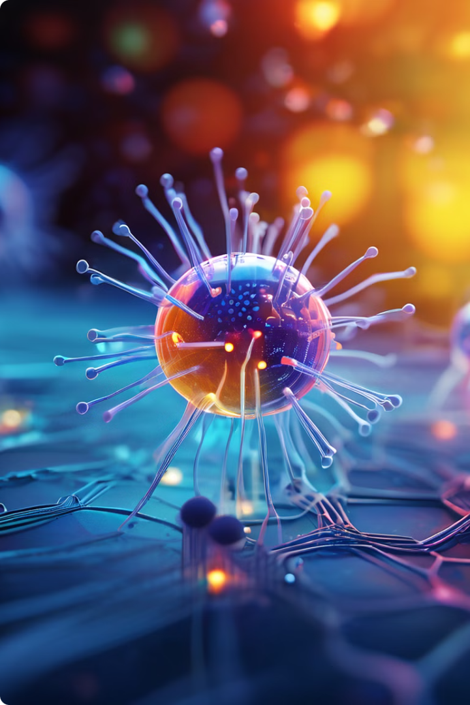
Cytoskeleton and Nucleus: An Overview
The cytoskeleton and nucleus are two essential components of eukaryotic cells that play fundamental roles in maintaining cellular structure, organization, and function. The cytoskeleton, a dynamic network of protein filaments, provides structural support, enables movement, and facilitates intracellular transport. The nucleus, the cell's control center, houses the genetic material (DNA) and directs cellular activities. These two structures are intricately linked, and their interactions are crucial for numerous cellular processes. This presentation delves into the intricate world of the cytoskeleton and nucleus, exploring their components, functions, and the dynamic interplay between them.

Slide 4
Components of the Cytoskeleton
Microtubules
Actin Filaments
Intermediate Filaments
Microtubules are hollow, rigid cylindrical structures made up of α- and β-tubulin dimers. They are the largest cytoskeletal filaments and play crucial roles in cell division, intracellular transport, and maintaining cell shape. Microtubules are involved in the movement of chromosomes during mitosis and meiosis, and they serve as tracks for motor proteins, such as kinesin and dynein, which transport organelles and vesicles throughout the cell.
Actin filaments, also known as microfilaments, are thin, flexible, helical structures composed of the protein actin. They are responsible for cell movement, muscle contraction, and maintaining cell shape. Actin filaments interact with myosin, another protein, to generate the force required for muscle contraction. They also play a role in cell division, forming the contractile ring that pinches the cell in two.
Intermediate filaments are fibrous, rope-like structures made up of various proteins, including keratin, lamin, and vimentin. They provide structural support to cells and help maintain their shape. Intermediate filaments are also involved in anchoring organelles, forming the nuclear lamina, and providing mechanical strength to tissues.

Slide 5
Functions of the Cytoskeleton
1
Cellular Shape and Support
2
Cell Movement
The cytoskeleton acts as the cell's internal scaffolding, providing structural support and maintaining the cell's shape. This is particularly important for cells that lack rigid cell walls, such as animal cells.
The cytoskeleton plays a vital role in cell movement, both within the cell and for the cell as a whole. Actin filaments are involved in the movement of the cell itself, such as in crawling or amoeboid movement. Microtubules also facilitate movement by providing tracks for motor proteins that transport organelles and vesicles.
3
Intracellular Transport
4
Cell Division
The cytoskeleton acts as a network of highways, facilitating the transport of organelles, vesicles, and other molecules throughout the cell. Motor proteins, such as kinesin and dynein, move along microtubules and actin filaments, carrying their cargo to different parts of the cell.
The cytoskeleton plays a crucial role in cell division, ensuring that chromosomes are accurately separated into daughter cells. Microtubules form the spindle fibers that attach to chromosomes and pull them apart during mitosis and meiosis. Actin filaments also participate in cell division by forming the contractile ring that pinches the cell in two.

Slide 6
Structure and Composition of the Nucleus
Nuclear Envelope
Nucleoplasm
The nuclear envelope is a double membrane that encloses the nucleus. It regulates the passage of molecules between the nucleus and the cytoplasm. The outer membrane is continuous with the endoplasmic reticulum (ER) and contains ribosomes. The inner membrane is lined by the nuclear lamina, a meshwork of intermediate filaments that provides structural support to the nuclear envelope.
The nucleoplasm is the gel-like substance within the nucleus. It contains the genetic material (DNA) in the form of chromatin. The nucleoplasm also contains various enzymes, proteins, and other molecules involved in DNA replication, transcription, and RNA processing.
Nucleolus
Chromatin
The nucleolus is a dense region within the nucleus where ribosomes are assembled. It contains ribosomal RNA (rRNA) genes, which are transcribed into rRNA. The nucleolus also contains proteins that assemble with rRNA to form ribosomal subunits.
Chromatin is the complex of DNA and proteins found within the nucleus. It consists of DNA wrapped around histone proteins, which help to compact and organize the DNA. During cell division, chromatin condenses into visible chromosomes.

Slide 7
Roles of the Nucleus in Cell Function
Genetic Information Storage
DNA Replication
Transcription
Regulation of Gene Expression
The nucleus is where DNA replication occurs, ensuring that each daughter cell receives a complete copy of the genetic material. This process involves unwinding the DNA double helix, synthesizing new strands complementary to the original strands, and packaging the newly replicated DNA into chromosomes.
Transcription is the process of copying DNA into RNA. This occurs in the nucleus, where specific regions of DNA are transcribed into messenger RNA (mRNA). mRNA carries the genetic information from the nucleus to the ribosomes in the cytoplasm, where it is translated into proteins.
The nucleus plays a crucial role in regulating gene expression, controlling which genes are transcribed and translated into proteins. This regulation ensures that the appropriate proteins are produced at the right time and in the right amount, maintaining cellular function and responding to changing environmental conditions.
The nucleus serves as the central repository for the cell's genetic information, contained in DNA. DNA is organized into chromosomes, which carry the instructions for building and maintaining the cell.

Slide 8
Interactions between the Cytoskeleton and Nucleus
Interaction
Description
Nuclear Positioning and Movement
The cytoskeleton, particularly microtubules, helps position and move the nucleus within the cell. Motor proteins, such as dynein, can attach to the nuclear envelope and move the nucleus along microtubule tracks.
Nuclear Envelope Integrity
Intermediate filaments, specifically lamins, are crucial for maintaining the structural integrity of the nuclear envelope. They form a network that supports the nuclear membrane and prevents its breakdown.
Nuclear Transport
The cytoskeleton is involved in the transport of molecules between the nucleus and the cytoplasm. Microtubules provide tracks for motor proteins that carry molecules across the nuclear envelope.
Chromatin Organization
The cytoskeleton, particularly actin filaments, can interact with chromatin, influencing its organization and positioning within the nucleus. This interaction is thought to play a role in gene regulation.

Slide 9
Importance of the Cytoskeleton-Nucleus Relationship
Cell Division
Signal Transduction
Intracellular Transport
Cellular Shape and Organization
The cytoskeleton's role in moving and separating chromosomes during cell division is crucial for accurate inheritance of genetic material. Without this coordinated interaction, cells could not divide properly, leading to developmental defects and disease.
The cytoskeleton plays a critical role in signal transduction pathways, relaying information from the cell's environment to the nucleus. This allows the cell to respond appropriately to external cues, such as hormones and growth factors.
The efficient transport of molecules between the nucleus and the cytoplasm is essential for cellular function. The cytoskeleton's role in facilitating this transport is crucial for maintaining cellular homeostasis and responding to changing environmental conditions.
The cytoskeleton's role in maintaining cellular shape and organizing the nucleus is essential for proper cellular function. Without these structures, cells would be unable to perform specialized tasks, such as muscle contraction or nerve impulse transmission.

