Slide 1
DANTULARI NARAYANA RAJA COLLEGE (AUTONOMUS)
ADIKAVI NANNAYA UNIVERSITY
Department of Biochemistry
Conducted BY SIR.RAMESH (HOD) M.SC M.PHIL

Slide 2
ORGANIZATION OF CELL STRUCTURE

Slide 3
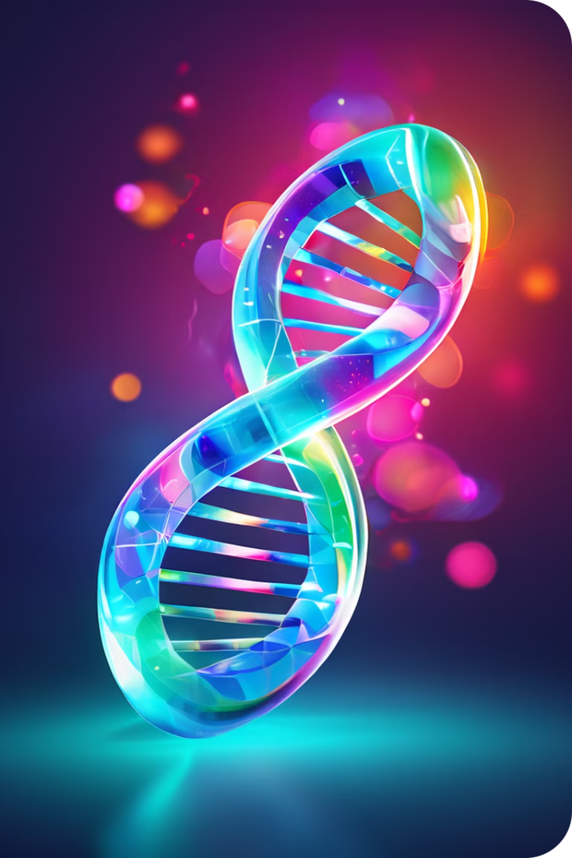
Unveiling the World of Genes and Chromosomes
Welcome to the fascinating realm of genes and chromosomes, the fundamental building blocks of life. This presentation will guide you through the intricate world of these molecular structures, revealing how they store, transmit, and express our genetic information. We will explore their structure, organization, and how they contribute to the diversity of life.

Slide 4
Structure of DNA Molecules
At the heart of every living organism lies DNA, a remarkable molecule that holds the blueprint for life. DNA's structure resembles a twisted ladder, known as a double helix. Two strands of nucleotides, composed of a sugar, a phosphate group, and a nitrogenous base (adenine, guanine, cytosine, or thymine), intertwine and are linked by hydrogen bonds between complementary bases. Adenine always pairs with thymine, and guanine with cytosine, ensuring the correct sequence for genetic information.
1
Double Helix
2
Nucleotide Bases
The iconic double helix structure of DNA allows for efficient storage and replication of genetic information.
The four nitrogenous bases, adenine, guanine, cytosine, and thymine, are the building blocks of the genetic code. Their specific sequence determines the order of amino acids in proteins, ultimately shaping our traits.
3
Sugar-Phosphate Backbone
4
Hydrogen Bonds
The sugar-phosphate backbone provides structural support and stability to the DNA molecule, ensuring its integrity and ability to carry genetic information.
Hydrogen bonds between complementary bases hold the two strands of DNA together, forming the double helix structure. These bonds are crucial for the stability and accurate replication of genetic information.

Slide 5
Chromosomal Organization in Eukaryotic Cells
In eukaryotic cells, DNA is carefully organized into structures called chromosomes. Each chromosome comprises a single, continuous DNA molecule wrapped around histone proteins. This intricate packaging allows for the efficient storage and regulation of genetic information within the nucleus of the cell. Humans inherit one set of 23 chromosomes from their mother and another set from their father, resulting in 23 pairs of chromosomes, totaling 46 chromosomes. The arrangement of genes on chromosomes, their order, and their physical location are crucial for proper functioning of the cell and organism.
Chromosome Structure
DNA Packaging
Each chromosome consists of two identical sister chromatids held together at the centromere. The telomeres, protective caps at the ends of the chromosomes, prevent degradation and maintain the integrity of the DNA molecule.
DNA is tightly wrapped around histone proteins, forming nucleosomes. These nucleosomes then coil and fold to create a compact, organized structure called chromatin.
1
2
3
4
Chromatin Condensation
Genetic Information
During cell division, chromatin further condenses to form visible chromosomes, ensuring the proper distribution of genetic information to daughter cells.
Genes, the functional units of heredity, reside on chromosomes. These genes carry instructions for building and maintaining an organism.

Slide 6
Chromatin and Histone Proteins
Chromatin is a complex mixture of DNA and protein that forms the building blocks of chromosomes. Histone proteins are essential for organizing and compacting DNA within the nucleus. These proteins act as spools around which DNA winds, creating nucleosomes, the basic unit of chromatin structure. The association between DNA and histone proteins is dynamic and plays a crucial role in regulating gene expression, allowing certain genes to be active while others are inactive.
Histones
Nucleosomes
Chromatin Remodeling
Histones are small, positively charged proteins that bind to negatively charged DNA, facilitating the formation of nucleosomes.
Nucleosomes are the basic unit of chromatin structure, consisting of DNA wrapped around a core of eight histone proteins.
Chromatin structure is not static. It can be remodeled through modifications to histones, allowing for changes in gene expression and DNA accessibility.

Slide 7
Centromeres, Telomeres, and Chromosome Structure
Chromosomes are not simply linear stretches of DNA; they have specific structures that contribute to their function and stability. The centromere is a specialized region that serves as the attachment point for spindle fibers during cell division, ensuring the proper segregation of chromosomes to daughter cells. Telomeres are protective caps at the ends of chromosomes that prevent DNA degradation and maintain the integrity of the chromosome. They also play a role in regulating cell division and lifespan.
Structure
Function
Centromere
Attachment point for spindle fibers during cell division, ensuring proper chromosome segregation
Telomeres
Protective caps at the ends of chromosomes, preventing DNA degradation and maintaining chromosome integrity

Slide 8
Chromosome Replication and Segregation
Before a cell can divide, it must duplicate its entire genome, including all chromosomes. This process is called DNA replication, and it involves the unwinding of the double helix, separating the two strands, and using each strand as a template to synthesize a new complementary strand. The result is two identical copies of the original chromosome, called sister chromatids. During cell division, the sister chromatids are pulled apart, ensuring that each daughter cell receives a complete set of chromosomes. This precise replication and segregation of chromosomes is crucial for maintaining genetic stability and ensuring the correct transmission of genetic information from one generation to the next.
DNA Replication
The double helix unwinds, and each strand serves as a template to synthesize a new complementary strand.
Sister Chromatid Formation
Two identical copies of the original chromosome are created, called sister chromatids, held together at the centromere.
Chromosome Condensation
Chromatin condenses into visible chromosomes, making it easier for them to be segregated during cell division.
Chromosome Segregation
Sister chromatids separate and migrate to opposite poles of the cell, ensuring that each daughter cell receives a complete set of chromosomes.

Slide 9
Genetic Variation and Chromosome Abnormalities
While the organization and replication of chromosomes are highly precise, variations can occur. Genetic variation arises from changes in the DNA sequence, such as mutations or rearrangements of chromosomes. These variations can be inherited or acquired during the lifetime of an individual and can contribute to the diversity of life. However, some chromosomal abnormalities can lead to genetic disorders. For example, aneuploidy, the presence of an abnormal number of chromosomes, can result in conditions like Down syndrome, Turner syndrome, and Klinefelter syndrome.
Mutations
Chromosomal Rearrangements
Genetic Testing
Gene Therapy
Changes in the DNA sequence can alter the function of genes, potentially leading to disease.
Genetic testing can identify chromosomal abnormalities and provide insights into an individual's genetic predisposition to certain diseases.
Emerging technologies like gene therapy hold promise for treating genetic disorders by altering the expression or function of genes.
Deletions, insertions, translocations, and inversions of chromosomal segments can disrupt gene expression and function.

