Slide 1
DANTULARI NARAYANA RAJA COLLEGE (AUTONOMUS)
Department of Biochemistry
Conducted BY SIR.RAMESH (HOD) M.SC M.PHIL

Slide 3
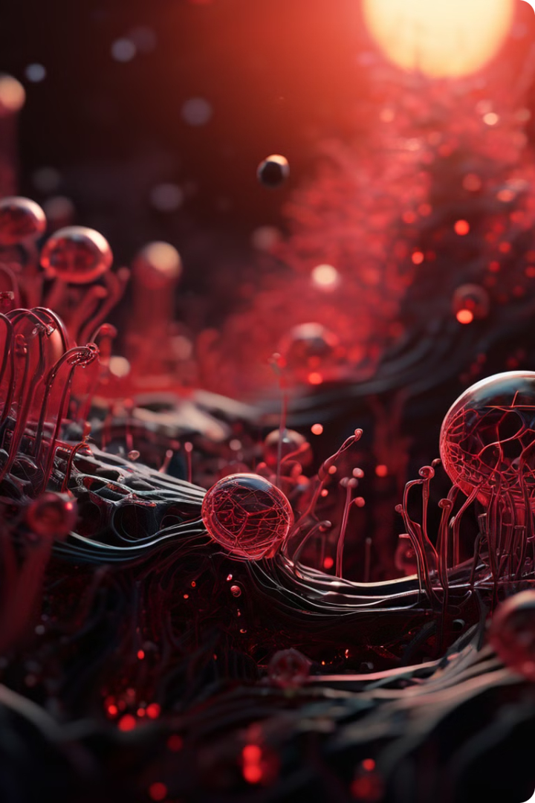
Genetic Engineering in Microorganisms
Explore the transformative power of genetic engineering in microorganisms.

Slide 4
Microorganisms as Model Organisms
1
Simplicity
2
Rapid Growth
Single-celled organisms offer a streamlined genetic system.
Fast generation times allow for rapid genetic study.
3
Genetic Tractability
4
Versatility
Easy manipulation of genes for research and development.
Wide range of applications in various fields.

Slide 5
Genetic Modification Techniques
1
Gene Cloning
Isolating and copying specific genes.
2
Gene Editing
Precisely altering DNA sequences.
3
Transformation
Introducing new genetic material.

Slide 6
Applications in Biotechnology
Biopharmaceuticals
Bioremediation
Agriculture
Cleaning up environmental pollutants.
Developing disease-resistant crops.
Production of therapeutic proteins.

Slide 7
Ethical Considerations
Unforeseen Consequences
Safety Concerns
Potential risks of unintended genetic changes.
Ensuring the safety of genetically modified organisms.
Equity and Access
Public Perception
Fair distribution of benefits and risks.
Addressing societal concerns and building trust.

Slide 8
Challenges and Limitations
Technical Hurdles
Regulatory Frameworks
Cost and Resources
Efficient gene delivery and expression.
Strict guidelines for genetic modification.
High cost of research and development.

Slide 9
Future Directions and Outlook
Synthetic Biology
Genome Engineering
Microbiome Research
Personalized Medicine
Creating novel biological systems.
Precise manipulation of entire genomes.
Understanding and manipulating microbial communities.
Tailoring treatments based on individual genetics.

