Slide 1
DANTULARI NARAYANA RAJA COLLEGE (AUTONOMUS)
ADIKAVI NANNAYA UNIVERSITY
Conducted BY SIR.RAMESH (HOD) M.SC M.PHIL

Slide 3
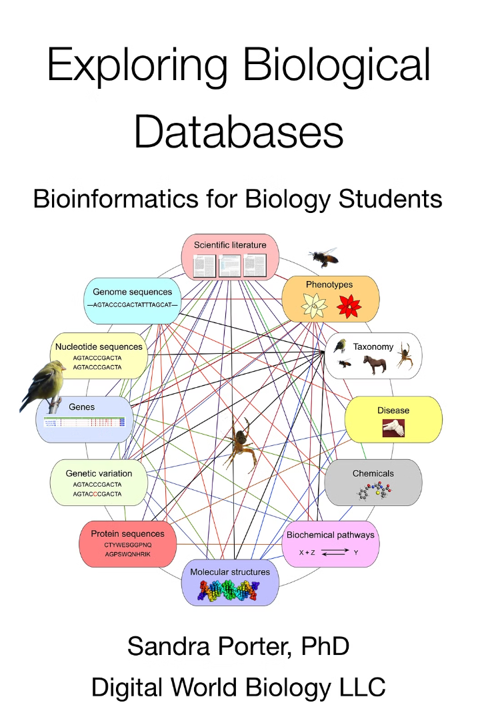
Introduction to Biological Databases
Biological databases are comprehensive repositories of biological information, including DNA sequences, protein structures, and genomic data. These databases play a crucial role in modern life sciences, enabling researchers to access and analyze vast amounts of biological data.

Slide 4
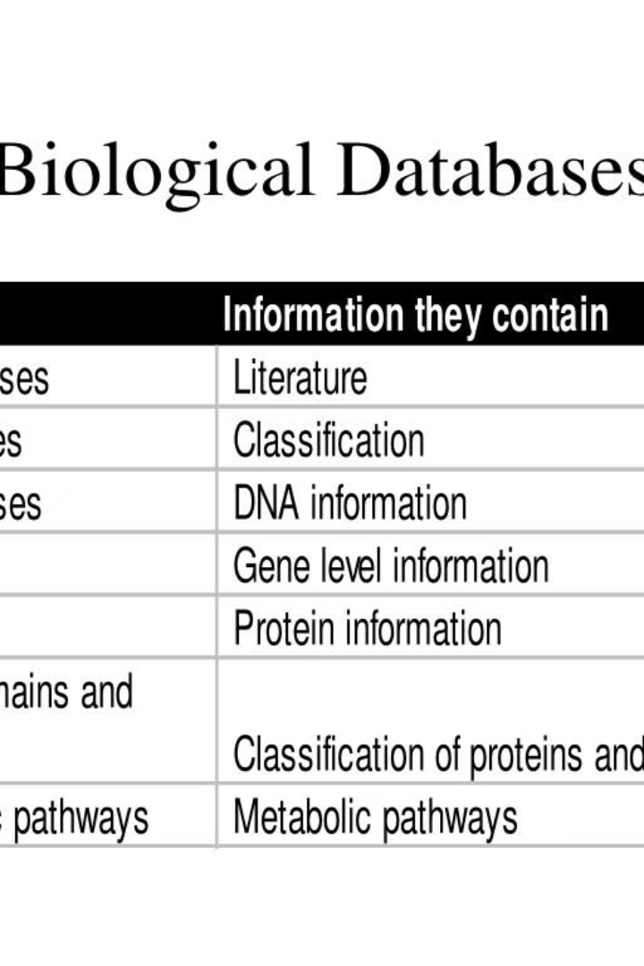
Types of Biological Databases
Biological databases come in many forms, each designed to store and organize different types of data relevant to the study of living organisms and their functions.

Slide 5
Sequence Databases
DNA/RNA Sequence Databases
Protein Sequence Databases
Specialized Sequence Databases
These repositories store the genetic sequence information for various organisms, allowing researchers to access and analyze DNA and RNA data.
These databases house the amino acid sequences of proteins, facilitating the study of protein structure, function, and evolution.
Certain databases focus on specific types of sequences, such as those related to viruses, bacteria, or certain diseases, providing targeted data for researchers.

Slide 6
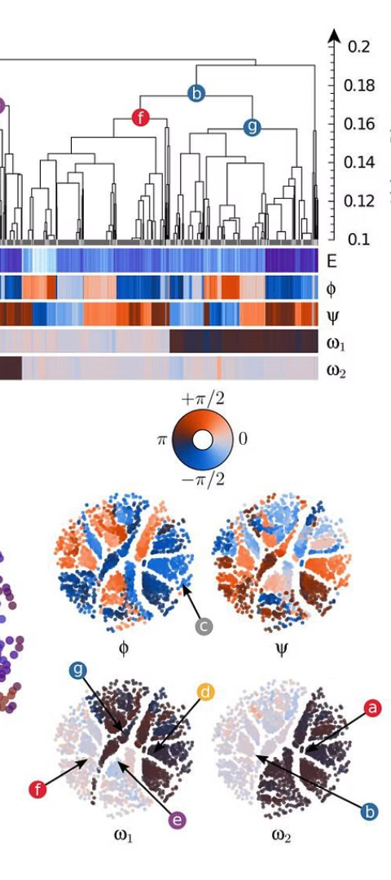
Structure Databases
1
Protein Structure Databases
These databases store 3D structural information about proteins, obtained through experimental techniques like X-ray crystallography and NMR spectroscopy. They provide insights into protein function and interactions.
2
Nucleic Acid Structure Databases
These databases catalog the 3D structures of nucleic acids, such as DNA and RNA. They are important for understanding genetic information storage and gene expression mechanisms.
3
Ligand Structure Databases
These databases contain structural data on small molecules that can bind to proteins, enabling the study of drug-target interactions and the development of new therapeutics.

Slide 7
Genome Databases
NCBI Genomes
1
Comprehensive database of sequenced genomes
Ensembl
2
Genome browser and database for vertebrate species
GenBank
3
Annotated collection of publicly available DNA sequences
Genome databases are comprehensive repositories of DNA sequence information for various organisms. They provide access to annotated genome sequences, allowing researchers to study the genetic makeup and evolution of different species. These databases integrate genomic data with tools for analysis and visualization, enabling discoveries in fields like evolutionary biology, genetics, and medicine.

Slide 8
Importance of Biological Databases
Biological databases are crucial repositories of data that drive scientific research and discovery. They enable researchers to access and analyze vast amounts of genomic, proteomic, and other biological data, leading to groundbreaking advancements in fields like medicine, agriculture, and biotechnology.

Slide 9
Research and Discovery
Enhanced Scientific Research
Biological Insights
By analyzing the data stored in these databases, scientists can uncover patterns, identify relationships, and gain deeper insights into the complex mechanisms underlying living organisms. This knowledge drives further research and innovation.
Biological databases are invaluable tools that enable researchers to access a vast repository of genetic, molecular, and structural data. This information fuels new discoveries and advances in fields like medicine, biotechnology, and evolutionary biology.

