Slide 1
DANTULARI NARAYANA RAJA COLLEGE (AUTONOMUS)
ADIKAVI NANNAYA UNIVERSITY
GUIDANCE BY SIR.RAMESH (HOD) M.SC M.PHIL

Slide 2
Bioinformatics

Slide 3
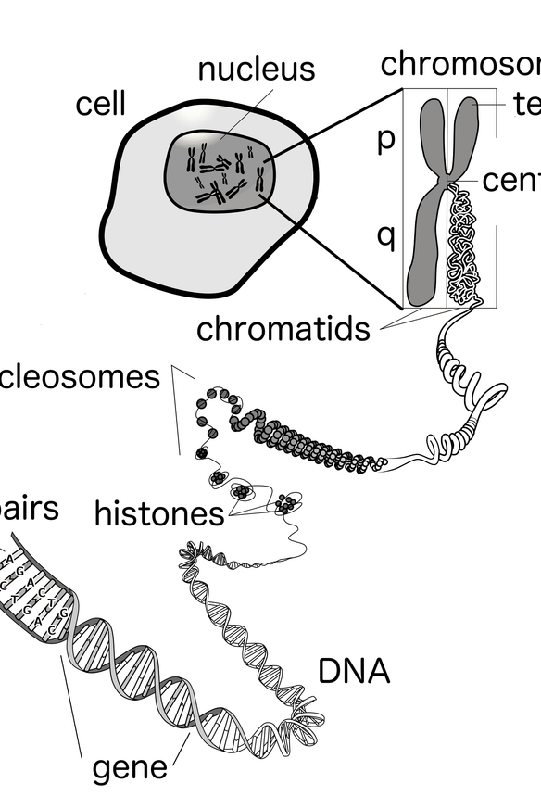
What is the Genome?
The genome is the complete set of genetic instructions that provide the blueprint for the development and functioning of a living organism. It contains all the hereditary information encoded in the DNA (deoxyribonucleic acid) molecules within the cells of a living being, whether it's a plant, animal, or microorganism.

Slide 4
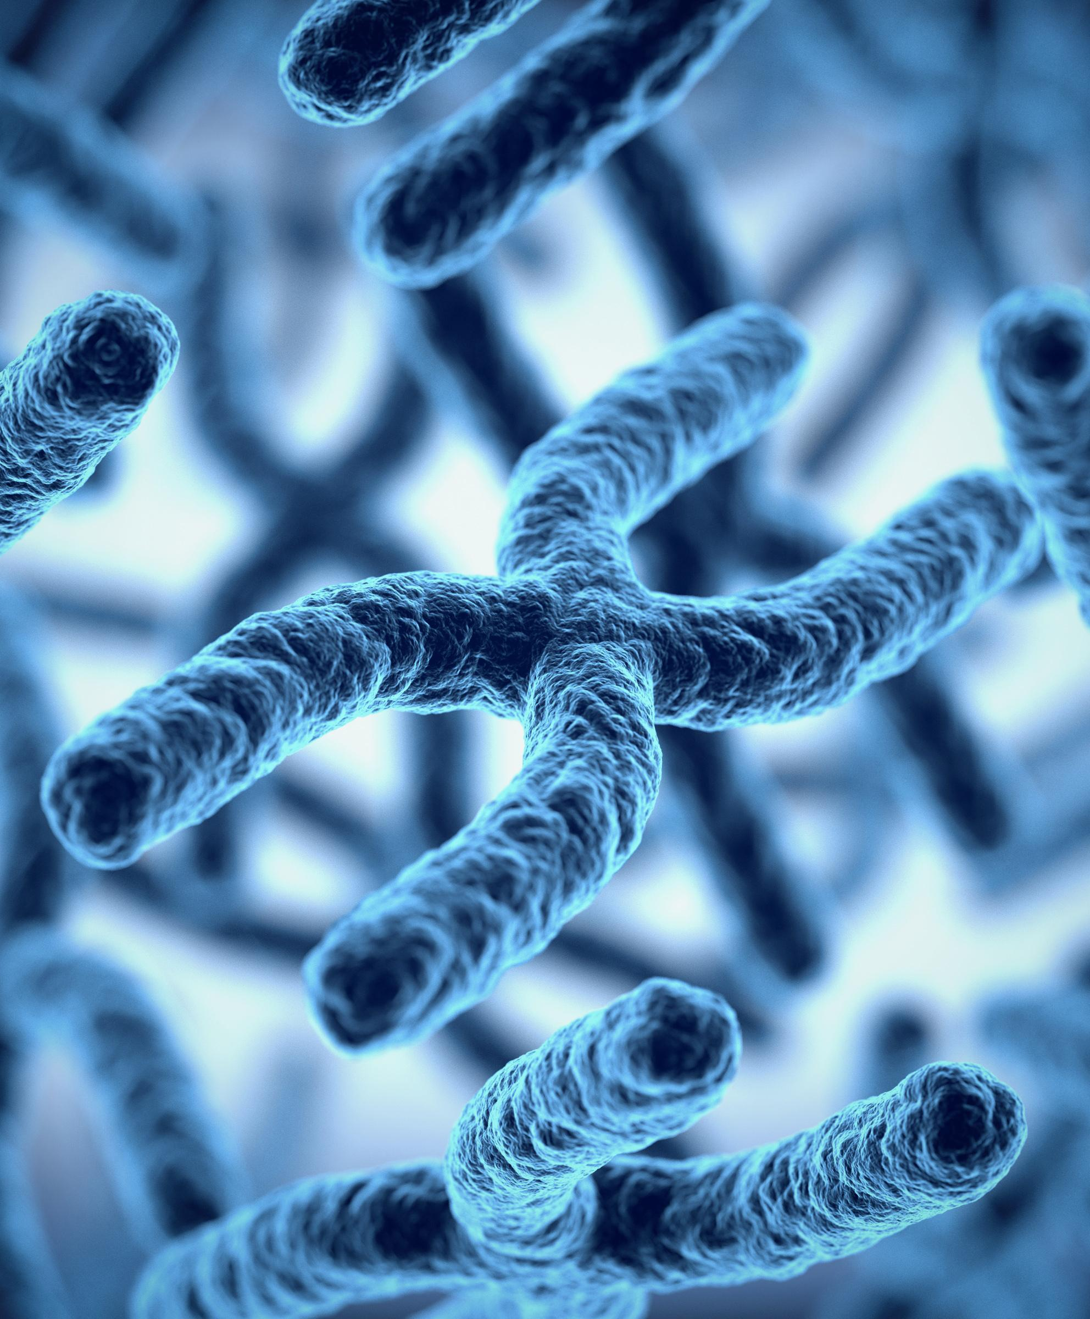
Genomics
Genomics is the comprehensive study of the entire genome, which is the complete set of genetic information found in an organism. It involves analyzing and interpreting the structure, function, and evolution of genomes to gain a deeper understanding of biological systems.

Slide 5
History of Genomics
The field of genomics has undergone a remarkable evolution, tracing its roots back to the early 20th century. Pioneering scientists laid the groundwork for understanding the fundamental structure and function of genetic material, paving the way for the groundbreaking discoveries that would shape the modern era of genomics.

Slide 6
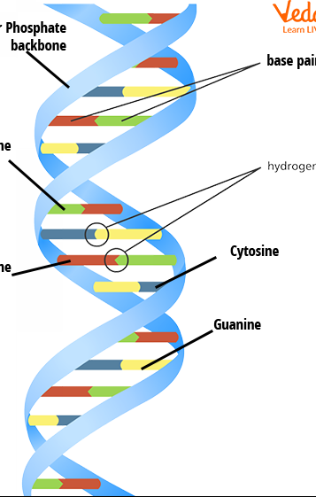
Goals of Genomics
Genomics is a rapidly evolving field with ambitious goals that aim to revolutionize our understanding of the genetic code and its impact on living organisms. The primary objectives of genomics research include deciphering the complete DNA sequences of various species, identifying and mapping all genes, and elucidating their functions and interactions within complex biological systems.

Slide 7
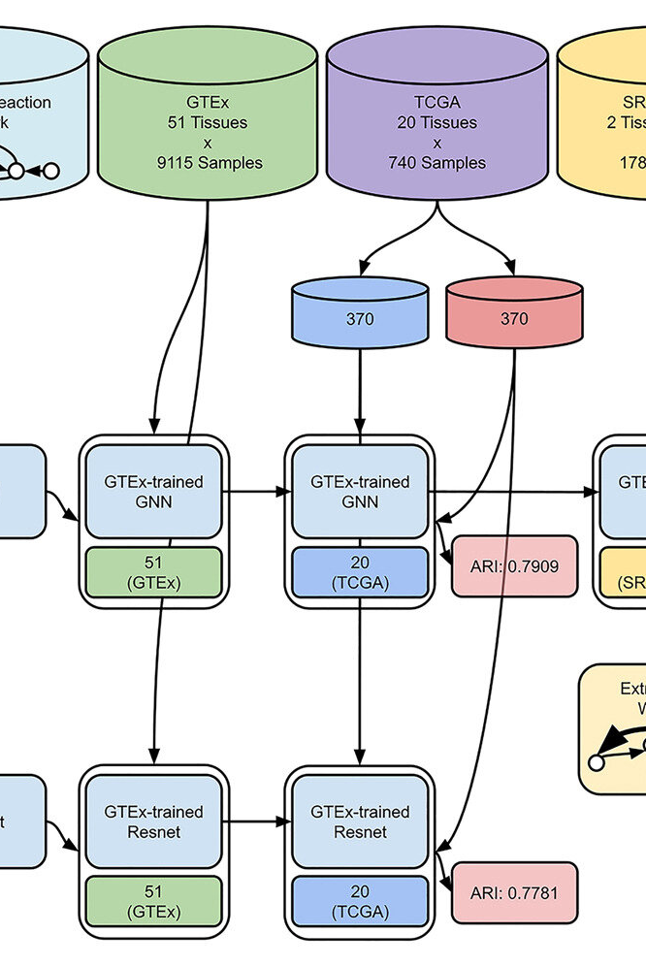
Map-Based Sequencing
Map-based sequencing is a powerful technique in genomics that involves constructing physical maps of chromosomes or DNA fragments to guide the sequencing process. This approach leverages the known location and order of DNA sequences to efficiently sequence the entire genome.

Slide 8
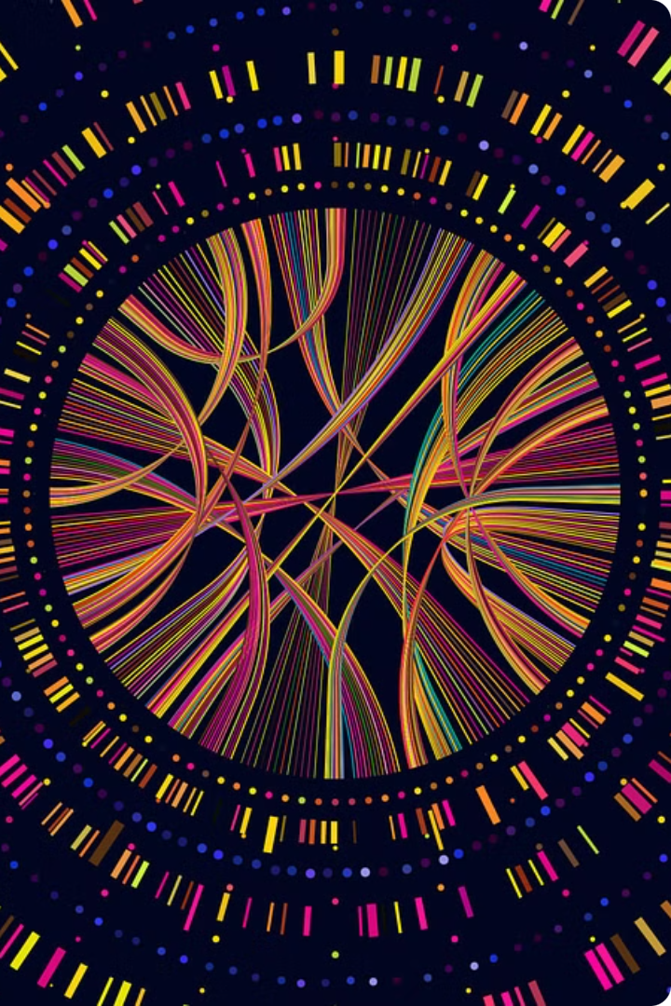
Finding the Genes
Identifying the specific locations of genes within the genome is a crucial step in understanding the genetic makeup of an organism. Advances in genome sequencing and bioinformatics tools have enabled researchers to effectively map and annotate the positions of genes across entire genomes.

Slide 9
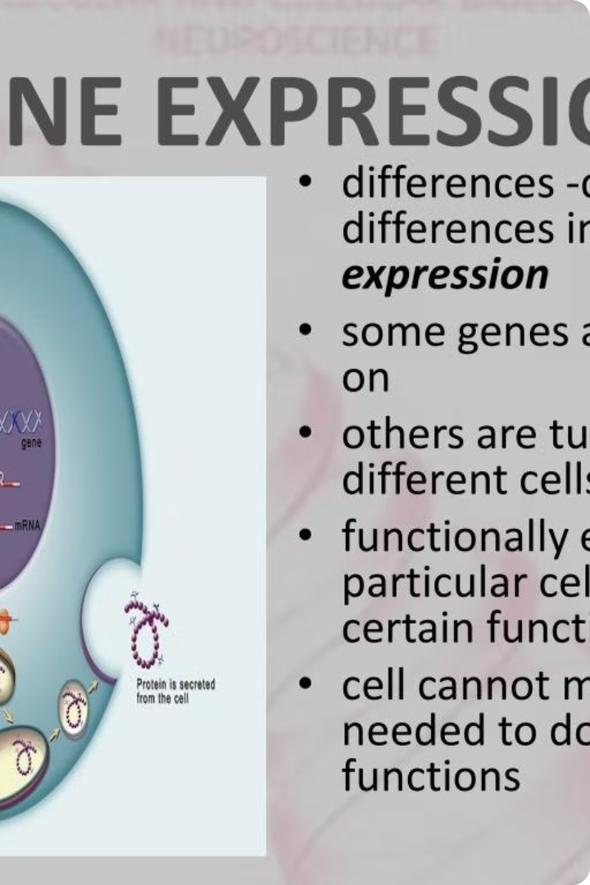
Gene Function
Understanding the function of genes is a crucial aspect of genomics. By studying gene expression and the proteins they encode, researchers can uncover the biological roles and mechanisms underlying various cellular processes.

Slide 10
Genomic Data and the Arabidopsis Genome
The rapidly growing field of genomics has led to the accumulation of vast amounts of biological data, including the complete genome sequence of the model plant Arabidopsis thaliana. This small flowering weed has become a crucial tool for understanding plant genetics and gene function.

Slide 11
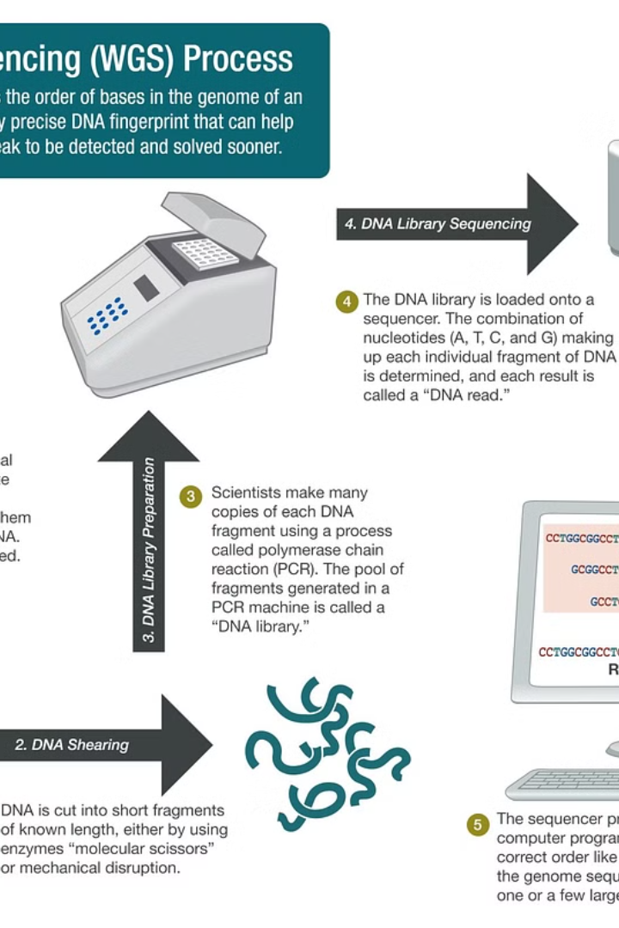
Sources of Huge Biological Data
The rapid advancements in genomic and biological technologies have led to the generation of massive amounts of data. These data come from various sources, including high-throughput DNA sequencing, protein analysis, and imaging techniques. The ability to collect and store this wealth of information has revolutionized the field of bioinformatics.

Slide 12
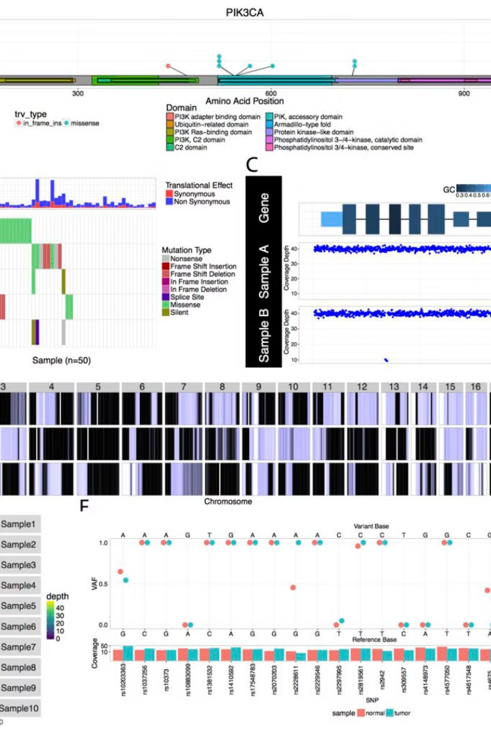
The Challenges and Conclusion
As the field of genomics continues to evolve, it faces a number of significant challenges. The sheer volume of data being generated, the complexity of genomic interactions, and the need for advanced computational tools and storage solutions are just a few of the obstacles researchers must overcome. Despite these hurdles, the potential benefits of genomic research remain immense, paving the way for groundbreaking discoveries in medicine, agriculture, and beyond.

