Slide 1
DANTULARI NARAYANA RAJA COLLEGE (AUTONOMUS)
ADIKAVI NANNAYA UNIVERSITY
Conducted BY SIR.RAMESH (HOD) M.SC M.PHIL

Slide 3
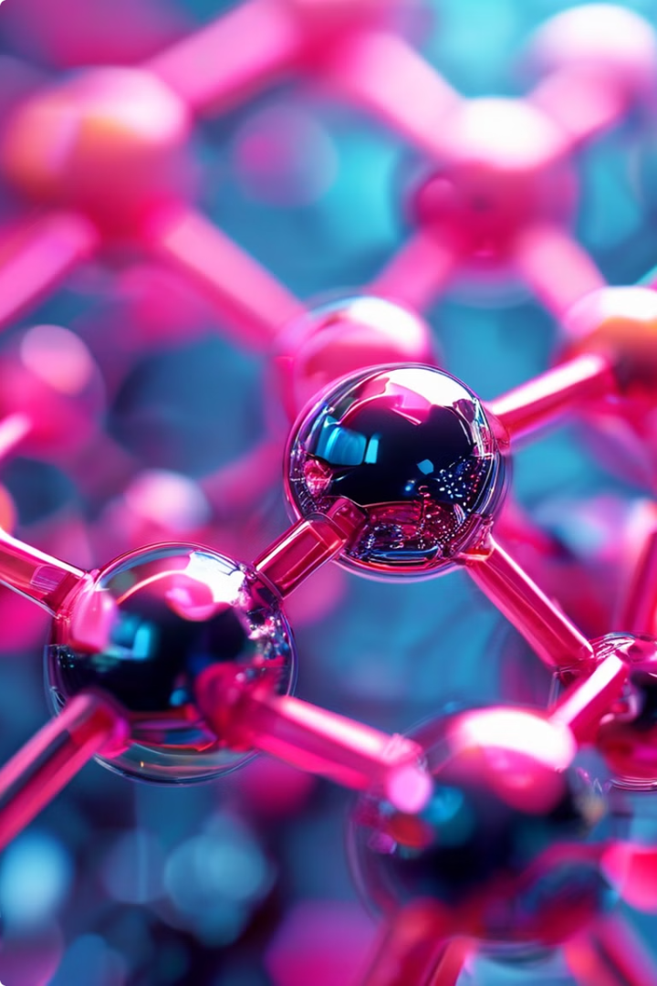
Proteomics
Proteomics is the large-scale study of proteins, their structures, functions, and interactions within living organisms. It provides a comprehensive understanding of the complex biological processes that drive life.

Slide 4
The Importance of Proteomics
1
Biomarker Discovery
2
Drug Development
Proteomics enables the identification of disease-specific proteins that can be used as biomarkers for early diagnosis and monitoring.
Proteomics helps understand the molecular mechanisms of disease, leading to the development of more effective and targeted therapeutic interventions.
3
Personalized Medicine
Proteomic analysis can inform personalized treatment strategies by revealing individual variations in protein expression and function.

Slide 5
Applications of Proteomics
Disease Diagnosis
Pharmaceutical Research
Biomarker Validation
Proteomics can identify disease-specific protein biomarkers, enabling early detection and improved patient outcomes.
Proteomics plays a crucial role in drug discovery, target identification, and the study of drug mechanisms of action.
Proteomics provides a robust framework for validating potential biomarkers, ensuring their reliability and clinical utility.

Slide 6
Techniques Used in Proteomics
Mass Spectrometry
Gel Electrophoresis
Mass spectrometry is a powerful analytical technique that identifies and quantifies proteins based on their mass-to-charge ratio.
Gel electrophoresis separates proteins based on their size and charge, enabling the analysis of complex protein mixtures.
Chromatography
Bioinformatics
Chromatographic techniques, such as liquid chromatography, purify and fractionate proteins for further analysis.
Bioinformatics tools and databases facilitate the storage, analysis, and interpretation of large-scale proteomic data.

Slide 7
Challenges in Proteomics
Dynamic Range
1
The wide dynamic range of protein abundances in biological samples poses a significant challenge for comprehensive protein detection and quantification.
2
Sample Complexity
Biological samples often contain a vast number of proteins, requiring advanced separation and identification techniques to analyze the complete proteome.
Protein Modifications
3
Post-translational modifications of proteins can affect their structure, function, and interactions, adding complexity to proteomic analysis.

Slide 8
Future of Proteomics
Technological Advancements
Personalized Medicine
Integrative Approaches
Continued improvements in mass spectrometry, bioinformatics, and other proteomic technologies will drive a deeper understanding of biological systems.
Proteomics will play a pivotal role in the development of personalized therapies and the implementation of precision healthcare.
Combining proteomics with other "-omics" disciplines, such as genomics and metabolomics, will provide a more comprehensive view of biological processes.

Slide 9
Conclusion
Comprehensive Understanding
Innovative Solutions
Transformative Potential
Proteomics has revolutionized our understanding of the complex web of biological processes that underpin life.
The insights gained from proteomics research will continue to drive the development of innovative diagnostic tools and therapeutic interventions.
As the field of proteomics continues to evolve, it holds immense promise for advancing human health and unlocking the mysteries of life.

