Slide 1
DANTULARI NARAYANA RAJA COLLEGE (AUTONOMUS)
ADIKAVI NANNAYA UNIVERSITY
Conducted BY SIR.RAMESH (HOD) M.SC M.PHIL

Slide 3
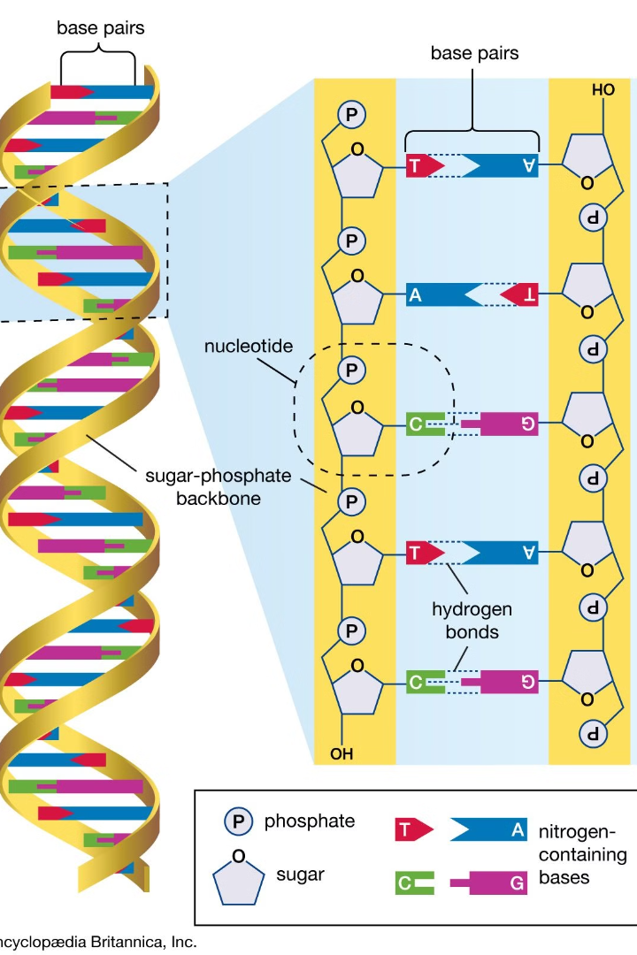
Introduction to Sequence Alignment
Sequence alignment is a fundamental technique in bioinformatics that compares DNA, RNA, or protein sequences to identify similarities and differences. It's crucial for understanding evolutionary relationships, predicting protein structure, and detecting genetic variations.

Slide 4
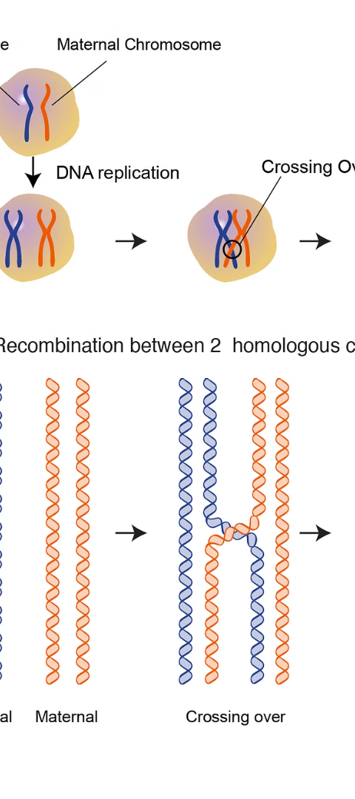
What is Homology?
1
Evolutionary Relatedness
2
Structural Similarity
Homologous sequences share a common evolutionary ancestor, indicating they are evolutionarily related.
Homologous proteins often have similar 3D structures, despite potential differences in their amino acid sequences.
3
Functional Equivalence
Homologous genes or proteins may have equivalent biological functions, even if they are from different species.

Slide 5
Types of Sequence Alignment
Global Alignment
Local Alignment
Multiple Sequence Alignment
Compares entire sequences and finds the best overall match, even if there are gaps or mismatches.
Identifies the most similar regions between two sequences, ignoring less conserved areas.
Aligns three or more sequences simultaneously to find conserved regions across a gene family or protein domain.

Slide 6
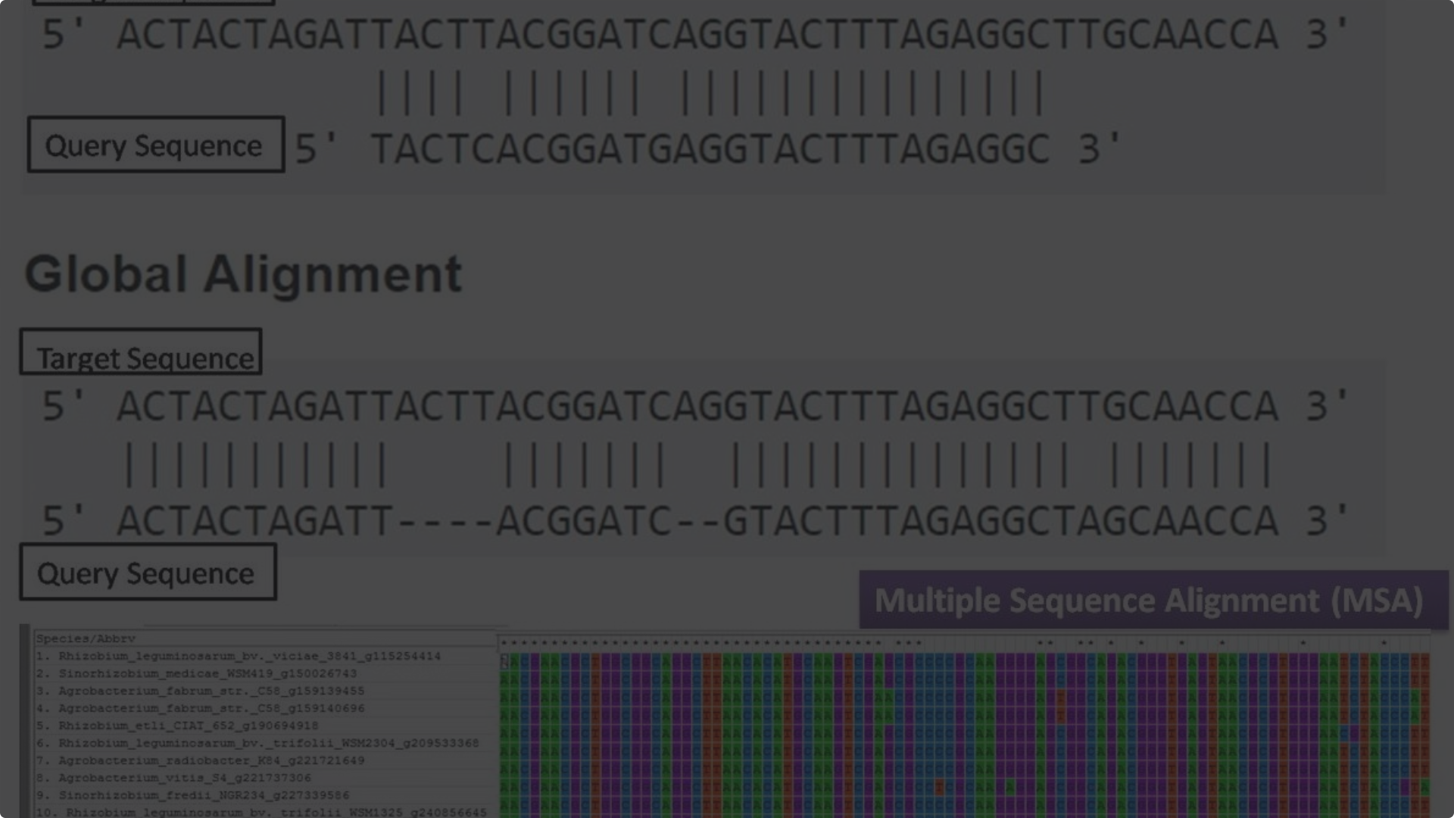
Global Alignment
Needleman-Wunsch
Scoring Matrices
A classic algorithm that finds the optimal global alignment between two sequences.
Assigns scores to matches, mismatches, and gaps to determine the best alignment.
1
2
3
Dynamic Programming
Uses a systematic approach to build the alignment, ensuring the overall optimal solution.

Slide 7
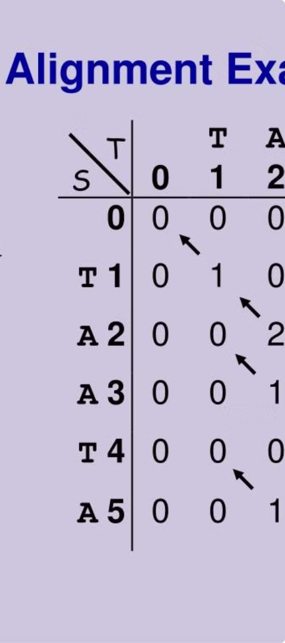
Local Alignment
Smith-Waterman
A local alignment algorithm that finds the most similar subregions between two sequences.
Sliding Window
Compares a small, movable window between the sequences to identify high-scoring local alignments.
Scoring Systems
Use gap penalties and substitution matrices to determine the significance of local alignments.

Slide 8
Algorithms for Sequence Alignment
BLAST
FASTA
A fast algorithm that quickly searches for similar sequences in a database.
A heuristic algorithm that uses word matching to identify related sequences.
Hidden Markov Models
Progressive Alignment
Statistical models that can identify distant evolutionary relationships between sequences.
Builds multiple sequence alignments by iteratively aligning pairs of sequences.

Slide 9
Applications of Sequence Alignment Homology
Evolutionary Analysis
Protein Structure Prediction
Drug Discovery
Genetic Variation Analysis
Identifying homologous drug targets in pathogens can aid in developing new treatments.
Studying homologous sequences reveals phylogenetic relationships and evolutionary histories.
Homologous proteins often have similar 3D structures, enabling structure modeling.
Comparing homologous sequences detects mutations and genetic differences between individuals.

