Slide 1
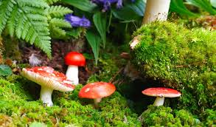
PLANT BIODIVERSITY& ITS IMPORTANCE
PRESENTED
BY
DR.P.PRASANNA KUMARI
H.O.D BOTANY
DNR COLLEGE
BHIMAVARAM

Slide 2
INTRODUCTION
Nature manifest diversity in plants, animals and microbes among the living domain, apart from non-living things of the nature.
Basis of natural biodiversity is variation. Biodiversity is a complex and balanced network of different species, which are mutually dependent upon each other.
We the human being are completely dependent on the biodiversity for the food, fuel, fiber, and medicine. Thus he becomes a component of biodiversity.
Biodiversity is a condition for the long- term sustainability of the environment.
Bio means life and diversity means variation. Hence, biodiversity means variation in life forms.

Slide 3
Biodiversity has many interpretations and it is commonly used to replace the long established and more clearly defined terms “species diversity” and “species richness”.
Biologist most often define biodiversity in terms of SPECIES DIVERSITY and SPECIES RICHENESS.
Species diversity refers to the various kinds of species inhabiting in that particular area.
Species richness refers the number of individuals of a species in a particular area.

Slide 4
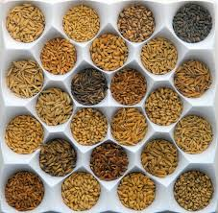
SPECIES DIVERSITY
PEAR SPECIES
RICE SPECIES

Slide 5
DEFINITIONS:
1). Biologist most often define biodiversity as the “totality of genes, species and ecosystems of a region. 3 biological variety are species, gene and ecosystem.
2). In 2003 Campbell defined 4th critical diversity called molecular diversity.
3). Wilcox defined biodiversity as variety of life forms of all levels of biological systems. (molecular, organismic, population, species and ecosystem.)
4).Global biodiversity strategy (UNED1992) defined biodiversity as “The totality of genes, species and ecosystems of a region.”
5). Saundlund et al (1993) defined biodiversity as “ The structural and functional variety of life forms at genetic, population, species, community and ecosystem levels.”

Slide 6
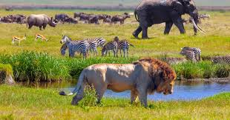
ECOSYSTEM DIVERSITY
ECOSYSTEM DIVERSITY

Slide 7
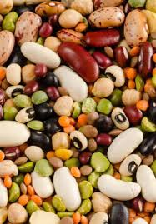
GENETIC DIVERSITY

Slide 8
Concepts of Biodiversity:
1).Biodiversity is the variety of life on earth.
2).It is generally described at three levels: Genetic, Species and ecosystem diversities
3).All life forms that make up diversity, including humans, are ultimately connected to all other life forms and to their physical environment.
4). No one living element of any ecosystem can survive independent of the others.
5). Connections among living and non-living elements keep the environment functioning and healthy.
6). Human impact on the environment directly or indirectly affect the function of other living things and by extension ourselves.

Slide 9
SCOPE OF BIODIVERSITY
1). The science of biodiversity is the unifying force to provide a connection within the broad field of biology.
2). Biodiversity is the backbone for agriculture, aquaculture, animal husbandry and forestry. It is host of applied branches of biology. E g: microbiology.
3). Biodiversity stands at the very foundation of development in a rapidly changing world.
4).To satisfy the rapidly growing population basic needs like food, shelter etc. will multiply load on environment.
Green revolution almost achieved its goal in product from agriculture and reached stagnation.
5). At present the fresh water supply is scarce. The uncultivated land is little. Soil quality has already started deteriorating world wide.

Slide 10
6). Hence, new varieties of useful plants and new breeds of domesticated animals have to be constantly evolved for increased yield. (productivity, desired life time, disease resistance).
7).An effort to increase the quality and quantity of bio resources is possible only if we have adequate information and knowledge about their wild relatives.
8). Wild relatives are the genetic source for their further improvement through conventional or biotechnological methods.
9). Since bio diversity deals with biological resources it is very important to study critically for the germplasm of useful plants and animals along with their surroundings, especially for their wild relatives.

Slide 11
GERMPLASM STORE

Slide 13
10). Bio diversity provide knowledge to reconstruct and restore changed or altered ecosystem because of globalization and deforestation.
11).biodiversity will offer new sources of food, medicine, and other requirements in the coming years.
12).Industrial development is possible only by exploring the great potential of the still unknown biological resources for which biodiversity is the way.
13). Biodiversity is the resource on which all human existence depends
A). Biodiversity is the pillar of human development.
B). Practice of sustainable exploration of biological resources.
C). The sustainable development is in four facets. They are
economic, environmental, social and cultural facets of biodiversity.

Slide 14
THANK YOU ALL

