Slide 1
Dr. N. Vijaya Kumar Lecturer in Chemistry DNR College (A)

Slide 2
Group -16- elements : The Oxygen family ( Chalcogens)
O
S
Se
Te
Po

Slide 3
The Oxygen family ( Chalcogens)
These are called as chlcogens due to their ore forming tendency.
Occurrence: Oxygen is most abundant of all the elements. It occurs in the free state as O₂ , 23% by mass of the atmosphere. It also occurs in the form of ozone(O₃), In the form of mineral as silicate minerals.
Other elements of this group are less abundant in the earth crust.

Slide 4
Electronic configuration: Their general electronic configuration is ns²np⁴.
Trends in atomic & physical properties :
Atomic and ionic radii : The atomic and ionic radii of group 16 elements are smaller than 15 group elements. The atomic and ionic radii increases down the group.
Ionization enthalpy: The first ionization enthalpy (I₁) of group 16 elements is lower than group 15 elements. (because electronic configuration of group 15 elements is symmetrical and more stable). (3) Electron gain enthalpy : The electron gain enthalpy decreases down the group but exceptionally the electron gain enthalpy of oxygen is less than the other elements of the group this is due to the smaller size of oxygen atom, smaller size of p-orbital, high electron density, greater repulsion felt by the incoming electron.

Slide 5
Electronegativity : The elements of this group have higher values of E.N. than Group 15, due to the smaller size of atoms. Oxygen is the second most electronegative element.
Non-metallic character / Metallic character: Oxygen and sulphur are non-metallic where as Se and Te are metalloids , Polonium is however metallic in nature but it is a radioactive.
Melting and boiling points : The m.p. and b.p. increases down the group, due to the increase in atomic size, increase in van der Waals forces of
attraction

Slide 6
Trends in chemical properties
Oxidation states: these elements can show positive and negative both types of o.s. For ex: oxygen can show -2 in H₂O, -1 in H₂O₂ and +2 in F₂O, The highest o.s. of this group is +6. The stability of +6 oxidation state decreases down the group due to inert pair effect.
Chemical reactivity: Oxygen is most reactive in the group, S is also very reactive at high temperature. The reactivity decreases down the group.

Slide 8
The elements of this group form number of halides in the oxidation states +1, +2,+3,+4 and +6.
(4
:
Hexahalides : Only fluorine forms hexahalides, their relative stability decreases down the group, because size of central atom increases, electronegativity decreases, bond polarity increases leading to increase in reactivity or decrease in stability.
SF₆ > SeF₆ > TeF₆
Here TeF₆ is less stable therefore undergo hydrolysis readily.

Slide 9
Preparation : Dioxygen is prepared by the following methods :
(1). By decomposition of oxygen-rich compounds :
2KMnO₄ ----------> K₂MnO₄ + MnO₂ + O₂
2BaO₂ ----------> 2BaO + O₂
(2) Laboratory method :
In the laboratory, dioxygen is produced by heating a mixture of potassium
chlorate and manganese dioxide in the ratio 4:1 in a hard glass test tube at 147⁰C.
2KClO₃ (s) -----------------> 2KCl (s) + 3O₂(g).
It can also be prepared in the laboratory by the action of water on sodium peroxide.
2 Na₂O₂ (s) + 2 H₂O (l) ---------> 4 NaOH (aq) + O₂(g)

Slide 10
:
The most economical method for the commercial
preparation of dioxygen is liquefaction of air followed
by fraction distillation.
Dioxygen can also be prepared by the electrolysis of water containing a small amount of a mineral acid or an alkali.
2H₂O (l) ------------------> 2H₂ (g) + O₂ (g).D

Slide 11
:
(1) Physical properties :
Dioxygen is a colourless and odourless and tasteless gas.
It is slightly soluble in water, sustain marine and aquatic life.
It liquefies at -183⁰C and freezes at -218⁰C.

Slide 12
(2)
Action on litmus : Dioxygen is neutral to litmus.
Supporter of combustion : It is not combustible but supports combustion.
Oxidation : It is a powerful oxidizing agent can oxidize metals, non-metals and other compounds to their respective oxides.
reaction with metals :
4Na + O₂ -------> 2Na₂O, 2Na + O₂ -------> Na₂O₂
2Ca + O₂ ------> 2CaO
Reaction with non-metals :
2H₂ + O₂ ------> 2H₂O
N₂ + O₂ --------> 2NO
S + O₂ ---------> SO₂
2 C + O₂ ----------> 2CO , C + O₂ (excess) --------> CO₂

Slide 14
Uses : In addition to its importance in normal respiration and combustion processes, oxygen is used in oxyacetylene welding, in the manufacture of
many metals, particularly steel. Oxygen cylinders are widely used in hospitals,
high altitude flying and in mountaineering. The combustion of fuels, e.g.,
hydrazines in liquid oxygen, provides tremendous thrust in rockets.

Slide 15
Oxides : A binary compound of oxygen with another element is called oxide. As
already stated, oxygen reacts with most of the
elements to form oxides.
The oxides vary widely in their nature and properties.
Oxides can be simple (e.g., MgO, Al₂O₃ ) or mixed (Pb₃O₄, Fe₃O₄).
Simple oxides can be classified on the basis of their acidic, basic or
amphoteric character.
(i) Acidic oxides : An oxide that combines with
water to give an
acid is known as acidic oxide (e.g., SO₂, Cl₂O₇, CO₂, N₂O₅ ).

Slide 16
For example,
SO₂ (g)+ H₂O(l) ----> H₂SO₃ (aq)
As a general rule, only non-metal oxides are acidic but oxides of some metals in high oxidation state also have acidic character (e.g., Mn₂O₇, CrO₃, V₂O₅).
Basic oxides : The oxides which give a base with water are known as basic oxides (e.g., Na₂O, CaO, BaO). For example,
Na₂O(s) + H₂O (l) ------> 2NaOH( aq)
In general, metallic oxides are basic.
Amphoteric oxides: Some metallic oxides exhibit a dual behaviour.
They show characteristics of both acidic as well as basic oxides. Such
oxides are
known as amphoteric oxides. They react with acids as well as alkalies. For example, Al₂O₃ , ZnO, PbO reacts with acids as well as alkalies.

Slide 17
(iv) Neutral oxides : There are some oxides which are neither
acidic nor basic. Such oxides are known as neutral oxides.
Examples of neutral
oxides are CO, NO and N₂O.

Slide 18
Ozone
Ozone is an allotropic form of oxygen. it is formed from atmospheric oxygen in the presence of sunlight.
This ozone layer protects the
earth’s surface from an excessive concentration of ultraviolet (UV) radiations.
Preparation :
Ozone is obtained when silent electric discharge is passed through pure, cold and dry oxygen in a apparatus called the ozoniser.
During this reaction, conversion of O₂ to ozone is 10% and
therefore the product is called ozonised oxygen.
3O₂ (g) ------------------------------> 2O₃(g), ∆H⁰ = + 142 kJ mol⁻¹
Since the reaction is endothermic ,silent discharge produce less
heat and thus prevent the decomposition of ozone back to oxygen.

Slide 19
Structure of ozone : The central oxygen in ozone is sp² hybridized containing a lone pair of electrons. As a result, ozone has an angular structure with a bond angle of 117⁰.
Physical properties : Pure ozone is a pale blue gas, dark blue liquid and violet-black solid. Ozone has a characteristic smell and in small concentrations it is harmless. However, if the concentration rises above about 100 parts per million,
breathing becomes uncomfortable resulting in headache and nausea.

Slide 20
Chemical properties :
(i) Oxidising agent : Due to the ease with which it liberates atoms of nascent oxygen (O₃ ----> O₂ + O), it acts as a powerful oxidising agent. For example, it
oxidises lead sulphide to lead sulphate and iodide ions to
iodine.
PbS(s) + 4O₃(g) ---> PbSO₄(s) + 4O₂(g)
2I⁻(aq) + H₂O(l) + O₃(g) ----> 2OH⁻(aq) + I₂(s) + O₂(g)
When ozone reacts with an excess of potassium iodide solution buffered with a borate buffer (pH 9.2), iodine is liberated which can be titrated against a standard solution of sodium thiosulphate. This is a quantitative method for estimating O₃ gas.

Slide 21
Uses : Ozone is used as a germicide, disinfectant and for sterilising water. It is also used for bleaching oils, ivory, flour, starch, etc. It acts as an oxidising agent in the manufacture of potassium permanganate.

Slide 22
Sulphur
allotropic forms : Sulphur forms numerous allotropes of which the yellow rhombic (a-sulphur) and monoclinic (β -
sulphur) forms are the most important.
The stable form at room temperature is rhombic sulphur,
which
transforms to monoclinic sulphur when heated above 369 K.
compounds of sulphur : (1) Sulphur dioxide (SO₂) : Sulphur dioxide is formed together with a little (6-8%) sulphur trioxide
when sulphur is burnt in air or oxygen:
S(s) + O2(g) -->SO2 (g)
In the laboratory it is readily generated by treating a sulphite with dilute sulphuric acid.

Slide 23
SO₃ ²⁻(aq) + 2H⁺ (aq) --->H₂O(l) + SO₂ (g)
Industrially, it is produced as a by-product of the roasting of
sulphide ores.
4 FeS (s) + 11 O₂ (g) ------> 2 Fe₂O₃(s) + 8SO₂(g)
The gas after drying is liquefied under pressure and stored in steel cylinders.

Slide 24
Properties : Sulphur dioxide is a colourless gas with pungent smell and is highly soluble in water. It liquefies at room temperature under a pressure of
two atmospheres and boils at 263 K. Sulphur dioxide, when passed through water, forms
a solution of sulphurous acid.
SO₂(g) + H₂O(l) --------> H₂SO₃.
It reacts readily with sodium hydroxide solution, forming sodium sulphite, which then reacts with more sulphur dioxide to form sodium hydrogen sulphite.
2NaOH + SO₂ -----> Na₂SO₃ + H₂O
Na₂SO₃ + H₂O + SO₂ ------> 2NaHSO₃
In its reaction with water and alkalies, the behaviour of sulphur
dioxide is very similar to that of carbon dioxide. Sulphur dioxide reacts with chlorine in the presence of charcoal (which acts as a catalyst) to give sulphuryl chloride, SO₂Cl₂. It is
oxidised to sulphur trioxide by oxygen in the presence of vanadium(V) oxide catalyst. SO₂(g) + Cl₂ (g) ---------> SO₂Cl₂(l)
2 SO₂(g) + O₂(g) --------> 2 SO₃(g)

Slide 25
When moist, sulphur dioxide behaves as a reducing agent. For example, it converts iron(III) ions to iron(II) ions and decolourises acidified potassium permanganate(VII) solution; the latter reaction is a convenient test for the gas.
2Fe³⁺ + SO₂ + 2 H₂O --------> 2Fe²⁺ + SO₄ + 4H
2- +
5SO₂ + 2MnO ⁻ + 2 H O -----> 5SO ²⁻ + 4H⁺ + 2 Mn²⁺
4 2 4
The molecule of SO₂ is angular.

Slide 26
Uses : Sulphur dioxide is used (i) in refining petroleum and sugar (ii) in bleaching
wool and silk and (iii) as an anti- chlor, disinfectant and preservative.

Slide 27
Sulphuric acid
This is an oxoacid of S, having molecular formula H₂SO₄. Industrial process of manufacture of sulphuric acid : These days sulpuric acid is mostly prepared by the contact process. The acid produced by this method is free from arsenic impurities.
Sulphuric acid is manufactured by the Contact Process
which involves three steps:
burning of sulphur or sulphide ores in air to generate SO₂.
conversion of SO₂ to SO₃ by the reaction with
oxygen in the presence of a catalyst (V₂O₅), and
absorption of SO₃ in H₂SO₄ to give Oleum (H₂S₂O₇).

Slide 28
Properties and uses :
(1) Acidic character : In aqueous solution, H₂SO₄ ionizes in two
steps :
H₂SO₄ (aq) -----------> H⁺ (aq) + HSO₄ (aq) ; = 1 x 10³
-
^{K}a1
HSO ⁻ (aq) -----------> H⁺(aq) + SO ²⁻(aq) ;
K = 1.2 x 10⁻²
3 4 a2
Thus H₂SO₄ acts as a strong diprotic or dibasic acid and forms tow series of salts, sulphates and bisulphates.

Slide 29
(2) Dehydrating agent : Conc. H₂SO₄ has a strong affinity for water and hence it acts as a strong dehydrating agent. For example,
Conc.
^{C}12^{H}22^{O}11
----H-₂-_{S}-_{O}-₄----------> 12 C + 11 H₂O ( charring of sugar)
(3) Oxidising agent : Hot concentrated sulphuric acid is a moderately strong oxidizing agent. In this respect, it is intermediate between phosphoric and nitric

Slide 30
Both metals and non-metals are oxidised by concentrated sulphuric acid, which is reduced to SO₂.
Cu + 2 H₂SO₄(conc.) ------>CuSO₄ + SO₂ + 2H₂O 3S + 2H₂SO₄(conc.) -------> 3SO₂ + 2H₂O
C + 2H₂SO₄(conc.) -------->CO₂ + 2 SO₂ + 2 H₂O
Uses : Sulphuric acid is a very important industrial chemical. A nation’s industrial strength can be judged by the quantity of sulphuric acid it produces and consumes. It is needed for the manufacture of hundreds of other compounds and also in many industrial processes. The bulk
of sulphuric acid produced is used in the manufacture of fertilisers (e.g., ammonium sulphate, superphosphate). Other uses are in:
(a) petroleum refining (b) manufacture of pigments, paints and dyestuff intermediates (c) detergent industry (d) metallurgical applications (e.g., cleansing metals before enameling, electroplating and galvanising
(e) storage batteries (f) in the manufacture of nitrocellulose products and (g) as a laboratory reagent.
Oxoacids of sulphur (structures only) :
Sulphur forms a number of oxoacids such as H₂SO₃, H₂S₂O₃, H₂S₂O₄, H₂S₂O₅ etc. For structure kindly go through NCERT text book.

Slide 31
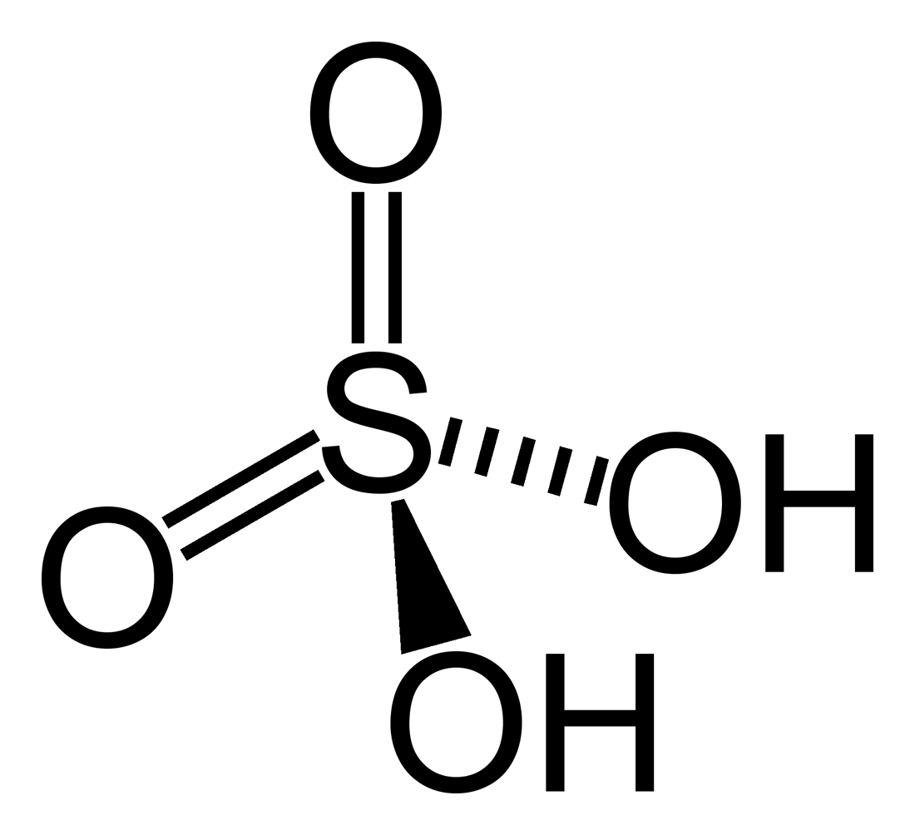
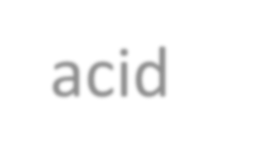
Structure of Sulphuric acid
It is a dibasic acid means it can donate to protons in aqueous medium the H atoms those are directly bonded with oxygen atom are metal replaceable & come as H⁺ in water

Slide 32
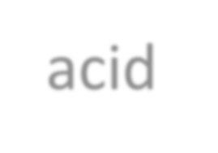
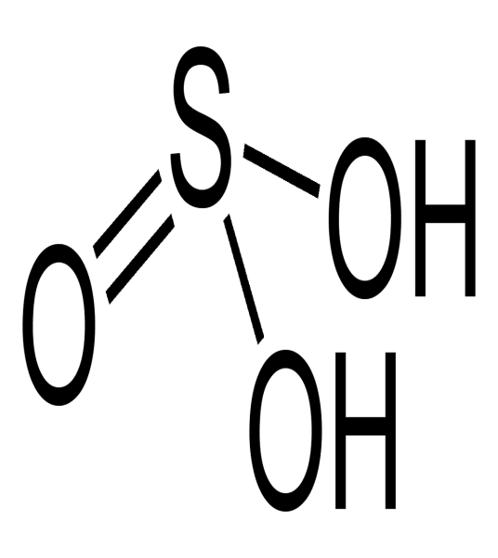
Structure of sulphurous acid
It is also dibasic acid like sulphuric acid but it has one lone pair of electrons on the S atom, due to this it can act as a reducing agent. it

Slide 33
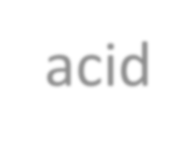
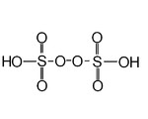
Peroxydisulphuric acid
It is also known as Marshall’s acid. It has one peroxide linkage. It a power ful oxidising agent.

Slide 34
THE END

