Slide 1
CHEMISTRY OF
D-BLOCK ELEMENTS
Dr. N. Vijaya Kumar Lecturer in Chemistry DNR College (A)

Slide 2
Chemistry of d-block elements
Position of d-block in periodic table
Electronic configuration
Trends in properties of these elements w.r.t. -
size of atoms & ions
reactivity
catalytic activity
oxidation state
complex formation ability
colour
magnetic properties
nonstoichiometry
density, melting & boiling points.

Slide 3
Introduction
In the periodic table the d block consist of the elements of group 3 to 12.
The d orbital of the d-block elements in four periods are filled.
The three series of the transition metals are 3d series from Sc to Zn, 4d series from Y to Cd and 5d series from La to Hg.
The fourth 6d series begins from Ac and is incomplete till now.

Slide 4
Position of d-block in periodic table
The elements with incompletely filled d-subshell in their ground state or most stable oxidation state are named as d-block elements.
They are additionally named as transition elements.
The partially filled subshells incorporate the (n-1) d subshell.
All the d-block elements have a similar number of electrons in the furthest shell.
Consequently, they indicate comparable chemical properties.

Slide 5
Position of d-block in periodic table
The transition elements are set amongst S and P block elements in the periodic table.
They begin from the fourth period of the long type of periodic table.

Slide 7
Electronic Configuration
The external electronic configuration stays consistent.
Be that as it may, an electron is added to the penultimate shell till the d-subshell achieves its full limit.
There are three series of elements relying upon the n-1 d orbital that is being filled.
The orbitals are dispatched altogether of their expanding energy i.e. an orbital of lower energy is filled first.
Therefore 4s orbital with lesser energy is filled first to its full degree then the 3d orbital with higher energy is filled.
The precisely half-filled and totally filled d-orbitals are extraordinarily stable.

Slide 8
Electronic Configuration
The electronic configuration of the first series can be represented as 1s²2s²p⁶ 3s²p⁶d¹⁻¹⁰ 4s²
The electronic configuration of the second series can be represented as 1s²2s²p⁶ 3s²p⁶d¹⁻¹⁰ 4s²p⁶d¹⁻¹⁰ 5s²
The electronic configuration of the third series can be
represented as 1s²2s²p⁶
_{3s}2_{p}6_{d}1-10 _{4s}2_{p}6_{d}1-
10 _{5s}2_{p}6_{d}1-10 _{6s}2

Slide 9
Electronic Configuration
Exceptional Electronic Configuration of:
Ni: [Ar] 4s¹ 3d⁹
Pt: [Xe] 6s¹ 5d⁹
Pd: [Kr] 4d¹⁰ 5s⁰

Slide 10
Reactivity
As we go from the top left to the bottom right corner of the d block, electronegativities generally increase, densities and electrical and thermal conductivities increase, and enthalpies of hydration of the metal cations decrease in magnitude
Consistent with this trend, the transition metals become steadily less reactive and more “noble” in character from left to right across a row.
Most of the transition elements react with mineral acids and liberate
hydrogen gas
They are mostly having high ionization potential and are in general
less reactive.

Slide 11
Catalytic activity
The rate of chemical reaction increase by decrease in energy of activation of the reactant. This decrease is caused by the catalyst, probably altering the path of reaction.
Bonds are formed between reactant molecules and atoms on the surface of the
catalyst (first row transition metals uses 3d and 4s-electrons for bonding).
This results in the formation of reaction intermediates which provides the lower
activation energy and therefore, increases the rate of the reaction.
These reaction intermediates decompose to form the product and regenerate the catalyst. Many transition metals are used as catalysts for reactions. Fe, Co, Pt, Cr, Mn, etc., are the commonly used transition metal catalysts.

Slide 12
i) Due to variable oxidation states of transition metals they can absorb and re-emit a wide range of energies. Thus, they can provide necessary activation energy.
Catalytic property of 3d series elements also explained as follow.
iii) Transition metals possess free valencies on the surface. Hence, they can adsorb the reacting molecules.
Thus, the concentration of the reactants increases on the surface. This increases the rate of reaction.

Slide 13
Many transition elements show catalytic activity
Metalloenzymes – are biological catalysts require metal ions for their activity.
that
Nitrogenase enzyme contains Fe and Mo, haemoglobin contains Fe (II) and Ribonuleotide reductase consists of Co

Slide 14
Oxidation state
All the transition elements, aside from the first and last individuals from the series, display various oxidation states.
They indicate variable valency in their compounds.
Some fundamental oxidation conditions of the primary, second and third transition series elements are given beneath in tables.

Slide 15
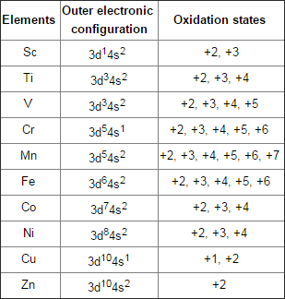
Oxidation States of 3d Series

Slide 16
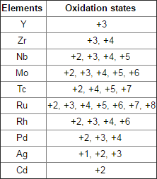
Oxidation States of 4d Series

Slide 17
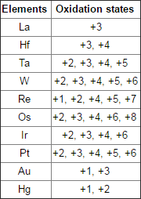
Oxidation State of 5d Series

Slide 18
Size of Atoms and Ions
Generally the sizes of atoms/ions of the elements go on decreasing
from left to right across the rows in the transition series, as –
The extra nuclear charge increases as atomic number increases
The extra electrons are added into the same d-shell
d-shell electrons are having poor shielding effect.
The size of atoms and ions goes on increasing from the first
transition series elements in the groups of transition elements.
The atomic and ionic size goes on increasing from top to bottom
due to addition of new shell every time.
This is applied in the Sc group.
The electrons filled into the antipenultimate 4f shell of lanthanides, which causes steady decrease in size called as Lanthanide contraction.

Slide 19
Causes for Variable Oxidation States
The valence electrons of the transition elements are in (n-1) d and ns orbitals which have a little distinction in energies. Both energy levels can be utilized as a part of bond development.
They demonstrate the +2 oxidation state because of the 2 electrons
in ns orbitals when the electrons of (n-1) d stay unaffected.
The higher oxidation state from +3 to +7 is because of the utilization of all 4s and 3d electrons in the transition series of elements. In the excited state, the (n-1) d electrons get to be bonding and give the variable states to the iota.
Subsequently, the variable oxidation state is because of the support
of both ns and (n-1) d orbitals in bonding.

Slide 20
Important features of oxidation state of transition metals
The most basic oxidation condition of 3d series is
+2 with the exception of scandium, because of the loss of two ns electrons.
This demonstrates d orbitals are more stable than s orbitals after scandium.
The ionic bonds are by and large framed in +2 and +3 state while the covalent bonds are shaped in higher oxidation states.
Covalent bonds are framed by the sharing of d- electrons. For instance permanganate particle MnO4–, all bonds shaped amongst manganese and oxygen is covalent.

Slide 21
The most noteworthy oxidation state increments with expanding nuclear number of element, achieves greatest in the center and after that begins diminishing as appeared in the table.
For instance, Iron demonstrates the normal oxidation condition of
+ 2 and + 3, however ruthenium and osmium in a similar group shape compounds in the +4, + 6 and + 8 oxidation states.
The elements in the start of the series display less oxidation state in view of having smaller number of electrons to lose or contribute. The elements amidst the series demonstrate the best number of oxidation.
For instance; Mn demonstrates all the oxidation states from +2 to
+7. The most elevated oxidation state appeared by any transition
metal is eight which is demonstrated by Ru and Os.

Slide 22
Complex formation ability
Formation of Complex Compounds
The cations of transition metals have great tendency to form complexes with several molecules or ions called ligands.
The bonds involved in the formation of complexes are coordinate and hence the complexes are called coordinate complexes.
The structure of these complex ions is linear, square, planar, tetrahedral, octahedral depending upon nature of hybridization of metal ions.

Slide 23
The highly electronegative and basic ligand like F⁻, Cl⁻ can form complexes with transition metals even though there are in high oxidation states due to the presence of small, highly charged or neutral ligands with lone pair of electrons that can form strong sigma bond by donating a lone pair of electrons.
In a transition series the stability of complexes increases with the rise in atomic number.
The transition metal atom reveals multiple oxidation state; the higher valent ion forms more stable complexes.

Slide 24
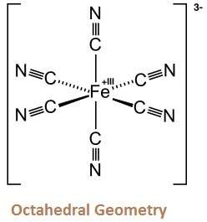
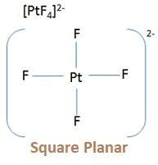
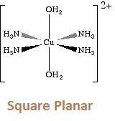
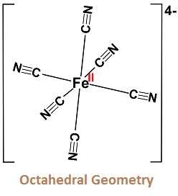
[Fe (CN)6]^{3–}
[PtCl4]^{2–}
[Cu(NH3)4]²⁺
[Fe(CN)6]^{4–}

Slide 25
The transition metals are found to form complexes due to the factors –
Small size and high charge on the metal ions
Availability of vacant low ‘d’ orbitals to accept lone pair of electrons donated by other group of ligands.
Availability of variable oxidation state
Ability to form pi bonds – multiple bonding

Slide 26
Colour
Most d-block metal compounds are coloured in their solid or liquid
states.
In the case of transition metal ions, under the influence of ligands, the degeneracy of the 5 d-orbitals is lost and they separate into two distinct energy levels.
e_{g} set: d _{x2- y2} and d_{z2} orbitals
t_{2g} set: d_{xy}, d_{xz} and d_{yz} orbitals
In the transition metal particles, the electrons can be advanced from
one energy level to another energy level in a similar d-subshell.
This process is called d-d-transition.
By this property just transition elements indicates color.

Slide 27
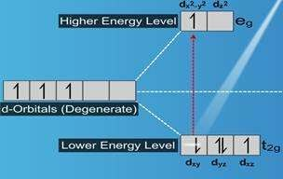
Colour
When white light is incident on a transition metal ion, the electron in the lower energy d-orbital set absorbs certain radiations and gets promoted to a d-orbital set of higher energy.
The transmitted radiation devoid of
the absorbed complementary absorbed light.
radiations is the colour of the
This complementary colour is the
colour of the substance.

Slide 28
Oxidation states of metal ions and their colour
No. of unpaired electrons | Oxidation state and colour of the compound formed by ion
0 | Ti ^{4+,} Cu+, Zn ²⁺ (colourless)
1 | Ti ³⁺ (Purple), V⁴⁺, Cu ²⁺ (blue)
2 | V 3+, Ni ²⁺ (green)
3 | V ²⁺, Cr ³⁺ (violet)
4 | Cr ²⁺ (blue), Mn ³⁺ (violet), Fe ²⁺ (green)
5 | Mn ²⁺ (pink), Fe ³⁺ ⁽yellow)

Slide 29
Magnetic properties
The magnetic properties of d-Block Elements are dictated by the number of unpaired electrons in it.
There are two fundamental sorts of substances.

Slide 30
Magnetic properties

Slide 31
Magnetic properties
(i) Paramagnetic substances
The paramagnetic character emerges in view of the nearness of unpaired electrons. Paramagnetic substances are the substances which are pulled in by the magnetic field.
(ii) Diamagnetic Substances
Diamagnetic character emerges as a result of the nonappearance of unpaired electrons. Diamagnetic substances are the substances which are repulsed by the magnetic field.

Slide 32
Magnetic properties
A large portion of the transition elements and their compounds are paramagnetic and are pulled in by the magnetic field.
More prominent the number of unpaired electrons in the substance more noteworthy is the paramagnetic character; the magnetic character of a substance is expressed as magnetic moments.
Bigger the magnetic moment's value, the more noteworthy is the paramagnetic character.

Slide 33
Magnetic properties
Notwithstanding paramagnetic and diamagnetic substance, there are a couple of substances, for example, iron which is exceedingly magnetic when contrasted with other metals.
These substances are known as Ferromagnetic Substances.
The Gouy method is used to measure magnetic suceptibilities.
(4.2 from book)

Slide 34
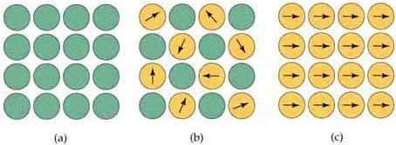
Magnetic properties
Types of magnetic behavior:
Diamagnetic; no centers (atoms or ions) with magnetic
moments.
Simple paramagnetic; centers with magnetic moments are not
aligned unless the substance is in a magnetic field.
Ferromagnetic; coupled centers aligned in a common direction.

Slide 35
Nonstoichiometry
Transition elements is the formation of non-stoichiometric compounds
A compound in which the constituent ions are not exactly in the same ratio as indicated by chmeical formula of the compound is known as non-stoichiometric compound and the phenomenon is known as stoichiometry.
Transition elements form compounds are manily stoichiometric due to presence of variable oxidation state of metal ions and also due to defects in the crystal littice.
This gives rise to semiconductivity in these compounds.

Slide 36
Density
The nuclear volume of transition elements is much lower than those of S and P block elements.
This is a result of the filling of the (n-1)d orbitals that cause an expansion in the atomic charge and pulls the electrons internally. This leads to a diminishment in nuclear volume.
With the decline in the nuclear volume, the nuclear thickness of these elements increments.
Osmium consists of the highest density.

Slide 37
In a given transition series, the thickness increments in moving over the period and achieves the greatest value at group VIII.
The thickness increases as we move down the group.
The nuclear sizes of elements of the second and third transition series are approximately same, yet their nuclear weights increment to almost double and the densities of elements of third transition series are by and large twice of the corresponding second transition series.

Slide 38
Melting & boiling points
Melting and Boiling Points
They indicate high melting and boiling points.
This can be credited to the nearness of solid metallic bonding because of the overlapping of (n-1)d orbitals and covalent bonding of the unpaired d orbital electrons.
Since Zn, Cd and Hg have totally filled (n-1)d orbitals they are not anticipated that they would frame covalent bonds.
Thus, they demonstrate lower melting point as compared to
other d-block elements.

Slide 39
Summary
All transition-metal cations have d^{n} electron configurations; the ns electrons are constantly lost before the (n − 1) d electrons.
Transition metals are described by the presence of different oxidation states.
Most transition-metal compounds are paramagnetic
The most astounding conceivable oxidation state, relating to the formal loss of all valence electrons, turns out to be progressively less stable as we go from group 3 to group 8, and it is never seen in later groups.

Slide 40
Thank You

