Slide 1
Benzene and Its Reactivity
Dr. N. Vijaya Kumar Lecturer in Chemistry DNR College (A)
1

Slide 2
Background
Benzene (C₆H₆) is the simplest aromatic hydrocarbon (or arene).
Four degrees of unsaturation.
It is planar.
All C—C bond lengths are equal.
Whereas unsaturated hydrocarbons such as alkenes, alkynes and dienes
readily undergo addition reactions, benzene does not.
Benzene reacts with bromine only in the presence of FeBr₃ (a Lewis acid),
and the reaction is a substitution, not an addition.
2

Slide 3
Background
August Kekulé (1865) proposed that benzene was a rapidly equilibrating mixture of two compounds, each containing a six-membered ring with three alternating π bonds.
All C—C bond lengths are equal!
James Dewar (1967) : the Dewar benzene was prepared in 1962 but it is not stable and it converts to
benzene
3

Slide 4
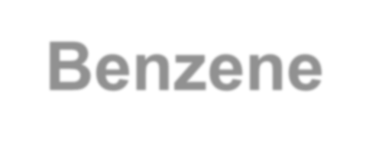
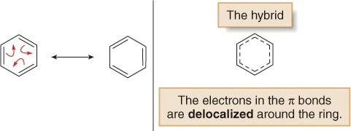
The Structure of Benzene: Resonance
The true structure of benzene is a resonance hybrid of the two Lewis structures.

Slide 5
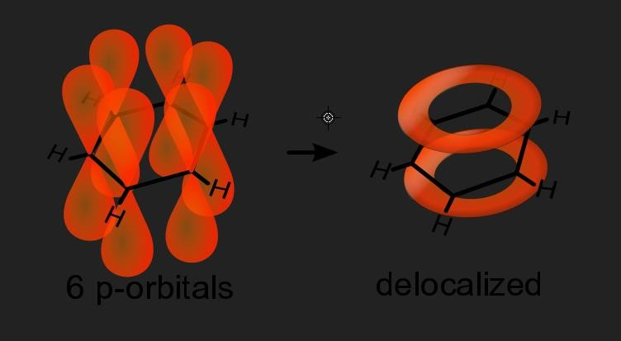
The Structure of Benzene: MO

Slide 6
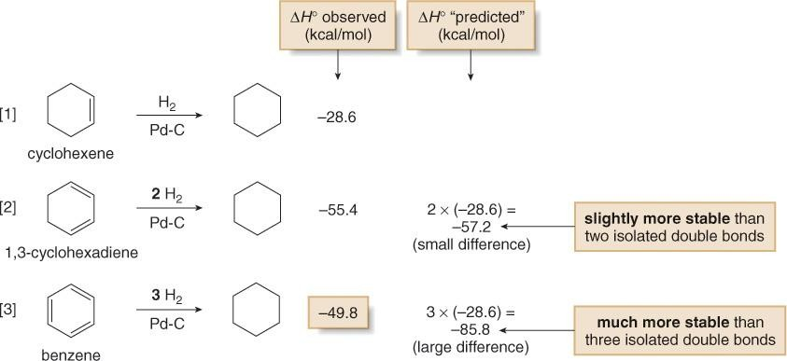
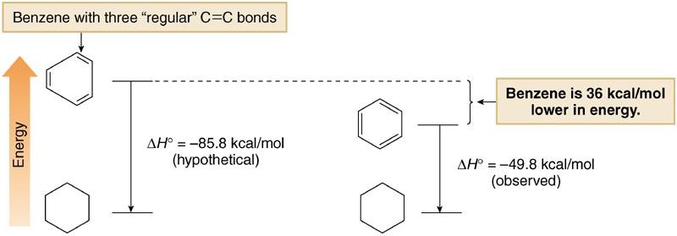
Aromaticity – Resonance Energy

Slide 7
Stability of Benzene - Aromaticity
Benzene does not undergo addition reactions typical of other highly unsaturated compounds, including conjugated dienes.

Slide 8
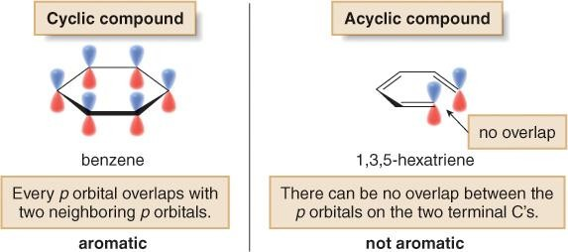
The Criteria for Aromaticity
Four structural criteria must be satisfied for a compound to be aromatic.
[1] A molecule must be cyclic.

Slide 9
The Criteria for Aromaticity
[2] A molecule must be completely conjugated (all atoms sp²).
[3] A molecule must be planar.

Slide 10
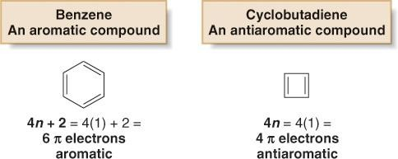
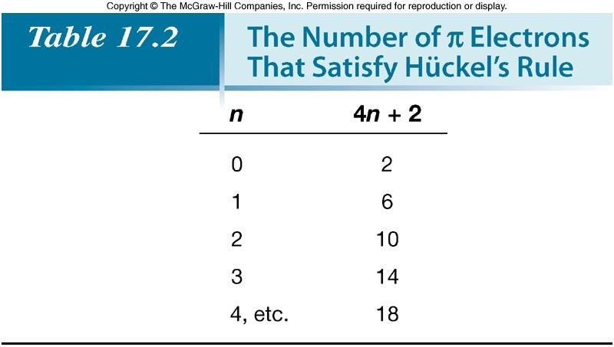
The Criteria for Aromaticity—Hückel’s Rule
[4] A molecule must satisfy Hückel’s rule.

Slide 11
The Criteria for Aromaticity—Hückel’s Rule
Aromatic—A cyclic, planar, completely conjugated compound with 4n + 2
π electrons.
Antiaromatic—A cyclic, planar, completely conjugated compound with 4n
π electrons.
Not aromatic (nonaromatic)—A compound that lacks one (or more) of the following requirements for aromaticity: being cyclic, planar, and completely conjugated.

Slide 12
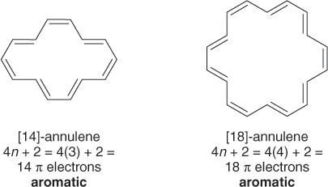
Examples of Aromatic Rings
Cyclooctatetraene
8 π electrons
planar antiaromatic
puckered nonaromatic

Slide 13
Polycyclic Aromatic Hydrocarbons
biphenyl terphenyl No interactions
between rings
naphthalene 61 kcal/mol
anthracene 84 kcal/mol
phenanthrene
92 kcal/mol
1.36 Å
1.40 Å

Slide 14
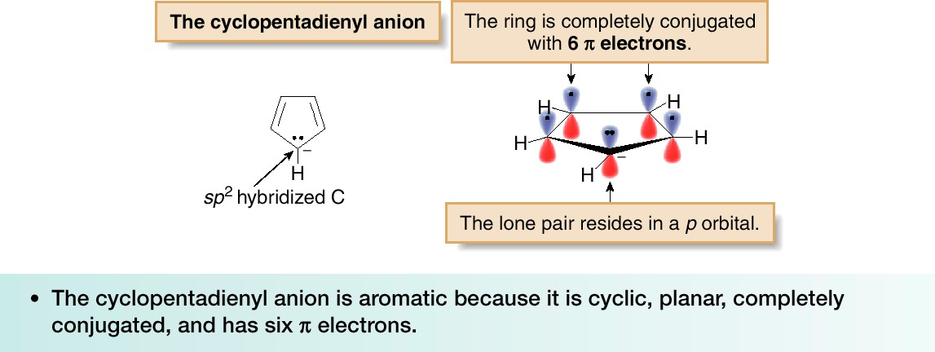
Other Aromatic Compounds

Slide 15
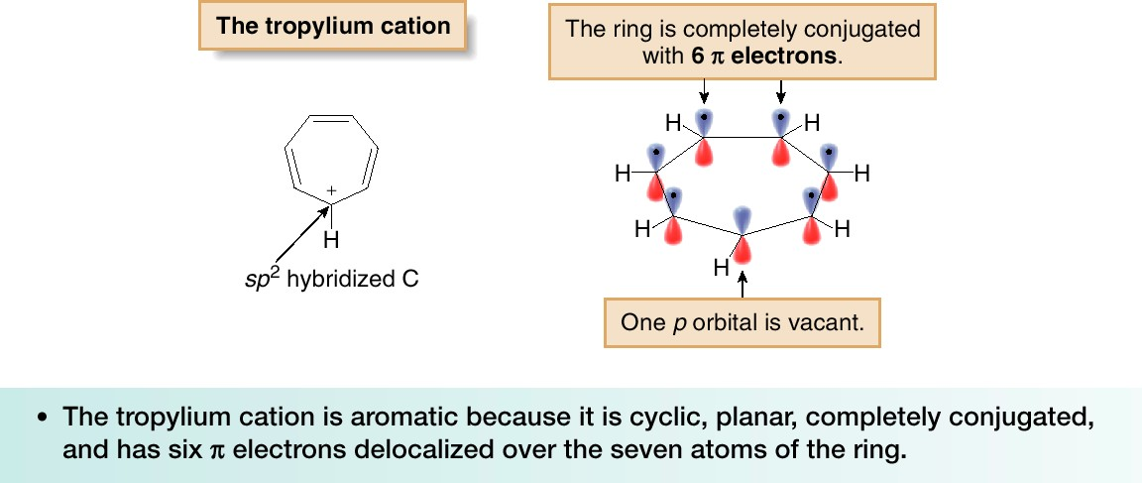
Other Aromatic Compounds

Slide 16
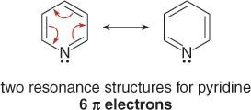
Aromatic Heterocycles
2H-pyran
4 π electrons nonaromatic
2H-pyrilium ion 6 π electrons aromatic
16

Slide 17
Aromatic Heterocycles
furan
thiophen
17

Slide 18
Nomenclature: 1 Substituent
Systematic:
Common:
19

Slide 19
Nomenclature: 2 Substituents
Identical:
1,2-dibromobenzene
o-dibromobenzene
Different:
1,3-dibromobenzene
m-dibromobenzene
1,4-dibromobenzene
p-dibromobenzene
20

Slide 20
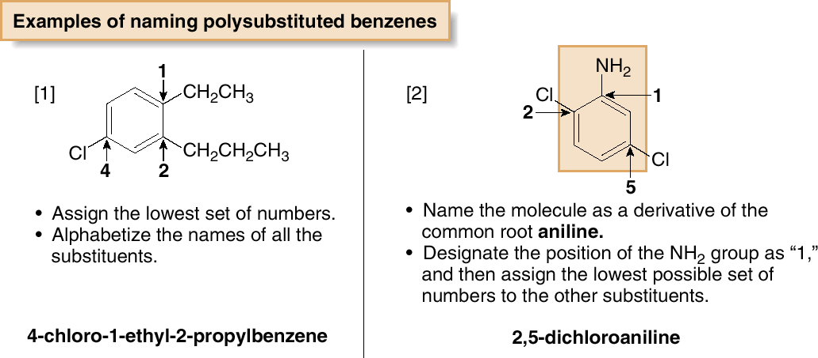
Nomenclature: 3 or More Substituents

Slide 21
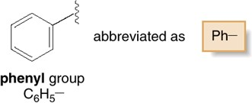
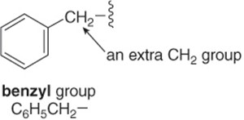
Nomenclature
A benzene substituent is called a phenyl group, and it can be abbreviated in a structure as “Ph-”.
The benzyl group:
Aryl groups:

Slide 22
Interesting Aromatic Compounds
Benzene and toluene, are obtained from petroleum refining and are
useful starting materials for synthetic polymers.
Compounds containing two or more benzene rings that share carbon— carbon bonds are called polycyclic aromatic hydrocarbons (PAHs). Naphthalene, the simplest PAH, is the active ingredient in mothballs.

Slide 23
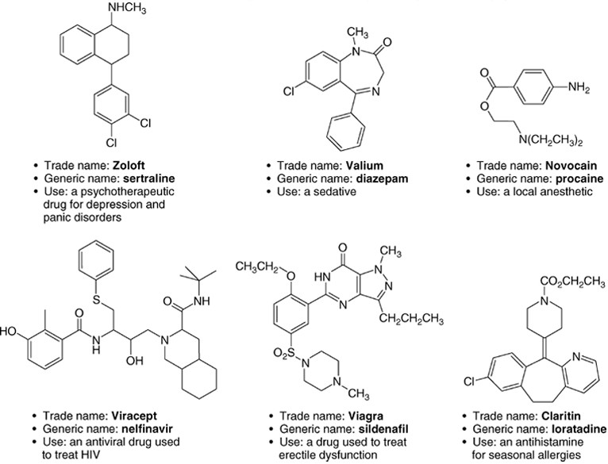
Interesting Aromatic Compounds

Slide 24
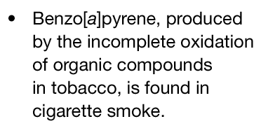
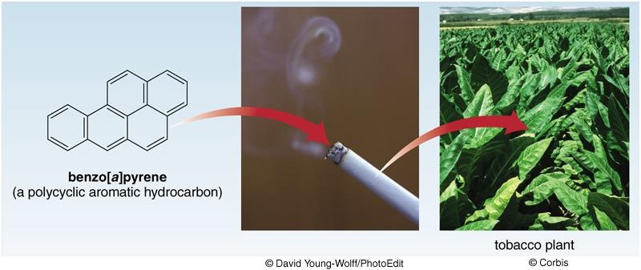
Interesting Aromatic Compounds
When ingested or inhaled, benzo[a]pyrene and other similar PAHs are
oxidized to carcinogenic products.
25

Slide 25
Electrophilic Aromatic Substitution

Slide 26
Introduction

Slide 27
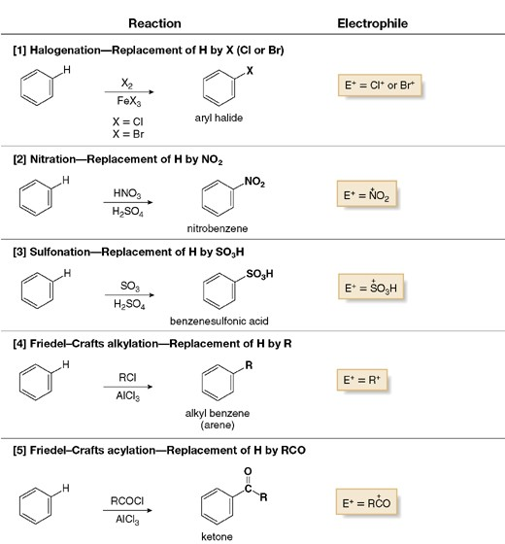
Introduction

Slide 28
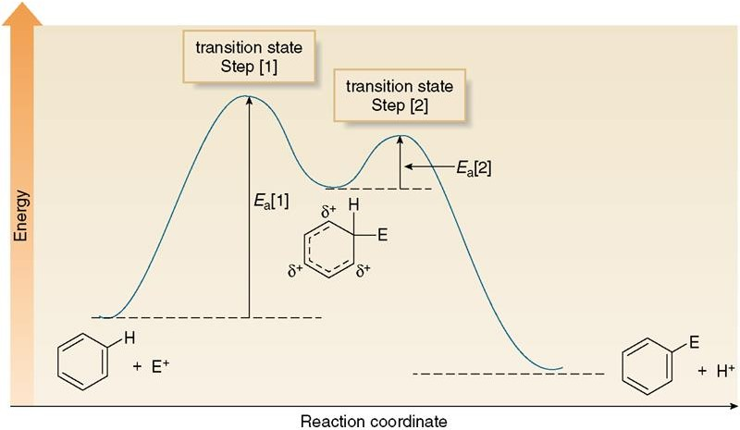
Mechanism

Slide 29
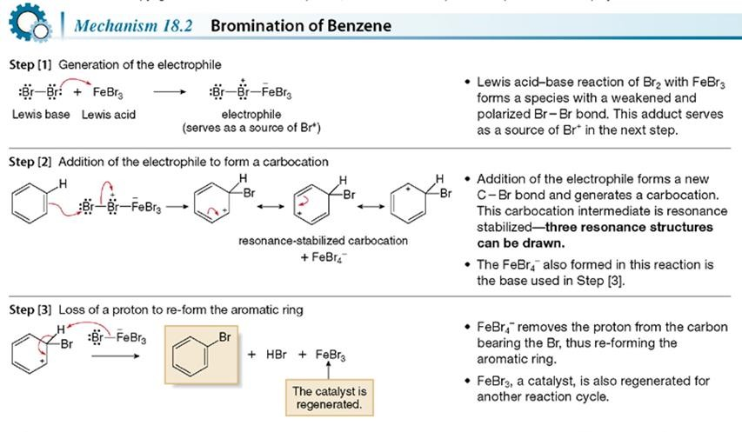
Halogenation

Slide 30
Nitration

Slide 31
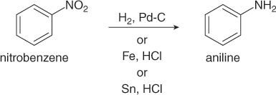
Nitro Group Reduction
Aromatic nitro groups (NO₂) can readily be reduced to amino groups (NH₂) under a variety of conditions.

Slide 32
Sulfonation

Slide 33
Friedel-Crafts Alkylation
Best with 2ry and 3ry halides

Slide 34
Friedel-Crafts Alkylation
Other functional groups that form carbocations can also be used as starting materials.

Slide 35
Limitations
[1] Vinyl halides and aryl halides do not react in Friedel-Crafts alkylation.
[2] Disubstituted products are obtained in F.-C. alkylations, but not in acylations.
More reactive
than benzene

Slide 36
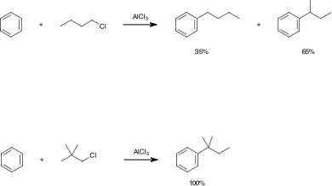
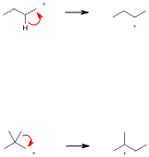
Limitations
[3] Rearrangements can occur.
1ry less stable
2ry more stable
1ry less stable
3ry more stable
40

Slide 37
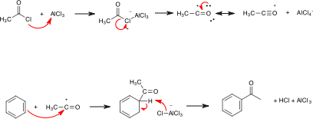
Friedel-Crafts Acylation

Slide 38
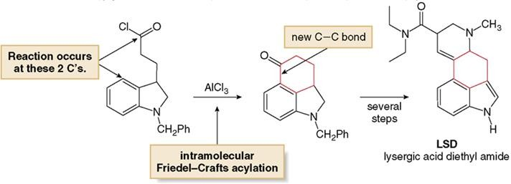
intramolecular Friedel-Crafts reactions.

Slide 39
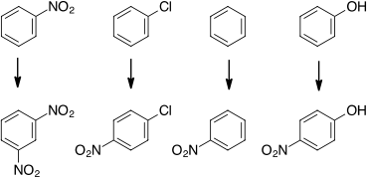
Nitration of Substituted Benzenes
Relative
rates
6 x 10⁻⁸
0.033
1
1000
Substituents modify the electron density in the benzene ring, and this affects the course of electrophilic aromatic substitution.

Slide 40
Substituted Benzenes
Inductive effects (through σ bonds):
- I
+ I
- I | -NH3⁺ -CF3 | -NH2, -NHR -NR2 | -OH -OR | -F -Cl -Br -I | -CHO -COR -COOH -COOR | -CN | SO3H SO2R | -NO2
+ I | -CH3 -Alkyl -SiR3 | 44

Slide 41
Substituted Benzenes
Resonance effects (through π bonds) are only observed with substituents containing lone pairs or π bonds.
Substituents containing lone pairs are electron donating (+ R)
δ+
δ-
Substituents –Y=Z (C₆H₅-Y=Z), where Z is more electronegative than Y are
electron accepting (- R)
δ-
δ+

Slide 42
Substituted Benzenes: Activation
 |  | + R |  |  | - R
 |  | +R > -I |  | -I >+R
- I | -NR3+ CF3 | -NH2, -NHR -NR2 | -OH -OR | -F -Cl -Br -I | -CHO -COR -COOH -COOR | CN | SO3H SO2R | -NO2
+ I | -CH3 -Alkyl -SiR3
Substituents that increase the electron density on the ring activate the ring towards electrophiles. Substituents that decrease the electron density on the ring deactivate the ring towards electrophiles.
To predict whether a substituted benzene is more or less electron rich than benzene itself, we must consider the net balance of both the inductive and resonance effects.

Slide 43
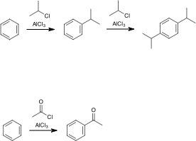
Substituted Benzenes: Activation
More reactive than benzene
Less reactive
than benzene

Slide 44
Substituted Benzenes: Orientation
+R > -I (-OR, -NR2 ): activating, o- p- directing
30%
traces
70%
-I > +R (-F, -Cl, -Br, -I ): deactivating, o- p- directing
35%
traces
65%
-I, -R (-NO₂, -SO3H, -CN, -COR): deactivating, m- directing.
5%
90%
5%
48

Slide 45
Substituted Benzenes: Orientation
+ I: activating, -o -p directing (same as + R)
58%
5%
37%
- I: deactivating, -m directing (same as - R)
6%
91%
3%

Slide 46
Substituted Benzenes: Orientation
The new group is located either ortho, meta, or para to the existing substituent. The resonance effect of the first substituent determines the position of the second incoming substituent
+R
orto
para
-R
meta

Slide 47
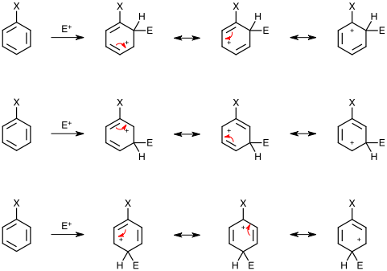
Substituted Benzenes: Orientation

Slide 48
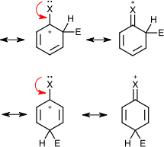
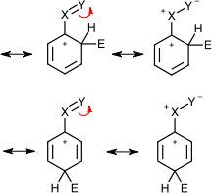
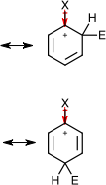
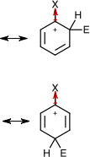
Substituted Benzenes: Orientation
+ R
-o, -p intermediates are resonance stabilised
- R
-o, -p intermediates are resonance destabilised
+ I
-o, -p intermediates are inductively stabilised
- I
-o, -p intermediates are inductively destabilised

Slide 49
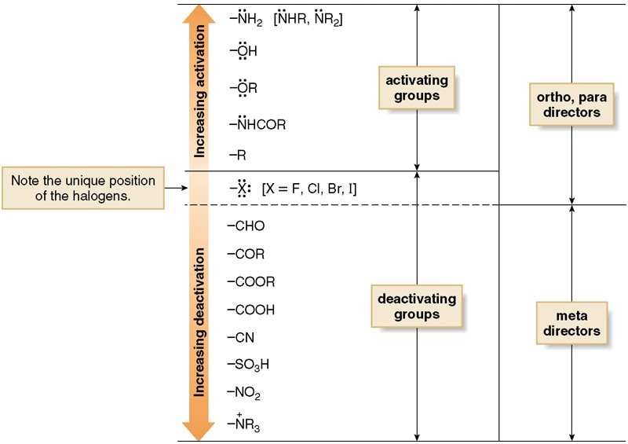
Substituent Effects. Summary

Slide 50
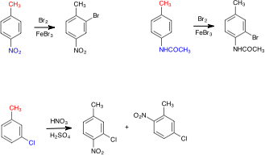
Disubstituted Benzenes
sterically
hindered

Slide 51
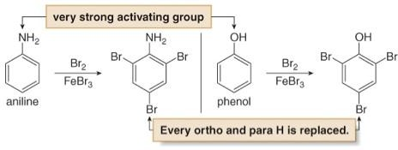
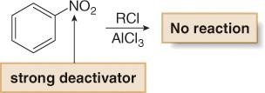
Further Examples

Slide 52
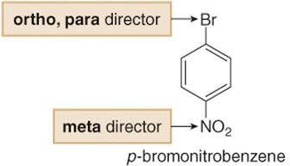
Synthesis of Polysubstituted Benzenes

Slide 53
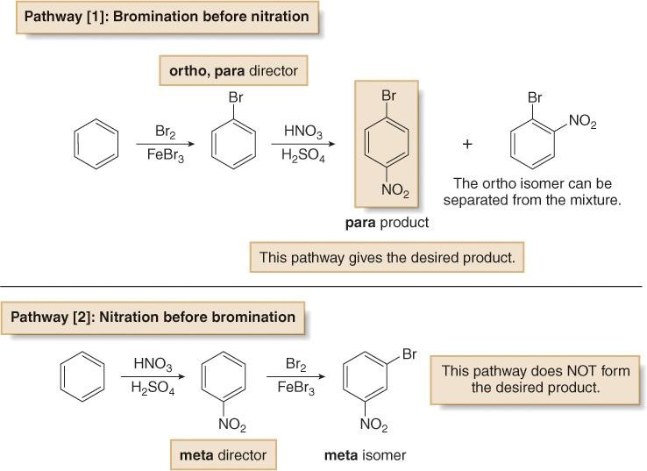
Synthesis of Polysubstituted Benzenes

Slide 54
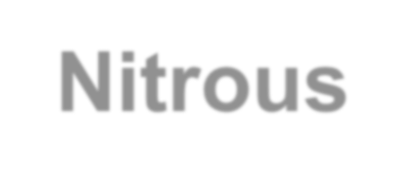
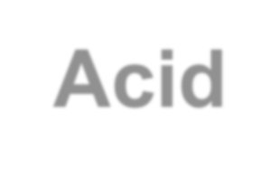
Reaction of Amines with Nitrous Acid

Slide 55
Reaction of Amines with Nitrous Acid
1. generation of the electrophile
nitrosonium ion
2. nitrosation
N-nitrosamine
3. acid-catalysed elimination
diazonium ion

Slide 56
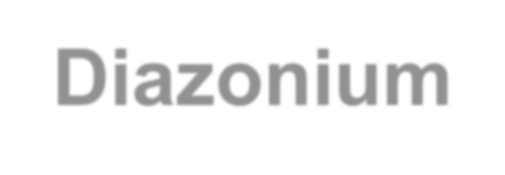
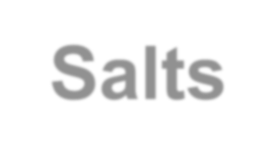
Substitution Reactions of Aryl Diazonium Salts
Aryl diazonium salts react with a variety of reagents to form products in
which a nucleophile Z replaces N₂, a very good leaving group.
The mechanism of these reactions varies with the identity of Z.

Slide 57
Substitution Reactions of Aryl Diazonium
Salts
A diazonium salt reacts with hypophosphorus acid to form benzene. This reaction is useful in synthesizing compounds that have substitution patterns that are not available by other means.
Cu₂O

Slide 58
Substitution Reactions of Aryl Diazonium
Salts
This is called the Sandmeyer reaction. It provides an alternative to direct chlorination and bromination of the aromatic ring using Cl₂ or Br₂ and a Lewis acid catalyst.
Since the cyano group can be converted into a variety of other functional groups, this reaction provides easy access to a wide variety of benzene derivatives.
64

Slide 59
Substitution Reactions of Aryl Diazonium
Sal
ts
This is a useful reaction because aryl fluorides cannot be produced by
direct fluorination with F₂ and a Lewis acid catalyst.
This is a useful reaction because aryl iodides cannot be produced by direct iodination with I₂ and a Lewis acid catalyst.

Slide 60
Substitution Reactions of Aryl Diazonium Salts
Diazonium salts provide easy access to many different benzene derivatives. Keep in mind the following four-step sequence, because it will be used to synthesize many substituted benzenes.

Slide 61
Substitution Reactions of Aryl Diazonium Salts

Slide 62
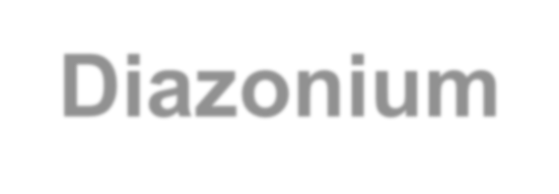
Coupling Reactions of Aryl Diazonium Salts
When a diazonium salt is treated with an aromatic compound activated by a strong electron-donor group, a substitution reaction takes place giving an azo compound.
Mechanism:
The para position is preferred for steric reasons

Slide 63
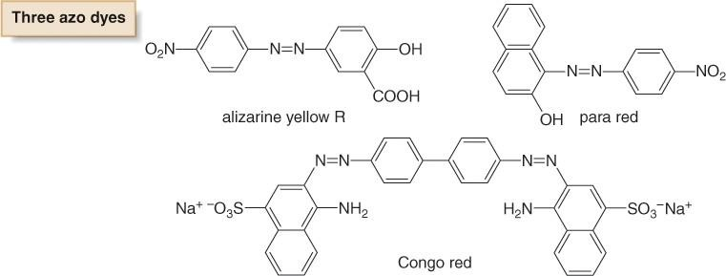
Azo Dyes
Azo compounds are highly conjugated, rendering them colored. Many of these compounds are synthetic dyes. Butter yellow was once used to color margarine.

Slide 64
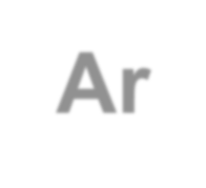
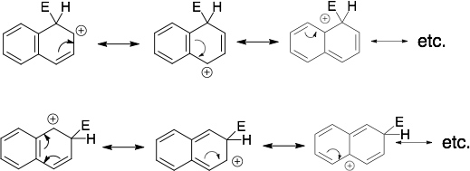
S_{E}Ar in Polyciclic Aromatic Compounds
aromatic
aromatic
not aromatic
aromatic

Slide 65
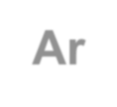
Nucleophilic Aromatic Substitutions, S_{N}Ar
Z = Electron Accepting Substituent (sigma or π: NO₂, CN, N₂⁺, SO₂R)
X = Leaving Group
Example

Slide 66
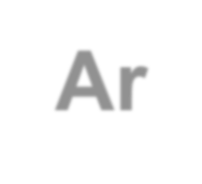
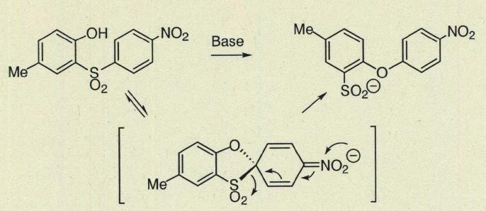
Examples of S_{N}Ar
1)
2)

Slide 67
Examples of S_{N}Ar
3)

Slide 68
Benzyne
Orbitals overlap

Slide 69
Side Chain Reactivity: Radical Halogenation
Benzylic C—H bonds are weaker than most other sp³ hybridized C—H bonds, because homolysis forms a resonance-stabilized benzylic radical.

Slide 70
Side Chain Reactivity

Slide 71
Side Chain Reactivity: Oxidation

Slide 72
Side Chain Reactivity: Reduction

Slide 73
Thank You

