Slide 1
The Toxic Tango: Unmasking the Dance of Air Pollution
G CHINNARAO

Slide 2
Unmasking the deadly embrace of air pollution and human health. Let's explore the intricate steps of this hazardous dance.

Slide 3

Invisible Threat
Invisible yet pervasive, air pollution silently inﬁltrates our lives. It's time to shed light on this stealthy adversary.

Slide 4

Pollutants Unveiled
From particulate matter to volatile organic compounds, a diverse cast of pollutants takes the stage in this toxic tango.

Slide 5
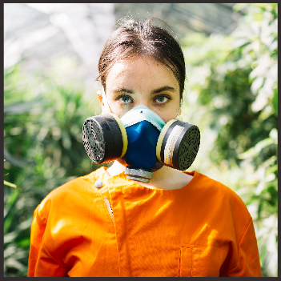
Human Impact
The toll on human health and the environment is profound. Let's uncover the devastating effects of air pollution on our world.

Slide 6

Dance of Solutions
Join the movement to combat air pollution. From policy changes to individual actions, together we can choreograph a cleaner, healthier future.

Slide 7
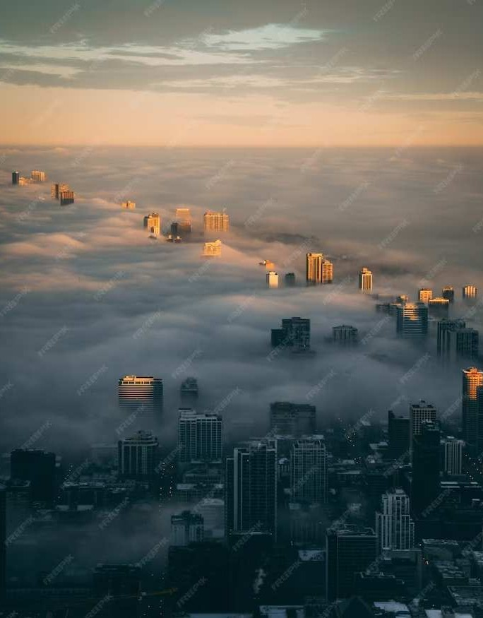
The Final Bow
As the curtain falls on our exploration, let's remember that the ﬁght against air pollution continues. Together, we can create a world where clean air takes center stage.

Slide 8
Thanks!
G CHINNARAO

