Slide 1

Understanding the Impact of Greenhouse Gases on Climate Change: A Comprehensive Analysis
A PRESENTATION BY CHINTA HEMASUNDAR

Slide 2

Introduction
The greenhouse gases are key drivers of climate change, impacting global temperatures and weather patterns. This presentation will provide a comprehensive analysis of their effects on the environment and society.

Slide 3


Greenhouse Gases 101
Understanding the role of carbon dioxide, methane, and nitrous oxide in trapping heat in the atmosphere is crucial for addressing climate change. This slide will explore their sources and
impacts.

Slide 4

Impact on Global Temperature
Rising levels of greenhouse gases contribute to the warming of the Earth's surface. This slide will delve into the correlation between greenhouse gas emissions and global temperature rise, backed by scientiﬁc evidence.

Slide 5
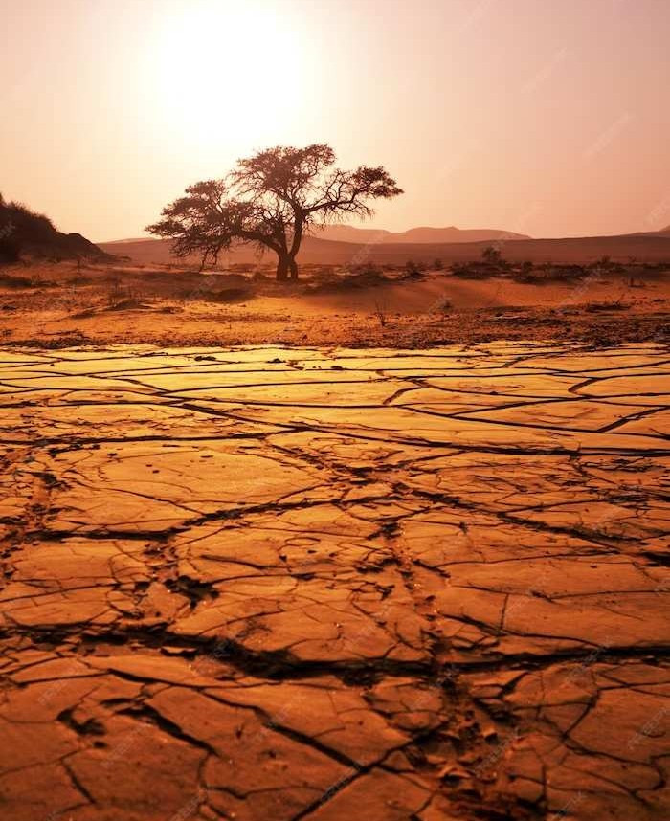

E treme Weather Events
The intensiﬁcation of hurricanes, droughts, and heatwaves can be linked to the increased concentration of greenhouse gases in the atmosphere. This slide will analyze the connection between these events and climate change.

Slide 6


Ocean Acidiﬁcation
Rising levels of carbon dioxide are causing the oceans to become more acidic, posing a threat to marine life and ecosystems. This slide will highlight the consequences of ocean acidiﬁcation due to greenhouse gas
emissions.

Slide 7

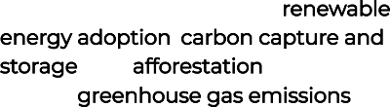
Mitigation Strategies
Effective measures such as renewable energy adoption, carbon capture and storage, and afforestation can help reduce greenhouse gas emissions. This slide will explore these strategies and their potential impact.

Slide 8


Policy Implications
Addressing greenhouse gas emissions requires international cooperation and policy interventions. This slide will discuss the role of policy frameworks, carbon pricing, and global agreements in combating climate change.

Slide 9
Conclusion
Understanding the complex relationship between greenhouse gases and climate change is essential for informed decision-making and collective action. This presentation has provided a comprehensive analysis of their impact on the environment and society.

Slide 10

Thanks!
CHINTA HEMASUNDAR

