Slide 1
BONDING IN METALS
Dr. N. Vijaya Kumar Lecturer in Chemistry DNR College (A)

Slide 2
Metals in periodic table
Currently, scientists know of 118 different elements.
About 91 of the 118 elements in the periodic table are metals.
There are 17 non metals in the periodic table ; most are gases (hydrogen, helium, nitrogen, oxygen, fluorine, neon, chlorine, argon, krypton, xenon and radon); one is a liquid (bromine); and a few are solids (carbon, phosphorus, sulfur, selenium, and iodine)..
The metalloids: boron (B), silicon (Si), germanium (Ge), arsenic (As), antimony (Sb), tellurium (Te), polonium (Po) and astatine (At) are the elements found step like line between metals and non metals.

Slide 3
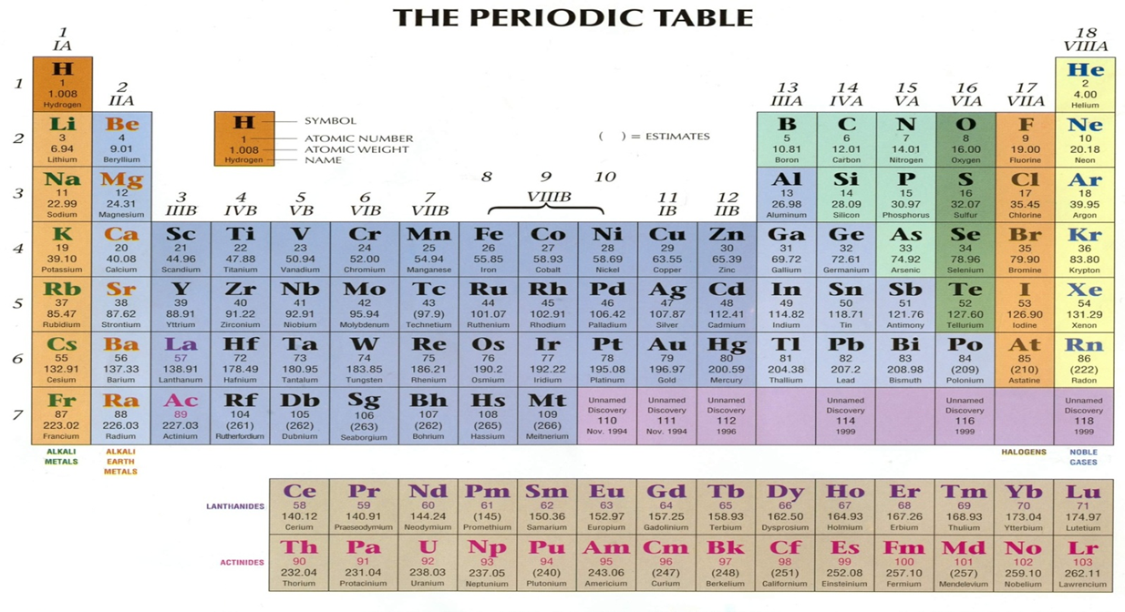

Slide 4
Characteristics of metals
Metals possess a peculiar shine on their surface called the metallic lustre
Metals have high density and are hard substances.
Metals have high melting point and boiling point.
Metals are good conductors of heat.
Metals have high electric conductivity which decreases with temperature.
Metals have high elastic.

Slide 5
Metals are malleable and ductile i.e., they can be hammered into sheets and can be drawn into thin wires.
Metals are opaque to light
Metals form solid solutions (called alloys) with each other easily.
Metals are generally electropositive elements
Finer the metallic particles more reactive is the metal.

Slide 6
Theory of bonding in metals
Metals are believed to posses a special type of bond known as metallic bond. The nature of metallic bond is explained in terms of theories namely ….
free electron theory
valence bond theory
molecular orbital or band theory

Slide 7
FREE ELECTRON THEORY

Slide 8
Free electron theory
This theory was proposed by Drude and Lorentz to explain the high electrical and thermal conductivity of metals.
Some of The atoms lose one or more ion but are free to move throughout the metal.
Thus these free moving electrons are said to delocalised.
Thus according to thus a metal may be regarded as an assembly of positive ions( cations immersed in a sea of mobile electrons or a sea of negative charge cloud)

Slide 9
It explains the following characteristics:
Non-directional bond:
bonds in metals are nondirectional because the electrons are NOT shared with one atom in one direction; however, they are shared with many other neighbouring atoms in all directions.
Weak bond...
Valence electrons are attracted simultaneously by a large number of atoms .
Net binding energy is very small and the bond formed is weak.

Slide 10
Thermal conductivity:
When a part of metal is heated
The electrons in that part absorb energy from the source of heat.
These energetic electrons move to the cooler parts and transfer the kinetic energy to the electrons present in that part on collision with them
And the process goes on till the temperature of all parts of the metal becomes same.

Slide 11
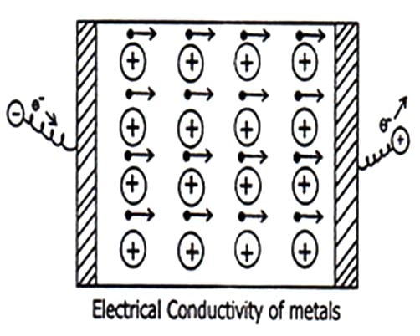
Electrical conductivity Of METALS
Metals are good conductors of electricity due to the presence of mobile electrons in metals.
When potential difference is applied across a metal sheet, free electrons start moving towards anode.
New electrons are discharged from the negative electrode leading to continuous flow of electrons i.e., current starts flows from negative to positive

Slide 12
Other characteristics explained by free electron theory..
Ductile and malleability:
It is due to the non-directional nature of the metallic bond
This is because of the fact that on application of force the metal ions can easily move from one lattice to another leading to change in shape of the metal.

Slide 13
Valance Bond Theory

Slide 14
Valence bond theory
It was proposed by pauling.
The structure of metals may be described in terms of covalent bonds that resonate among the alternate inter atomic positions in metals.
A molecule or ion having such delocalized electrons is represented by several contributing structures is called resonating structures or conical forms.
All the properties of such molecules can not be explained by one structure

Slide 15
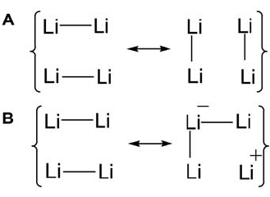
Lithium metallic crystal….
It reveal that one lithium atom is surrounded by eight nearest neighbours in the metallic crystall .
in lithium one valence electron is present which is insufficient to form eight covalent bonds with eight nearest neighbours the resonance of electron pair bond takes place as shown
It explains the following characteristics
Metallic luster:
When white light falls on clean and smooth surface the valence electrons absorb energy and get excited into the nearest higher orbital.
when this electrons returned to the ground state and absorbed energy is released as visible light this emitted light ray is responsible for the metallic luster

Slide 16
Characteristics
Electrical conductivity:
The bonded electrons in the metallic bond neither belong to a positive bond nor they are localized between any two atoms so they are free to move and hence allow electrical conductivity.
Higher density :
The close packing of atoms in metallic crystal explain the high density of metals.

Slide 17
Malleability and ductility
Due to the uniform charge distribution between the posititve ions when stress is applied the ions can change their position relative to their neighbouring atom without changing the internal environment.
LIMITATIONS
The resonance theory explain the qualitative explanation
But it does not explain metallic character in the liquid state or in solution

Slide 18
MOLECULAR ORBITAL THEORY
OR
BAND THEORY

Slide 19
Molecular Orbital Theory
Two atomic orbitals of equal energy combine together to form two molecular orbitals by LCAO Mehod similarly when three atomic orbitals are combined together by LCAO method three molecular orbitals are formed.
The energy of this molecular ortbitals are very close and appear as continuous energy bands hence this theroy is called band theory
Lithium crystal
If n number of lithium atoms are allowed to combine they will form three energy bands
1s band : it is formed by the combination of n number of 1s2 atomic orbitals this band is completely filled , so it is the non conduction band
2s band : it is formed by the combination of no of 2s1 atomic orbitals this band is half filled so it is the conduction band
The upper half of this band is empty while lower half of this band is completely filled .
2p band : it is formed by the combination of n number of 2p subshells this band is called empty bad as it contains no electrons

Slide 20
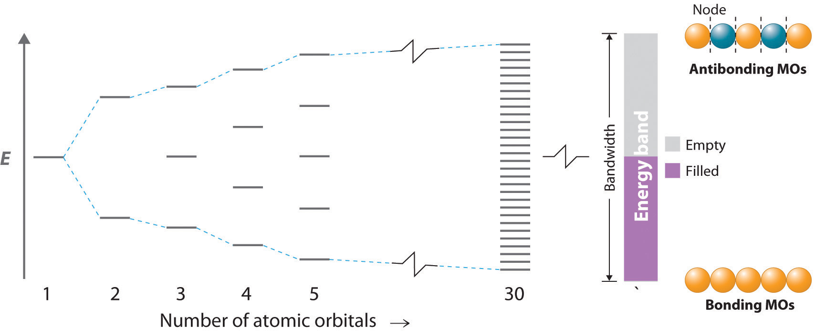
The gap between 1s band and 2s band is called forbidden gap.
as energy gap is very high here so the electrons can not be promoted form the lower 1s band to the higher 2s band
the level below which all bands are filled are called fermi level this may arises within a band or in the gap between two bands .
this theory explains easily the properties of conductors ,insulators and semi conductors

Slide 21
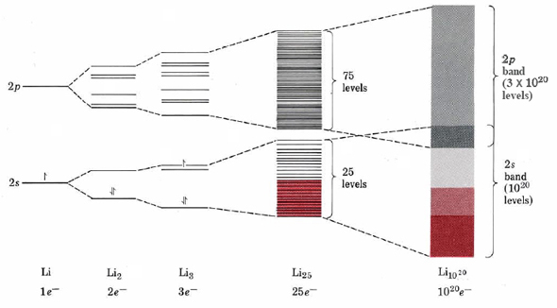
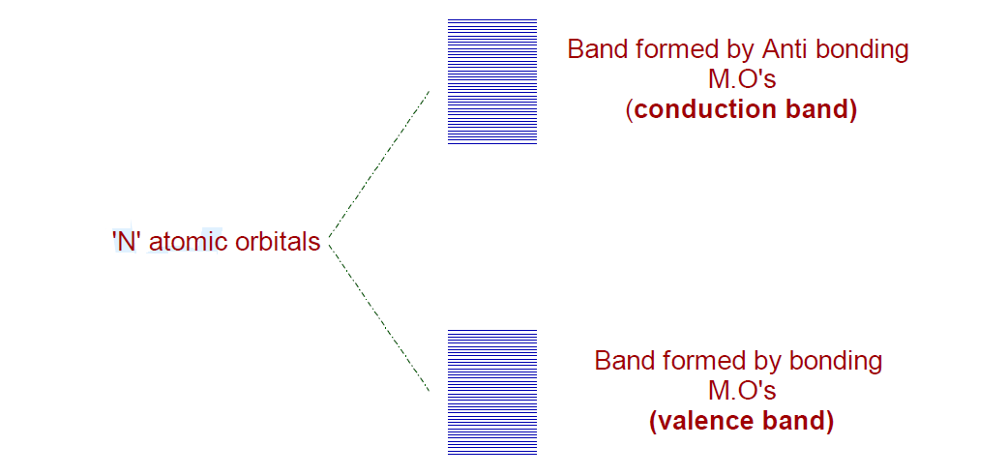

Slide 22
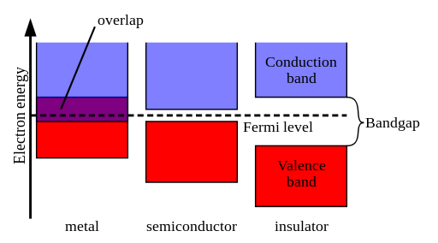

Slide 23
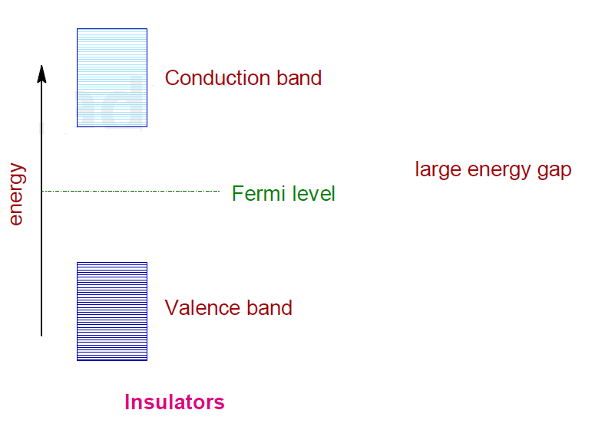
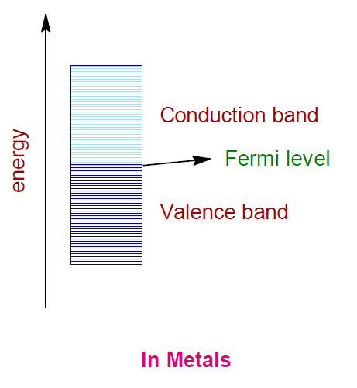
INSULATORS
Completely filled valence band.
More energy difference between the valence nd conduction band.
Due t the more energy gap the insulators cannot conduct electricity
conductors
Less energy gap between the valence band conduction band.
Valence band and conduction band are overlapped
Electrons can easily move from valence band to conduction band .
They can conduct electricity.

Slide 24
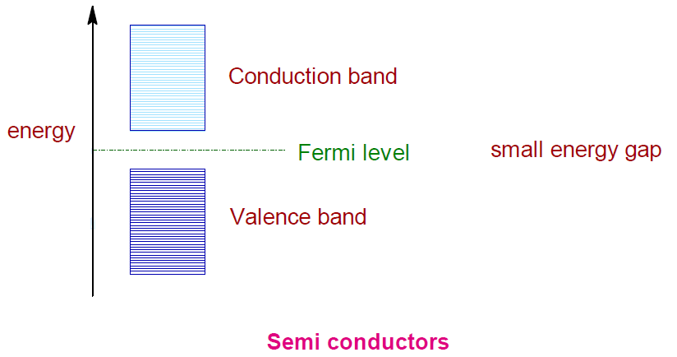
semiconductors
Less energy gap between the valence band and the conduction band.
Promoted electrons in the conduction band and unpaired electrons in the valence band conduct electricity.
Probability of promoting electrons rises with temperature the conductivity of semiconductors increases with temperature.
Hole is formed in valence band due to the transfer of electrons from valence band to conduction band.

Slide 25
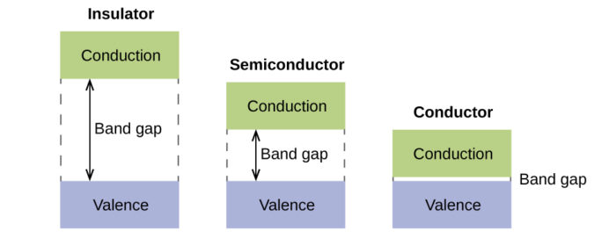

Slide 26
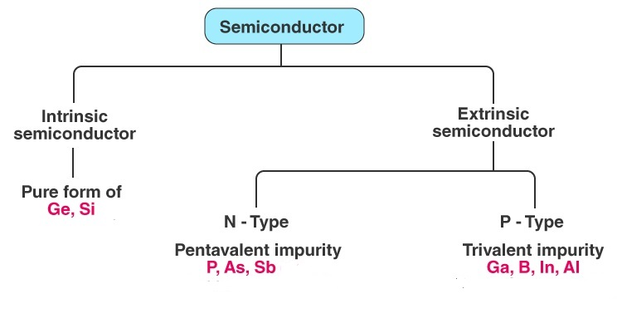
TYPES OF SEMI CONDUCTORS

Slide 27
Intrinsic Semiconductors
An intrinsic semiconductor is one which is extremely pure form.
Examples : pure germanium and silicon which have forbidden energy gaps of 0.72 eV and 1.1 eV respectively.
The energy gap is so small .
It is also defined as one in which the number of conduction electrons is equal to the number of holes
Extrinsic semiconductors
Those intrinsic semiconductors to which some suitable impurity or doping agent or doping has been added in extremely small amounts (about 1 part in 108) are called extrinsic or impurity semiconductors.
Depending on the type of doping material used, extrinsic semiconductors can be sub- divided into two classes:
(i) N-type semiconductors and
(ii) P-type semiconductors.

Slide 28
impurities
Donor impurities Are those elements which donate excess
electrons for conduction Ex. Pentavalent elements like antimony phosphorous arsenic
Acceptor impurities Are those elements which create positive carriers or holes that can accept electrons Ex. trivalent elements like boron ,gallium or indium

Slide 29
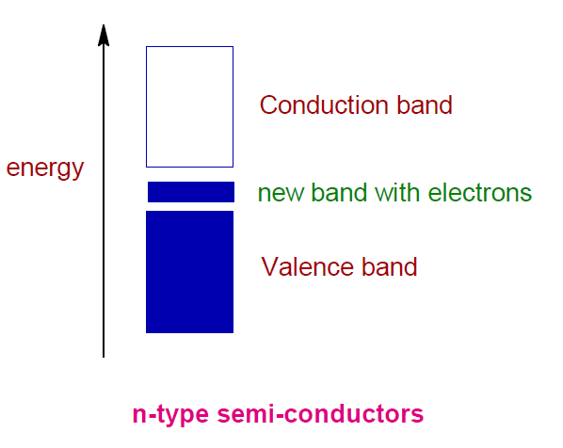
N-type semiconductors
N type comes from the negative charge of the electron.
In this semi conductors electrons are the majority carriers and holes are the minor carriers.
N type semiconductors are created by doping a intrinsic semiconductor with donor impurities.

Slide 30
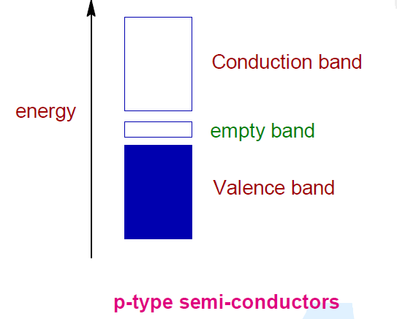
P-type semiconductors
P type refers to the positive charge of the hole.
In p type semiconductors holes are the majority carriers and electrons are the minority carriers.
P type semiconductors are created by doping a intrinsic semiconductors with acceptor impurities

Slide 31
Thank You

