Slide 1
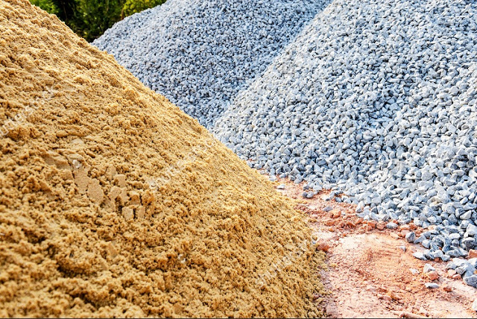
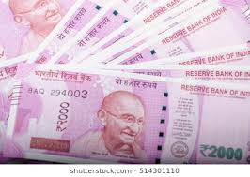
PHOTOSHOP FILE EDITING
R.RADHA RANI
LECTURER IN COMMERCE
D.N.R.COLLEGE
BHIMAVARAM

Slide 2
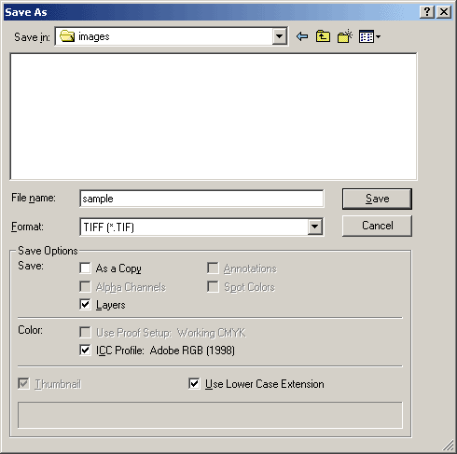
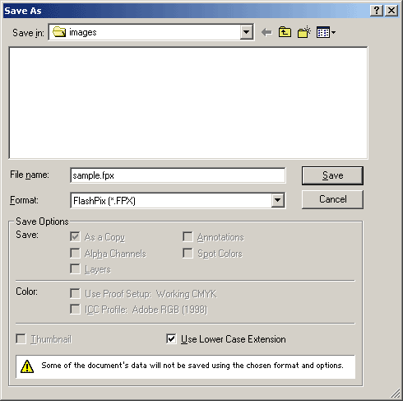
Photoshop: Saving the End Result
Photoshop Usability 6:
In Closing
After the editing, layering, and growing knowledge of the tools and tool box of Photoshop. The last step in understanding the prototyping of Photoshop is the saving process. The saving of the newly created or redesigned image is as important as its creation. In Photoshop the saving process gives you the option to save the image in a variety of ways, this includes but not limited to .tiff, .jpg, . .flashpix, etc. The adjustable format also includes saving as layers or as a single compressed format. Providing warning signal’s to the user (Novice or Professional’s) of the formatting and operations that will be halted once the design is saved.
File Name: Name file is saved as.
Format: The format that the file is being saved as, i.e. jpg, .tiff, etc.
Save Options: Saving as a copy, layers, etc.
Color: What color format the image is saved as, i.e. RGB, CMYK etc.
Photoshop Image A1-14

Slide 3
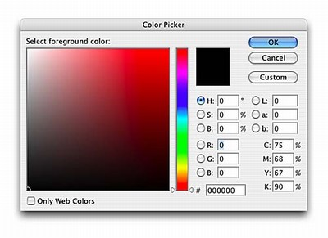
Photoshop: Tools of the Trade, Part 2
Photoshop Usability 3:
Tools Behaviors
Lets begin to analyze the tool box with a few tools that are of great importance.
Arrow: Selection of the art board area
Marquee: Comes in an oval, box or single row marquee.
Lasso: Allows selection or an image or the edges of the image in a non-specific form based on the users choice.
Crop: Allows the user to select a specific area of an image.
Gradient: Allows the user to change specific color areas of the image.
Stamp: Recreates the image as if copying the image over and over again.
Color Palette: One of the most important tools in the prototyping of the Photoshop application. It s design has so many functionalities that I would have to create a slide show focused on its many features. The color palette has a variety of functions, one such function is choosing a color, yes sounds simple but look at image A1-6
Photoshop Image: A1-6

Slide 4
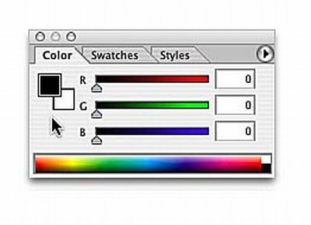
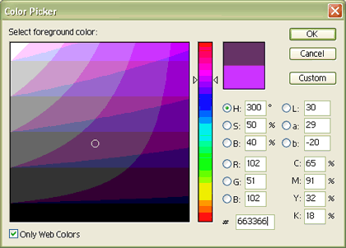
Photoshop: Tools of the Trade, Part 3
Photoshop Usability 3:
Multiple Color Palette Choices
Color Palette: The color palette comes in a variety of different forms with in Photoshop 3 other forms / tools are indicated in images A1-6, A1-7 and A1-8, but the color palette is not limited to just these tools present their have been an improvement on its selection but there are so many that only these few are the commonly used for me to present.
Photoshop Image A1-6
Photoshop Image A1-7
Photoshop Image A1-8

Slide 5
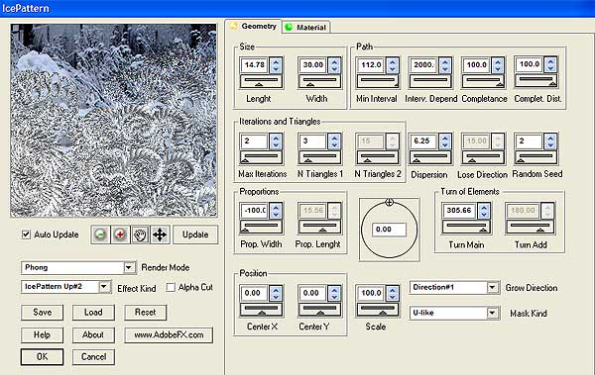
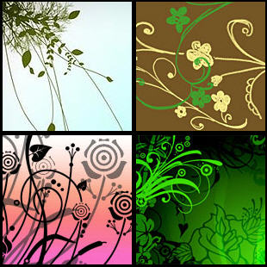
Photoshop: Image Manipulation
Photoshop Usability 5:
Images: Prototyping in Photoshop continues into the behaviors and attributes when focused on an image. The application to reiterate contains so many functionalities that one of importance that I have to mention is the Ice Patten. This newly created tool, see image A1-13, allows user to create an ice effect with in any image. Its manipulation ranges from the ice pattern size, circular design, iterations, position and much more. In the ice patter sample design you can see how the ice pattern tool can create wonderful images, this plant designs unique color schema can be attributed to all of the tools mentioned with in this presentation. From the color palette , to the layers and tools this design is proof that the prototyping this entire application deserves more attention but with such a small presentation not enough time.
Photoshop Image A1 -13
Ice pattern sample design

Slide 6
Creating a image
- Step1: Click “File” → Select “New”
- Step2: Type a name for your work in the name box
→ Decide the size of your work

Slide 7
Editing existing image
- Step 1: Click “File” → Select “Open”
- Step 2: Search the location of your image in the box → Click “Open”

Slide 8
Menu
< >
1. File
2. Edit
3. Image
4. Layer
5. Filter
6. View
7.Windows

Slide 9
1. File
a. Save, Save as, Save for web
- Save
- Save as: Save as a new filename
- Save for web: Save a image as a form
of “*.jpg” or “*.gif” which is used for
web image
b. Import, Export
- Import: Bring another image into the
canvas you are working
- Export: Sending the image you are
working to other applications
c. Print

Slide 10
File Formats
JPEG – Joint Photographic Experts Group
GIF – Graphics Interchange Format
PNG – Portable Network Graphics
Notes:
JPEG
Pronounced Jay-Peg
JPEG actually compression algorithm, not a file format
JPEG associated with JFIF (JPEG File
Interchange Format)
GIF
Pronounced Jiff, although most call it Giff
PNG
Pronounced Ping
Newer file format
Will see more in future

Slide 11
JPEG
Best for photos or continuous tone, full-color images
Uses 16 million colors
Browsers use reasonable approximations
Work in RGB mode
Uses lossy compression
Saving (Standard, Optimized, Progressive)
Notes:
Lossy Compression
Smaller Files
Discards Info
Removes Details & Color
Eye can’t see
Will lose quality when adjusting/reducing file size
Interlacing Effect with Progressive
Display low resolution image first
Followed by higher resolution
Fills in details
Ends with highest quality

