Slide 1
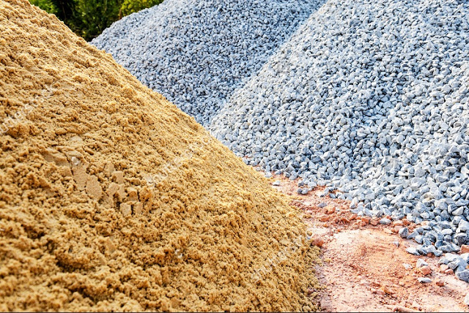
PHOTOSHOP EDITING AND LAYERS
R.RADHA RANI
LECTURER IN COMMERCE
D.N.R.COLLEGE
BHIMAVARAM

Slide 2
2. Edit
a. Undo, Step Forward/Backward
- Undo: Cancel the last work
- Step Forward: Move to the next stage
which you did
- Step Backward: Move to the previous
stage which you did
b. Cut, Copy, Paste
- Cut: Get rid of a part which you select
- Copy: Copy a part you select
- Paste: Attach the part you copied

Slide 3
3. Image
a. Mode: Select a type of color
b. Image size, Canvas size
- Image size: Change the size of the image
- Canvas size: change the size of the canvas
where you are working
(Bottom of your image)
c. Rotate canvas: Changing the direction of
your canvas

Slide 4
4. Layer
a. New, Delete
- New: Create a new layer
- Delete: get rid of a layer you selected
b. Arrange
- change the order of layers
c. Merge
- Make layers into one layer

Slide 5
5. Filter
Various Kinds of technical effects

Slide 6
6. View
a. Zoom in/out
- Zoom in
- Zoom out
b. Print size
- Help you to print only what you need
c. Extras
- Showing horizontal and vertical lines
by dividing into separate sectors

Slide 7
7. Windows
The same function with “view” in other
Windows applications such as MS-Office
You can select what you want to make
visible on your page and what you don’t
want to make visible on your page

Slide 8
D. Toolbar
1. Marqee, Lasso, Magic Wand, Crop
2. Move
3. Brush, gradient, paint bucket
4. Erase
5. Clone Stamp, Pattern Stamp
6. Smudge, Dodge, Sponge
7. Text
8. Set Foreground/Background color

Slide 9
1. Marqee, Lasso, Magic Wand, Crop
a. Marqee: Select a part of an image you are working
with arranged form such as rectangular and elliptical.
b. Lasso: Draw selection paths freehand with a mouse
- If you click and hold, you can change the tool
so that you can draw polygons
c. Magic wand: select all the same-color or similarly
colored adjacent pixels
d. Crop: Crop the image
- The selected area will be surrounded with a blinking
dotted line

Slide 10
2. Move
Move the image on a selected layer to other part of
canvas you are working
3. Brush, Gradient, Paint Bucket
a. Brush: basic tools for drawing a line
b. Gradient: this help you to paint stage by stage with
more than 2 colors
c. Paint Bucket: fill out a cropped part with just one
click of this tool

Slide 11
4. Erase
Erase what you cropped or where you click with
your mouse after selecting this tool
5. Clone Stamp, Pattern Stamp
a. Clone Stamp: copy a selected part and restore
it where you want
b. Pattern Stamp: this is nearly the same tool with
clone stamp, but you can arrange the shape you
cropped, and you can use it as a fixed shape

Slide 12
6. Smudge, Dodge, Sponge
Smudge: effect as such rubbing canvas
with fingers
b. Dodge: Make it bright the part where you scrub
with this tool.
c. Sponge: Saturate or desaturate selected part of
an image.
7. Text
- Type in various characters

Slide 13
8. Set foreground/background color
- Foreground color: the color of image what you
draw with a drawing tool such as brush tool
- Background color: when you use the gradient
tool, the color will be different from the foreground
color.

Slide 14
E. Palette
1. Color/Swatches/Styles Palette
2. History/Actions/Tool Preset Palette
3. Layers Palette

Slide 15
1. Color/Swatch/Styles Palette
Color Palette: Mix the color (basically
RGB colors) and select it for the
foreground and background colors.
c.f) In case of another color type, you can
choose it among the list of the pop-up menu
You can choose colors among the
samples of colors.
You can choose a special effect of
colors on the layer you selected, such
as texts, buttons, and images

Slide 16
2. history/Action/Tool preset Palette
History Palette: Photoshop automatically
save the process of your works. (basically
20 steps prior to the current work)
c.f) change the number of steps it saves:
Edit > Preferences > General (History States)
Actions Palette: Save basic technical effects
and adjust it to more than one image
Tool Preset Palette: Select the Brush which
you made and saved.

Slide 17
3. Layers Palette
Layer Palette: Separate each step of
Works from others.
By making layers and working different
steps on each layer, you can make
separate effects on each layer.

Slide 18
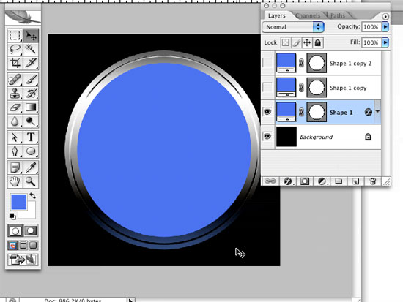
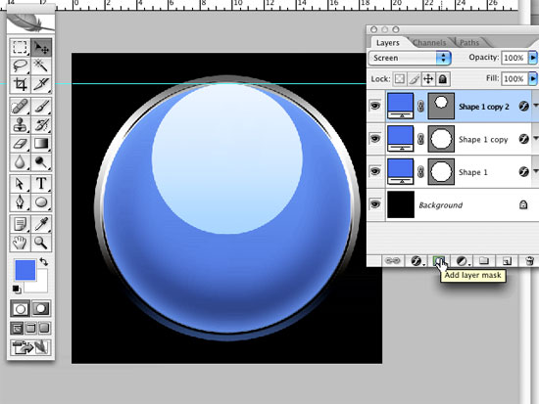
Photoshop: Layers and Attributes
Photoshop Usability 4:
Layers, Layers and More Layers
Working with layers when understanding a prototype in Photoshop can take some many different routes that the few mentioned with in this presentation was only to reduce this presentation to 10 minutes, due to the fact that Photoshop layers contain so many attributes that mentioning a few took long to decide based on a matter of importance to me and general user rather than the actual application design.
Layers: The layers box contains all the images in a, well layered order, designed to keep track of all images on the art board. Its functionalities include but are not limited to creating drop shadows, editing color with the use of the color palette, setting a default background (also editable), and again but not limited to, creating new folders for storage for more layers. Its unique design helps in the prototyping of Photoshop as a main functionality because it’s the central tool that assists in the understanding of how an artist can keep track of all the layers that go into a design, from text to graphics. See Photoshop images A1-9 and A1-10
Photoshop Image A1-9
Photoshop Image A1- 10

Slide 19
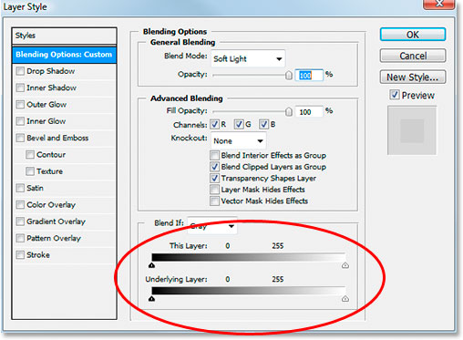
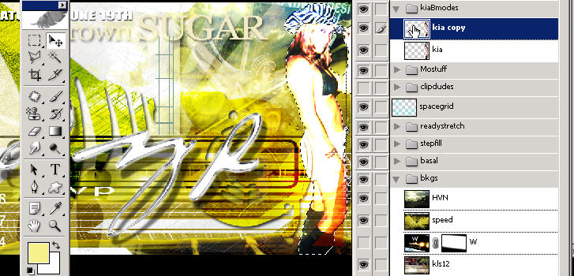
Photoshop: Layers and Attributes
Photoshop Usability 4 continued:
Layers, Layers and More Layers
Here is another example of how the layers tool in Photoshop can be manipulated with text, layer copies and shadowing. see image A1-11 and A-12.
Photoshop Image A1-11
Photoshop Image A1-12

Slide 20
THANK YOU

