Slide 1
PHOTOSHOP - OVERVIEW
R.RADHA RANI
LECTURER IN COMMERCE
D.N.R.COLLEGE
BHIMAVARAM

Slide 2
Introduction
1. Adobe Photoshop?
- The professional image-editing standard
2. Two general usage of Photoshop
- Creating images
Editing existing images
Notes:
-create images for print, the Web, wireless devices, and other media

Slide 3
How to get started?
Click “Start” > >> Find & click “Photoshop 7.0”

Slide 4
Find Photoshop Icon on the desktop
→ Double-Click the icon.

Slide 5
Photoshop Introduction
Prototyping:
*Prototyping is the process of quickly putting together a working model in order to test various aspects of a design to illustrate ideas or features and gather early user feedback. Prototyping is often treated as an integral part of the system design process, where it is believed to reduce project risk and cost. Often one or more prototypes are made in a process of iterative and incremental development where each prototype is influenced by the performance of previous designs, in this way problems or deficiencies in design can be corrected. When the prototype is sufficiently refined and meets the functionality, robustness, manufacturability and other design goals, the product is ready for production.
Introduction:
Amongst the many design tools there are out their for artist’s , Photoshop is regarded as one of the best design applications from an artist point of view. With its innovative and structured design it allows a Novice to become a Professional with a few clicks of a button from one of many tools that their standard tool box holds. So, from blur to eyedropper, Photoshop’s design provides users with a comfortable structured work environment for creating the most imaginative design’s in a short period of time.
Presentation:
The goal of this presentation is to show how easy and well defined Photoshop tools are for both a Novice and a Professional. As well as, how easy it is to use the predefined tools from a new layout to the color picker. Hope you enjoy it.

Slide 6
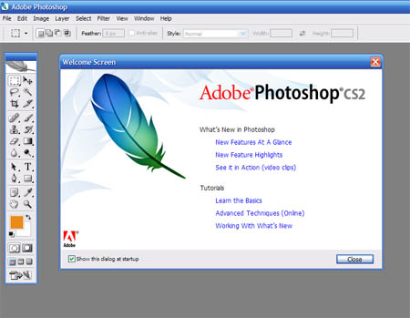
Photoshop: History
Photoshop:
*Adobe Photoshop is a graphics editor developed and published by Adobe Systems. It is the current market leader for commercial bitmap and image manipulation, and is the flagship product of Adobe Systems. It has been described as "an industry standard for graphics professionals” and was one of the early "killer applications" on Macintosh.
The current (10th) iteration of the program, Photoshop CS3, was released on 16 April 2007. "CS" reflects its integration with other Creative Suite products, and the number "3" represents it as the third version released since Adobe re-branded its products under the CS umbrella. Photoshop CS3 features additions such as the ability to apply non-destructive filters, as well as new selection tools named Quick Selection and Refine Edge that make selection more streamlined.
On April 30th, Adobe released Photoshop CS3 Extended, which includes all the same features of Adobe Photoshop CS3 with the addition of capabilities for scientific imaging, 3D, and high end film and video users.
(* - wiki reference )

Slide 7
Photoshop: Beginning
Photoshop Usability 2:
New or Imported Files
To prototype with Photoshop after the creation of the art board the user can then proceeds to the next step in understanding the Photoshop tool design process For example a user can either create a new image/ art board A1-4 or open an already predetermined image, with which the user will see as the image appears in the center stage of the application as indicated in image A1-3 or A1 -4 . The creation of an art board is so simple and easy to understand that the user (Novice or Professional) can begin to alter the new or pre-created image with a click by click method that needs no memorization technique.
Photoshop Image : A1-3
Photoshop Image : A1-4

Slide 8
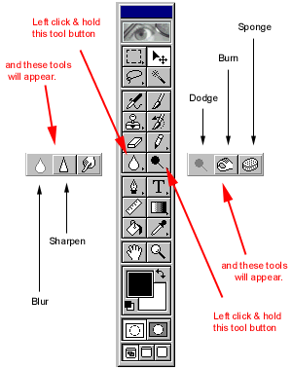
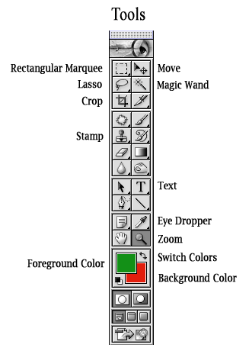
Photoshop: Tools of the Trade
Photoshop Usability 3:
Tools and Functionalities
The next step in understanding Photoshop prototyping is to understand the applications built in tools and their functionalities. Once an image is selected or a new art board is opened see images A1-3 and A1 -4, the user (Novice or Professional), can then proceed onto the next step as which is toolbox and their functionalities. Designed in and easy to manipulate and straightforward layout the tool box as indicated in image A1- 5, is critical to the user for any form of design.
The tool box’s layout from top to bottom is designed based on importance from Novice to Professional. Beginning first with the arrow tool and ending with the color palette, its design gives all options that a user would need to manipulate an image from color to size.
Photoshop Image : A1-5

Slide 9
What is Photoshop?
Photo retouching, image editing, and color
painting program; graphic design tool
Create high-quality digital images
Tools & special effects capabilities
Manipulate scanned images, slides, & original artwork
Isolate parts of an image for experimentation & individual editing
And lots more…..

Slide 10
Uses of Photoshop
Art (line drawings, charcoal, color original)
Photographic
Restoration
WWW (GIFS, JPEGS, etc.)
Montage
Halftones, Duotones, Tritones, Quadtones
Color Separations
Posterizations
Special Effects

