Slide 1
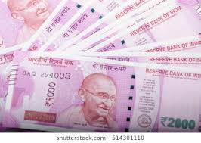
ENTERPRISE RESOURCE PLANNING FUNCTIONAL MODULES
R.RADHA RANI

Slide 2
ERP SOLUTION AND FUNCTIONAL MODULES
ERP is enterprise resource planning. It Is cross-functional enterprise system driven by an integrated suite of software module that support the basic internal business process of an organization.
The purpose served by an ERP system is that of organizing, codifying and standardization of business process and information or data

Slide 3
Modules of erp
The generic ERP package represents the commonly operated business model of the organization. It is build with function model like
Finance
Materials
Marketing
Sales
Personnel

Slide 4
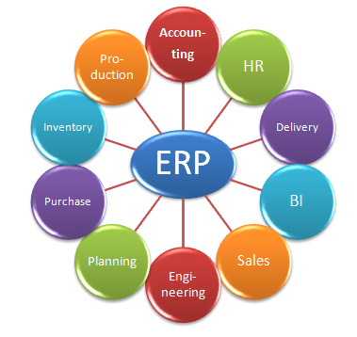
Erp modules

Slide 5
Functional Modules

Slide 6
ERP Implementation

Slide 7
Planning Evaluation and selection of ERP system
A successful ERP project requires selecting an ERP solution, implement the solution, manage changes and examine the practicality of the system, Wei and Wang, (2004). Wrong ERP solution choice would either fail the implementation or weaken the system to a greater impact on the enterprise, Hicks, (1995); Wilson, (1994).
Planning
RFP
Solution Evaluation
Negotiation
Selection and Agreement
ERP Software & Hardware (Solution) Evaluation and Selection Steps
Define Requirements
Shop Round for Product
Clarify Requirements
Evaluation Vendor Inquiry
Interact with Vendors
Negotiate Agreement
Action Agreement

Slide 8
IMPLEMENTATION LIFE CYCLE

