Slide 1
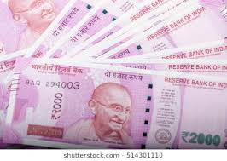
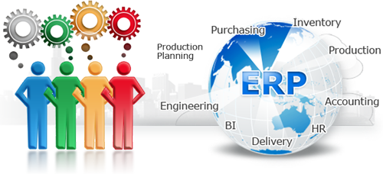
ENTERPRISE RESOURCE PLANNING OVERVIEW
R.RADHA RANI

Slide 2
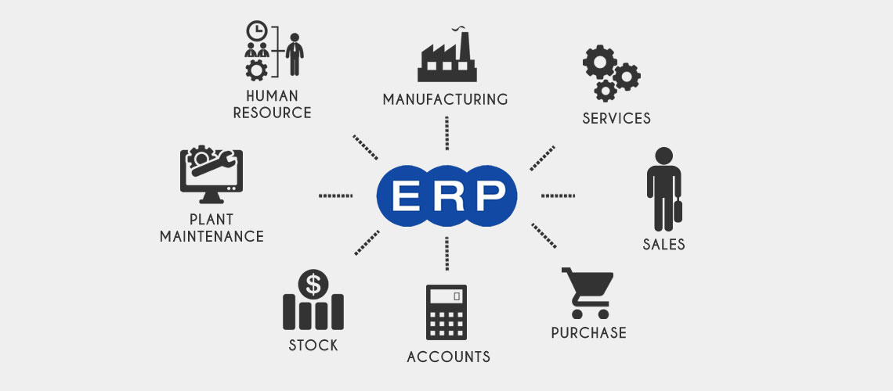
WHAT IS ERP…?
An ERP system includes core software components, often called modules, that focus on essential business areas .
finance and accounting, HR, production and materials management, customer relationship management (CRM), and supply chain management.
Organizations choose which core modules to use based on which are most important to their particular business.

Slide 3
Enterprise resource planning (ERP) is business management software—usually a suite of integrated applications—that a company can use to collect, store, manage and interpret data from many business activities, including
Product planning, cost Manufacturing or service delivery Marketing and sales Inventory management Shipping and payment
ERP provides an integrated view of core business processes, often in real-time, using common databases maintained by a database management system.
ERP systems track business resources— cash, raw materials, production capacity—and the status of business commitments: orders, purchase orders, and payroll.
The applications that make up the system share data across the various departments that provide the data.
ERP facilitates information flow between all business functions, and manages connections to outside stakeholders.

Slide 4
EVOLUTION OF ERP

Slide 5
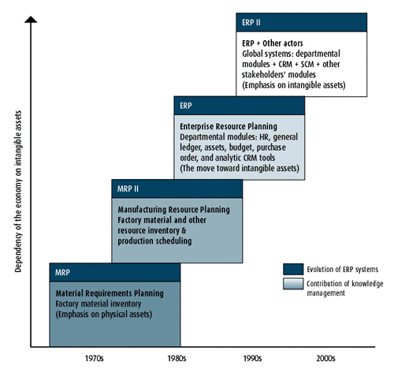

Slide 6
BENEFITS OF erp
1.Competition. Manufacturers cannot afford to put off an ERP implementation while their competition invests in ERP and starts reaping the many benefits we’ll touch on below.
2.Efficiency. more efficient for companies to collect data, no matter what department they’re working in.
3.Forecasting. Enterprise resource planning software gives your users, and especially managers, the tools they need to create more accurate forecasts.
4.Collaboration. Collaboration between departments is a crucial and often necessary part of the business.

Slide 7
5.Scalability. Did you know? Structured ERP systems allow the addition of new users and functions to grow the initially implemented solution over time.
6.Integrated Information. This means you can integrate platforms like your CRM software with the ERP system, keeping data consistent, accurate, and unique. Know your customer, their orders, and your inventory.
7.Cost Savings. With one source of accurate, real-time information, ERP software reduces administrative and operations costs.
8.Streamlined Processes. Manufacturing software automates business operations cross-departmentally, providing accurate, real-time information to everyone utilizing the solution.

Slide 8
9.Mobility. An advantage of ERP solutions like WorkWise ERP software is having access to a centralized database from anywhere you work.
10.Reporting. ERP software helps make reporting easier and more customizable. With improved reporting capabilities, your company can respond to complex data requests more easily.
11.Productivity. Save time and increase productivity levels. Sound too good to be true? It’s not with ERP software. By having redundant processes automated.
12.Regulatory Compliance. A benefit of ERP software which sometimes goes unnoticed is how it ties well into regulatory compliance in the manufacturing industry.

Slide 9
12.Flexibility. Modern ERP software systems are robust, flexible, and configurable. They are not a one-size-fits-all proposition but can be tailored to the unique needs of a business.
13.Customer Service. It’s easier to provide high-quality customer service using an enterprise solution, especially when you’re using one as well-equipped as WorkWise ERP.
14.Security. A new system will improve the accuracy, consistency, and security of data, all through built-in resources and firewalls.

Slide 10
Issues to planning design
Implementation Costs
ERP Vendors
Selecting the Right Employees
Training Employees
Training Employees
Employee Morale

