Slide 1
GOODS AND SERVICES TAX (GST)
Presentation by
J. SURESH
Lecturer in Commerce
D.N.R. College (A) ,
Bhimavaram

Slide 2
What is GST?
‘G’ – Goods ‘S’ – Services ‘T’ – Tax
“Goods and Service Tax (GST) is a comprehensive tax levy on manufacture, sale and consumption of goods and service at a national level.
GST is a tax on goods and services with value addition at each stage having comprehensive and continuous chain of set-of benefits from the producer’s/ service provider’s point up to the retailer’s level where only the final consumer should bear the tax.”

Slide 3




Need for GST
Introduction of a GST to replace the existing multiple tax structures of Centre and State taxes is not only desirable but imperative in the emerging economic environment. Increasingly, services are used or consumed in production and distribution of goods and vice versa. Separate taxation of goods and services often requires splitting of transaction values into value of goods and services for taxation, which leads to greater complexities, administration and compliances costs. Integration of various taxes into a GST system would make it possible to give full credit for inputs
taxes collected.
GST, being a destination-based based on VAT principle, would also
consumption tax
greatly help in removing economic distortions and will help in development of a common national market.

Slide 4
Justification of GST
Despite the success of VAT, there are still certain shortcomings in the structure of VAT, both at the Centre and at the State level.
A. Justification at the Central Level
i. At present excise duty paid on the raw material consumed is being allowed as input credit only.
For other taxes and duties
paid for post- manufacturing expenses, there is no
mechanism for input credit under the Central Excise Duty Act.
Contd….

Slide 5
i.
adfl
ii. Credit for service tax paid is being allowed manufacturer/ service provider to a limited extent. In order to give the credit of service tax paid in respect of services consumed, it is necessary that there should be a comprehensive system under which both the goods and services are covered.
iii. At present, the
service tax is levied on only. Many other large
restricted items
number of services could not be taxed. It is to reduce the effect of cascading of taxes, which means levying tax on taxes.
Contd…

Slide 6

B. Justification at the State Level
A major defect under the State VAT is that the State is charging VAT on the excise duty paid to the Central Government, which goes against the principle of not levying tax on taxes.
Many of the States are still continuing with various types of indirect taxes, such as luxury tax,
entertainment tax , entry tax etc.
As tax is being levied on inter-state transfer of goods, there is no provision for taking input credit on CST leading to additional burden on the dealers.
iii.

Slide 7
Model of GST
The dual GST model
proposed by the Empowered
Committee and accepted by the Centre will have dual system for imposing the tax. GST shall have two components i.e.
Central GST
State GST
Central Excise duty, additional excise duty, services tax and additional duty of customs (equivalent to excise), state VAT entertainment tax, taxes on lotteries, betting and gambling and entry tax (not levied by local bodies)would be subsumed within GST

Slide 8
GST - Salient Features
It would be applicable to all transactions of goods and service.
It to be paid to the accounts of the Centre and the States separately.
The rules for taking and utilization of credit for the Central GST and the State GST would be aligned.
Cross utilization of ITC between the Central GST and the State GST would not be allowed except in the case of inter-State supply of goods.
The Centre and the States would have concurrent jurisdiction for the entire value chain and for all taxpayers on the basis of thresholds for goods and services prescribed for the States and the Centre.
The taxpayer would need to submit common format for periodical returns, to both the Central and to the concerned State GST authorities.
Each taxpayer would be allotted a PAN-linked taxpayer identification number.

Slide 9
Subsuming of Existing Taxes
The sub-sumation should result in free flow of tax credit in intra and inter-State levels so that unrelated taxes, levies and fees are not be subsumed under GST.
Sl. No . | Subsumed under CGST | Subsumed under SGST
1 | Central Excise Duty | VAT / Sales tax
2 | Additional Excise Duties | Entertainment tax (unless it is levied by the local bodies).
3 | Excise Duty-Medicinal and Toiletries Preparation Act | Luxury tax
4 | Service Tax | Taxes on lottery, betting and gambling.
5 | Additional CVD | State Cesses and Surcharges (supply of goods and services)
6 | Special Additional Duty of Customs - 4% (SAD) | Entry tax not in lieu of Octroi
7 | Surcharges
8 | Ceses

Slide 10
What will be out of GST?
Levies on petroleum products
Levies on alcoholic products
Taxes on lottery and betting
Basic customs duty and safeguard duties on import of goods into India
Entry taxes levied by municipalities or panchayats
Entertainment/ Luxury taxes levied by local bodies
Electricity duties/ taxes
Stamp duties on immovable properties
Taxes on vehicles

Slide 11
Chargeability
S G S T- State GST
Both Tax charged on all Intra state transactions S G S T levied by State Govt. and C G S T levied by the Central Govt.
C G S T-Central GST
I G S T-Integrated GST: -
Applicable on interstate transaction, aggregate of C G S T and S G S T Rate Transfer of funds through Clearing Agency.

Slide 12

Example
Suppose R N R =24%
i.e. S G S T – 12% C G S T – 12%
Invoice for Intra State (A)
For Inter State (B)
Taxable Value | = | 100 | Taxable Value | = | 100
S G S T | = | 12 | I G S T | = | 24
C G S T | = | 12 | Add Tax 1% | = | 01
Total Value | = | 124 | Total Value | = | 125
Adjustment of Input Tax Credit
ITC available – S G S T Rs.4/-, C G S T Rs.5/-, IGST Rs.20/-

Slide 13
Example
SGST Payable | 12 | CGST Payable- | 12 | IGSTPayable | 24
S G S T | 4 | C G S T | 5 | I G S T | 8
I G S T | 6 | I G S T | 6 | S G S T | nil
 |  |  |  | C G S T | nil
Net Payable | 2 | Net payable | 1 | Net payable | 16
Order of utilization of ITC:
Particulars Order of Utilization
IGST CGST SGST
IGST, CGST, SGST CGST, IGST
SGST, IGST

Slide 14
Taxable Person
It will cover all types of person carrying on business activities,
i.e. manufacturer, job-worker, trader, importer, exporter, all types of service providers, etc.
If a company is having four branches in four different states, all the four branches will be considered as TP under each jurisdiction of SGs.
All the dealers/ business entities will have to pay both the types of taxes on all the transactions.
A dealer must get registered under CGST as it will make him entitle to claim ITC of CGST thereby attracting buyers under B2B transactions.
Importers have to register under both CGST and SGST as well.

Slide 15
Supply
The taxable event for levy of Goods and Services Tax (GST) is ‘supply’. Section 3 of the Model GST Act covers the meaning and scope of ‘supply’. Supply is defined in inclusive manner.
So we also need to see ordinary or natural meaning of supply besides these inclusions for determining the scope of the levy.
The specific inclusions under the term ‘supply’ are as under:
All forms of supply of goods and/or services such as sale, transfer, barter, exchange, license, rental, lease or disposal made or agreed to be made for a consideration by a person in the course or furtherance of business.

Slide 16
Supply
Supplies made or agreed to be made without a consideration as specified in Schedule I. Schedule I lists 5 items namely, permanent transfer/disposal of business assets; temporary application of business assets to a private or non‐business use; services put to a private or non‐business use; assets retained after deregistration; and supply of goods and / or services by a taxable person to another taxable or non‐taxable person in the course or furtherance of business.
This implies that stock transfers and supply of goods/services between two separately registered units/branches whether in the same State or not, will be deemed as supply.

Slide 17
Supply
However, supply of goods by a registered taxable person to a job‐worker in terms of section 43A shall not be treated as Supply of goods.
Importation of service with or without consideration: import of services is defined under the Model GST Act on lines broadly similar to the one in current service tax regime
Where a person acting as an agent who, for an agreed commission or brokerage, either supplies or receives any
goods and/or services on behalf of
any principal, the transaction between such principal and agent shall be
deemed to be a supply
Supply of any branded service by an aggregator, as defined in section 43B, under a brand name or trade name owned by him shall be deemed to be a supply of the said service by the said aggregator

Slide 18
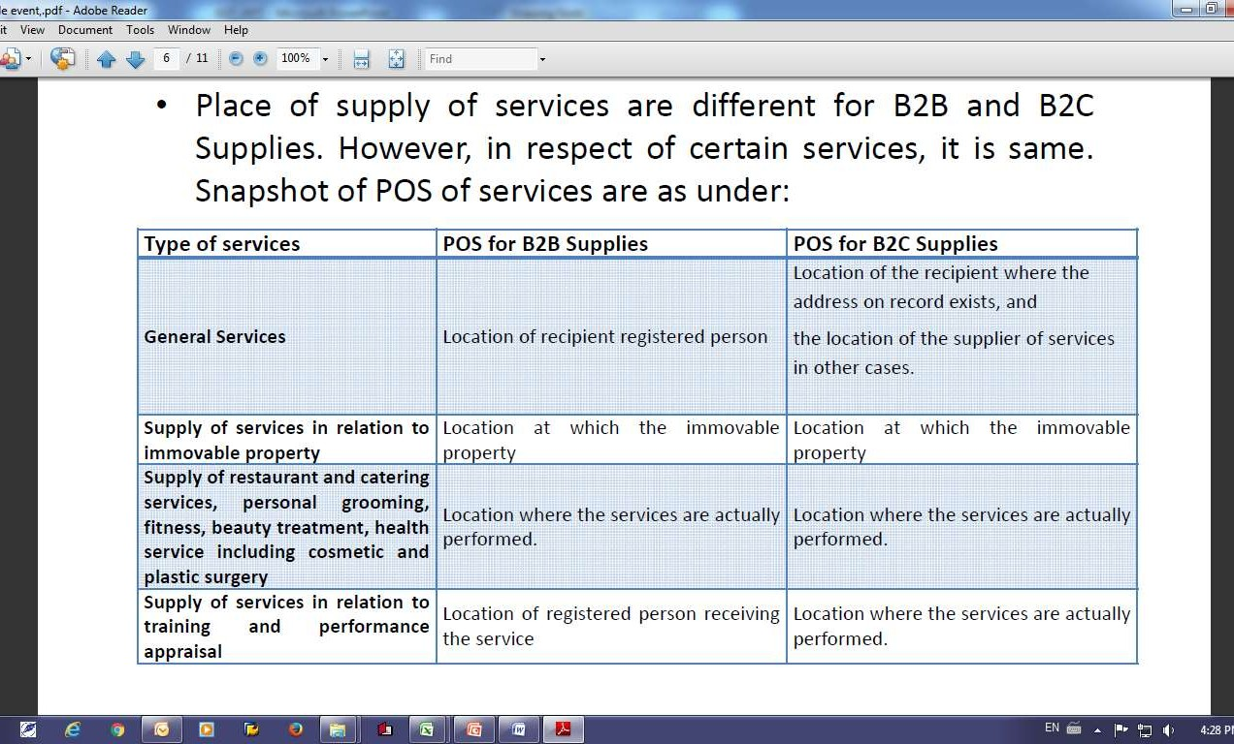
Place of Supply

Slide 19
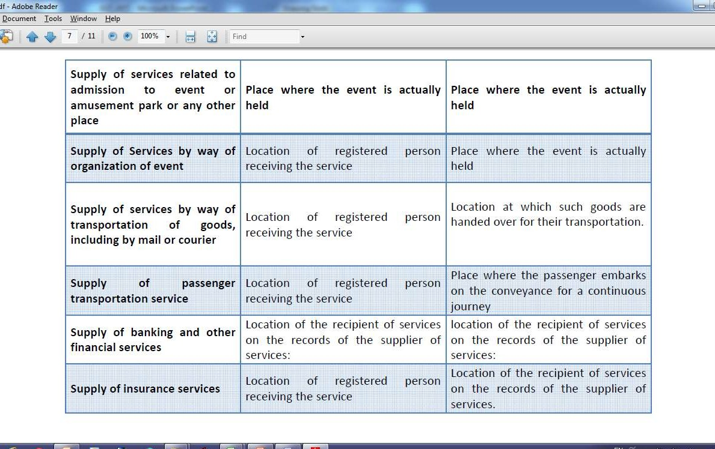
Place of Supply Contd…

Slide 20
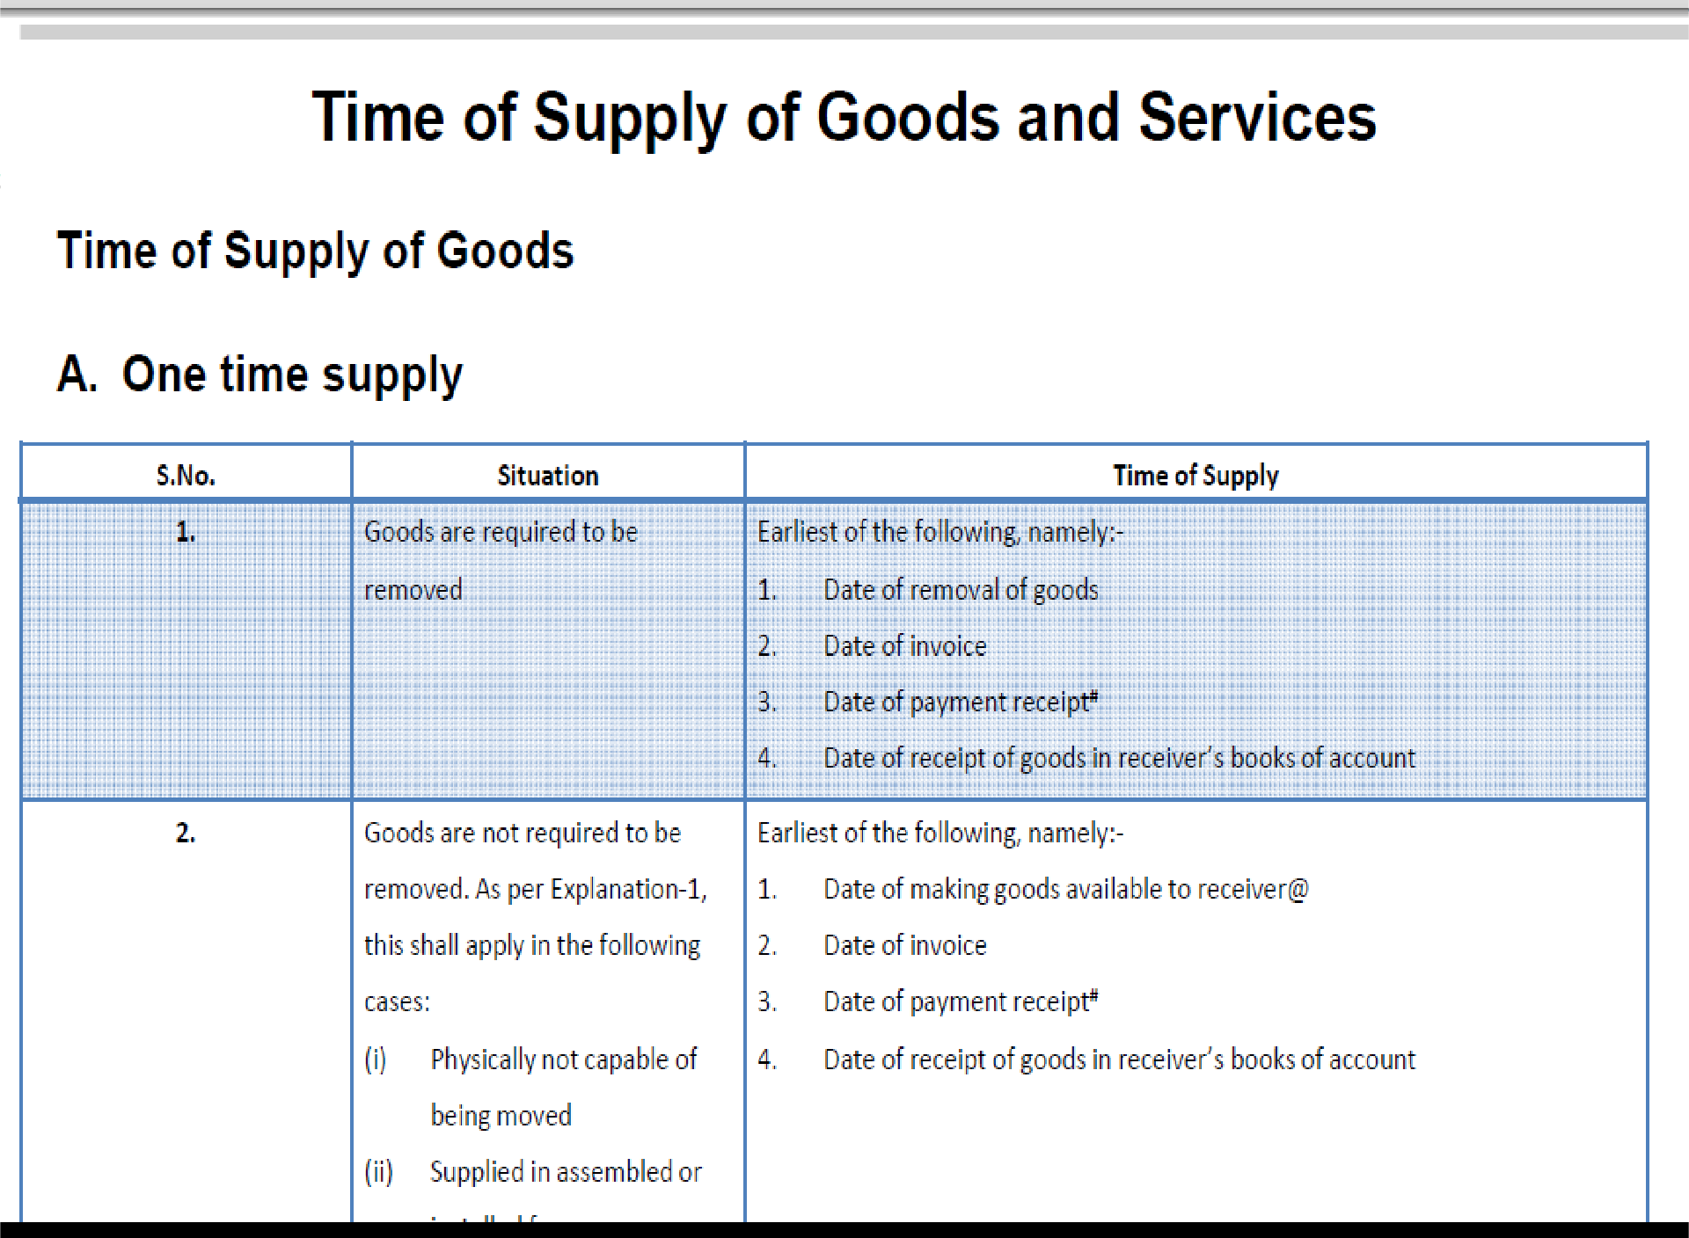

Slide 21
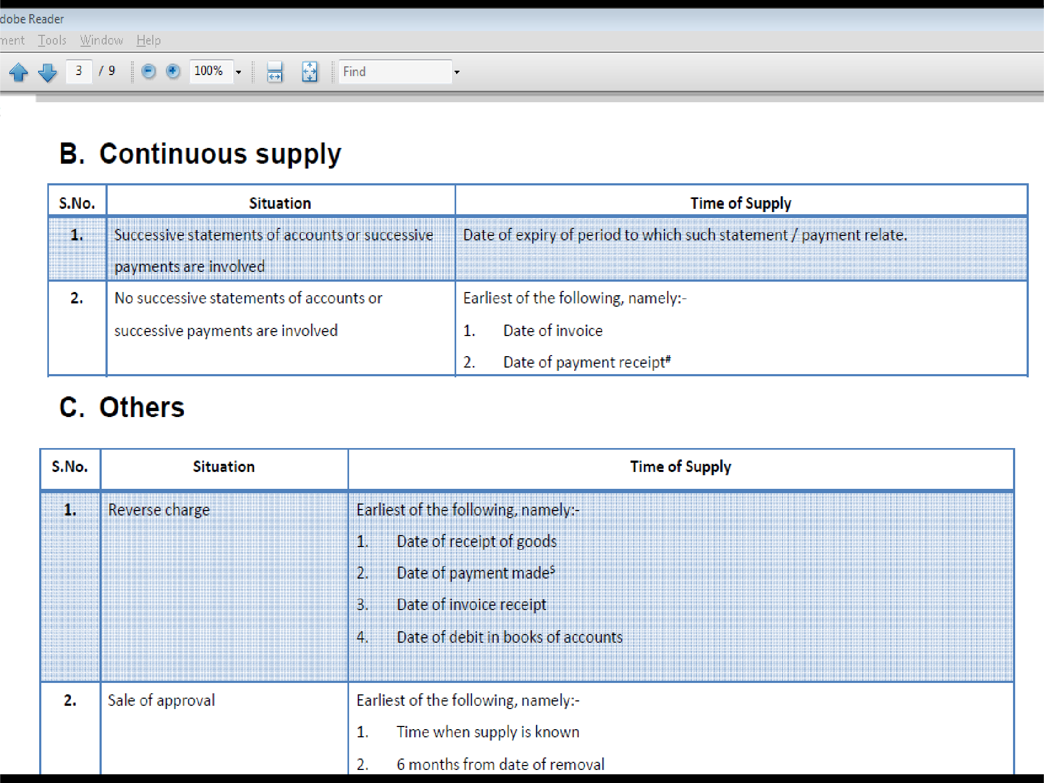

Slide 22
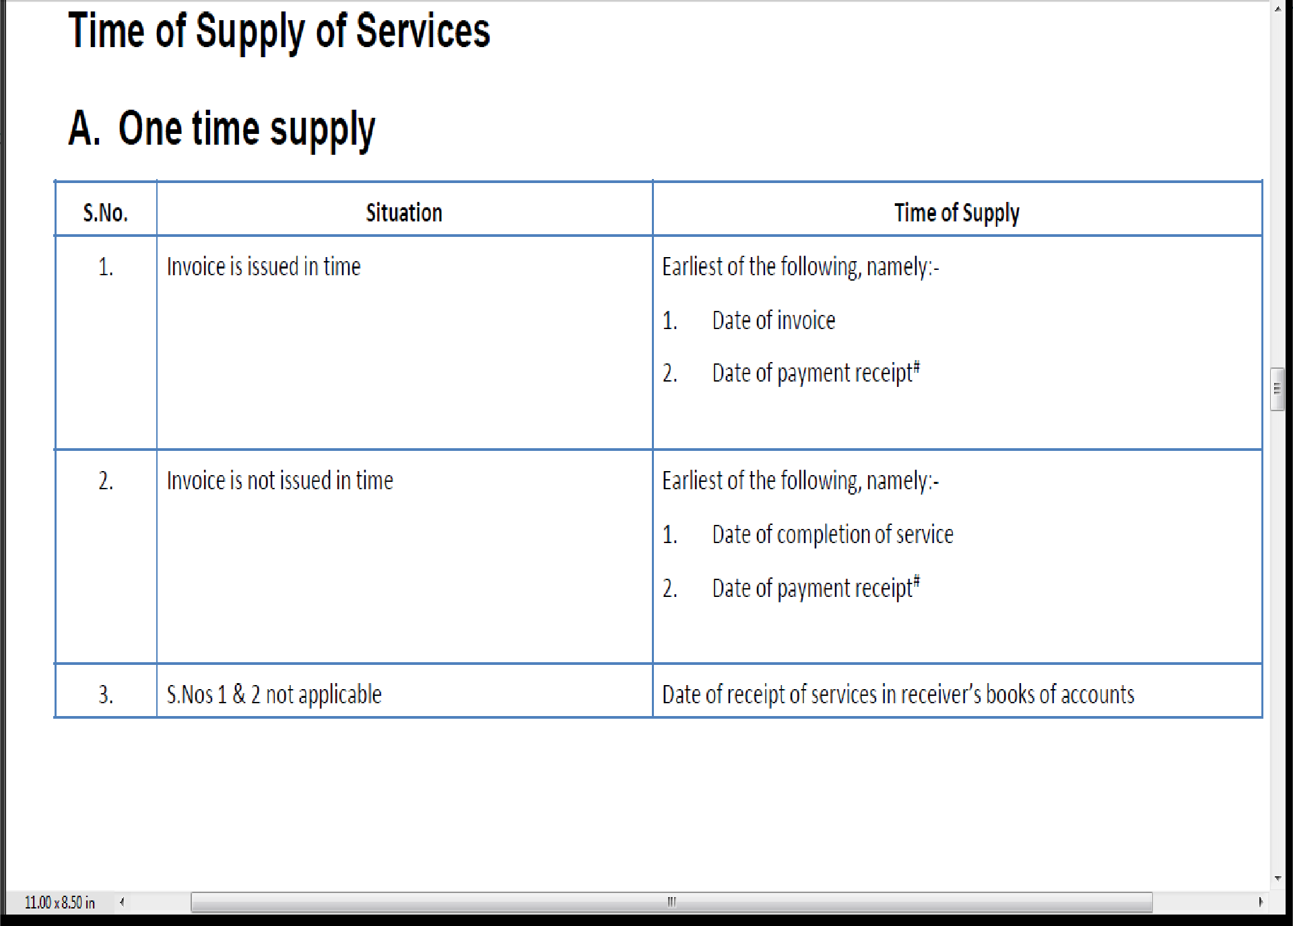
Contd…

Slide 23
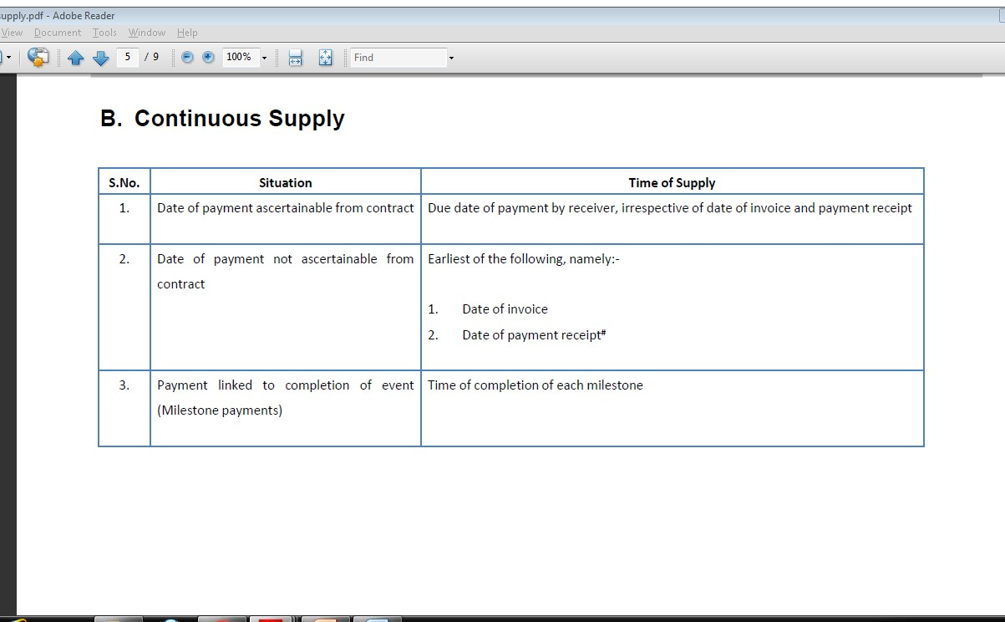

Slide 24
C. Others
S.No | Situation | Time of Supply
1 | Reverse charge | Earliest of the following, namely:- Date of receipt of service Date of payment made$ Date of invoice receipt Date of debit in books of accounts
2 | Cessation of supply of services before its completion of | Time of cessation of such supply
3 | Residuary Periodical return to be filed Others | Due date of filing of periodical return Date of payment of CGST/SGST

Slide 25
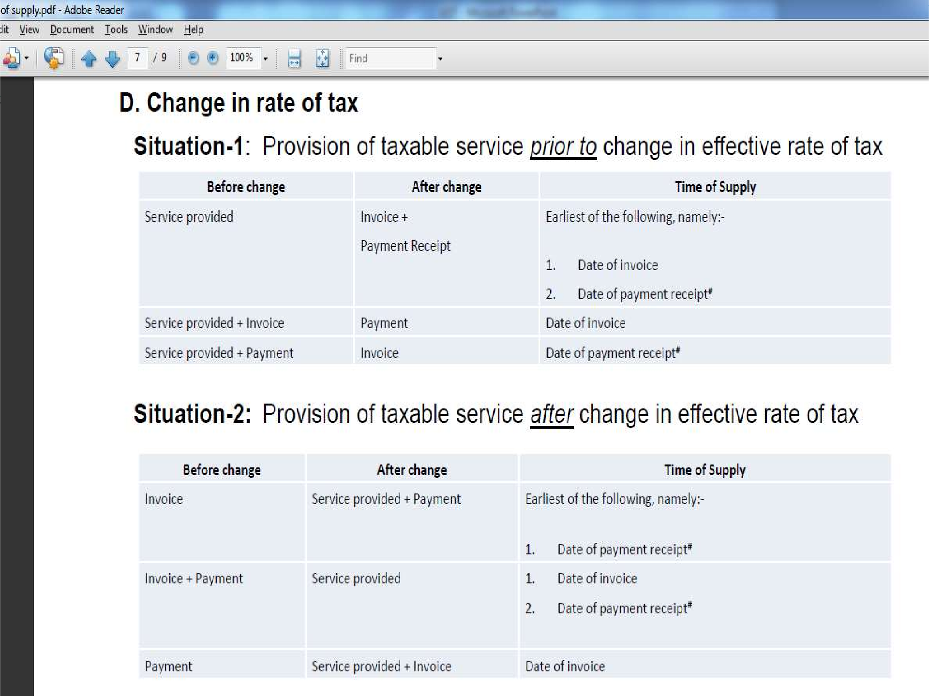

Slide 26
Registration under GST
Each taxpayer will be allotted a state wise PAN based 15-digit Goods and Services Taxpayer Identification Number (‘GSTIN’)

Slide 27
Registration
The persons liable for taking Registration are specified in Schedule III. They include –
Persons crossing threshold of aggregate turnover of Rs. 9 lakhs in a financial year. Threshold is Rs. 4 lakhs for North-Eastern States.
Persons making inter-State taxable supply
Persons liable to pay GST under reverse charge Whether service provider are working under threshold limit or not.
Contd…

Slide 28
Registration
Input Service Distributor
Aggregator
E-Commerce Operator.
Separate registration is required to be taken in each State. There is no provision for centralized registration.
Existing taxpayers will be issued Registration Certificate on a provisional basis valid for 6 months.
Composition Scheme has been introduced in respect of taxable persons whose aggregate turnover does not exceed fifty lakhs

Slide 29



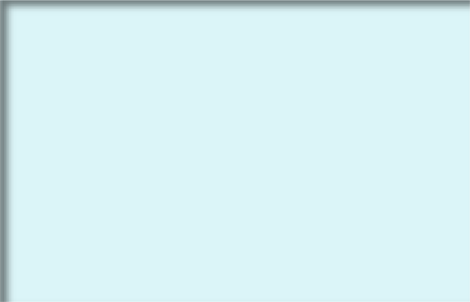
Structure of Registration No.
STATE
CODE
PAN NO.
ENTITY
CODE
BLANK
CHECKDIGIT
1 2
3 To
12
13
14
15
In terms of Indian Census 2011 each State to have a unique code, such as 09 for UP
To be kept blank for future use
To be alpha-numeric (1-9 an then A-Z); to be assigned depending on number of registration a legal entity has within one state

Slide 30
VALUATION
The value of a supply of goods and/or services for the purposes of the levy of CGST / SGST or IGST, as the case may be, shall be the transaction value, that is the price actually paid or payable for the said supply of goods and/or services where the supplier and the recipient of the supply are not related and the price is the sole consideration for the supply.

Slide 31
VALUATION
Section 15(2) of the Model GST Law provisions for certain inclusions and exclusions while determining the value. The expenditure incurred by the recipient of supply on behalf of supplier shall be included in the transaction value. Free issue/discounted supplies by recipient, royalties, license fees are included in the transaction value. All the incidental expenses like packing, commission incurred by the supplier at the time of or before the delivery of the goods. CGST / SGST and IGST has to be paid on any taxes duties, fees and charges levied under any other statute. Subsidies linked to the supply shall be includable in the transaction value. However, CGST / SGST and IGST is not applicable on discounts agreed between the parties at or beforethe time of supply

Slide 32
VALUATION
Where transaction value is not available resort has to be taken to the GST Valuation (Determination of the Value of supply of Goods and Services) Rules, 2016
[‘GST Valuation Rules’] for determination of the value of supply. As per Rule 7 of the said Rules, where the proper officer has reason to doubt the truth or accuracy of the value declared, he may ask thesupplier to furnish further information, including documents or other evidence. But if he still has reasonable doubt about the truth or accuracy of the value declared, it shall be deemed that the transaction value cannot be determined

Slide 33
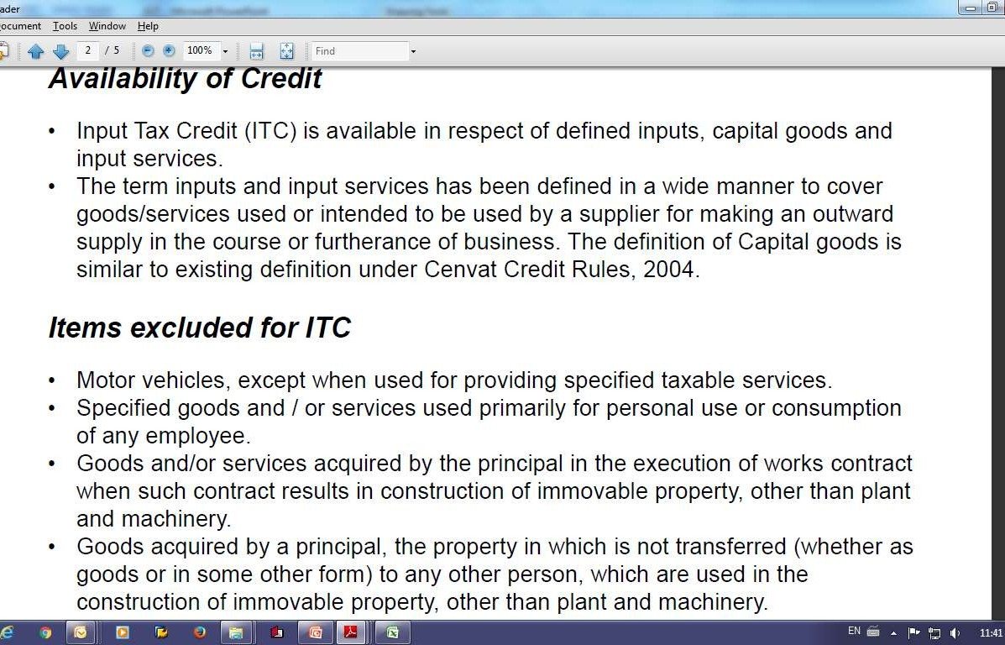
INPUT TAX CREDIT

Slide 34
CONDITION FOR AVAILING ITC
Taxpayer is in possession of a valid document
Taxpayer has received the goods and/or services. Further, an Explanation has been added to enable the availment of ITC in certain situation without actual receipt of goods. Further in case where the goods against an invoice are received in lots or instalments, the registered taxable person shall be entitled to the credit upon receipt of the last lot or instalment.
The tax charged in respect of such supply has been actually paid to the credit of the appropriate government, either in cash or through utilization of input tax credit admissible in respect of the said supply.
Taxpayer has furnished the return
ITC on an invoice is not available after the filing of the return under section 27 for the month of September following the end of financial year to which such invoice pertains or filing of the relevant annual return, whichever is earlier

Slide 35
Matching Concept
ITC is available only on provisional basis until the supplier makes the tax payment and files a valid return.
The claim of input tax credit in respect of invoices and/or debit notes relating to inward supply shall be matched with the details of corresponding outward supply.
In case of mismatch and where the supplier has not made the tax payment, the ITC shall be reversed with interest.
Interest is from the date of wrong availment or utilization
There is specific provision for reclaim of ITC and interest in case of subsequent matching.

Slide 36
RETURNS
Return form | Particulars | Due date
GSTR-1 | Outward Supplies | 10th of the next month
GSTR-2 | Inward Supplies | 15th of the Next month
GSTR-3 | Monthly Return Periodic | 20th of next month
GSTR-4 | Return by compounding taxpayer | 18th of the month next to the quarter
GSTR-5 | Return by non resident taxpayer | Within 7 days of the last days of registration
GSTR-6 | Return by Input Service Distributor | 13th of the next month
GSTR-7 | Tds Return | 10th of the next month
GSTR-8 | Annual return | 31st December of next F.Y.
ledgers | ITC ledger, cash ledger, tax ledger | On a continuous basis

Slide 37
ASSESSMENT
Type of Assessment
Self Assessment Provisional Assessment Scrutiny of Returns
Assessment of non filing of returns Assessment of unregistered person Summary Assessment
Audit General and/or Specific

Slide 38
Transitional Provision
Migration of existing taxpayer to GST
Carried forward of Cenvat Credit in return to be allowed as ITC
Unavailed cenvat credit on CG not c/f in return to be allowed in certain situation
Input held in stock to be allowed in certain situation
Exempted goods returned to the place of business on or after appointed date
Pending refund calim to be disposed of under earlier law
Claim of cenvat credit to be disposed of under earlier law
Finalization of proceedings relating to output tax liability
Treatment of amount recovered or refunded in persuance of assessment or adjudication proceedings

Slide 39
Benefits
In absence of CST & Entry Tax GST provide common market.
Distinction between goods & services will go therefore double taxation may be avoided.
Net realization will increase.
Invoicing /Accounting will be simple
Concept of manufacturing will be replaced by concept of value addition.
Zero rating(Export) will be more comprehensive and easier.
Big Central Excise Tariff will go.
GST Proposed rate is below R.N.R. i.e. (20% to 22%) impact on Manufacturing Sector
Cost of production reduced.
Hassle free supply of goods. Scrutiny at check post may be reduced, road permit will go away.
Supply chain re-structuring.
Adverse effect on unorganized small manufacturer.

Slide 40
Steps for implementing GST
A:- Assessment of GST Impact
Understand key area’s impacting on Business
Continuously update and track policy development out of GST
Identify and analyze any area of adverse impact and prepare contingency measures.
Prepare the transmition road map and align relevant team

Slide 41
Steps for implementing GST
B:- Following points should be reviewed:
Domestic supplies v/s Imports
In house v/s contract manufacturing
Pricing Strategies
Warehousing/Stocking location
Direct Sale/Stock Transfer

Slide 42
Steps for implementing GST
C:- Change in Computerisation
I:- Output to be aligned with GST
Invoicing
Purchase Order
O.E.F
Stock Transfers
MIS
II:- Master Data to be aligned
Suppliers registration no.
Customer registration no
GST rate master
Input Tax Credit eligibility master

Slide 43
Steps for implementing GST
III:-Transaction to be aligned with GST
Inventory Valuation Module
Input Tax Credit register
MIS Report
Revision of pending order/contracts with IIIrd parties
Collection/settlement of bills from suppliers and service providers
Minimum stock of semi finished/finished goods at units & sales depots

Slide 44
Impact of Matching System
Supplier’s bill will be entered without any deductions
Deduction shall be made through debit/credit notes (Address Costing Issue)
Deal with good/ law abiding supplier/service providers because non compliance by them will create problem to us
Diversion of goods from one RS to other will not be possible.
This system require efficeint working

Slide 45
Direct Sales/ Goods Transfer
GST should be paid on goods transfer, hence working capital will be block in stock
In case of goods transfer transaction value is not allowed in SAP, then how the problem be resolved
Pricing of goods transfer is very problematic so get answer of the problem

Slide 46
Sales Related Issue
Free scheme may not be permissible.
Price should be same for all the buyer
Discount scheme should be known to buyer at or before the supply.

