Slide 1





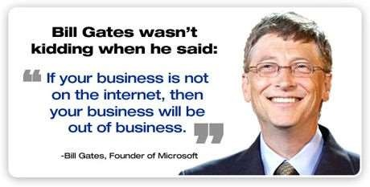
By-Group 5
PGDM GEN. Sec-B
10

Slide 2


CONTENTS
What is E-Commerce ?
Features, advantages, disadvantages
Origin
Timeline
Business Models
E-Commerce Process
10

Slide 3

Online Transactions
Various Modes of Payment
Legal Aspects
Real Examples: Flipkart, Amazon, eBay, Alibaba
Contribution in Indian Economy
10

Slide 4

WHAT IS E-COMMERCE ?
E-commerce is a transaction of buying or selling online.
It draws on technologies such as mobile commerce, electronic funds transfer, supply chain
management, Internet marketing, online transaction processing, electronic data
interchange (EDI), inventory management systems, and automated data collection systems.
Modern electronic commerce typically uses the World Wide Web for at least one part of the transaction's life cycle although it may also use other technologies such as e-mail.
10

Slide 5

Or, in short any commercial activity performed electronically or online with some technology is a gift of E-Commerce.
The World Trade Organization (WTO) distinguishes six main instruments of electronic commerce:
  The Telephone,
  The Fax,
  The Television,
  Electronic payment and money transfer systems,
  Electronic Data Interchange, and
  The Internet
10

Slide 6

FEATURES
Non-Cash Payment − E-Commerce enables use of credit cards, debit cards, smart cards, electronic fund transfer via bank's website and other modes of electronics payment.
24x7 Service availability − E-commerce automates business of enterprises and services provided by them to customers are available anytime, anywhere. Here 24x7 refers to 24 hours of each seven days of a week.
Advertising / Marketing − E-commerce increases the reach of advertising of products and services of businesses. It helps in better marketing management of products / services.
10

Slide 7

Improved Sales − Using E-Commerce, orders for the products can be generated any time, any where without any human intervention. By this way, dependencies to buy a product reduce at large and sales increases.
Support − E-Commerce provides various ways to provide pre sales and post sales assistance to provide better services to customers.
Inventory Management − Using E-Commerce, inventory management of products becomes automated. Reports get generated instantly when required. Product inventory management becomes very efficient and easy to maintain.
Communication improvement − E-Commerce provides ways for faster, efficient, reliable communication with customers and partners.
10

Slide 8
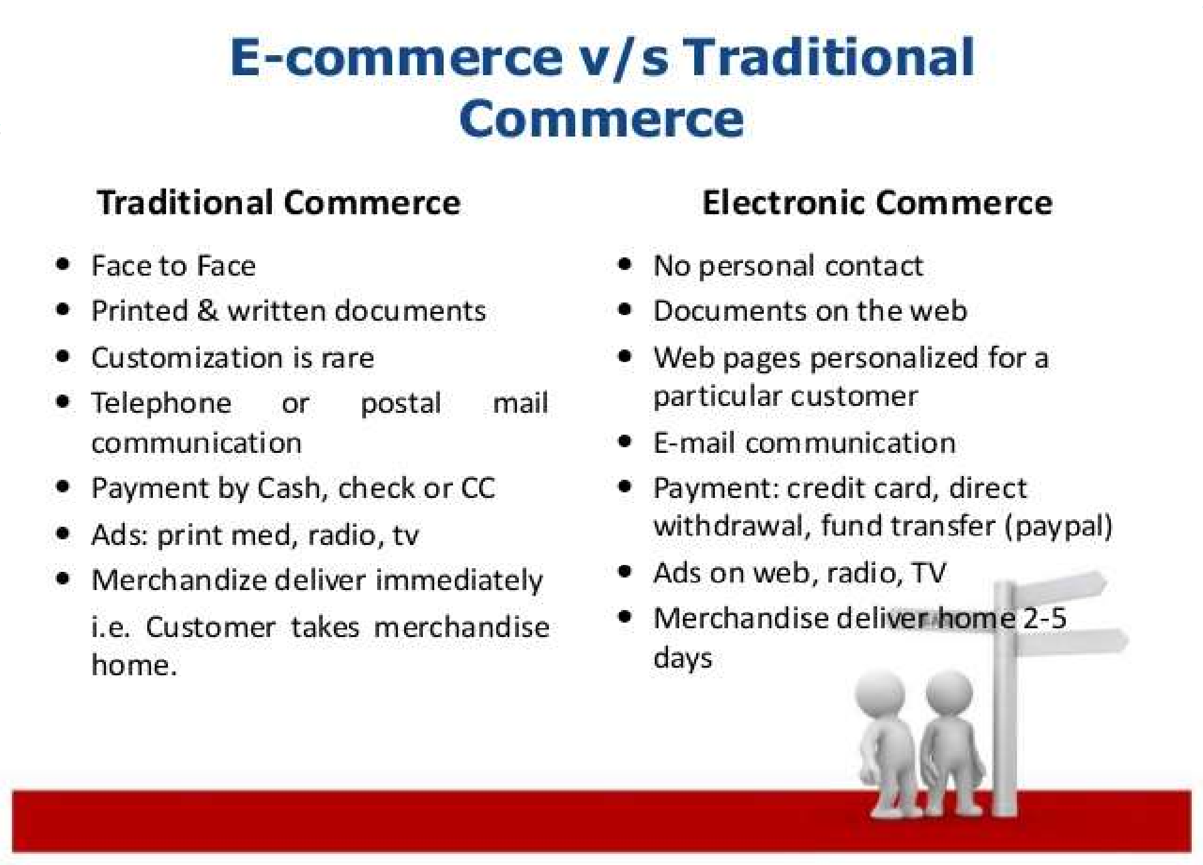

10

Slide 9
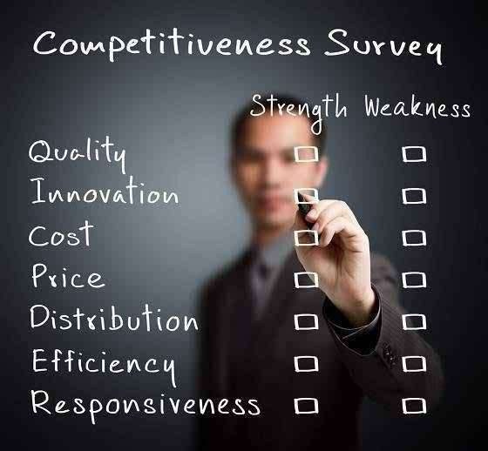
10

Slide 10

ADVANTAGES
E-Commerce advantages can be broadly classified in three major categories:
  Advantages to Organizations
  Advantages to Consumers
  Advantages to Society.
10

Slide 11
Advantages to Organizations
Using E-Commerce, organization can expand their market to national and international markets with minimum capital investment. An organization can easily locate more customers, best suppliers and suitable business partners across the globe.
E-Commerce helps organization to reduce the cost to create process, distribute, retrieve and manage the paper based information by digitizing the information.
E-commerce improves the brand image of the company.
10

Slide 12
E-commerce helps organization to provide better customer services.
E-Commerce helps to simplify the business processes and make them faster and efficient.
E-Commerce reduces paper work a lot.
E-Commerce increased the productivity of the organization. It supports "pull" type supply management. In "pull" type supply management, a business process starts when a request comes from a customer and it uses just-in-time manufacturing way.
10

Slide 13
Advantages to Customers
24x7 support. Customer can do transactions for the product or enquiry about any product/services provided by a company any time, any where from any location. Here 24x7 refers to 24 hours of each seven days of a week.
E-Commerce application provides user more options and quicker delivery of products.
E-Commerce application provides user more options to compare and select the cheaper and better option.
10

Slide 14

A customer can put review comments about a product and can see what others are buying or see the review comments of other customers before making a final buy.
E-Commerce provides option of virtual auctions.
Readily available information. A customer can see the relevant detailed information within seconds rather than waiting for days or weeks.
E-Commerce increases competition among the organizations and as result organizations provides substantial discounts to customers.
10

Slide 15

Advantages to Society
Customers need not to travel to shop a product thus less traffic on road and low air pollution.
E-Commerce helps reducing cost of products so less affluent people can also afford the products.
E-Commerce has enabled access to services and products to rural areas as well which are otherwise not available to them.
E-Commerce helps government to deliver public services like health care, education, social services at reduced cost and in improved way.
10

Slide 16

Disadvantages
E-Commerce disadvantages can be broadly classified in two major categories:
  Technical disadvantages
  Non-Technical disadvantages
10

Slide 17

Technical Disadvantages
There can be lack of system security, reliability or standards owing to poor implementation of e-Commerce.
Software development industry is still evolving and keeps changing rapidly. In many countries, network bandwidth might cause an issue as there is insufficient telecommunication bandwidth available.
Special types of web server or other software might be required by the vendor setting the ecommerce environment apart from network servers.
It becomes difficult to integrate E-Commerce software or website with the existing application or databases. There could be software/hardware compatibility issue as some E- Commerce software may be incompatible with some operating system or any other component.
10

Slide 18
Non-Technical Disadvantages
Initial cost: The cost of creating / building E-Commerce application in-house may be very high.
There could be delay in launching the E-Commerce application due to mistakes, lack of experience.
User resistance: User may not trust the site being unknown faceless seller. Such mistrust makes it difficult to make user switch from physical stores to online/virtual stores.
Security/ Privacy: Difficult to ensure security or privacy on online transactions.
Lack of touch or feel of products during online shopping. E- Commerce applications are still evolving and changing rapidly.
Internet access is still not cheaper and is inconvenient to use for many potential customers like one living in remote villages.
10

Slide 19

ORIGIN OF E-COMMERCE
Electronic Data Interchange(EDI) – It is an electronic communication method providing standards for exchanging data via any electronic means, either internal or external.
EDI was inspired by developments in military logistics and inspired development of the “Berlin Airlift” in 1948, London Airport Cargo EDP Scheme (LACES) at Heathrow Airport, London, UK, in 1971 and many more.
It uses standards such as ANSI X12, EDIFACT, or an XML-based standard such as RosettaNet in the high tech industry.
10

Slide 20
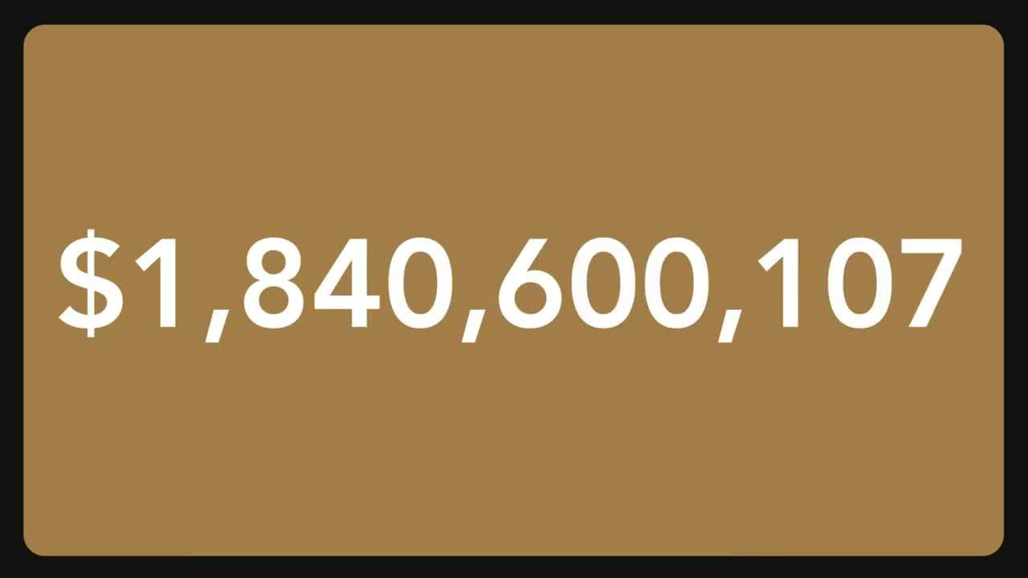
MOVIE TIME
JIMS ROHINI, NEW DELHI- 89 20

Slide 21
TIMELINE OF E-COMMERCE
1971 or 1972: The ARPANET is used to arrange a cannabis sale between students at the Stanford Artificial Intelligence Laboratory and
the Massachusetts Institute of Technology, later described as "the seminal act of e-commerce" in John Markoff's book What the Dormouse Said.
1979: Michael Aldrich demonstrates the first online shopping system.
1981: Thomson Holidays UK is the first business-to- business online shopping system to be installed.

Slide 22

1982: Minitel was introduced nationwide in France by France Télécom and used for online ordering.
1984: Gateshead SIS/Tesco is first B2C online shopping system and Mrs. Snowball, 72, is the first online home shopper
1984: In April 1984, CompuServe launches the Electronic Mall in the USA and Canada. It is the first comprehensive electronic commerce service.
1989: In May 1989, Sequoia Data Corp. Introduced Compumarket The first internet based system for e- commerce. Sellers and buyers could post items for sale and buyers could search the database and make purchases with a credit card.

Slide 23

1990: Tim Berners-Lee writes the first web browser, WorldWideWeb, using a NeXT computer.
1994: Netscape releases the Navigator browser in October under the code name Mozilla. Netscape 1.0 is introduced in late 1994 with SSL encryption that made transactions secure.
1994: Ipswitch IMail Server becomes the first software available online for sale and immediate download via a partnership between Ipswitch, Inc. and OpenMarket.
1995: Jeff Bezos launches Amazon.com and the first commercial-free 24-hour.
1995: Also, internet-only radio stations, Radio HK and NetRadio start broadcasting.

Slide 24

1995: eBay is founded by computer programmer Pierre Omidyar as AuctionWeb.
1996: E-gold, the first Digital Currency founded and backed by gold.
1996: IndiaMART B2B marketplace established in India.
1999: Alibaba Group is established in
China. Business.com sold for US $7.5 million to
eCompanies, which was purchased in 1997 for US
$149,000.
1999: The peer-to-peer filesharing
software Napster launches. ATG Stores launches to sell decorative items for the home online.

Slide 25

2000: The dot-com bust.
2001: Alibaba.com achieved profitability in December 2001.
2002: eBay acquires PayPal for $1.5 billion.
2003: Amazon.com posts first yearly profit.
2005: eBay acquires Baazee.com(founded in 1999) and enters the Indian market.
2007-09: Flipkart and Myntra were founded around the same time followed by Mobikwik in 2009.
2008-09: bitcoin was introduced marking the start of Digital currencies.

Slide 26
2010: Flipkart pioneered the Cash on Delivery (CoD) model, increasing e-commerce reach dramatically.
2012: Junglee was launched by Amazon as a price
aggregator and comparison tool. This marked Amazon’s low cost baby steps in the Indian market, especially at a time when the FDI regulations were in a state of flux.
2013: Myntra piloted a one hour delivery system in Delhi & Bangalore for delivery addresses located within a 5 kilometer radius of their warehouse by process innovation and reducing lag time.
2013: Amazon started providing CoD option in India, the only country in the world, to keep up with the market norm.

Slide 27
2014: Flipkart acquired Myntra and raised $1 billion at an enormous valuation of $7 billion
2014: Amazon tied up with BPCL in Mumbai and Delhi & local grocery stores allowing customers to pick up their packages from the retail chain In&Out run by BPCL at select filling stations, and quietly expands to all categories that major retailers are present, and stocks 15 million products, 5 million more than Flipkart
2014: Alibaba Group has the largest Initial public offering ever, worth $25 billion.

Slide 28

Michael Aldrich, an English inventor, innovator and entrepreneur is credited with developing the predecessor to online shopping.
The idea came about during a stroll with his wife and Labrador when Aldrich lamented about their weekly supermarket shopping expedition.
This conversation sparked an idea to hook a television to their supermarket to deliver the groceries. Immediately after the discussion Aldrich quickly planned and implemented his idea.
In 1979 Aldrich connected a television set to a transaction processing computer with a telephone line and created what he coined, “teleshopping,” meaning shopping at a distance.

Slide 29

In 1978 France Télécom, the country's PTT, began designing the Minitel network. By distributing terminals that could access a nationwide electronic directory of telephone and address information. Millions of terminals were lent for free to telephone subscribers.
In exchange for the terminal, the Minitel subscriber would be given free only the yellow pages (classified commercial listings, with advertisements); as the white pages were accessible for free on Minitel, and they could be searched by a reasonably intelligent search engine; much faster than flipping through a paper directory.
Minitel allowed access to various categories of services like phone directory (free), mail-order (retail), airline or train ticket purchases, information services, databases access and connection to message boards.

Slide 30
Business Models
E-Commerce or Electronics Commerce business models can generally categorized in following categories:-
  Business - to - Business (B2B)
  Business - to - Consumer (B2C)
  Consumer - to - Consumer (C2C)
  Consumer - to - Business (C2B)
  Business - to - Government (B2G)
  Government - to - Business (G2B)
  Government - to - Citizen (G2C)

Slide 31

Business-to-Consumer (B2C)
Common notion about e-commerce is that it is a business selling something through an online interface to a consumer. And this is the Business- to-Consumer (B2C) model. The most widely known ecommerce businesses, such as Flipkart, Amazon, etc. are ones where a retailer sells directly to a consumer.

Slide 32
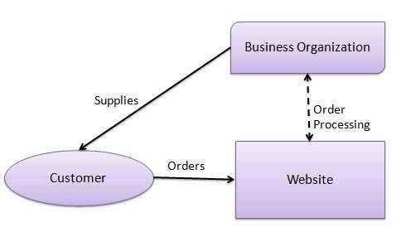

Slide 33
Business-to-Business (B2B)
Website following B2B business model sells its product to an intermediate buyer who then sells the product to the final customer.
As an example, a wholesaler places an order from a company's website and after receiving the consignment, sells the end product to final customer who comes to buy the product at wholesaler's retail outlet.

Slide 34
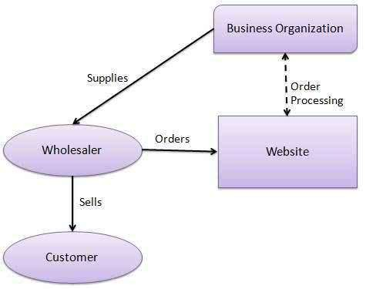

Slide 35
Consumer-to-Business (C2B)
In a consumer-to-business (C2B) model, consumers sell products and services to businesses, instead of it being the other way around. Example - Freelancer websites elance.com, where the end-user lists jobs that businesses (either individual or larger businesses) can buy from them. In a way, job portals are also C2B as
here, the ‘end-user’ (the prospective employee) lists their ‘product’ (resume) to attract businesses to hire them.

Slide 36
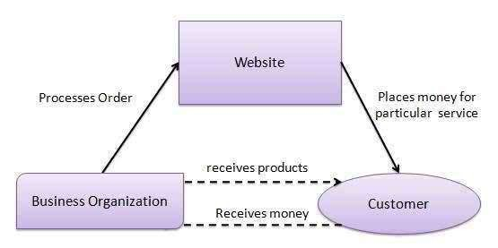

Slide 37

Consumer-to-Consumer (C2C)
In a consumer-to-consumer (C2C) model, the ecommerce website serves to facilitate the transaction between two consumers. Auction sites such as eBay (specifically when items are sold by individuals, rather than businesses listing products for auction) is a classic example of C2C e- commerce model.

Slide 38

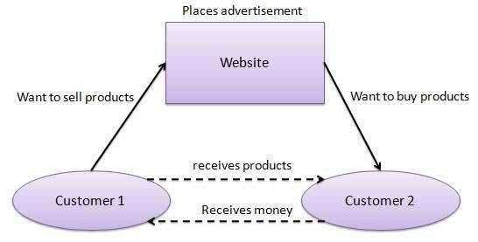

Slide 39

Business-to-Government (B2G)
B2G model is a variant of B2B model. Such websites are used by government to trade and exchange information with various business organizations. Such websites are accredited by the government and provide a medium to businesses to submit application forms to the government.

Slide 40


Government - to - Business (G2B)
Government uses G2B model to approach business organizations. These models support auctions, tenders and application submission functionalities.

Slide 41


Government-to-Citizen (G2C)
Government uses G2C model to approach citizens directly. Examples for such models can be websites providing services like registration for birth, marriage, etc. A main objective of G2C websites is to reduce average time for servicing people’s requests for various government linked services.

Slide 42
The process of ecommerce
The consumer uses web browser to connect to the home page of a merchant web site on the internet.
The consumer browses the catalogue of products featured on the site and selects items to purchase. The selected items are placed in electronic equivalent of a shopping cart.
When the consumer is ready to complete the purchase of selected items, The site provides a bill and ship to address for purchase and delivery.

Slide 43
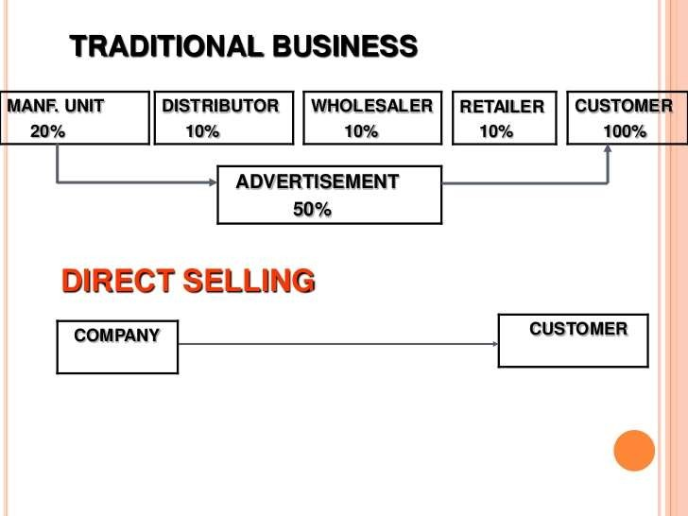

Slide 44

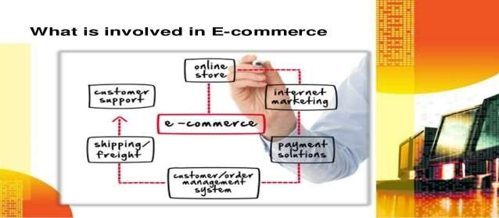
Order Processing
Purchasing a product initiates the system of physical distribution.
Using a successful order fulfillment system, employees can track customer orders, locate products, and resolve any problems that arise as items move from warehouse to shipping company to customer's doorstep.

Slide 45
Warehousing and Inventory Control
Online businesses that deal in material goods still need to store and inventory their products. An e- commerce business needs a warehousing system that makes it easy to take and fill orders quickly.
Goods that sell quickly should be placed near the dock doors.
Products that are similar to each other should be kept together so they can be located easily

Slide 46
Setting up an
E-Commerce BUSINESS
Creating a proprietary (own) ecommerce website
Starting a proprietary ecommerce business requires a web development team, online marketing team and a payment gateway for receiving payments. Starting a proprietary ecommerce website is a long-term initiative and requires a good amount of investment in terms of money and effort to build up a successful business.

Slide 47

GST registration
A GST registration is a must for becoming a seller on a ecommerce portal or while starting a proprietary ecommerce website.
GST registration is required for anyone selling goods or products in India and must be obtained from central board of excise and custom.

Slide 48
Bank Account
Once the Company is incorporated a bank account can easily be opened in the name of the business by contacting a Bank.
Opening of bank account is essential to list on a ecommerce marketplace or obtain payment gateway for a ecommerce website.

Slide 49
Payment Gateway
A payment gateway would be required for a proprietary
ecommerce website to process customer payments.
Payment gateway provides allow for the website to accept credit card, debit card, net banking, internet banking payments from multiple banks and credit card companies.
Therefore, one payment gateway is sufficient to accept many forms of online payments.
Once, a payment is received from the customer, the payment is sent to the bank account of the business by the payment gateway provide in one or two business days.

Slide 50
ONLINE Transactions
There are various ways of making payments through electronic modes such as electronic wallets, smart cards, software wallets, credit cards, debit cards, net banking and more.
Online stores that collect money from consumers in any other way than Cash need to rely on a service provider typically known as a Payment Gateway provider.
A payment gateway is an e-commerce application service provider that processes credit card payments for e-businesses and online retailers.

Slide 51

It acts as the go between the consumer who is making purchases and the bank that is authorizing the bank issued payment instrument such as a credit card to be used for the payment.
It is the equivalent of making a payment over the counter when one is physically purchasing something. These payment gateways are like the middlemen between the purchaser and the company providing the product.

Slide 52
Various mode of payments
Credit cards – The most widely used form of electronic money today. Several million credits cards are being used to make online payments in India. Many E-Commerce sites allow you to pre-store your credit card number securely so that you don’t have to key in the number each time. Currently, the largest user base in e-commerce uses credit cards for payments.
Debit card – The second largest e-commerce payment medium in India. Using a debit card proves to be a preferred choice for customers who want to stay within their spending capacity.

Slide 53

Net Banking – Another easy way to make online payments. It is similar to using a debit card for paying money that exists in the user’s current or savings account but it does not require the user to have a card for the payment purposes. While completing the purchase the consumers needs to put in their net banking id and pin.
Reward Points – An indirect way for online payments. On certain things that are purchased by a person, a number of rewards points will be awarded which will get added to the his account. In the next transaction, the buyer can choose to pay for their next purchase using the accumulated rewards points, which will replace what they would otherwise be paying as money.

Slide 54
Prepaid Cards – This is a relatively new and fast growing payment method. Typically a consumer may buy or be gifted a prepaid card that can be used online. Usually this would be for a particular brand or for a retailer. Some online retailers have their own gift cards which are sold to their customers, who in turn may use it for themselves or as give them as gifts. Gift cards have their own authentication system and this may vary from issuer to issuer. Summary If you are a new online retail store or a brand planning to set up an online store, you should contact a reliable payment gateway partner to assist with getting your online store to accept various forms of payment as above. (Cont.)

Slide 55

(Cont.)
For Cash on Delivery and Bank Cheques, you would need to have a separate process and this would have to be reflected in your web store software as an option for consumers to choose. Select a good Payment Gateway provider who gives you the maximum options and is also constantly adding new options based on the evolving marketplace and methods of payment. In case companies like Net Distribution are operating your online store, they will take care of selecting a good payment gateway that accepts all forms of payments that may be applicable in the ecommerce industry in India.

Slide 56
Mobile Money – Out of India’s 1.2 billion people, only a small percentage have bank accounts. Amongst that massive unbanked population, many hundreds of millions have mobile phones, and for them, mobile money is likely to be hugely beneficial. Even for smaller transactions, where credit cards are not accepted, it might be simpler to just hand over cash. But if you don’t have sufficient cash, then mobile money becomes useful. However, mobile money would be convenient to buy a movie ticket or pay your utility bills on your phone, where otherwise you might have to key in your entire credit card number, CVV number, etc, every time you make a payment.(Cont.)

Slide 57

(Cont.)
It’s meant for transactions between Rs 50 – Rs 500 to buy things like games, music, e-books, and virtual goods in games, and where people may not want to use credit or debit cards. In India, this is a developing payment option and still evolving in terms of regulations and guidelines. As on date the main method to pay for products using your mobile is still linked to your bank account. Payments using mobile carrier billing i.e. where your payments are deducted from your mobile prepaid balance or billed to your post-paid account are still restricted to services provided through the mobile operator for value added services. Mobile carrier billing has not yet started for ecommerce transactions though this is expected to
flourish soon.

Slide 58

Legal Aspects
The Information Technology Act, 2000 (“IT Act”) deals with contractual aspects of use of electronic records.
The validity of electronic transactions is established under the IT Act. The act establishes that an ecommerce transaction is legal if the offer and
acceptance are made through a ‘reasonable’ mode.
The objectives of the Information Technology Act, as outlined in the preamble, are to provide legal recognition for E-commerce transactions.

Slide 59
The Act lays down procedures for networking operations and for civil wrongs and offences.
The Indian Information Technology Act does not have any express provision regarding the validity or formation of online contracts.
A communication sent by an offeror to an offeree through indirect means, such as an email that passes multiple servers and spam mails, is not regarded as a reasonable mode under the IT act. Reasonable modes of acceptance in an ecommerce transaction are:
Direct mail from the offeree to the offeror.
Acceptance by conduct, which is pressing an ‘Accept’ button to an offer.

Slide 60
The Information Technology (Amended) Act, ITAA, was amended in 2008 to increase security of e-commerce transactions, with special provisions for legal recognition of digital signatures and electronic documents. Section 43A of ITAA holds ecommerce companies accountable for protection of personal data.
When an ecommerce company fails to protect personal data of its customers or is negligent in maintaining and implementing reasonable security practices, and if this results in wrongful loss of an online buyer, the laws are clear that its body corporate is wholly liable to pay the damages by means of monetary compensation.

Slide 61


Flipkart.COM
Company Profile
Founders: Sachin Bansal; Binny Bansal CEO : Kalyan Krishnamurthy
th
Founded: 5 Sept. 2007
Headquarters: Bangalore, Karnataka, IN Subsidiaries: Myntra, Jabong.com, PhonePe, eBay.in (India), eKart, Mallers.Inc, etc.
69

Slide 62

Flipkart was founded by Sachin Bansal and Binny Bansal, both alumni of the Indian Institute of Technology Delhi.
They worked for Amazon, and left to create their new company incorporated in October 2007 as Flipkart Online Services Pvt. Ltd.
The first product they sold was the book Leaving Microsoft To Change The World to a customer from Hyderabad.
Flipkart now employs more than 33,000 people.
After the success of its 2014 Big Billion Sale, a second Big Billion Sale was carried out , where it is reported that they saw a business turnover of $300 million in gross merchandise volume.
69

Slide 63
ACQUISITIONS
2011: Flipkart acquired the rights to Chakpak's , a Bollywood news digital catalogue, with 40,000 filmographies, 10,000 movies and close to 50,000 ratings.
2014: Acquired Myntra in an estimated 20 billion (US$310 million) deal.
2015: Flipkart acquired a mobile marketing start-up Appiterate(DSYN Technologies Pvt. Ltd.) to strengthen its mobile platform.
2015: Flipkart bought a minority stake in navigation and route optimization startup MapmyIndia to help improve its delivery using MapmyIndia assets.
69

Slide 64
2016: Flipkart’s Myntra acquires rival fashion shopping site Jabong for $70 million.
2017: In January, Flipkart funded Parenting Network Tinystep With $2 Million.
2017: In April, in exchange for an equity stake in Flipkart, eBay agreed to make a $500 million cash investment in and sell its eBay business to Flipkart; however, according to a company statement eBay would continue to operate as a separate entity from Flipkart.
69

Slide 65


AMAZON.com
Company Profile Founders: Jeff Bezos CEO : Jeff Bezos Founded: 5 July 1994
Headquarters: Seattle, Washington, United States
Subsidiaries: Zappos, Audible.Inc., Souq.com ,AbeBooks
69

Slide 66

HISTORY
The company was, spurred by what Amazon founder Jeff Bezos called his "regret minimization
framework," which described his efforts to fend off any regrets for not participating sooner in the Internet business boom during that time.
In 1994, Bezos left his employment as vice-president of D. E. Show& co, a Wall Street firm, and moved to Seattle, Washington.
He began to work on a business plan for what would eventually become Amazon.com.
69

Slide 67

On July 5, 1994, Bezos incorporated the company as Cadabra.Inc.
Bezos changed the name to Amazon.com, Inc. a few months later, after a lawyer misheard its original name as "cadaver“.
In September 1994, Bezos purchased the URL Relentless.com and briefly considered naming his online store Relentless, but friends told him the name sounded a bit sinister. The domain is still owned by Bezos and still redirects to the retailer.
The company went online as Amazon.com in 1995.
69

Slide 68

Mergers and acquisitions: Investment
2008: Engine Yard, a Ruby-on-Rails platform as a services (PaaS) company.
2010: Living Social, a local deal site.
2014: Acquired the '.buy' domain in an auction for
$4,588,888.
2014: Amazon announces a US$2 billion investment in India.
2016: Amazon announces an additional US$3 billion investment in India.
2017: Between May and July 2017, Amazon had pumped in Rs. 2000 Cr. in India with Rs. 130 Cr. pumped its payment arm Amazon Pay India.
69

Slide 69

Subsidiaries
2003: A9.com, a company focused on researching and building innovative technology
2004: Lab126, developers of integrated consumer electronics such as the Kindle.
2007: Endless.com, an e-commerce brand focusing on shoes.
2007: Brilliance Audio, the largest independent audio book
producer in the US.
2009: Create Space, self-publishing services for independent content creators, publishers, film studios and music labels; created by the internal merger of Custom Flix (on-demand DVDs for independent filmmakers) and Book Surge (self- publishing, on-demand printing, online distribution), both originally acquired 2005.
69

Slide 70

Product & Services
AmazonFresh
Amazon Prime
Amazon Web Services
Alexa
Appstore
Amazon Drive
Echo
Kindle
Fire tablets
Fire TV
Video
Kindle Store
Music
Music Unlimited
Amazon Digital Game Store
Amazon Studios
AmazonWireless
69

Slide 71


Alibaba group
Company Profile Founders: Jack Ma CEO : Daniel Zhang Founded: 4 April 1999
Headquarters: Hangzhou, China
Subsidiaries: Vendio, Shenzhen OneTouch, Yahoo Koubei, etc.
69

Slide 72

History
December 1999, Hector Ma and 17 other founders released their first online marketplace, named "Alibaba Online".
From 1999 to 2000, Alibaba Group raised a total of
US$25 Million from SoftBank, Goldman Sachs, Fidelity and some other institutions.
December 2001, Alibaba.com achieved profitability.
May 2003,Taobao was founded as a consumer e-commerce platform.
December 2004, Alipay, which started as a service on the Taobao platform, became a separate business.
October 2005, Alibaba Group took over the operation of China Yahoo as part of its strategic partnership with Yahoo Inc.
69

Slide 73
Alibaba Group Services
AutoNavi
Taobao
Alipay
Alibaba Cloud (Aliyun)
AliExpress
Yahoo! China
Aliwangwang
Laiwang
Alibaba Pictures
Youku Tudou
11 Main
South China Morning Post
Ali Health
Alisports
69

Slide 74


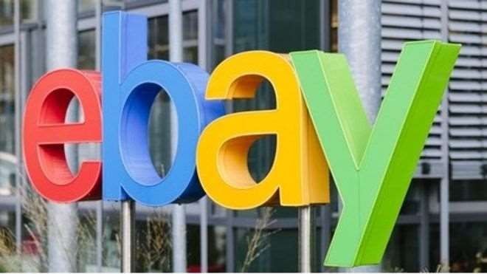
eBAY.IN
Company Profile Founders: Pierre Omidyar CEO : Devin Wenig Founded: 3 September 1995
Headquarters: San Jose, California, United States
Subsidiaries:StubHub, mobile.de, GittiGidiyor, Auction Co., etc.
69

Slide 75
History
The AuctionWeb was founded in California on September 3, 1995, by French-born Iranian- American computer programmer Pierre Omidyar as part of a larger personal site.
One of the first items sold on AuctionWeb was a broken laser pointer for $14.83.
Astonished, Omidyar contacted the winning bidder to ask if he understood that the laser pointer was broken. In his responding email, the buyer explained: "I'm a collector of broken laser pointers.
69

Slide 76
Acquisitions
StubHub
Craigslist
GittiGidiyor
Corrigon
69

Slide 77
Contribution in Indian Economy
E-Commerce is a growing sector in India. Just like the growth of IT industry in India through the 1990s, the 2010s will be remembered for the growth in the E-Commerce industry. In its present state the contribution of E- Commerce to GDP is around 0.2% which is expected to grow 15 times to around 2.5% by 2030.
By 2030 the contribution to GDP by E-Commerce is expected to reach to around 300 Billion Dollars which is around 20 Billion Dollars in its present state.
69

Slide 78

The impact of E-commerce in various sectors
Technology- One of the major drivers of technology will be E- Commerce industry and vice versa. We are seeing new age technological solutions(AI/Machine Learning) being taken up to solve the business problems to bring commerce to everyone digitally. This is seen in both B2C and B2B sector. Investment into technology sector is happening to drive growth in the E-Commerce domain.
Logistics- Logistics industry is both a bottleneck and a driver for e- commerce industry. For the same we see how last mile and inter- city logistics solutions have come up to digitally connect the different stakeholders across the country. The Uber model of moving passengers is implemented in some form or the other in the logistic sector. The growth of E-Commerce will drive innovation in the logistic sector to make the products available to the end user.
69

Slide 79
Travel- At the moment 70% of the contribution to E- Commerce comes from the travel sector which includes the online ticket bookings to other travel arrangements. This has made the market competitive by bringing all players on the same platform and has also given consumer more options. Travel industry will be earliest adopters to become completely digitised and that is thanks to E-Commerce.
Education- One of the industries to have the most profound impact of E-Commerce is the education. The ability of E-Commerce to provide quality education to everyone is immense. India will have one of the biggest set of youth population and hence the scope for education sector to be the biggest achievers because of E-Commerce is sure
69

Slide 80
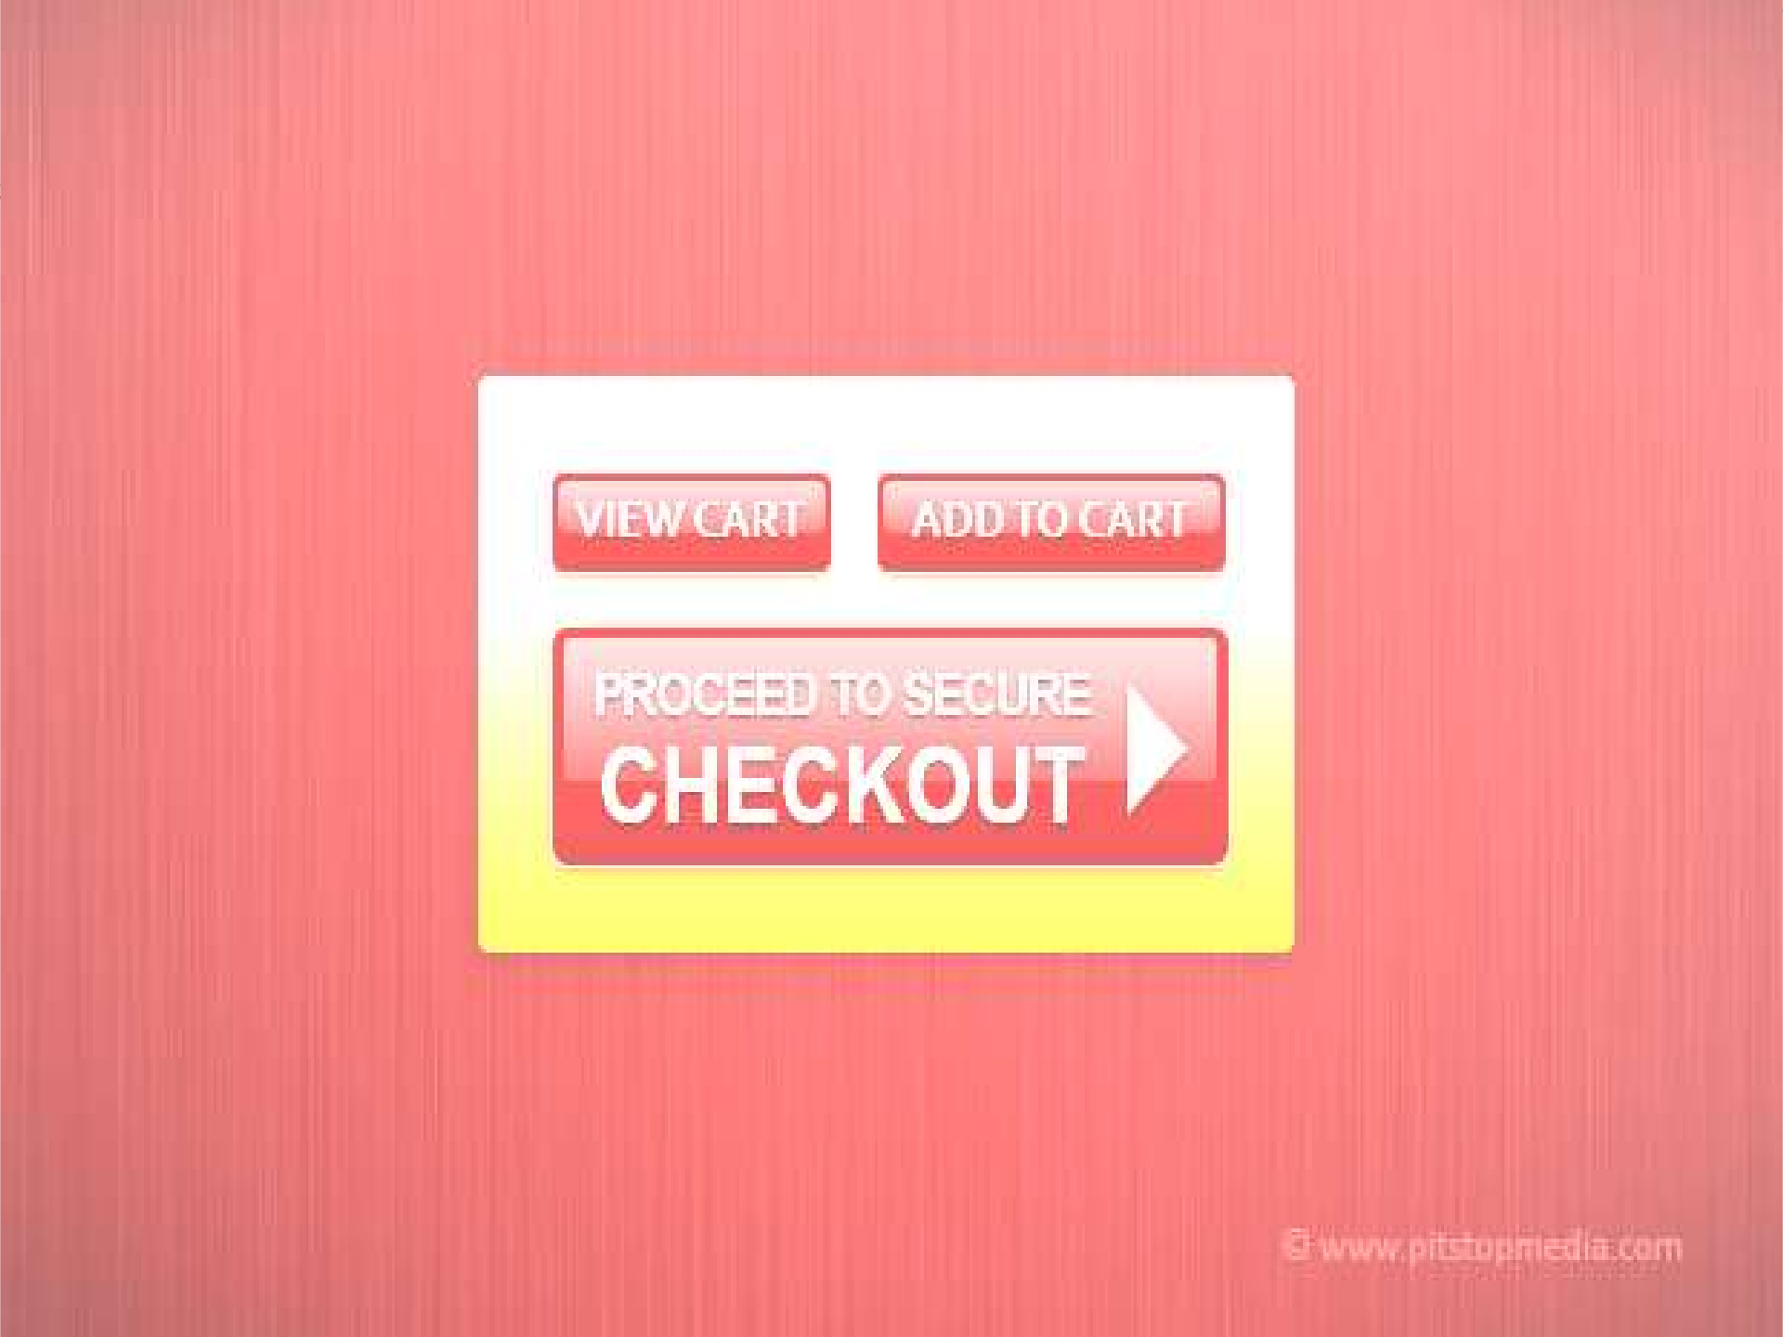
THANK YOU
Group 5:-
BHAVNESH
MADAN
SHASHANK GUPTA
SUVRAJIT SAHA
UDAY SHARMA
69

