Slide 1
COST ACCOUNTING
D.SRINIVASA RAJU
Lecturer in Commerce
D.N.R. College (Autonomous),
BHIMAVARAM

Slide 2

INTRODUCTION

Slide 3
Cost accounting is a process of collecting, recording, classifying, analyzing, summarizing, allocating and evaluating various alternative courses of action & control of costs.
Its goal is to advise the management on the most appropriate course of action based on the cost efficiency and capability.
Cost accounting provides the detailed cost information that management needs to control current operations and plan for the future.

Slide 4
OBJECTIVES

Slide 5
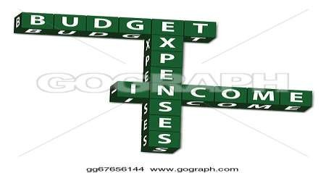
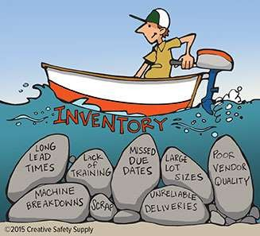
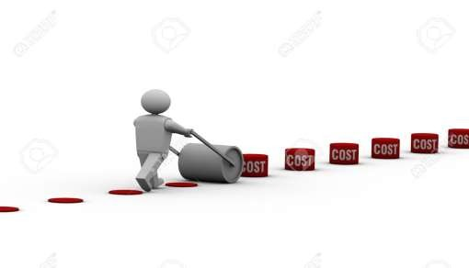
To control cost by using various techniques such as budgetary control, standard costing and inventory control.

Slide 6

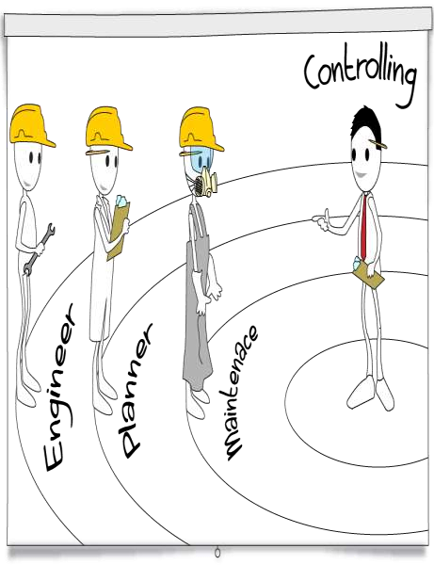

To provide information for decision making and planning to Formulate operative procedures.
To help in directing and controlling operations.
To ascertain costing profit.

Slide 7




To motivate to achieve the organization’s goals.

Slide 8

To measures the performance of managers and sub units within the organization.

Slide 9

To provide immediate information regarding stock of raw material, semifinished and finished goods.

Slide 10
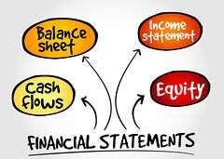
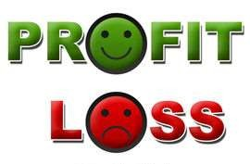
To facilitate preparation of financial and other statements.

Slide 11

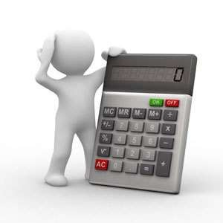
To help in estimation of cost of future.

Slide 12

SCOPES OF COST ACCOUNTING

Slide 13
Cost book keeping
It involves maintaining complete record of all cost incurred from their incurrence to their change to departments, products and services. Such recording is preferable done on the basis of double entry system.

Slide 14
Cost system:
Proper accounting for cost systems and procedures.
Cost analysis:
It involves the process of finding out the casual factors of actual costs varying from the budget cost and fixation of responsibility for cost increase.

Slide 15
Cost control:
Cost accounting is utilization of cost information for exercising control. It involves a detailed examination of each cost in the light of benefit derived from the incurrence of cost.

Slide 16
Cost report:
The ultimate function of cost accounting is presentation of reports. These reports are primarily for use by the management at different levels. Cost reports from the basis for planning and control, performance appraisal and managerial decision making.

Slide 17
Thank You

