Slide 1
DATABASE MANAGEMENT SYSTEM
OVERVIEW
R.RADHA RANI
LECTURER IN COMMERCE
D.N.R.COLLEGE
BHIMAVARAM

Slide 2
What is a DBMS?
Collection of interrelated data – manual or computerized or online
Set of programs to access the data
DBMS provides an environment that is both convenient and efficient to use.

Slide 3
Applications Areas of DBMS?
Banking: all transactions
Airlines: reservations, schedules
Universities: registration, grades
Sales: customers, products, purchases
Manufacturing: production, inventory, orders, supply chain
Human resources: employee records, salaries, tax deductions

Slide 4
Why do we use DBMS
To avoid data redundancy and inconsistency
Multiple file formats, duplication of information in different files
To avoid difficulty in accessing data
Need to write a new program to carry out each new task
To deal with data isolation — multiple files and formats
To deal with integrity problems
Integrity constraints (e.g. account balance > 0) become part of program code
Easy to add new constraints or change existing ones

Slide 5
Why do we use DBMS (contd..)
Atomicity of updates
Failures may leave database in an inconsistent state with partial updates carried out
E.g. transfer of funds from one account to another should either complete or not happen at all
Concurrent access by multiple users
Concurrent accessed needed for performance
Uncontrolled concurrent accesses can lead to inconsistencies
E.g. two people reading a balance and updating it at the same time
Security problems

Slide 6
Drawbacks of using file systems to store data
Data redundancy and inconsistency
Multiple file formats, duplication of information in different files
Difficulty in accessing data
Need to write a new program to carry out each new task
Data isolation
Multiple files and formats
Integrity problems
Integrity constraints (e.g., account balance > 0) become “buried” in program code rather than being stated explicitly
Hard to add new constraints or change existing ones
Notes:
6

Slide 7
Drawbacks of using file systems to store data (Cont.)
Atomicity of updates
Failures may leave database in an inconsistent state with partial updates carried out
Example: Transfer of funds from one account to another should either complete or not happen at all
Concurrent access by multiple users
Concurrent access needed for performance
Uncontrolled concurrent accesses can lead to inconsistencies
Example: Two people reading a balance (say 100) and updating it by withdrawing money (say 50 each) at the same time
Security problems
Hard to provide user access to some, but not all, data
Database systems offer solutions to all the above problems
Notes:
7

Slide 8
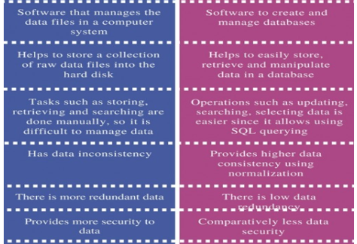
File System Vs Database System
File System
Database System

Slide 9
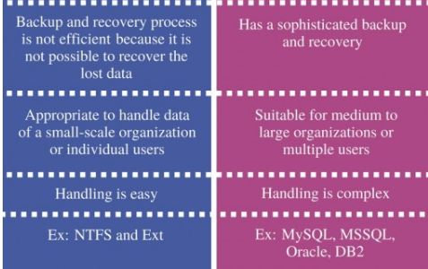
File System Vs Database System Cont…
File System
Database System

Slide 10
File System Issues
Redundancy of data: Data is said to be redundant if same data is copied at many places. If a student wants to change Phone number, he has to get it updated at various sections. Similarly, old records must be deleted from all sections representing that student.
Inconsistency of Data: Data is said to be inconsistent if multiple copies of same data does not match with each other. If Phone number is different in Accounts Section and Academics Section, it will be inconsistent. Inconsistency may be because of typing errors or not updating all copies of same data.
Difficult Data Access: A user should know the exact location of file to access data, so the process is very cumbersome and tedious. If user wants to search student hostel allotment number of a student from 10000 unsorted students’ records, how difficult it can be.
Unauthorized Access: File System may lead to unauthorized access to data. If a student gets access to file having his marks, he can change it in unauthorized way.
No Concurrent Access: The access of same data by multiple users at same time is known as concurrency. File system does not allow concurrency as data can be accessed by only one user at a time.
No Backup and Recovery: File system does not incorporate any backup and recovery of data if a file is lost or corrupted.

