Slide 1
BLOCK DIAGRAM OF A COMPUTER

Slide 2
Computer: Computer is an electronic device which can process data transformed into information. That is useful to people.
Block Diagram of a Computer: The computer has mainly three parts.
Input Unit
C.P.U(Central Processing Unit)
Output Unit

Slide 3
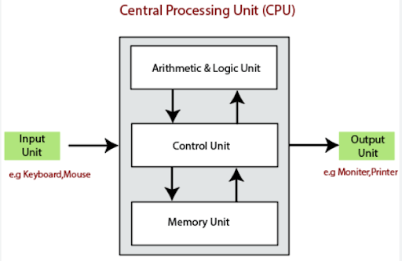

Slide 4
Input Unit : The standard input device is keyboard some of the input devices are mouse, scanner, touch screen, OMR(Optical Mark Recognition), OBR(Optical Barcode Recognition).
Central Processing Unit : It has three types
Memory Unit
Arithmetic and Logical Unit(A. L. U)
Control Unit
Memory Unit: It is known has internal memory or primary memory. It has two types.
RAM (Random Access Memory):It stores programs and instructions and data temporarily. Until the computer switch is turned off. Ram is volatile memory.
ROM (Read Only Memory): Rom is an non-volatile memory .The data that is stored in Rom is permanent.

Slide 5
Arithmetic and Logical Unit (A. L. U): It performs the actual arithmetic and logical unit processing. The result can be stored in the memory or it can be retained in arithmetic logical unit for further calculations.
Control Unit : It controls all other units in the system its main functions are
To control transfer of information between various units in the system.
To initiate appropriate functions by arithmetic logical unit.
Output Unit : It communicates the results of processing to the users in various forms. The standard output unit is monitor, V. D. U (Visual Display Unit).

Slide 6
THANK YOU

