Slide 1
FUNCTIONS
TYPES OF FUNCTIONS

Slide 2
Function: A function is a group of statements that together perform specific tasks. A large program can be split into smaller segments. So that it can be efficiently solved.
The function are categorized into two types
Pre-defined functions (or) Library functions.
User-defined functions

Slide 3
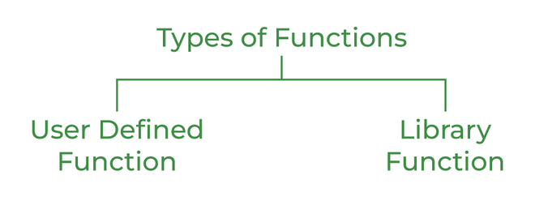

Slide 4
The major difference between the user defined functions and pre-defined functions are not required to be written by user. While writing a program. Many program required to a particular group of unstructured accessed repeatedly. From the different place with in the program. This repeated instructions can be placed in a single function and can be accessed whenever necessary.
Function is a group of statements that carries out to specific task. Every c program starts with atleast one function. Which is main( ). The main( ) calls another to share the work.

Slide 5
Library functions are pre-defined se of functions they task is limited.
Eg:-printf(), scanf(), sqrt()….etc.
These functions cannot modify. User defined functions are define by user. According to our requirement are called user defined functions.
Advantages of function:
1. It provides reusability. Because function calls many times.
2. Generally large programs can be divided into smaller programs.
3. It is too easy to modify.
4. It is easy to debug and find out the errors.

Slide 6
Function declaration:
Function declaration consists of three components such as return type, function name and arguments being passed. The function declaration must be ends with a semi column (;).
Syntax:-
return type function name (arg1, arg2 ……arg n);
int sum(int, int); float multi();

Slide 7
Function definition: The function definition consists of two components. The first line and the body of the function. The function definition is same as function declaration except that is does not end with a semi column(;)
Syntax:-
return type function name (arg 1,arg 2…..arg n)
{
function body; return(expression);
}
The body of the function may contain local variables, statements, expressions and also a return type.

Slide 8
THANK YOU

