Slide 1
components of DBMS

Slide 2
There are many components available in the DBMS. Each component has a significant task in the DBMS. A database environment is a collection of components that regulates the use of data, management, and a group of data. These components consist of people, the technique of Handel the database, data, hardware, software, etc. there are several components available for the DBMS. We are going to explain five main topics of the database below.
DBMS also give permission to the user to use the data according to their needs. The word "DBMS" contains information regarding the database program and the users. It also provides an interface between the user and the software. In this topic, we are going to discuss the various types of DBMS.

Slide 3
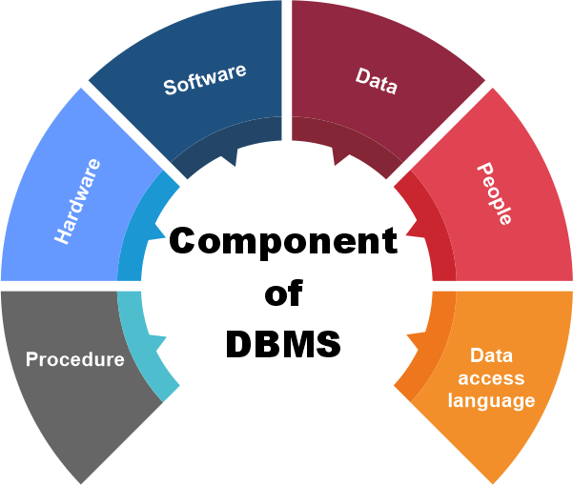

Slide 4
1. Hardware
Here the hardware means the physical part of the DBMS. Here the hardware includes output devices like a printer, monitor, etc., and storage devices like a hard disk.
In DBMS, information hardware is the most important visible part. The equipment which is used for the visibility of the data is the printer, computer, scanner, etc. This equipment is used to capture the data and present the output to the user.
With the help of hardware, the DBMS can access and update the database.
The server can store a large amount of data, which can be shared with the help of the user's own system.

Slide 5
2. Software
Software is the main component of the DBMS.
Software is defined as the collection of programs that are used to instruct the computer about its work. The software consists of a set of procedures, programs, and routines associated with the computer system's operation and performance. Also, we can say that computer software is a set of instructions that is used to instruct the computer hardware for the operation of the computers.
The software includes so many software like network software and operating software. The database software is used to access the database, and the database application performs the task.

Slide 6
3. Data
The term data means the collection of any raw fact stored in the database. Here the data are any type of raw material from which meaningful information is generated.
The database can store any form of data, such as structural data, non-structural data, and logical data.
4. Procedures
The procedure is a type of general instruction or guidelines for the use of DBMS. This instruction includes how to set up the database, how to install the database, how to log in and log out of the database, how to manage the database, how to take a backup of the database, and how to generate the report of the database.

Slide 7
5. Database Access Language
Database Access Language is a simple language that allows users to write commands to perform the desired operations on the data that is stored in the database.
Database Access Language is a language used to write commands to access, upsert, and delete data stored in a database.
Users can write commands or query the database using Database Access Language before submitting them to the database for execution.

Slide 8
THANK YOU

